Slide 1
New Zealanders before Passchendale
October 1917
Dr Christopher Pugsley

Slide 2
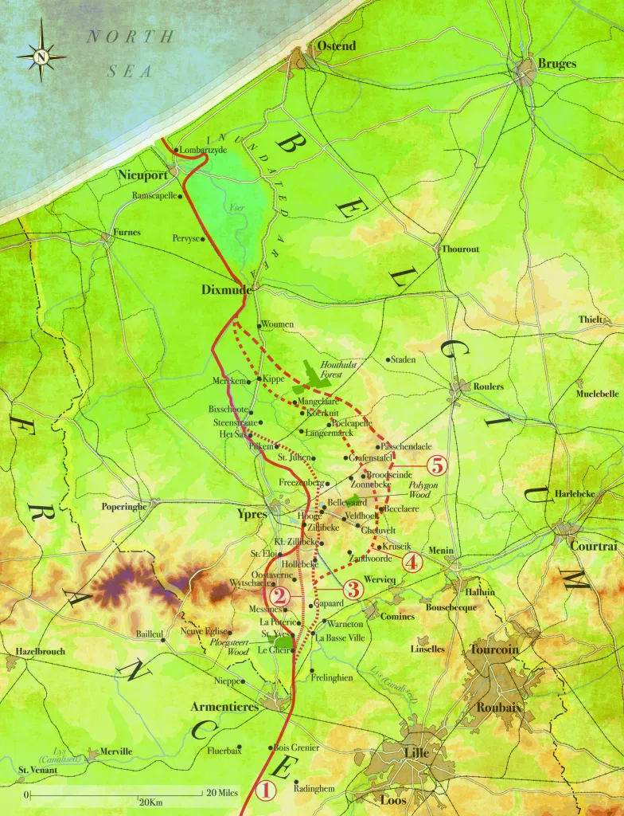
Why Passchendaele?
U-Boat base
Staden-Roulers railway

Slide 3
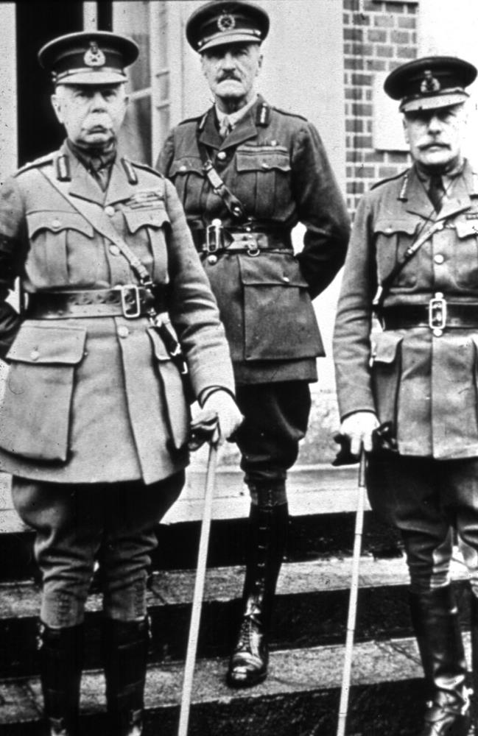
Messines 1917
The pleasure of working in Second Army
Under ‘Daddy’
Plumer

Slide 4
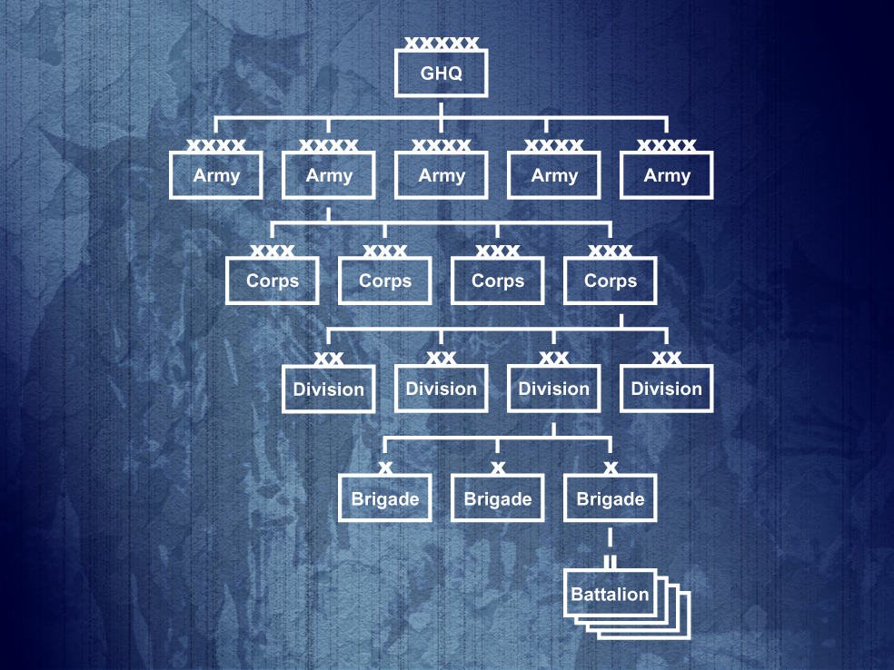
The British Expeditionary Force (BEF)
2ND ARMY
I ANZAC
II ANZAC
I ANZAC
NZ DIV
1NZ Inf Bde
1 Auck
2 Auck
1 Well
2 Well
2 NZ Inf Bde
1 Cant
2 Cant
1 Otago
2 Otago
3 NZ Rifle
Bde
1 Rifles
2 Rifles
3 Rifles
4 Rifles
4 NZ Inf Bde
3 Auck
3 Well
3 Cant
3 Otago

Slide 5
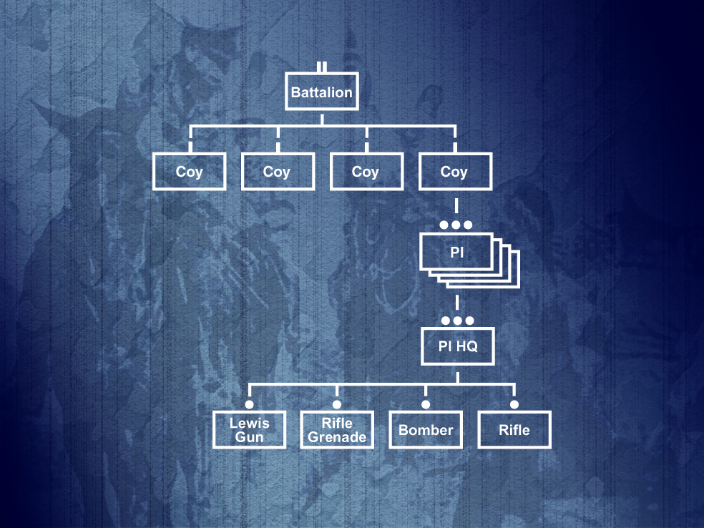
Reorganisation of Platoon Structure in 1917
The Platoon becomes the key tactical infantry
organisation

Slide 6
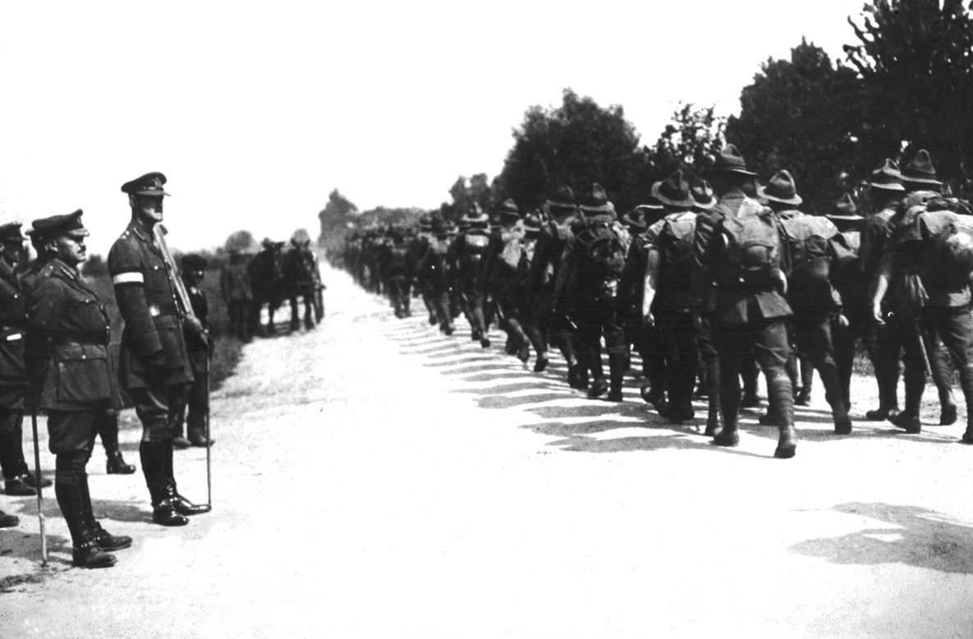
Training for the Flanders’ Offensive
Lt-Gen Sir A J Godley
GOC 11 ANZAC
Maj-Gen Sir A H
Russell GOC NZ Div

Slide 7
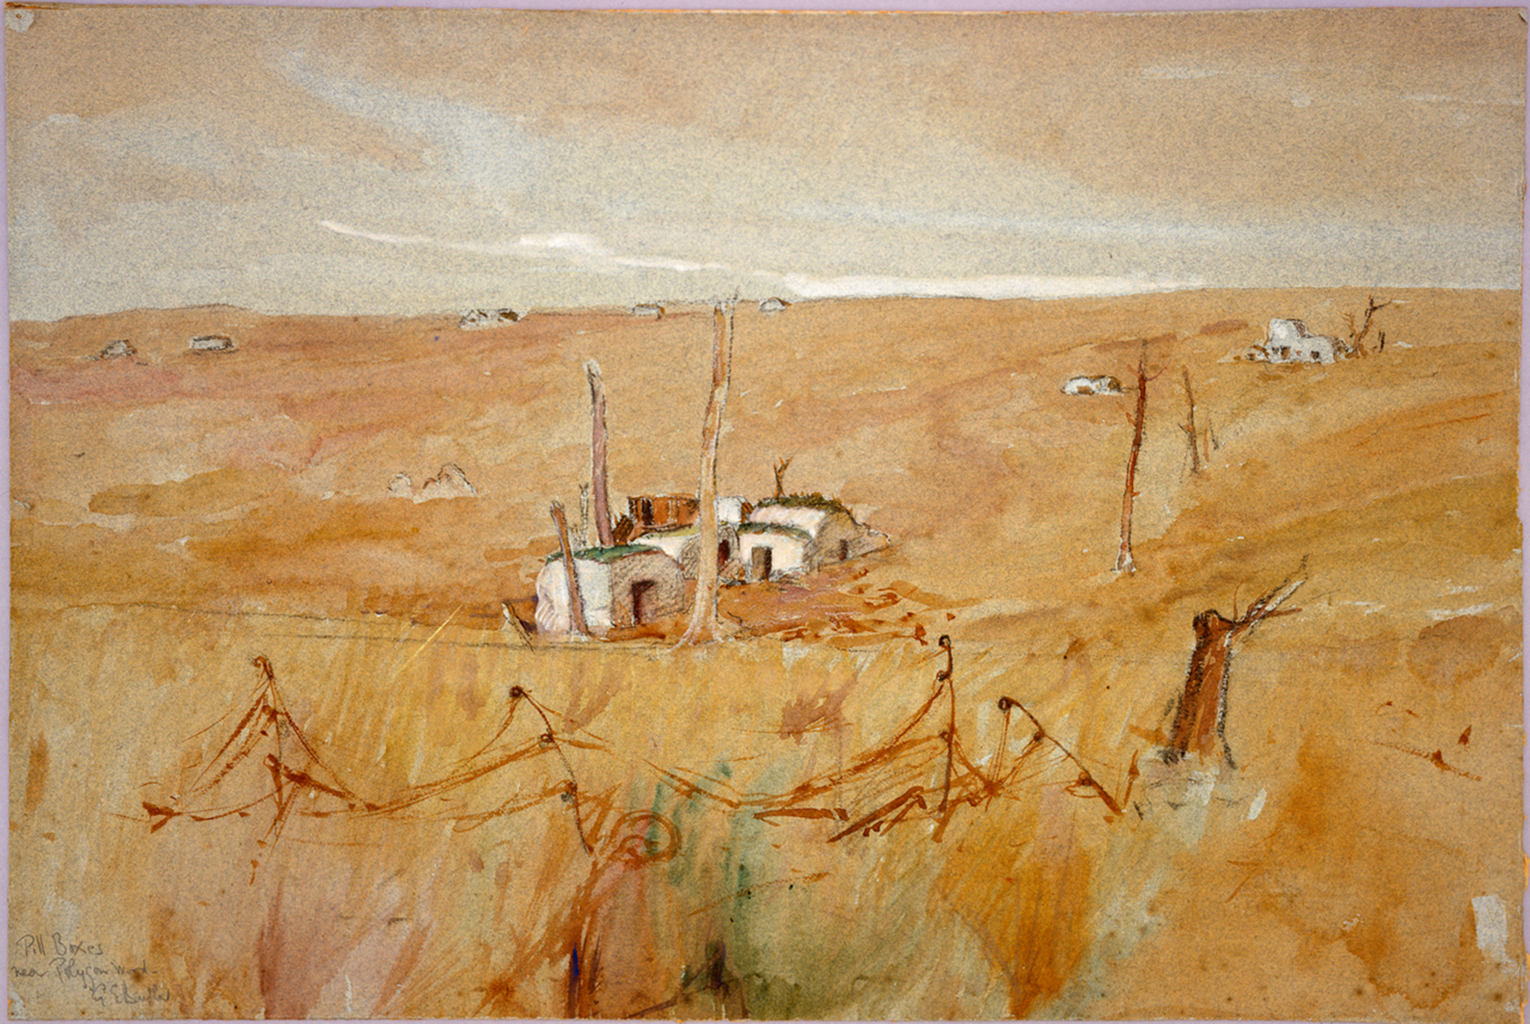
Evolving German Defensive Tactics in 1917

Slide 8
Evolving German Defensive Tactics in 1917

Slide 9
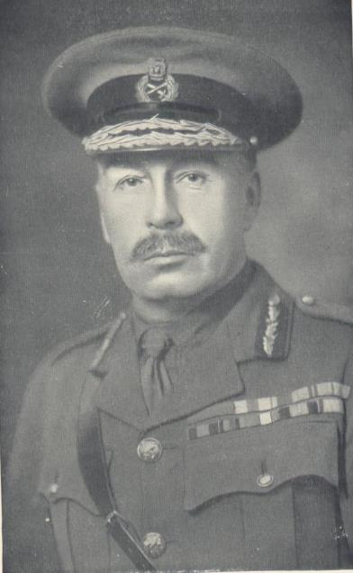
MATCHING German Defensive tactics
‘It was also clear that “Pill-box” fighting demanded skilful leading and resource on the part of subordinate commanders… Accordingly it was planned that the attack should be carried out by lines of sections, each section in file and separated from its neighbours by about twenty yards. This gave an opportunity of overwhelming a “Pill-box” by the co-operation of the nearest sections while the others made headway, and each part was to be cleared and garrisoned before the sections involved continued their advance.’
History of the 9th (Scottish) Division, p.226

Slide 10
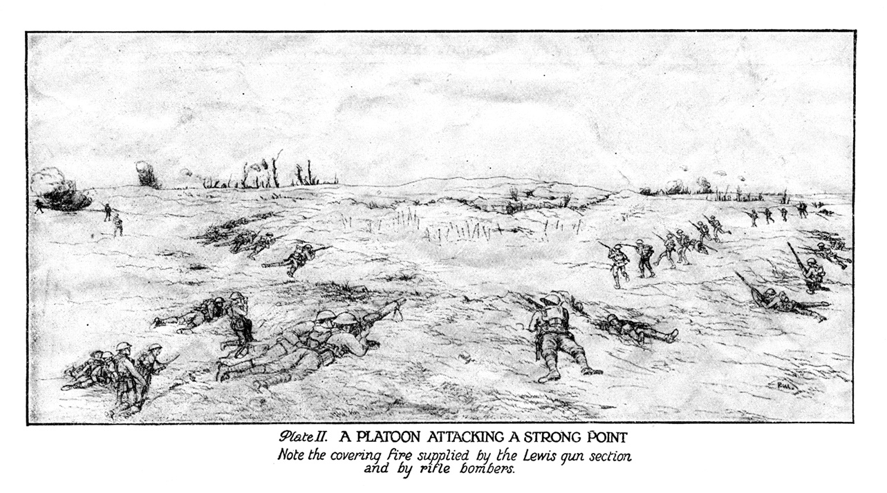
WORM FORMATIONS – PLATOON FIRE AND MOVEMENT

Slide 11
Training for the Flanders’ Offensive
Artillery co-ordination
Infantry Battalion Organisation
Platoon fire and movement drills
Bite and hold attacks
Preparation, planning and rehearsals

Slide 12
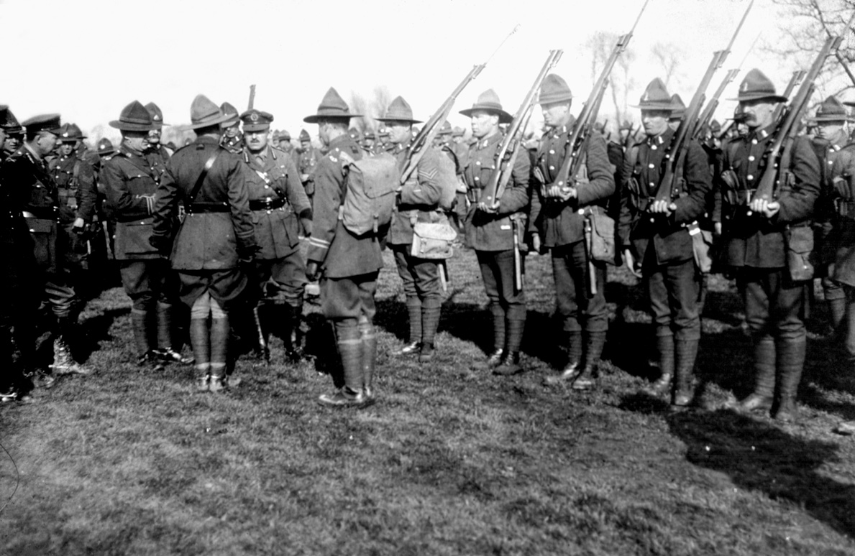
Russell demanded his junior leaders knew their men and did their job

Slide 13
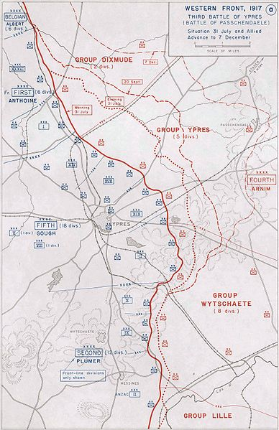
The Third Battle of Ypres
Gough Fifth Army 31 July-18 August.
Plumer Second Army 20 Sep

Slide 14
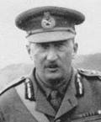
Gough and Third Ypres 31 July-16 August 1917
‘“We felt,” said a distinguished officer after the action, “that the Battle of Messines was won at Zero, and that the Battle of Ypres was lost long before it.”
Cyril Falls, The History of the 36th (Ulster) Division, p. 122.
Sound training no guarantee of Success

Slide 15
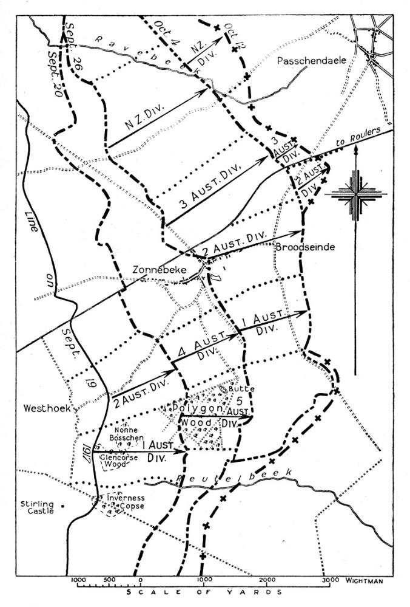
BATTLE OF MENIN ROAD
20 September
1917

Slide 16
BATTLE OF POLYGON WOOD
26 September 1917

Slide 17
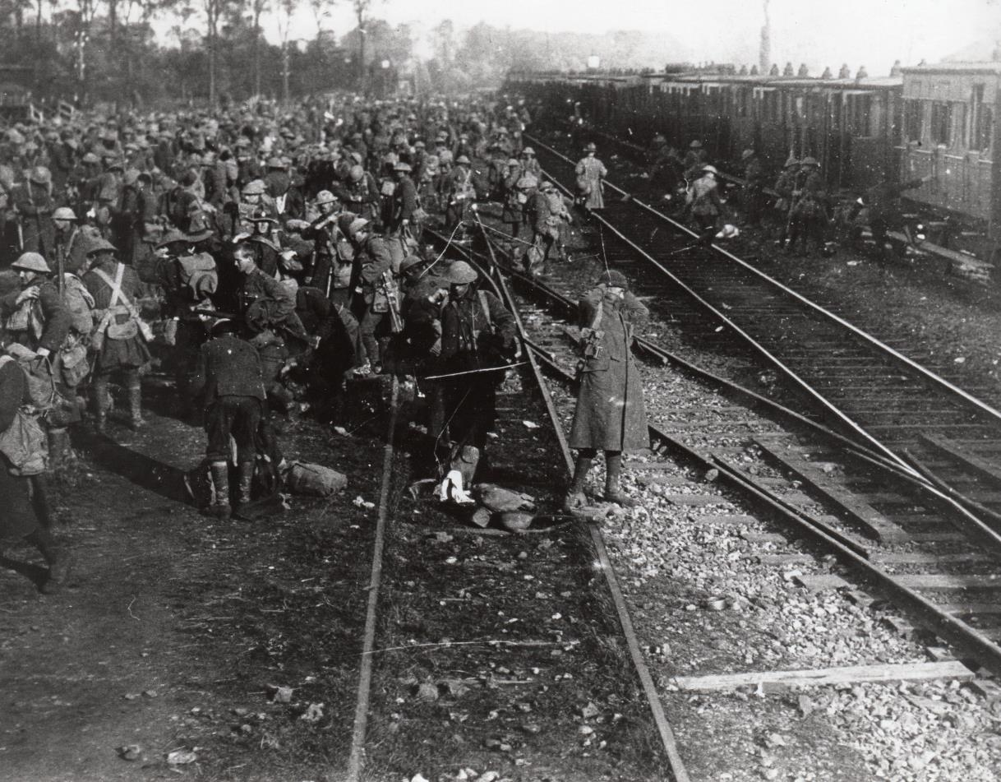

Slide 18
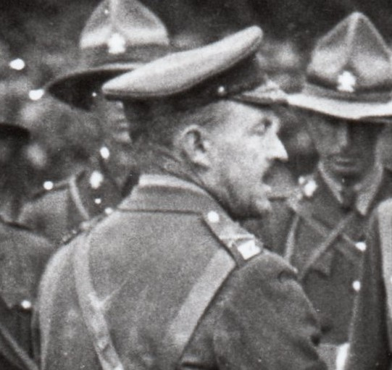
The New Zealanders before Passchendaele
“The Division figured in two separate attacks, one on the 4th October and the other on the 12th. In the first we were entirely successful and at a very moderate cost… We went out of the line almost at once and a British Division made another attack on the 9th, which was, for whatever reason, an entire failure. We were brought in on the 11th to renew the attack on the morning of the 12th. This though not an entire failure, was very nearly so.
Russell to Allen dated

Slide 19
BATTLE OF
BROODSEINDE
4 October 1917

Slide 20
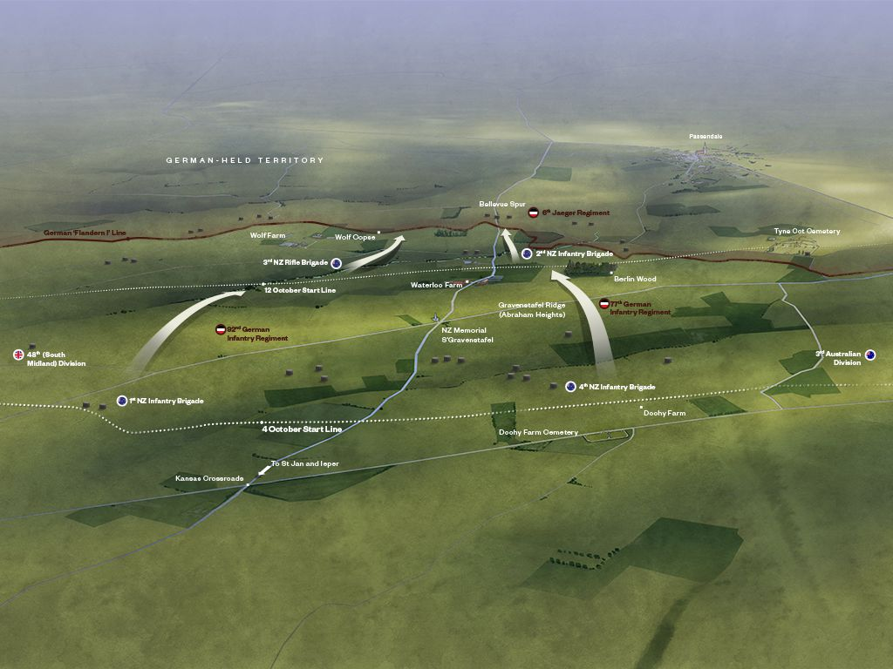

Slide 21
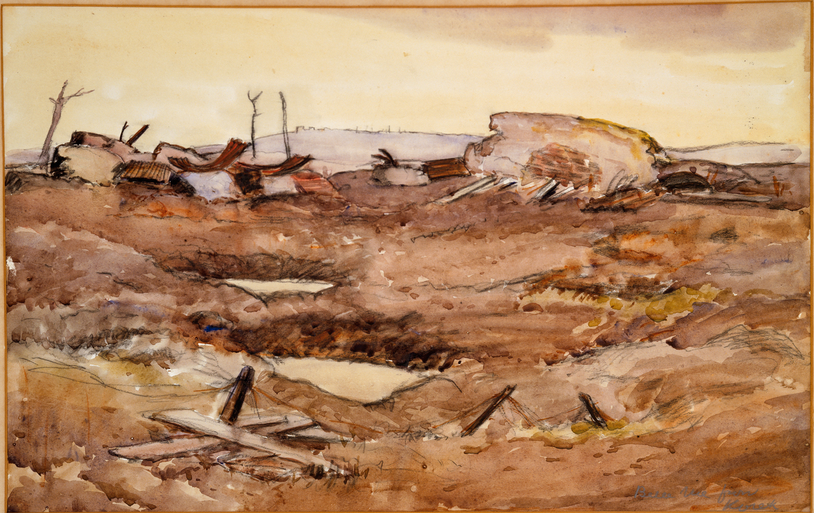

Slide 22
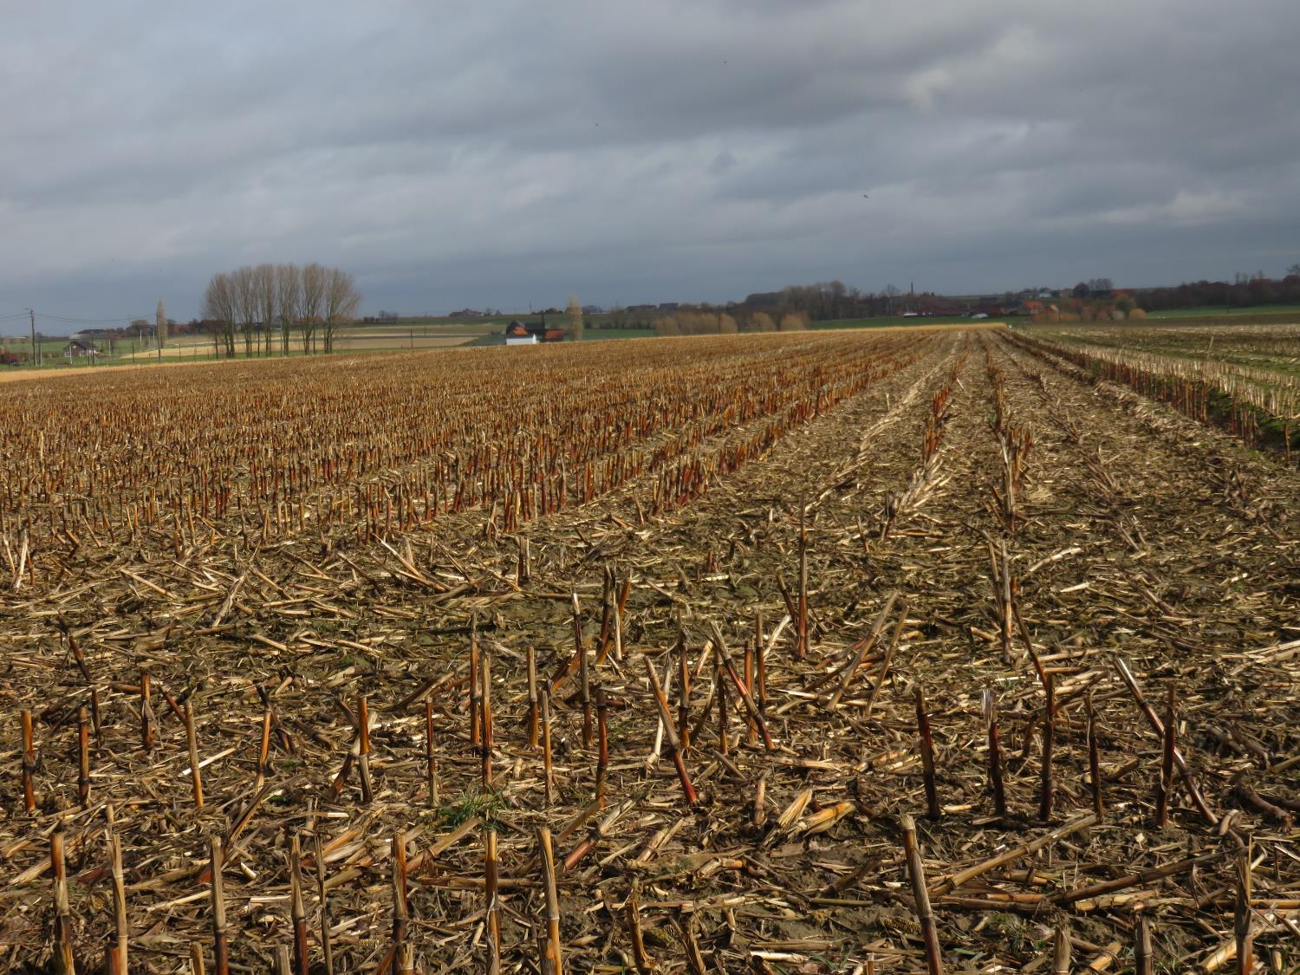

Slide 23
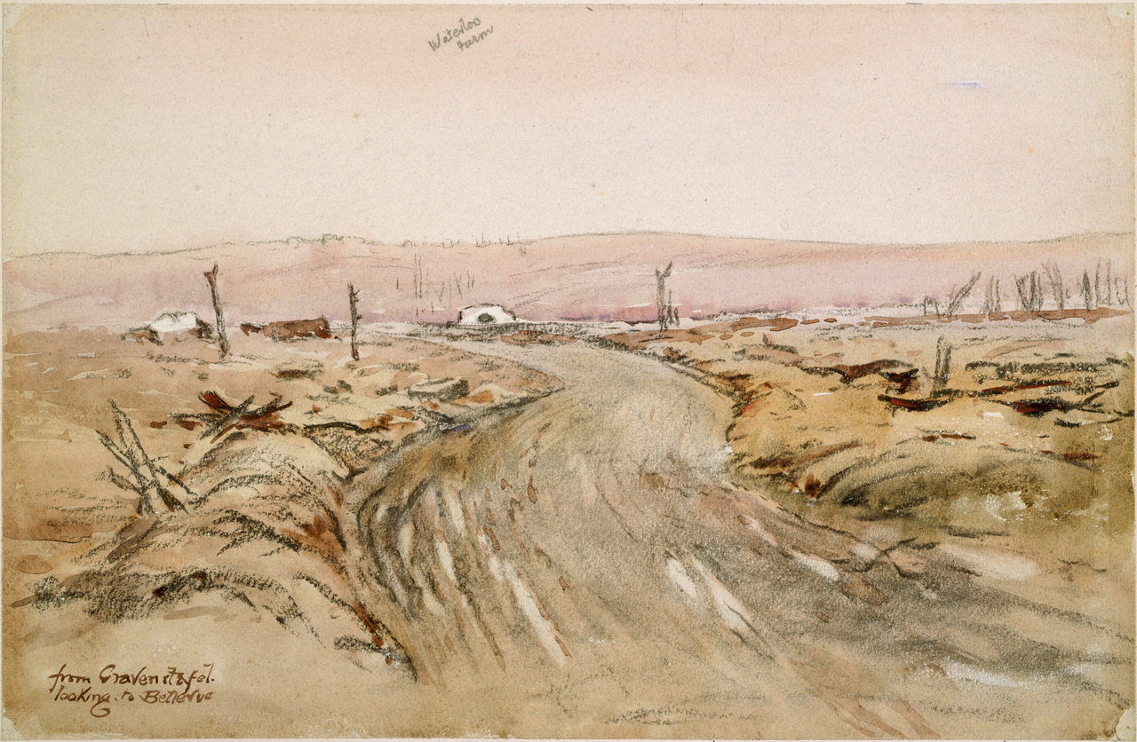

Slide 24
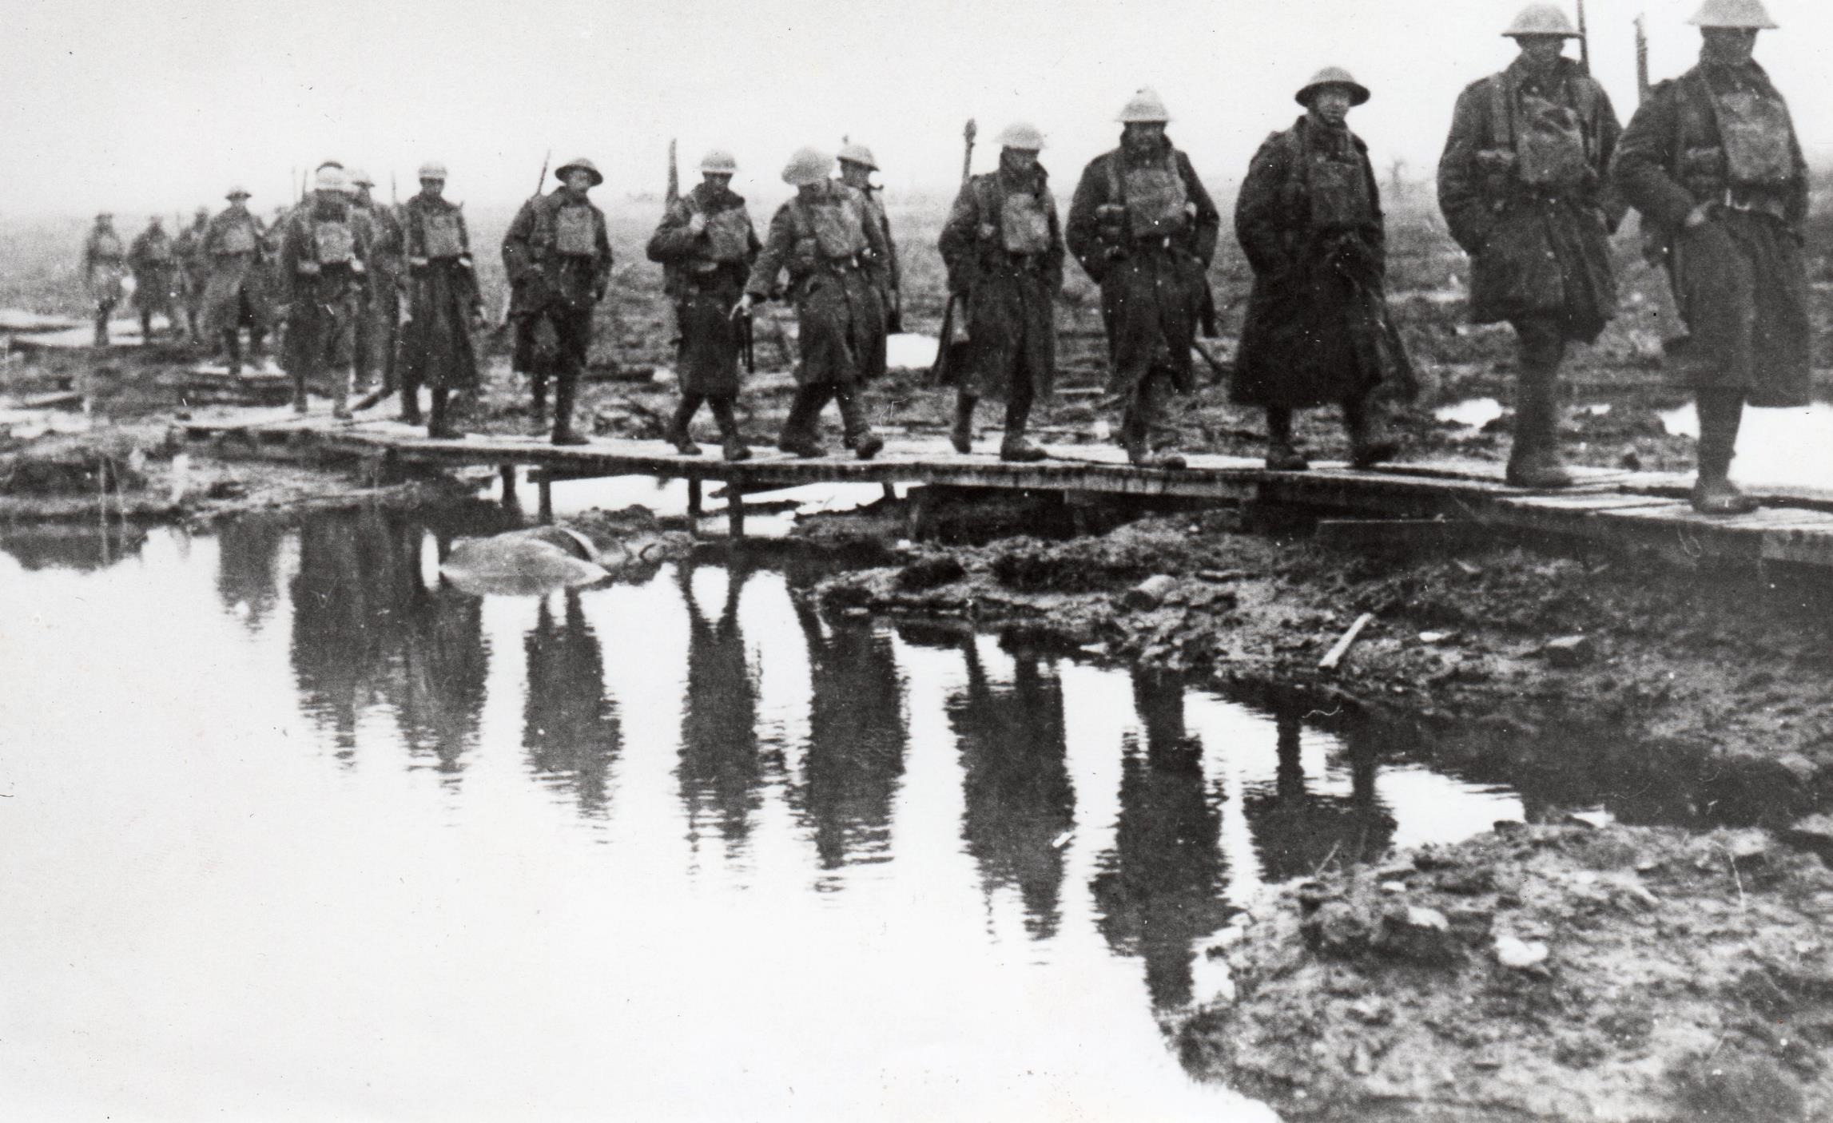
Unfortunately it is raining and the sun hasn’t the power to dry the ground so late in the year. We’ve got a very muddy time in front of us, and that means a lot. The mud is a much worse enemy than the Germans who did not, today, put up much of a show of resistance.’ Russell, 4 October 1917

Slide 25
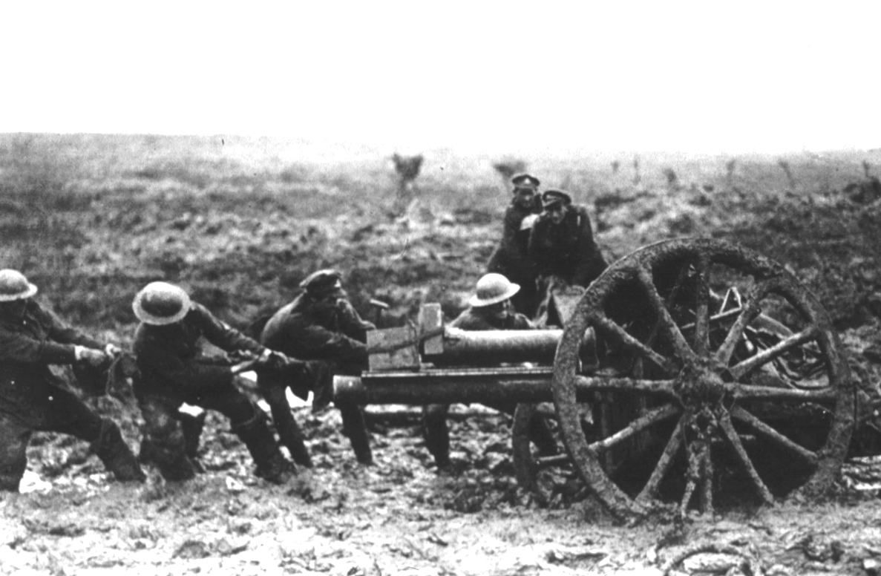
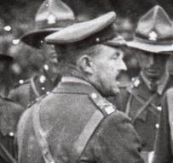
‘Gunfire always seemed to bring on the rain’
“Genl. Percival [49th Div], my successor, and I walked up to Spree Farm - wanted him to see roads.”
Major-General Russell Diary 5 October 2017

Slide 26
Godley’s Pride leads to Disaster 9 and 12 October 1917

Slide 28
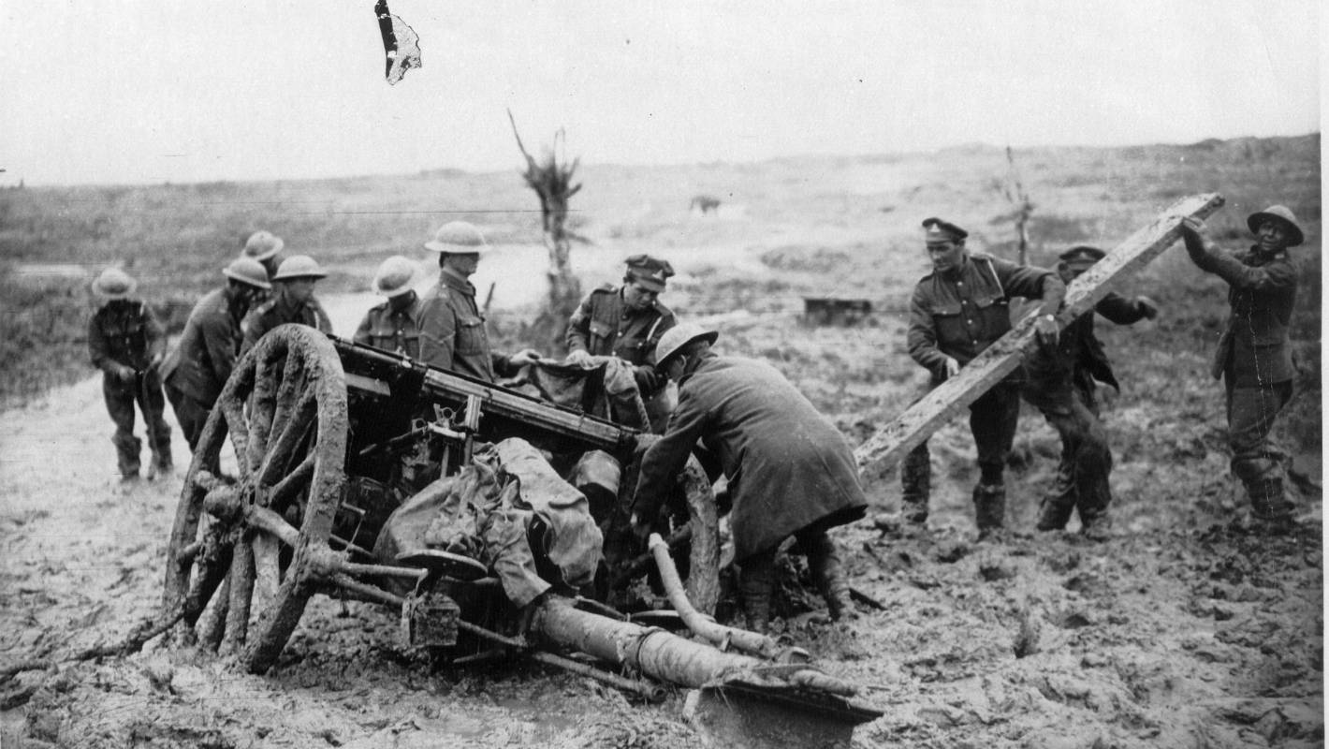
“Guns out of action were in every case either completely bogged or else blocked on the road”. .
Narrative of Operations of New Zealand Divisional Artillery.
From 1st to 20th October, 1917, WA 50/4/32, ANZ.

Slide 29
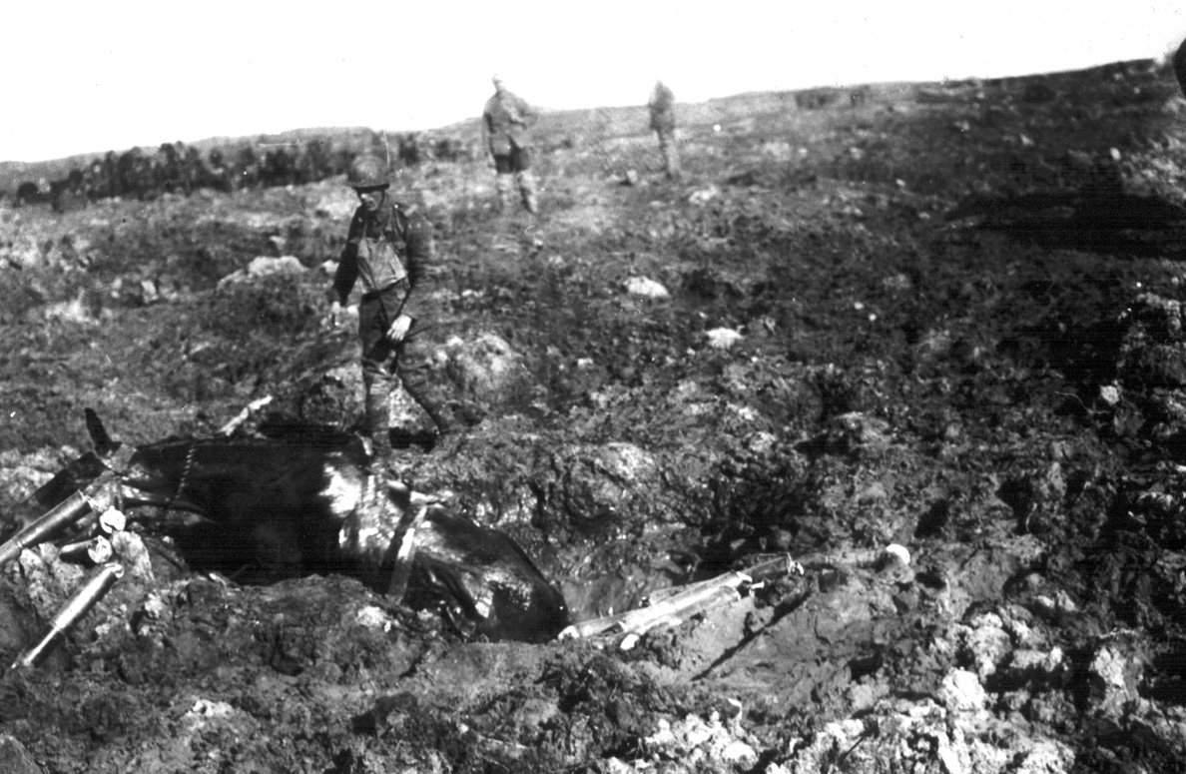

Slide 31
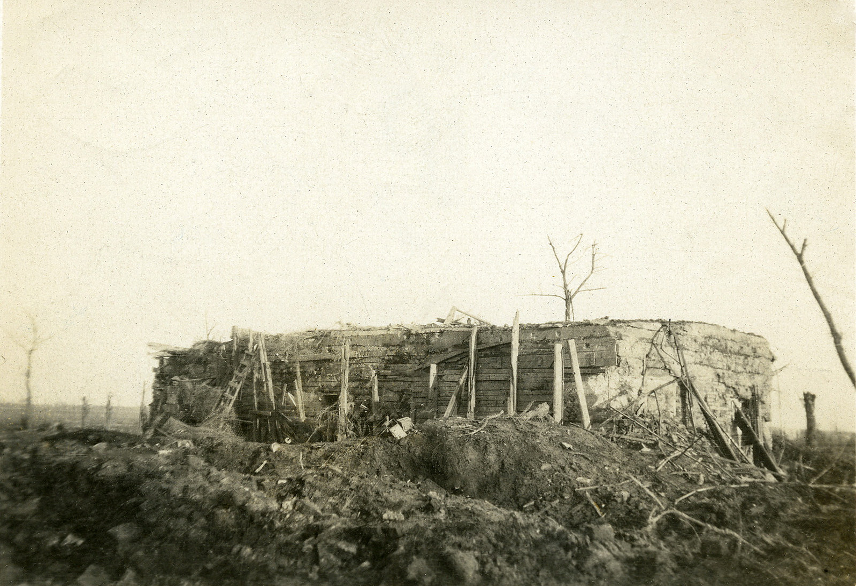

Slide 32
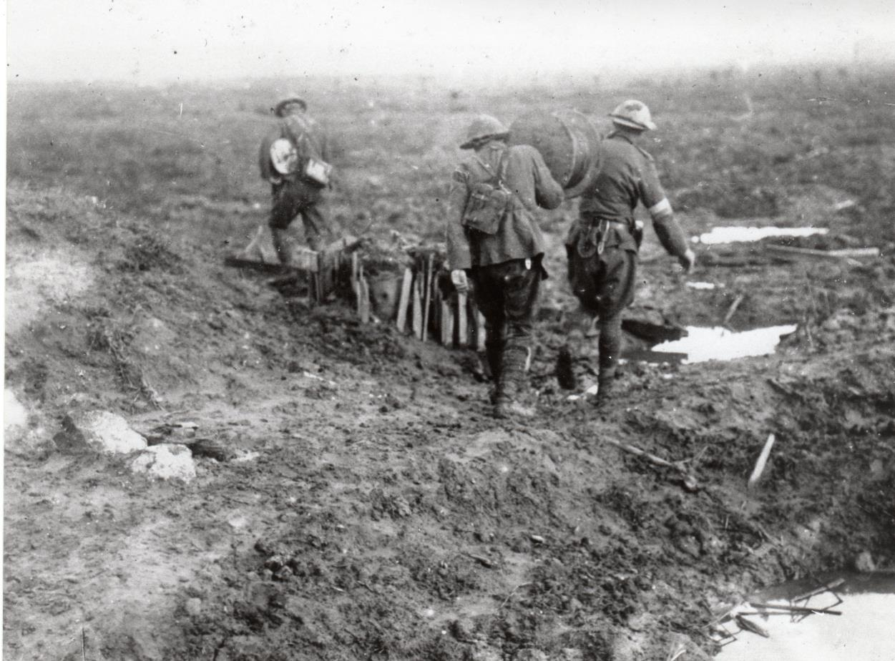

Slide 33
The New Zealanders before Passchendaele
Uncut wire was the cause of our failure. It is true that the Artillery barrage was quite inadequate, owing to the difficulty which had been experienced in getting guns forward, so reducing the number available, and also to the fact that with no stable platform from which to shoot, their registration was faulty and guns were frequently out of action owing to the trails or wheels shifting their position in the mud and soft ground, but, be the barrage good, bad or indifferent….’
Russell to Allen dated

Slide 34
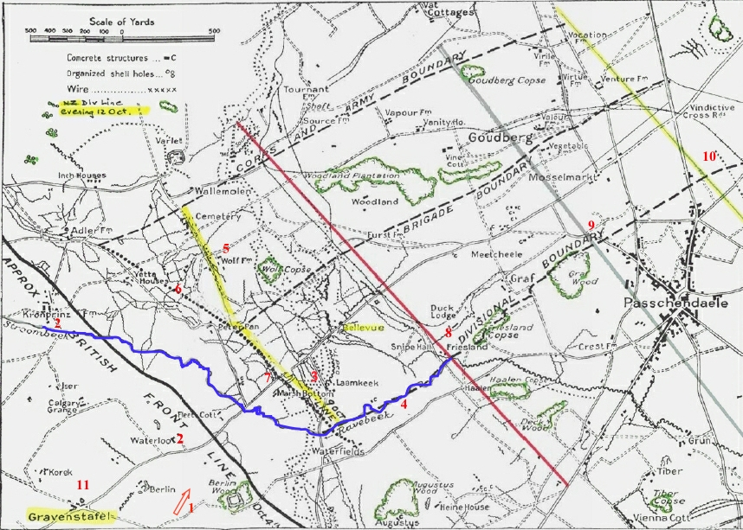
12 October 1917

Slide 35
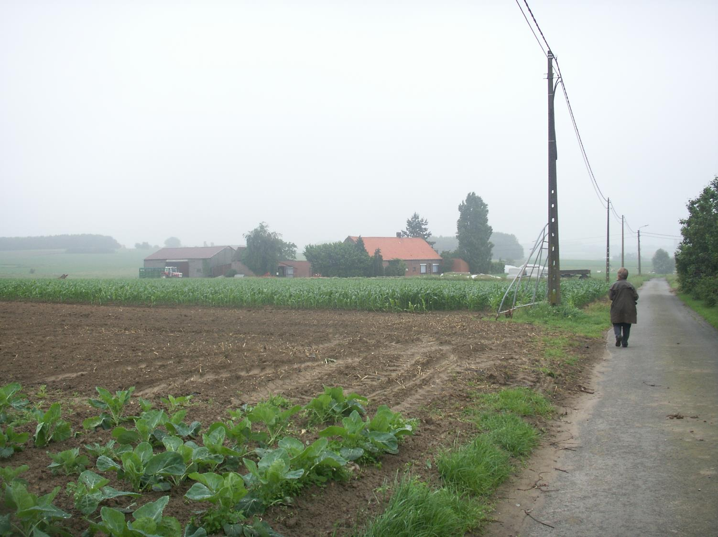

Slide 36
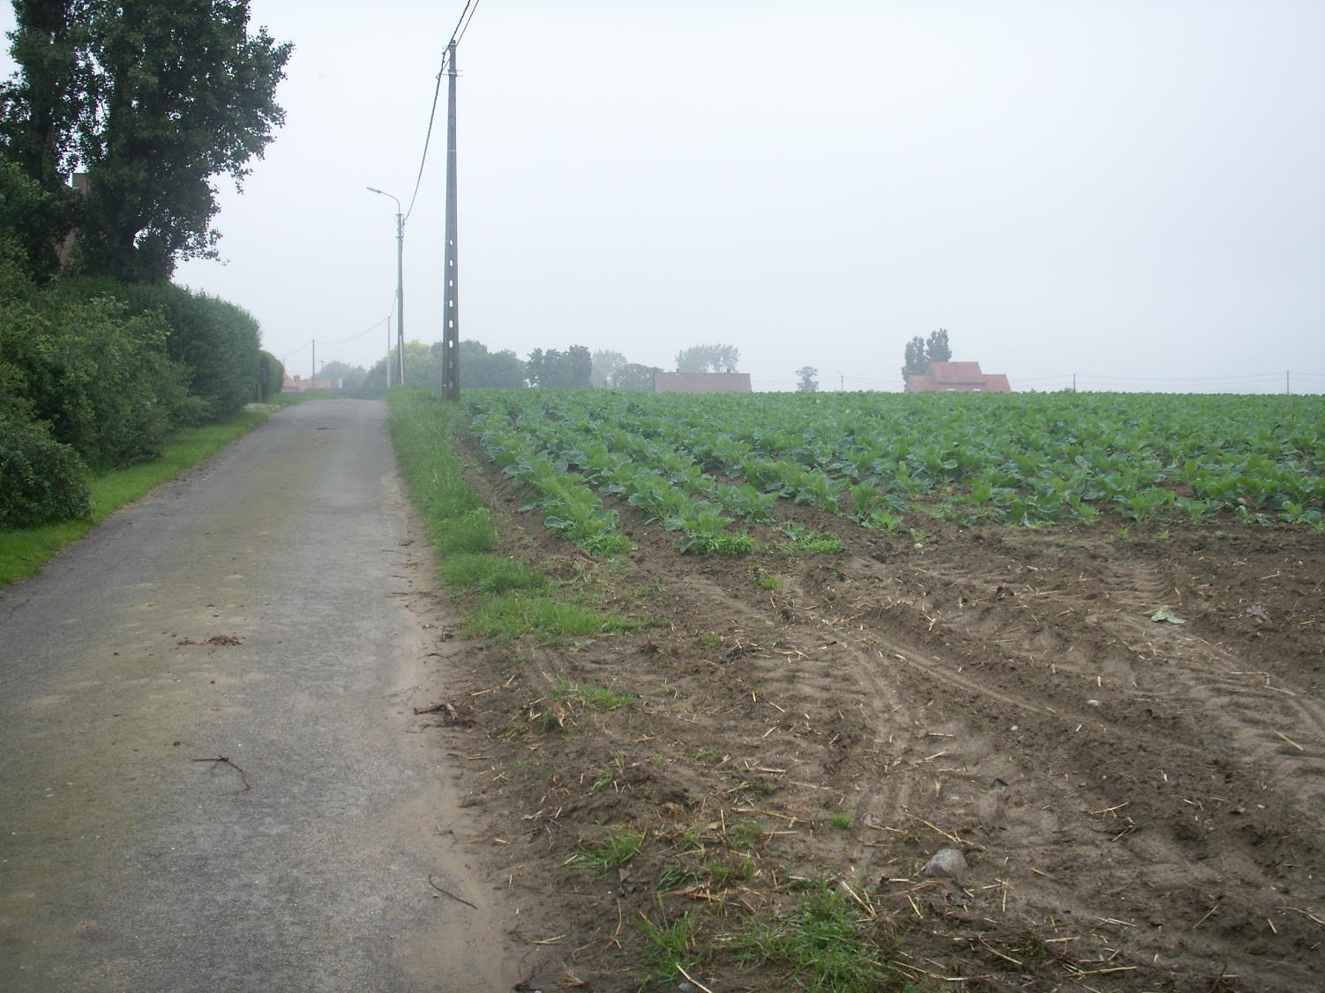

Slide 37
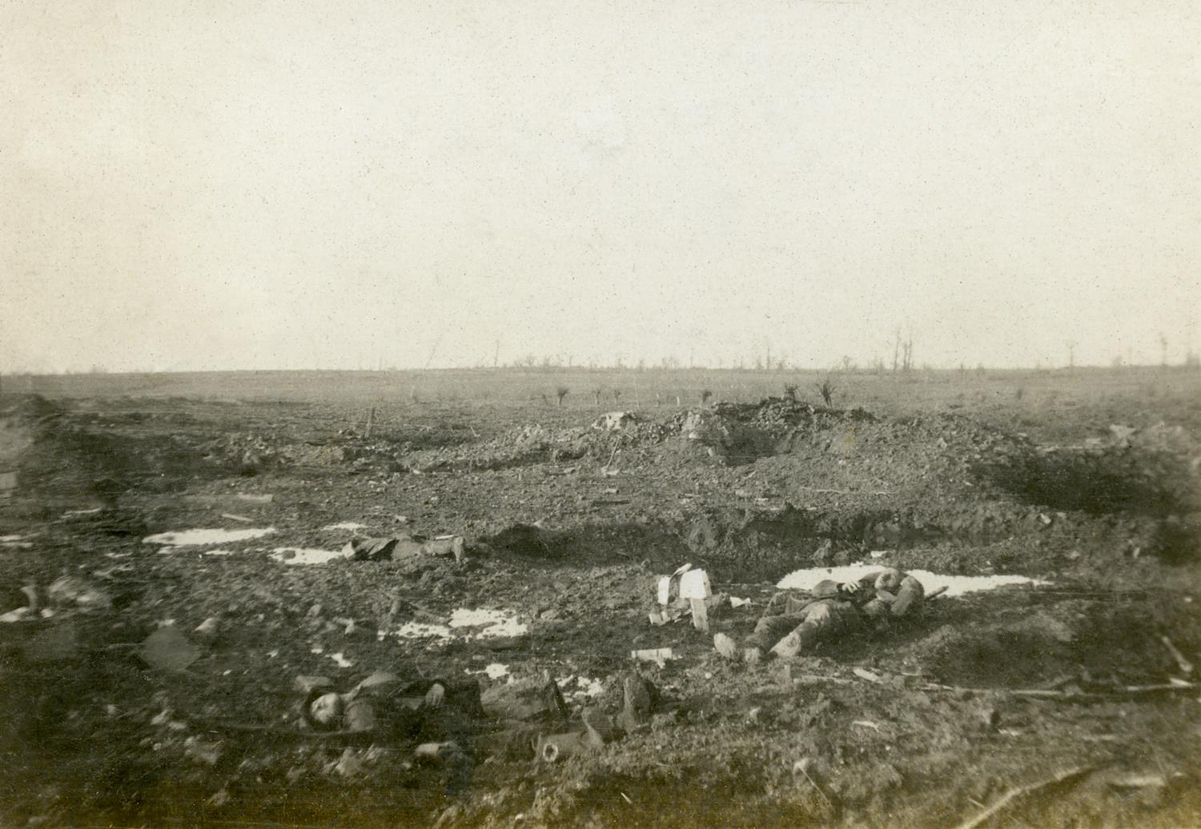

Slide 38
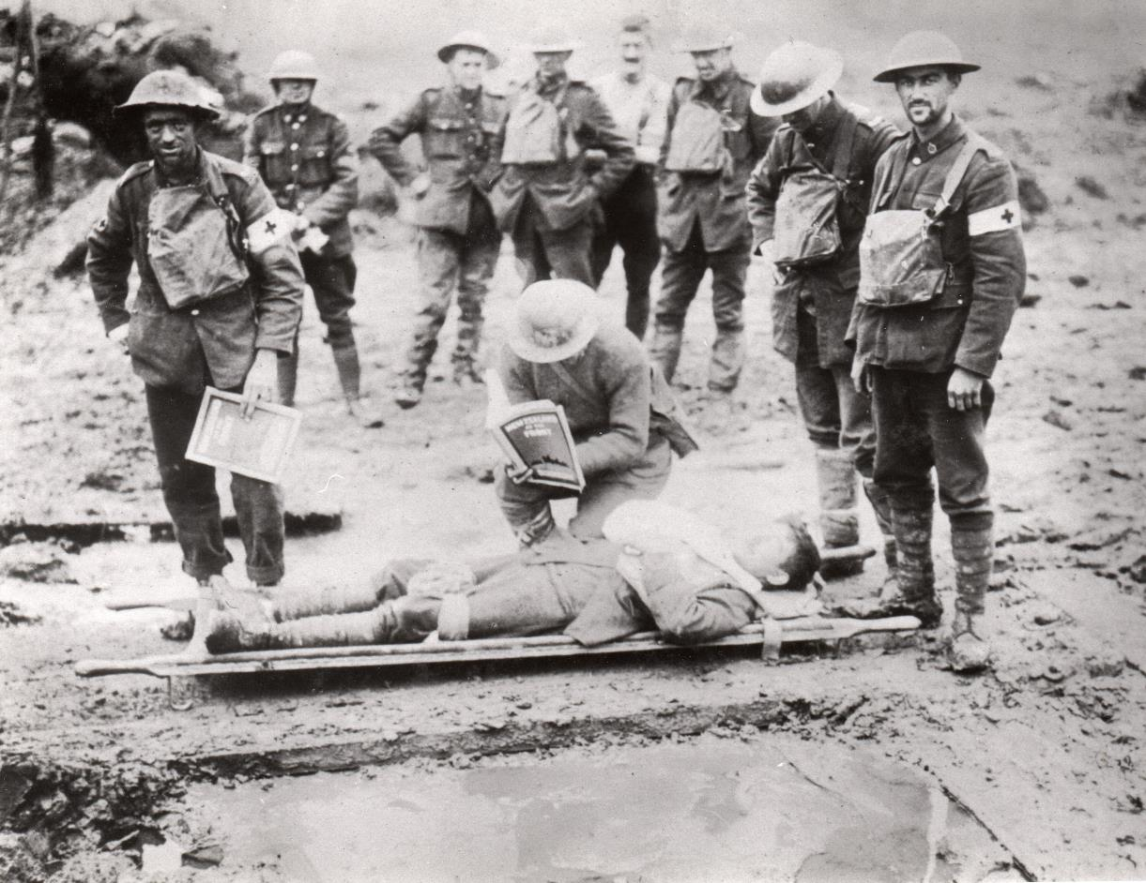

Slide 39
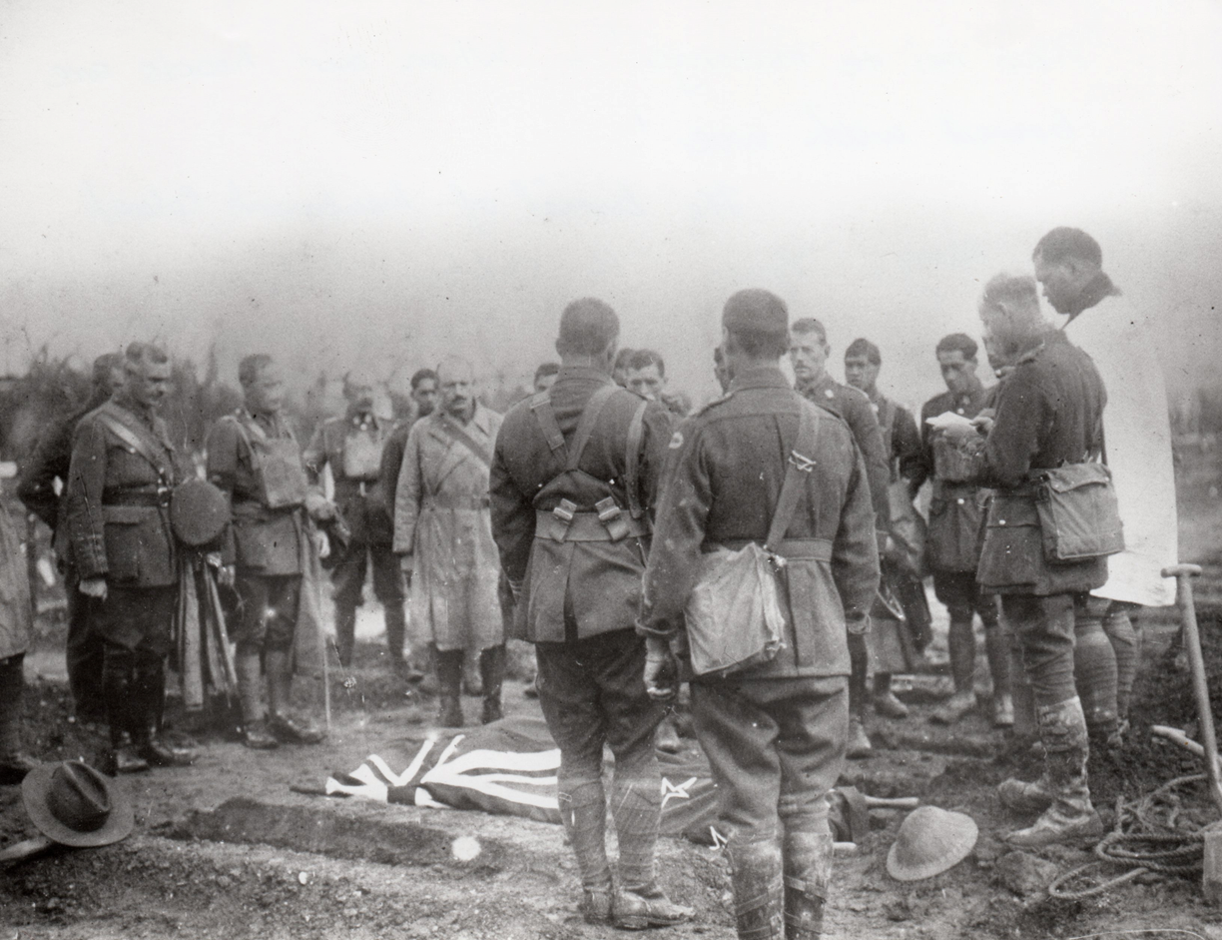
‘It is plain we attacked a strong position, stoutly defended with no adequate preparation, nor was the supporting barrage or rather the covering barrage such as to help us over the difficulty.’ Russell Diary 15-16 Oct 17
Burial of Lt Colonel George King, 1 Canterbury, former CO Pioneer Battalion

Slide 40
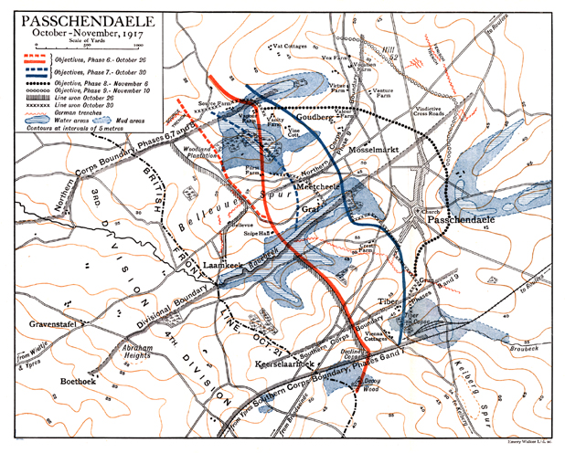
Battles of Passchendaele 26 Oct-17 Nov 17

Slide 41
The New Zealanders before Passchendaele
I am confident that our men would have got forward excepting for the insuperable difficulties of the wire. You cannot fight machine guns plus wire, with human bodies. Without the wire to check them the men would have tackled machine guns in spite of their losses. As it was, they tried heroically to tackle both. This was humanly impossible.
Russell to Allen dated

Slide 42
Interlocking Wire and Machine Guns without artillery cover

Slide 43
The New Zealanders before Passchendaele
“The Division only took over at 10 o’clock on the 11th and attacked at dawn on the 12th. Whatever the obstacles might have been on our front, it was too late to deal with them by Artillery preparation. We as a Divisional Staff, assumed that the wire had been cut. Assumption in war is radically wrong if by any means in your power you can eliminate the uncertain…
“In this case I got sufficiently accurate information as to the state of affairs, but 24 hours too late to be of any use. Had it been received 24 hours earlier one would have been in a position to ask for an extension of time before attacking to deal with the difficulty….
Russell to Allen dated

Slide 44
The New Zealanders before Passchendaele
“We cannot always expect to succeed, but I feel very sorry about it all when I think of the numbers of men who were lost. My chief fear is that the men may lose confidence in the arrangements made for them as they had always been taught that, provided the Staff arrangements are good, they are able to do anything that is asked of them…
‘In these days of Parliamentary criticism, questions may be asked as to the operations I refer to. The somewhat bald and concise statement I have made above accurately represents the position.”
. Major-General Sir Andrew Russell to James Allen, New Zealand Minister of Defence dated 7 November 1917, Allen Papers, National Archives.

Slide 45
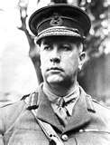
HAIG COMMITS CANADIAN CORPS
‘Every Canadian hated to go to Passchendaele… I carried my protest to the extreme limit… which I believe would have resulted in my being sent home had I had been other than the Canadian Corps Commander. I pointed out what the casualties were bound to be, and was ordered to go and make the attack.’ Lieutenant-General Sir Arthur Currie, GOC Canadian Corps

Slide 46
Battles of Passchendaele 26 Oct-17 Nov 17

Slide 47
At What Cost? – 17,000 Canadian casualties
1900 NZ Dead
4100 wounded.
842 dead 12 Oct

Slide 48
The New Zealanders before Passchendaele
I am confident that our men would have got forward excepting for the insuperable difficulties of the wire. You cannot fight machine guns plus wire, with human bodies. Without the wire to check them the men would have tackled machine guns in spite of their losses. As it was, they tried heroically to tackle both. This was humanly impossible.
Russell to Allen dated

Slide 49
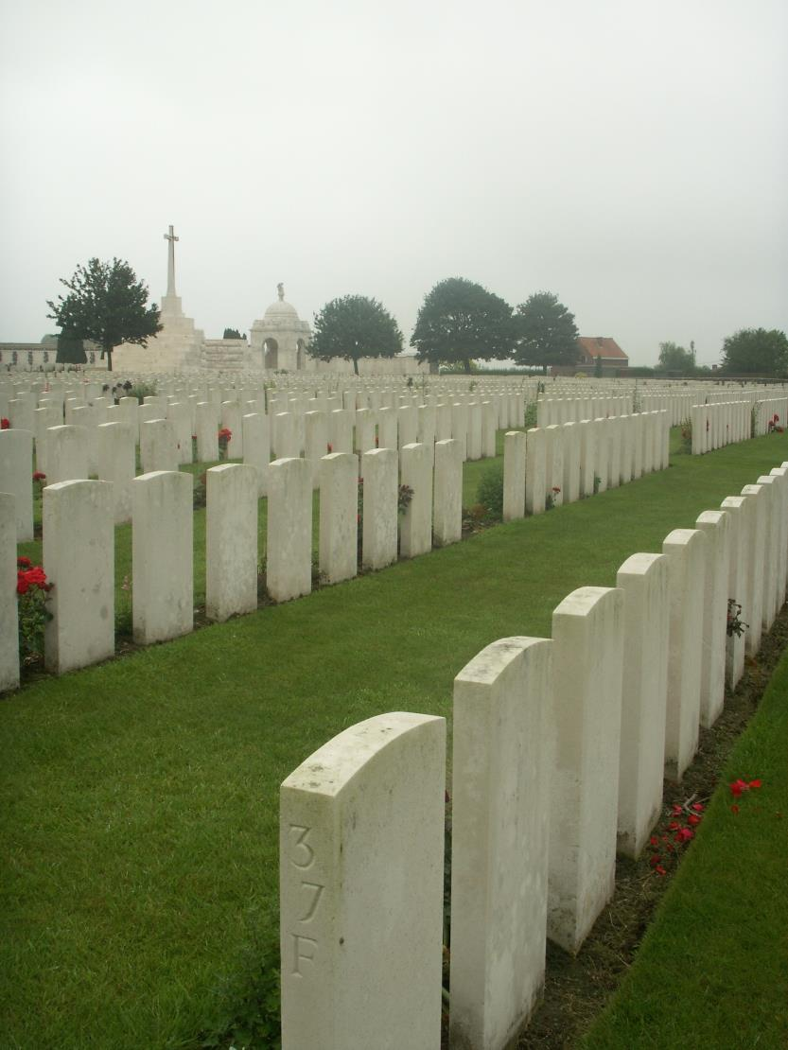
The Terrible cost of an over-extended battle in the Salient should not disguise the revolution and evolution in combined arms skills that was the remarkable feature of the BEF in 1917. Had Haig closed the battle after 9-12 October – 1917 would have been a year of success?

