Slide 1
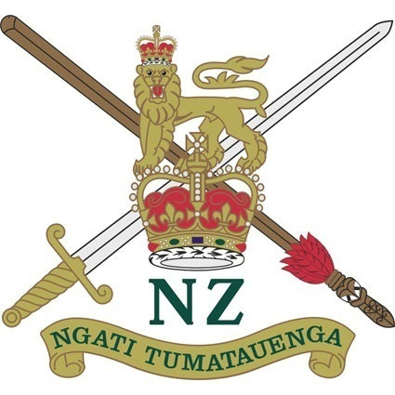
THE NZ ARMY: FOUNDATIONS
Lieutenant Colonel I.J. Brandon, RNZE

Slide 2
About Me
Joined the NZ Army in 1999 and commissioned into RNZE in 2002.
Served in a variety of Regimental, training and staff appointments during my career.
Operational service in Afghanistan, Sinai and Iraq.
Currently the Commanding Officer of 2nd Engineer Regiment.

Slide 3
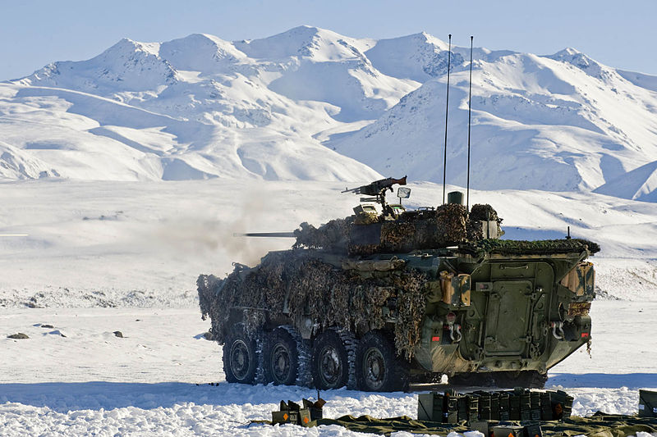
Scope
An overview of the formation and early history of the New Zealand Army:
Formation and Operations in New Zealand: 1845 – 1899
For the Empire: 1899 – 1918
Conclusion: relevance today

Slide 4
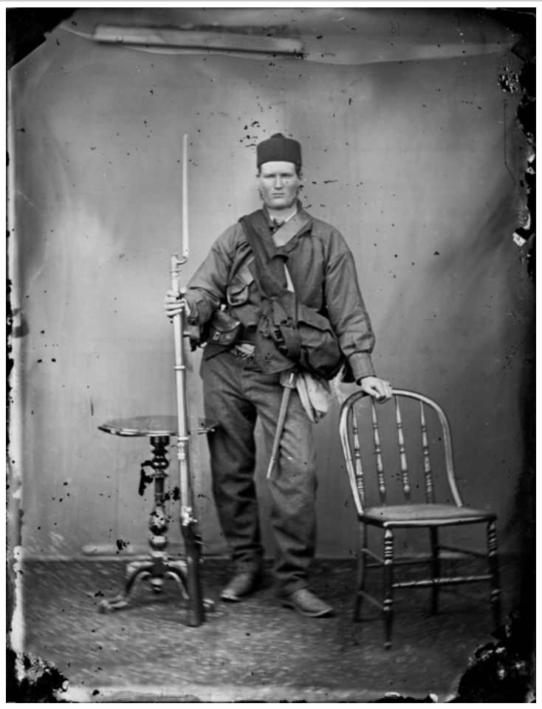
Formation and Operations in New Zealand: 1845 - 1899

Slide 5
The Militia 1845 - 1886
The official birthday of the Army was 25 March 1845, when the Legislative Council passed the first Militia Ordnance, in response to Hone Heke’s operations in the Auckland region.
A Militia Act was passed in mid-1858 by the New Zealand Parliament (which had first met in 1854). The country was divided into militia districts and a permanent training staff was provided for each district.
Until 1872, North Island militia units were frequently called out for service, as garrison troops (sometimes of frontier outposts) – but with only a few units being involved in minor skirmishes.

Slide 6
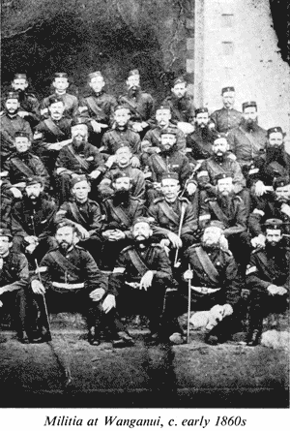

Slide 7
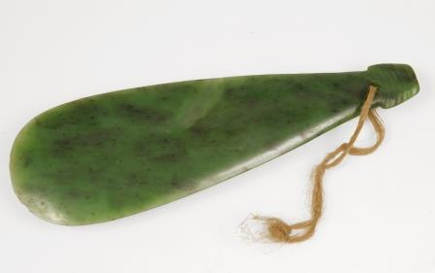
Ngati Tumatauenga
While the ‘official’ birthday of our Army was in 1845, our culture runs much deeper and integrates aspects of both Maori and European military heritage.
The Maori people became our tangata whenua hundreds of years before the arrival of Europeans, and by the time of first contact had developed a unique approach to warfighting.

Slide 8
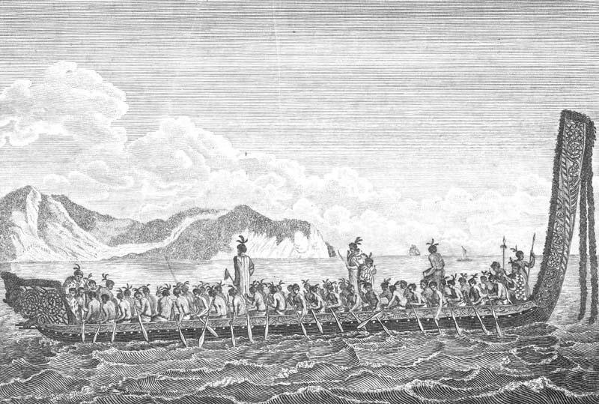
Ngati Tumatauenga
Maori were adept at using ground and cover to their advantage - expert at operating in difficult, forested terrain. They also made extensive use of waterways, using great waka to transport their taua along rivers or across bays and estuaries.

Slide 9
Ngati Tumatauenga
Practitioners of amphibious warfare: as illustrated in the battle for Kapiti Island in 1824.

Slide 10
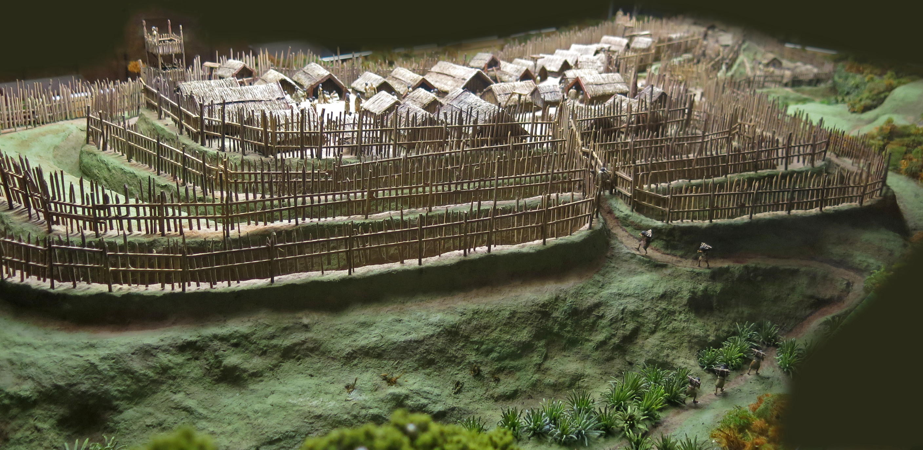
Ngati Tumatauenga
Experts at defensive warfare: the evolution of the pa.

Slide 11
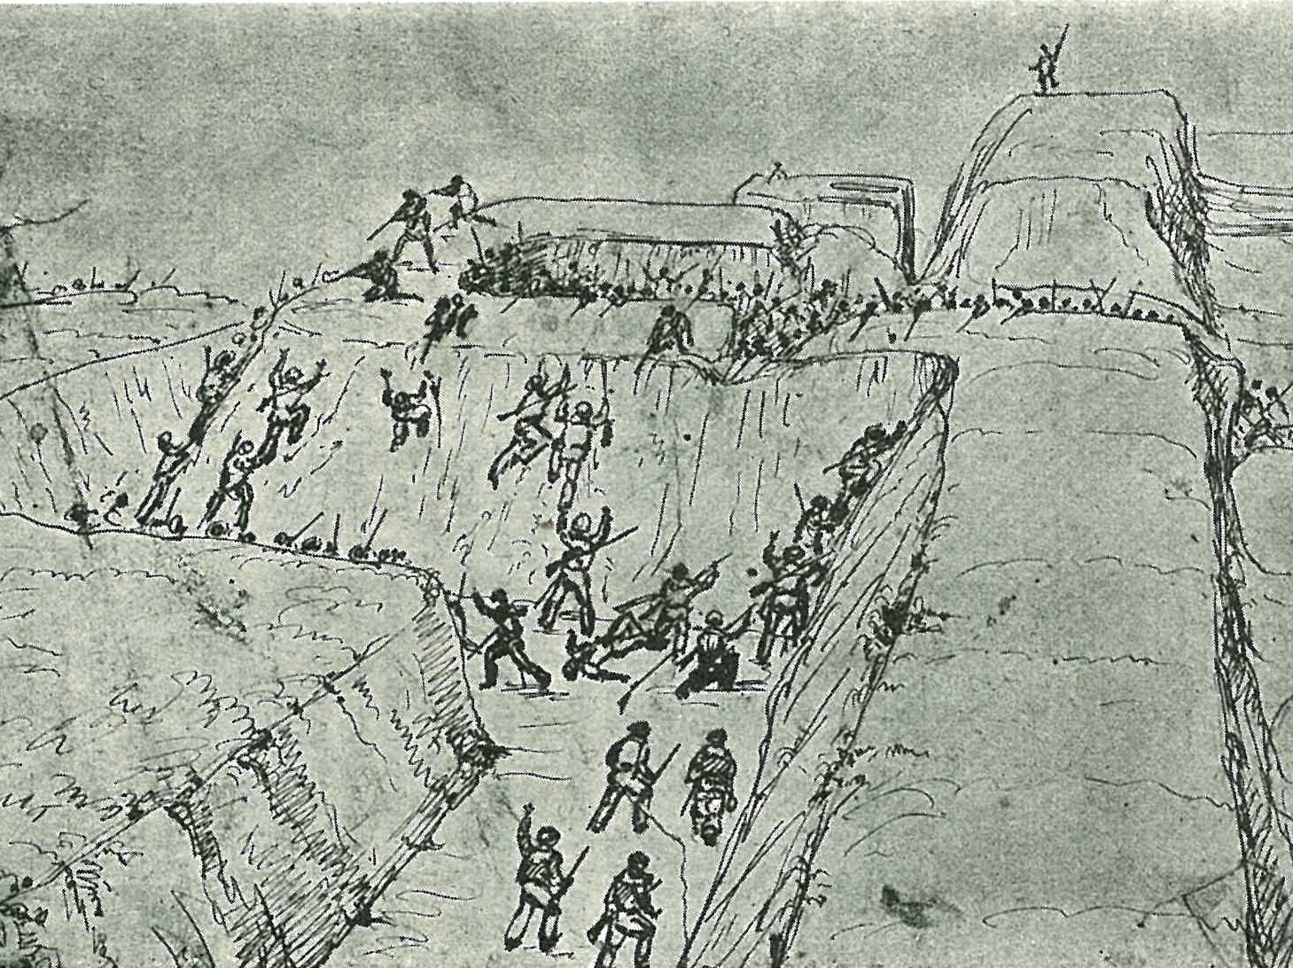

Slide 12
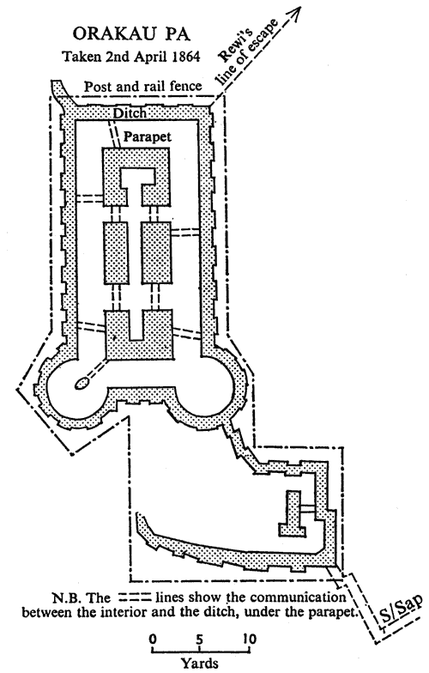

Slide 13
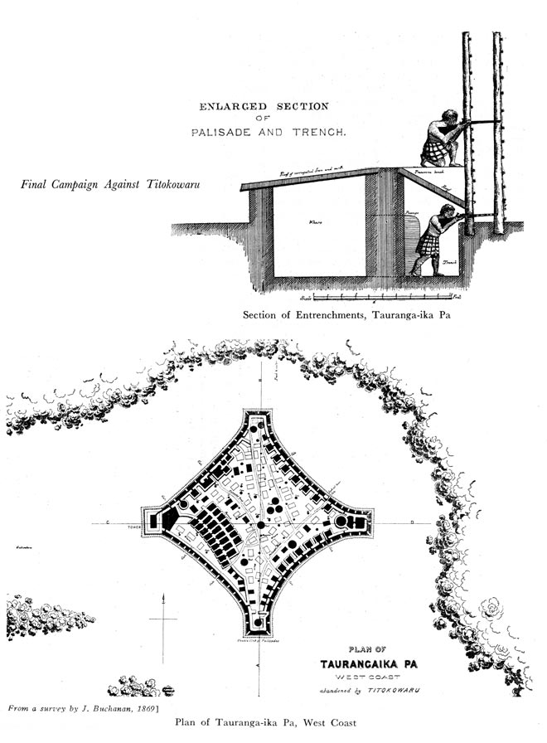

Slide 14
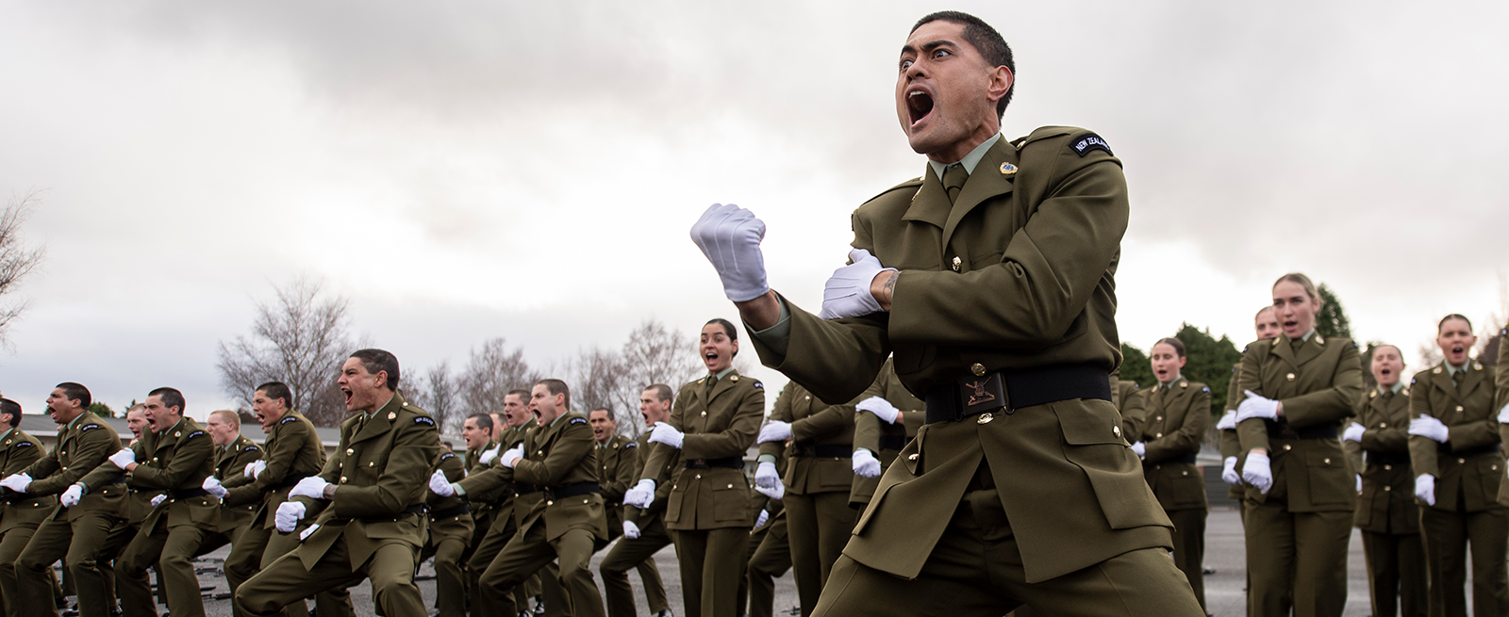
Ngati Tumatauenga

Slide 15
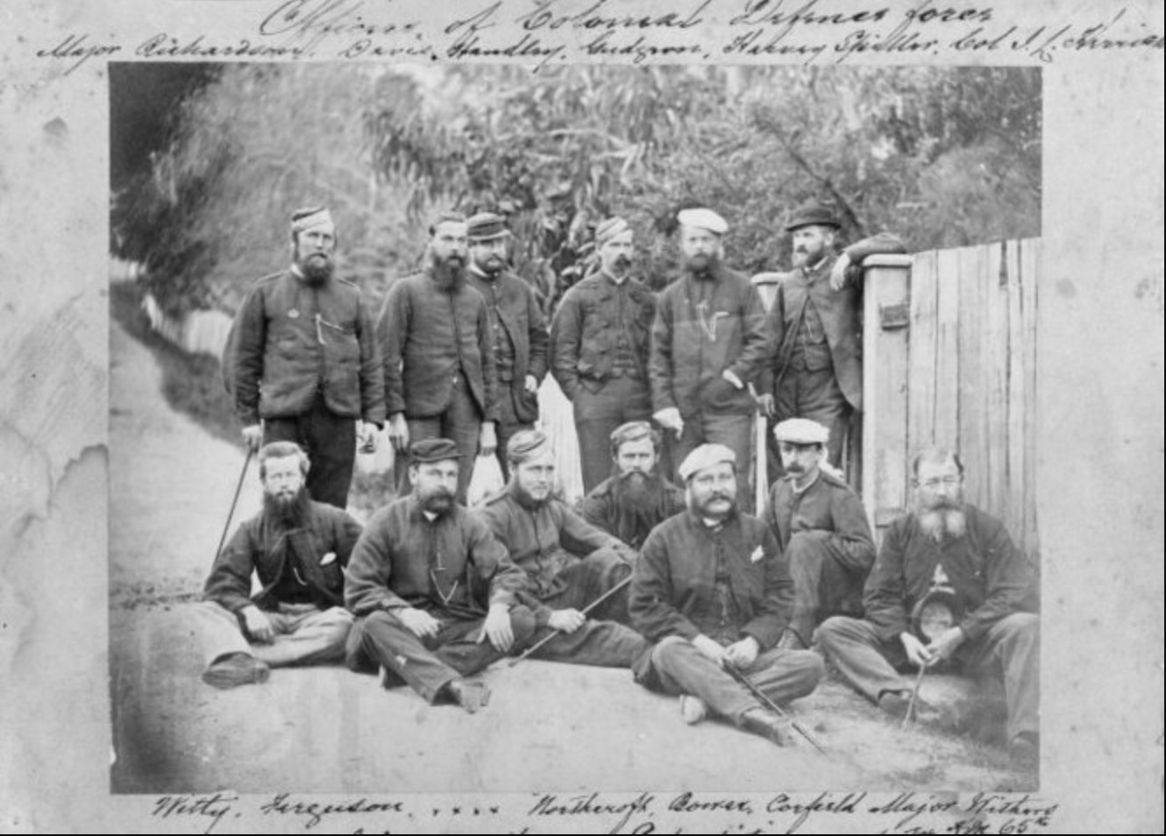
The Colonial Defence Force 1862 - 1867
The Colonial Defence Act of 1862 authorised the formation of the first Regular Force.

Slide 16
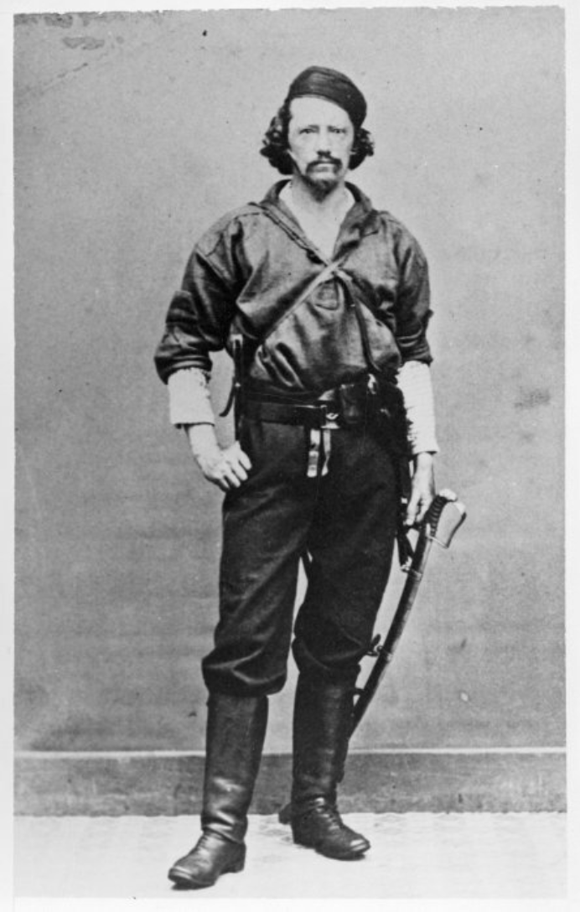

Slide 17
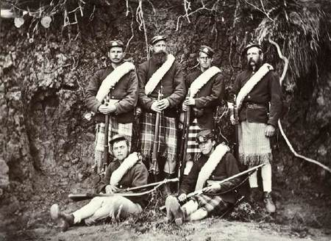
The Armed Constabulary 1867 - 1886
The Armed Constabulary Act was passed in 1867, with this force superseding the Colonial Defence Force.

Slide 18
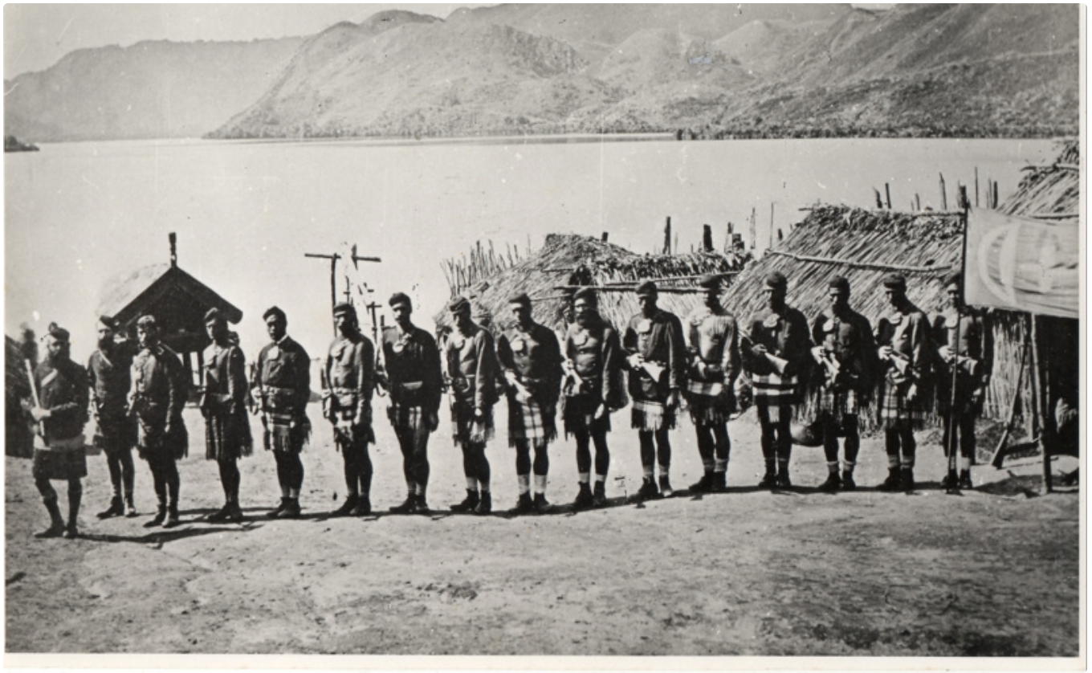

Slide 19
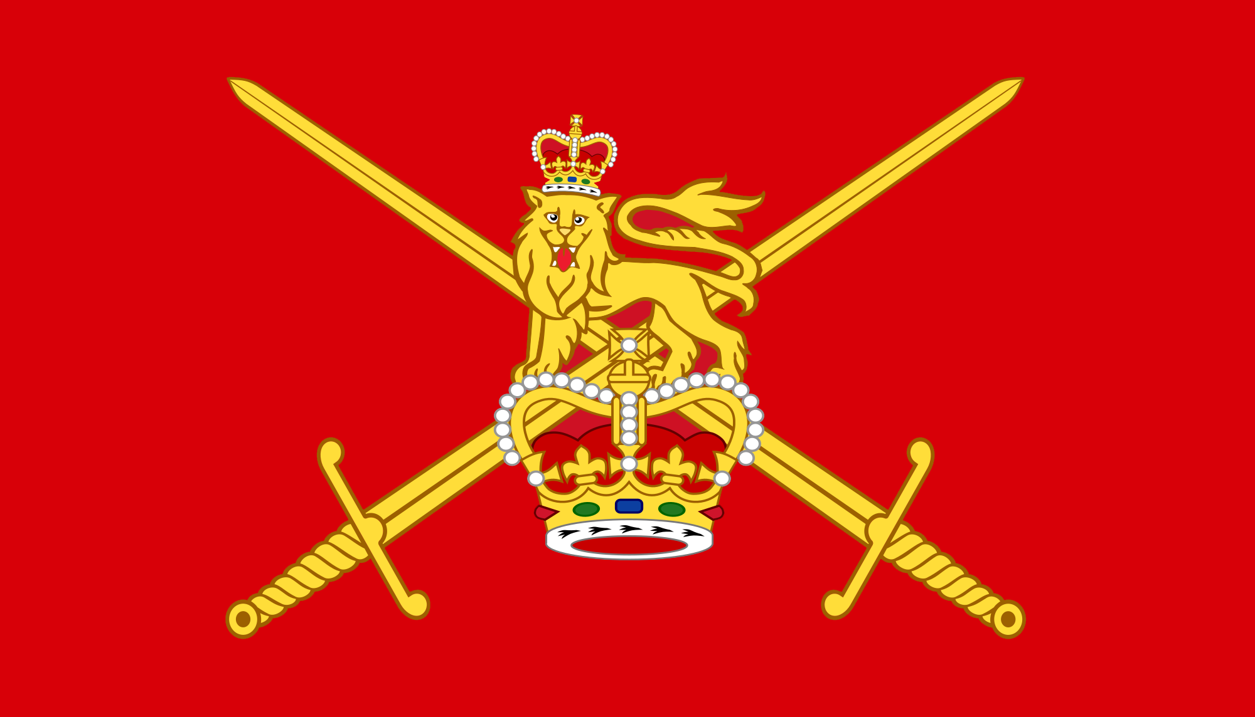
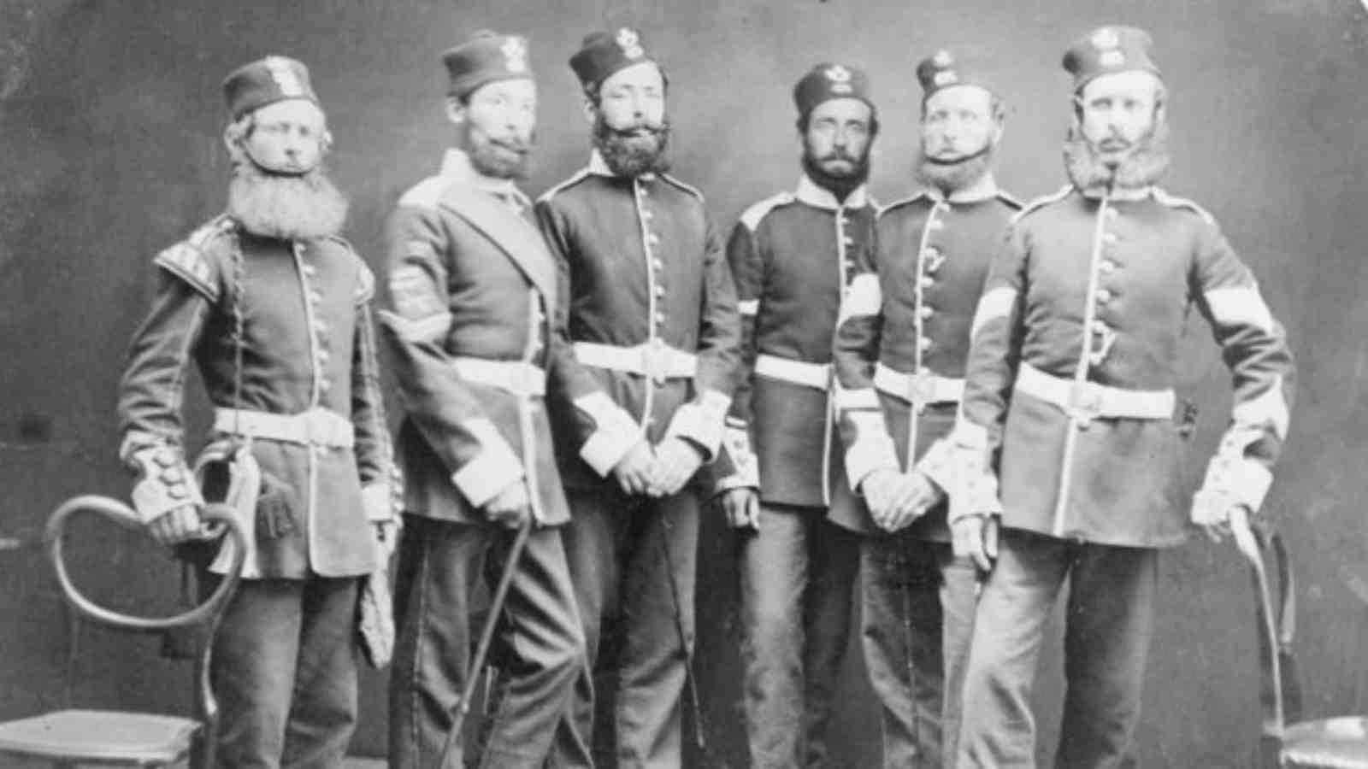
The British Army in NZ 1840 - 1870
British regular forces were active in New Zealand between 1840 and 1870, and bore the brunt of the fighting over that period.

Slide 20
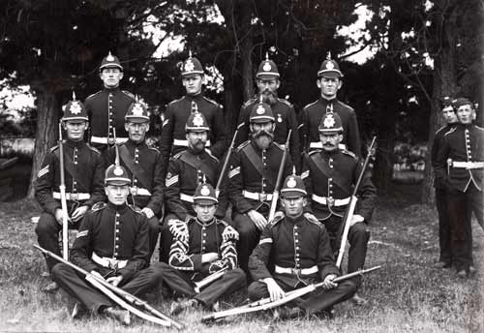
The Volunteers 1858 - 1909
Created by the Militia Act of 1858 and survived until the passing of the Defence Act 1909 which created the Territorial Force.

Slide 21
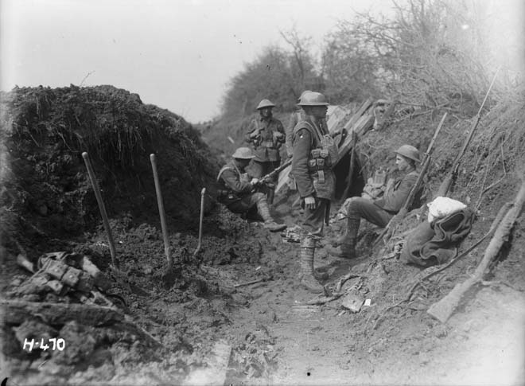
For the Empire
1899 - 1918

Slide 22
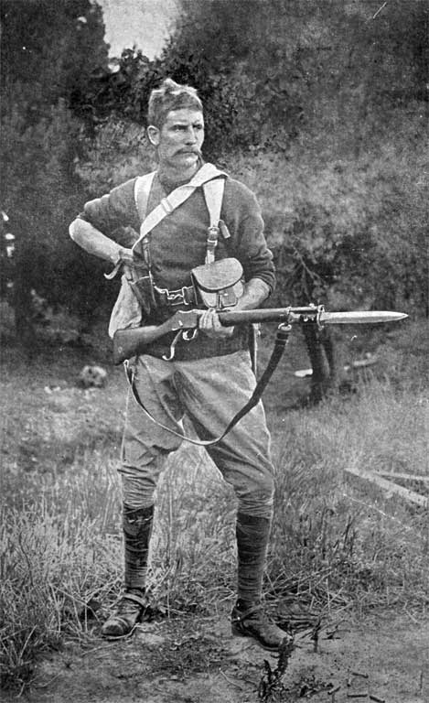
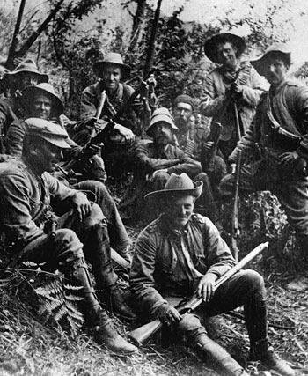
South Africa 1899 - 1902
New Zealand offered a contingent of mounted riflemen to the Imperial Government for operations against the Boer. It was a milestone: the first time we had contributed troops to an overseas theatre of war.

Slide 23
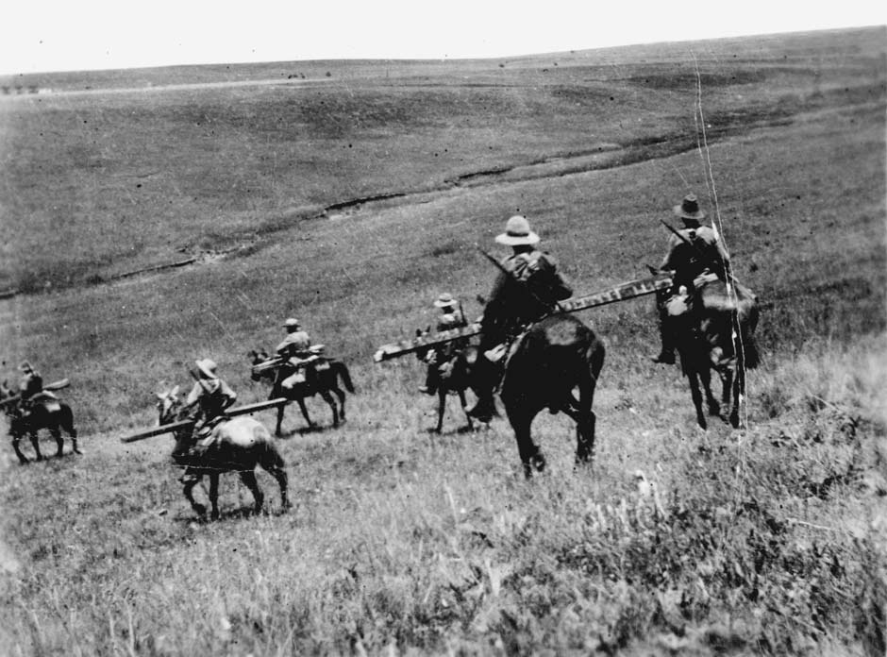

Slide 24
World War I 1914 - 1918
When war broke out in August 1914, New Zealand was in a position to offer Great Britain an expeditionary force.
At this time, there were 30,000 men under training in the Territorial Force. This formed the basis of the volunteer force that provided the initial Main Body as well as reinforcements for a further two years.

Slide 25
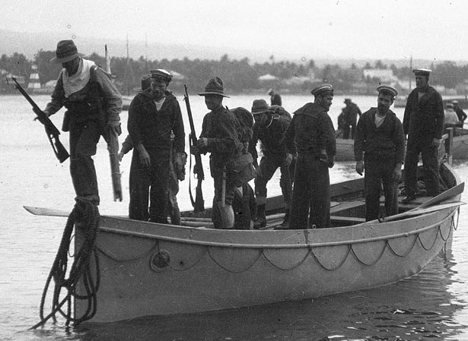
World War I: Samoa August 1914
A force of 1,413 men left New Zealand to occupy German Samoa, conducting an unopposed landing on 29 August 1914.

Slide 26
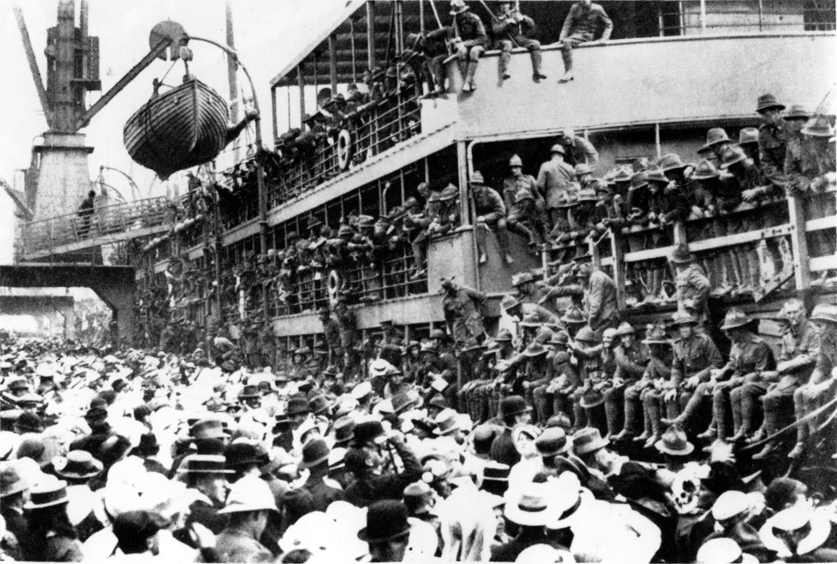
World War I: The Main Body October 1914 – February 1915
The Main Body consisted of four battalions of infantry, four mounted rifle regiments, a field artillery brigade and other ancillary arms: 8,427 Officers and men as well as 3,815 horses.

Slide 27
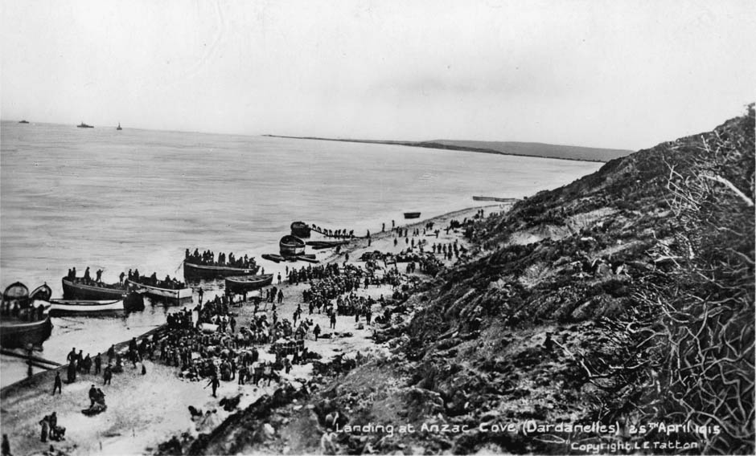
World War I: Gallipoli April – December 1915
New Zealand forces landed on the Gallipoli peninsula on 25th April 1915 as part of the ANZAC where they fought alongside the Australians for the next eight months in a desperate campaign against the Turks.

Slide 28
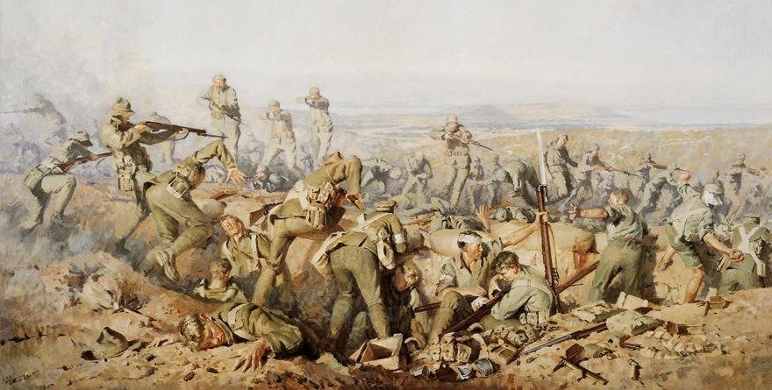

Slide 29
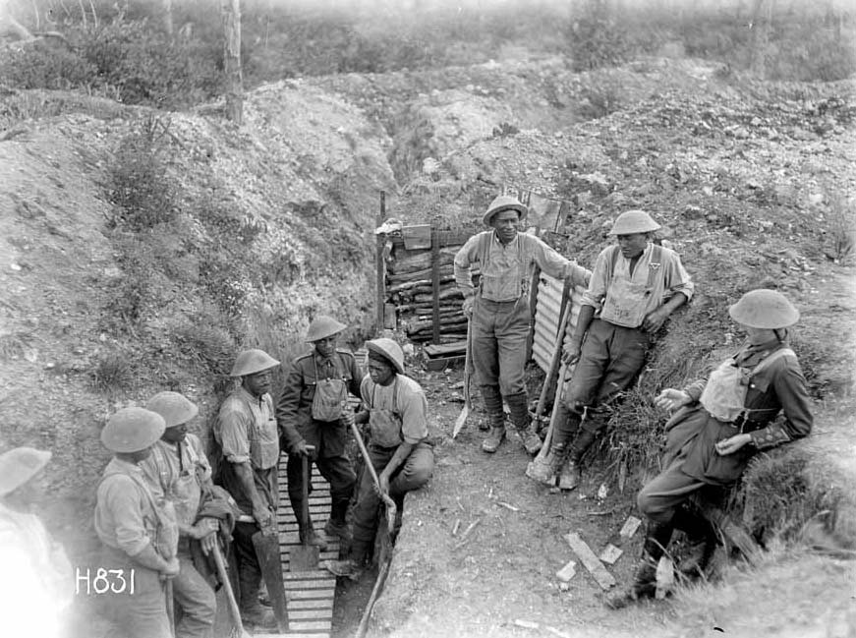
World War I: The Western Front April 1916 – November 1918
From Egypt the NZ Division was ordered to France, where they became mired in trench warfare.

Slide 30
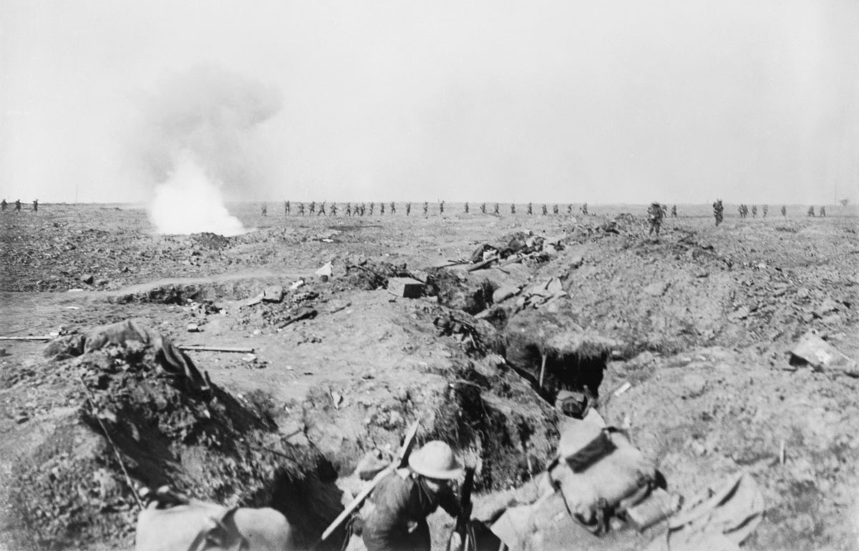
World War I: The Somme September 1916

Slide 31
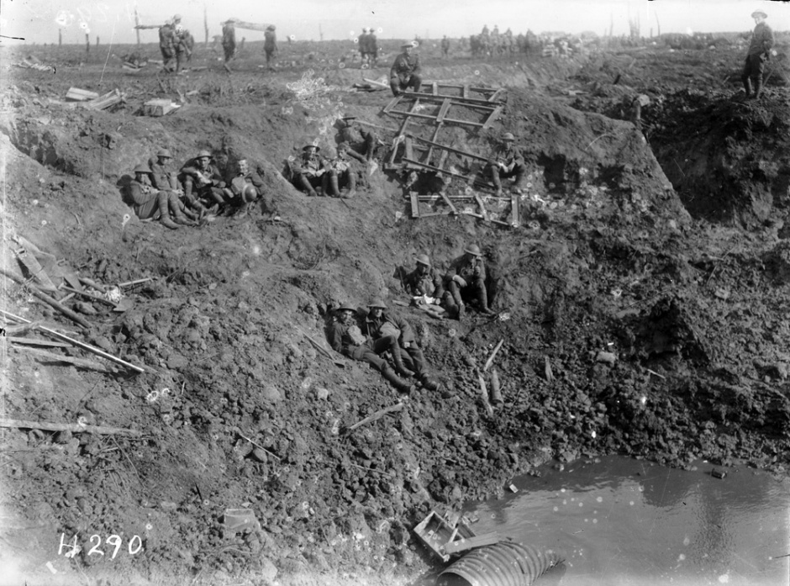
World War I: Arras, Messines and Passchendaele 1917

Slide 32
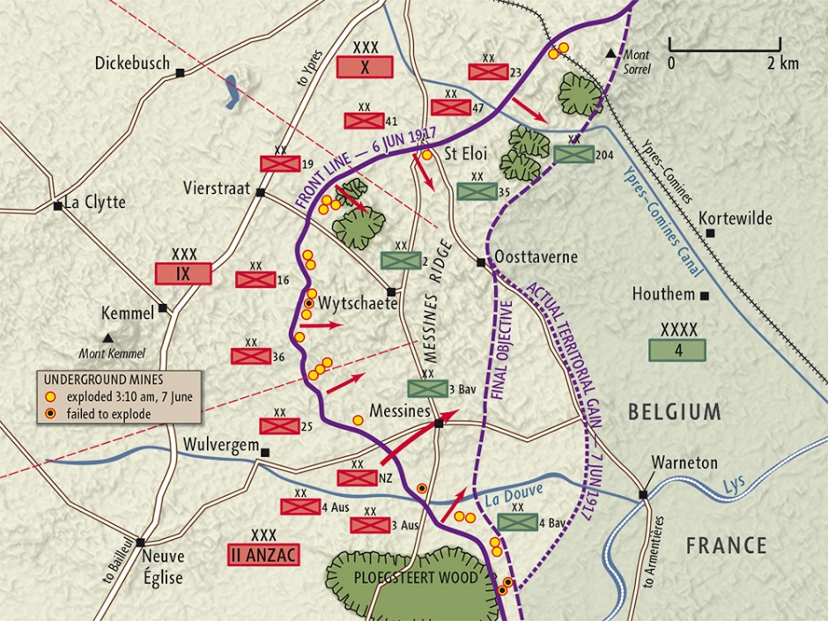

Slide 33
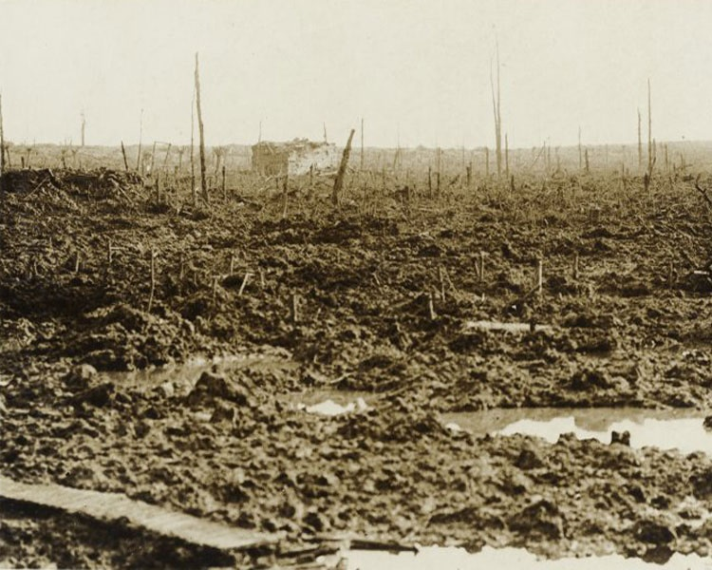

Slide 34
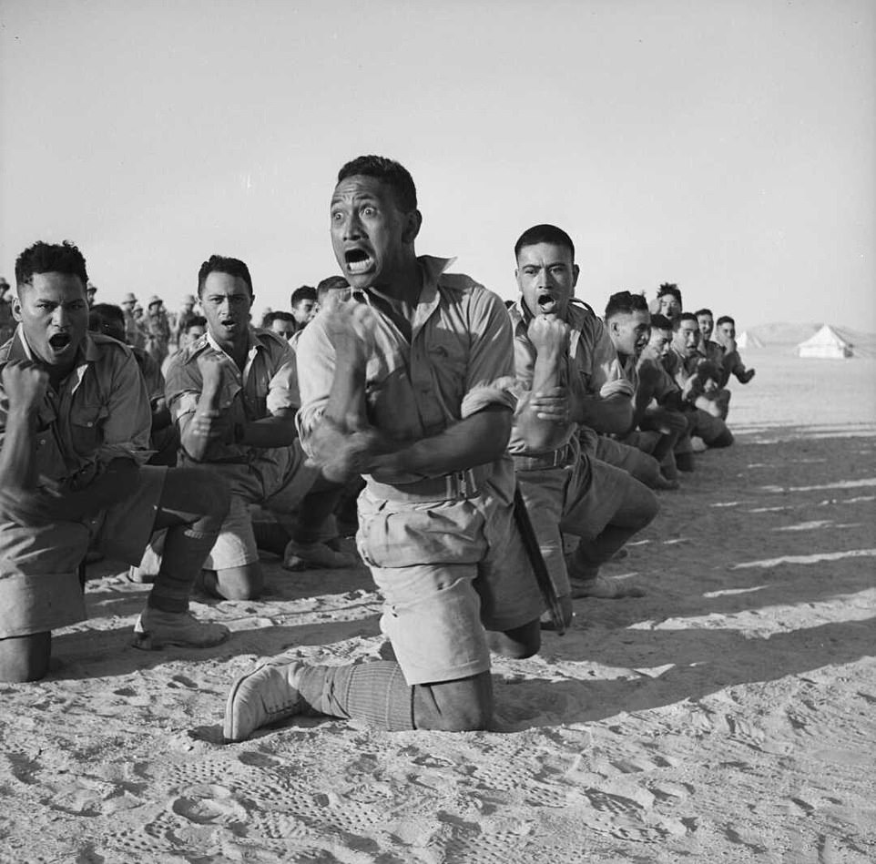
Conclusion

Slide 35
Foundations
Corps and Regimental structures.
Integration of military heritage: European and Maori.
A tradition of producing self-sufficient and resilient soldiers who punch above their weight.
A tradition of volunteerism, with a strong territorial component to compliment our regular forces.
A strong sense of national identity, and independence following WWI.

