Slide 1
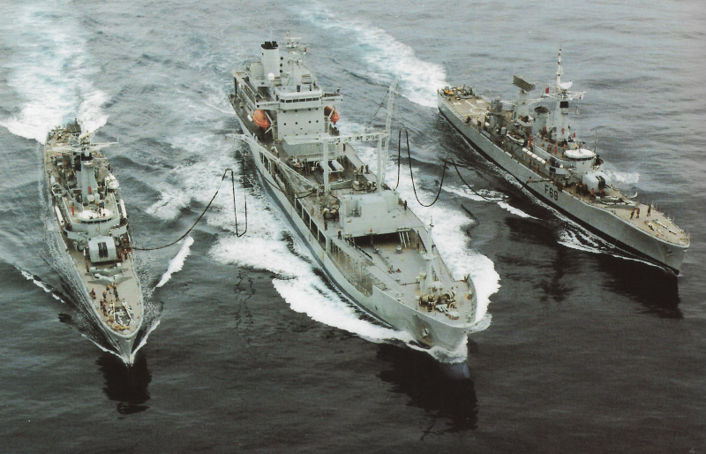
Soldiers Without Guns Part 1: The Navy's 1990 peace mission in Bougainville

Slide 2
Why talk about Operation Big Talk
Some facts about Bougainville
The origins of ‘the Bougainville crisis’
Operation Big Talk – and the responses to it
Bougainville afterwards
Sailors without Guns – a video
Final thoughts - and a poem

Slide 3
International Award Winning NZ Doc SOLDIERS WITHOUT GUNS Is FREE Online for All New Zealanders This Waitangi Weekend Thursday, 4 February 2021, 6:33pm
‘For those who don’t know the story, 20 years ago - the New Zealand Defence Force ended a 10 year civil war in Bougainville by leading a radical new cultural peacekeeping mission. All 14 previous peace attempts had failed. Their point of difference? Instead of taking guns, they took guitars and the Maori Cultural Group.’

Slide 4
A FILM BY WILL WATSON SOLDIERS WITHOUT GUNS THE UNTOLD STORY OF UNSUNG HEROES
‘The riveting journey of New Zealand soldiers as they land unarmed into the heat of a 10 year civil war using only the weapons of Music, Maori Culture and Love to create peace. This radical idea of sending soldiers without guns was condemned by the media because they felt the soldiers would be massacred given the first 14 peace attempts had failed.’

Slide 5
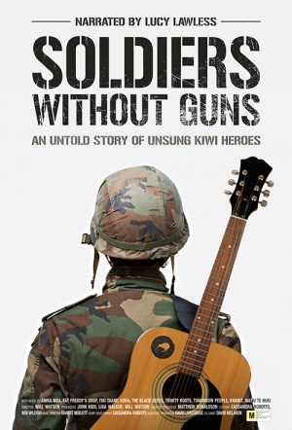
SOLDIERS WITHOUT GUNS
NZ documentarian Will Watson (Haka and Guitars) tells the story of how the 10-year Bougainville Civil War was ended by some guitar-toting Kiwis.
In 1997, after 14 failed peace agreements, the New Zealand army stepped into the conflict with a radical new plan - instead of bringing guns, the unarmed soldiers took guitars.
Condemned by the media, the peacekeeping mission pushed forward using only music, Māori culture and aroha to help end the worst civil war in the Pacific’s history.

Slide 6
A review with a difference
‘(The Director)(Will)Watson tells a lovely story. Unfortunately it's not the whole story.
The first peace talks were in 1990, culminating in the "Endeavour Accord" after talks were held on-board the RNZN contingent of Her Majesty's New Zealand Ships Waikato, Wellington and Endeavour. Sailors from these ships went ashore and performed waiata and haka as a response to the welcome from the Bogainvillians.
Watson would have us believe that it was only much later that this novelty alone ended the war and that the rest of the peace process was a "failure". This is disingenuous of Watson and disrespectful of all the efforts by many New Zealanders that went into the peace process over a decade.
No mention whatsoever was given to (then) Commander Dave Ledson and Naval Command at the time who made the decision to go in unarmed initially.
Watson has ignored history to provide a warm fuzzy story-line, but his story is simply incomplete.’(Audience Reviews)

Slide 7
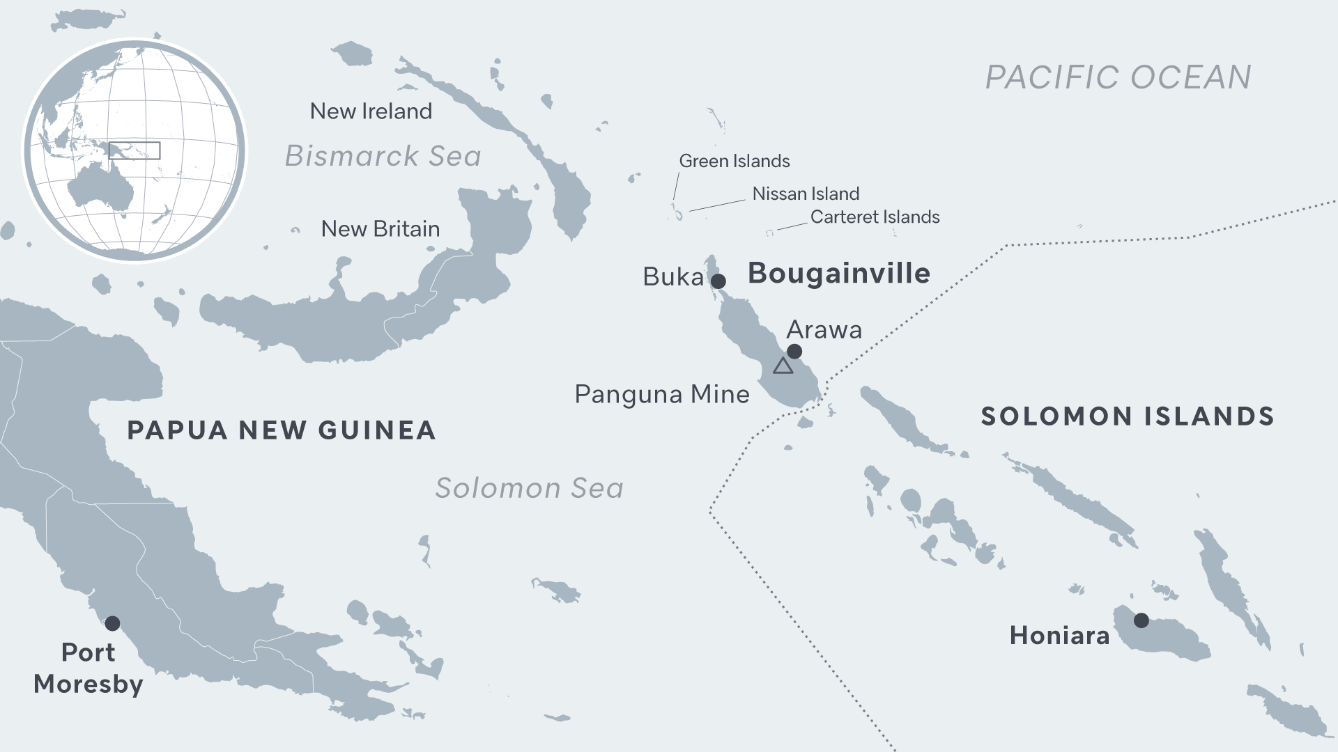
BOUGAINVILLE

Slide 8
BOUGAINVILLE

Slide 9
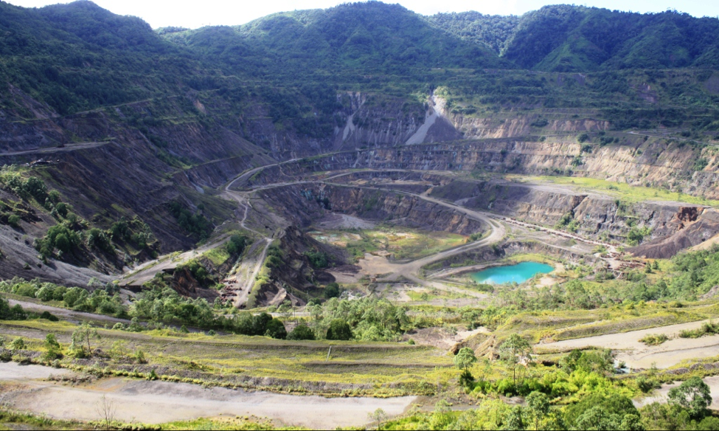
Panguna Copper Mine

Slide 10
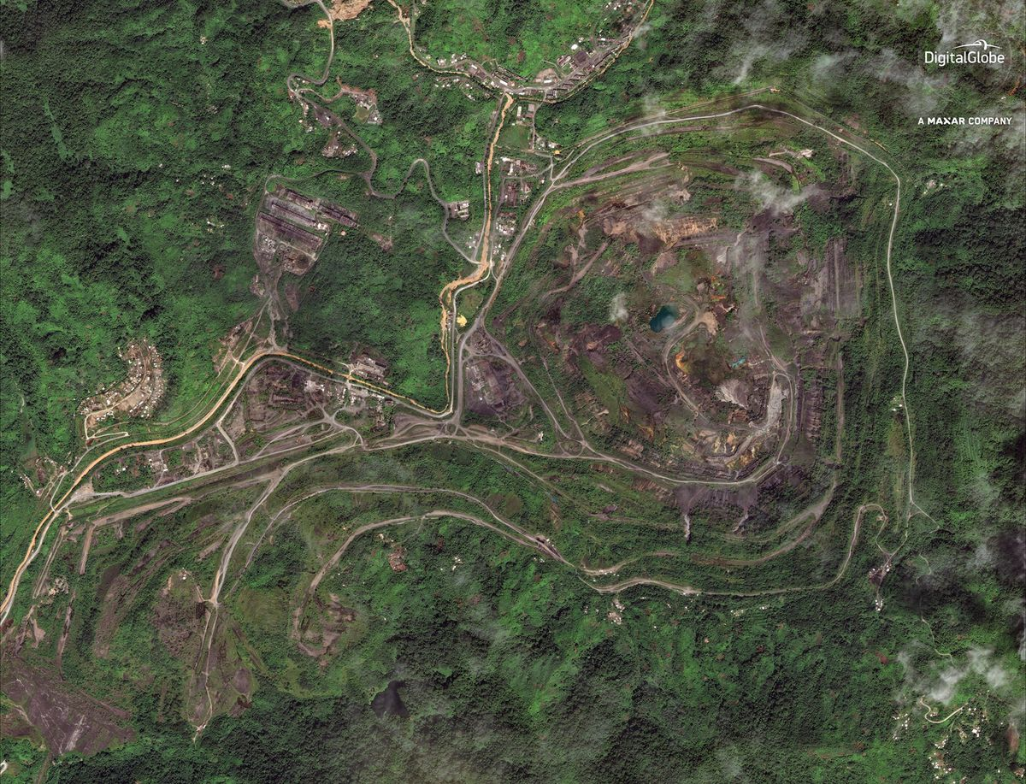

Slide 11
FRANCIS ONA

Slide 12
JOSEPH KABUI

Slide 13
SIR MICHAEL SOMARE ONBOARD HMNZS WELLINGTON

Slide 14
Kieta Harbour

Slide 15
Responses to the Endeavour Accord
"Peace at last" was the hopeful headline in the Post-Courier of 6 August 1990, reporting the signing on 5 August of the "Endeavour Accord" by the leading Bougainvillean Joseph Kabui and Sir Michael Somare, Foreign Minister of Papua New Guinea, at the end of eight days of "the most difficult negotiations in my life“. The previous 20 months had witnessed a bitter secessionist civil war on Bougainville costing over 100 lives.
The Endeavour Accord, agreed at the weekend, provided the basis for a negotiated settlement of the Bougainville crisis, Papua New Guinea's Prime Minister, Mr Namaliu, said last night. He said the accord, which provides for the resumption of government services to the rebel province, was "one of the most important agreements to be signed in Papua New Guinea since independence."(FINANCIAL REVIEW AUGUST 1990)

Slide 16
Continued…..
‘The road to peace has its ups and downs. The signing of the Endeavour Accord was a miraculous breakthrough. However, many see it as a failure since it was never applied. As I anguished over this in my times of quiet reflection I realised the failure lay in part, at my own door. I had not used my neutrality to help non-participants in the talks understand how the agreement had been reached so that they, too, could embrace it.’ (from the contribution of Alan Weeks to a plenary meeting at the Initiatives of Change Centre in Caux, Switzerland)
The NZ Prime Minister, Mr Palmer, said yesterday that New Zealand could take some credit for the peaceful resolution between the PNG Government and the Bougainville rebels.(Financial Review August 1990)

Slide 17
And in New Zealand’s Parliament - from the Government…
‘I seek to move that without the notice, that the House applauds the dedication and service of the New Zealand High Commissioner to PNG, Mr John Hayes, the staff of the High Commission in Port Moresby, the Commander of the Task Force, Commodore Ian Hunter, the complements of the Royal New Zealand Navy Ships Waikato, Wellington and Endeavour, and the New Zealand observer, Mr Tony Browne, for their work in support of the recent successful talks between the PNG Government and Bougainville representatives…’(Prime Minister, Geoffery Palmer)

Slide 18
And the Opposition….
‘The Opposition is naturally delighted that the New Zealand Navy had the fleet to make that possible….an accord has been achieved with the assistance of the New Zealand Government and, certainly, the New Zealand Navy…
All that New Zealand did, in the words of the Minister of External Relations and Trade, was put out the chairs and make the cucumber sandwiches…’ (Deputy Leader of the Opposition, Don McKinnon)

Slide 19
Sailors without Guns

Slide 20
Epilogue Part 1 -‘Doves Over The Pacific’ – by Reuben Bowd
‘This book tells the story of two regional peace support operations – Operation BIG TALK and Operation LAGOON conducted in Bougainville ….in 1990 and 1994. Both these operations are today largely forgotten as their story lies only in a handful of scattered archival files, some minor publications, and in the fading memories of the individual participants.
These operations, though short, were unique…and occurred in the absence of comparative models.
The contribution and achievements of those who served on these two operations deserve recognition and should not be forgotten.’

Slide 21
Epilogue Part 2 - Homecomings
Home is the Soldier
Home from the War
Beaming at the crowds lining the street
And at the celebration in their exuberant roar
Home is the Sailor
Home from the War
Smiling at families standing on the wharf
And at the quietude waiting there on the shore
David Ledson
2021

