Slide 1
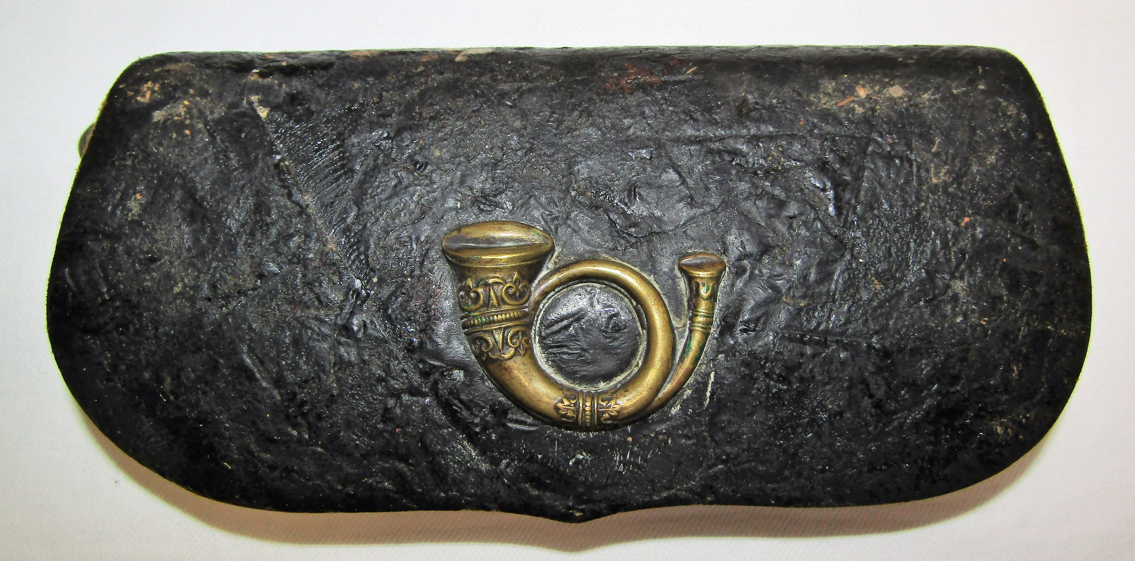
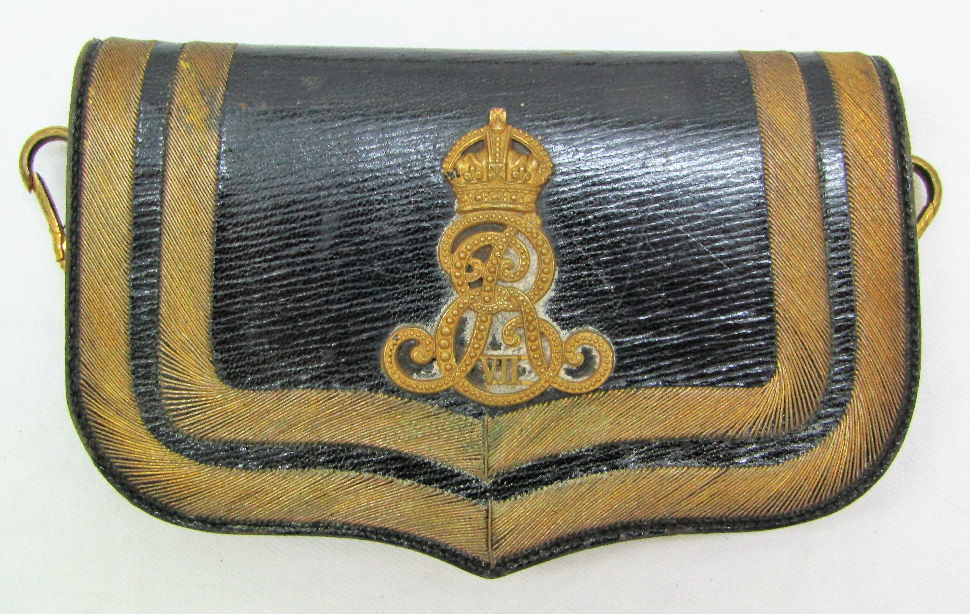
Pouch
Not a Cartouche pouch
Pouch design varies as some held ammunition, or binoculars,
telescope or for medical officers – surgical instruments.
Notes:
Same as the pouch belts and shoulder belts. Practical then ornamental.
Top- black japanned pouch of the 2nd Westland Volunteer Rifles late1860’s
Below an ornamental full dress pouch of the Medical corps with Edward VII cypher.

Slide 2
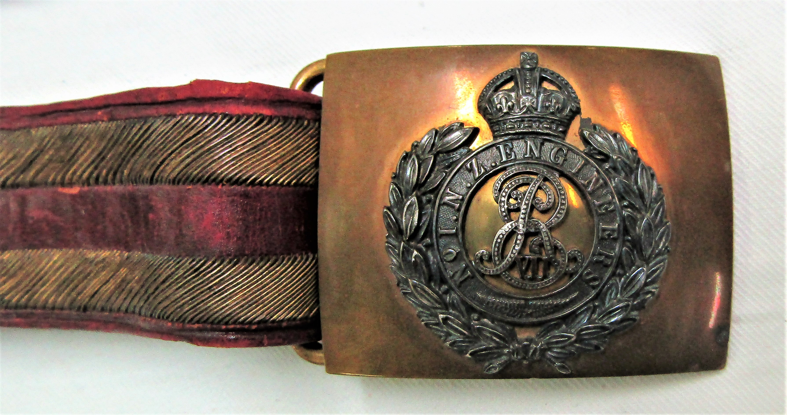
Sword Belts
Notes:
Sword belts were worn by NCO and Officers and often had an ornate buckle with the unit design.

Slide 3
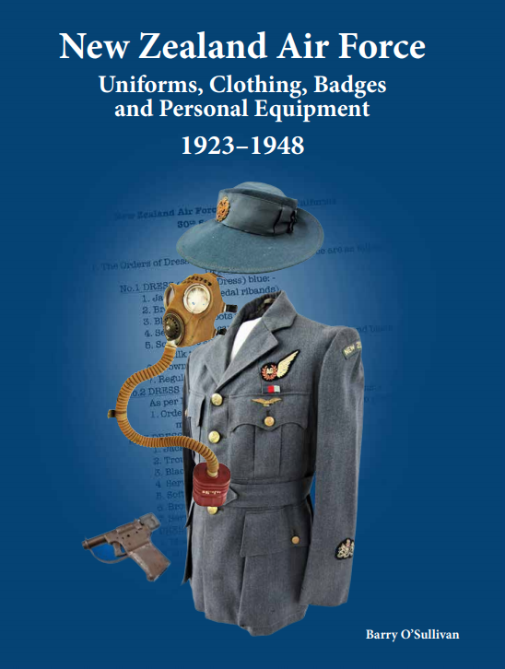
New Zealand Air Force Uniforms, Clothing, Badges and Personal Equipment 1923-1948
Due out next week.

Slide 4
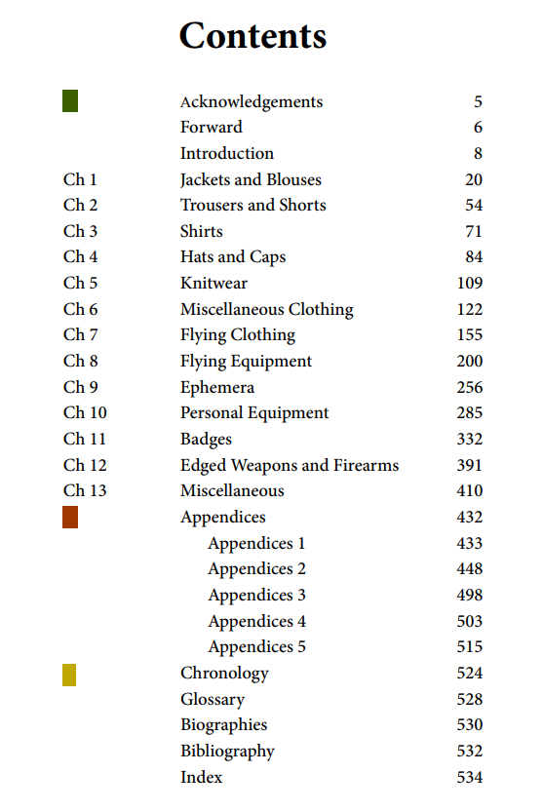

Slide 5
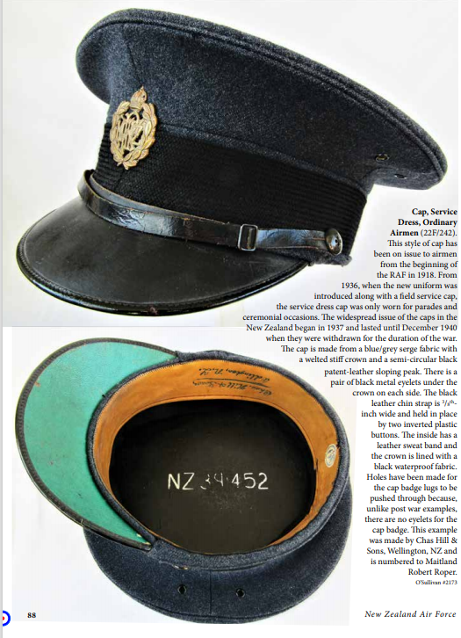
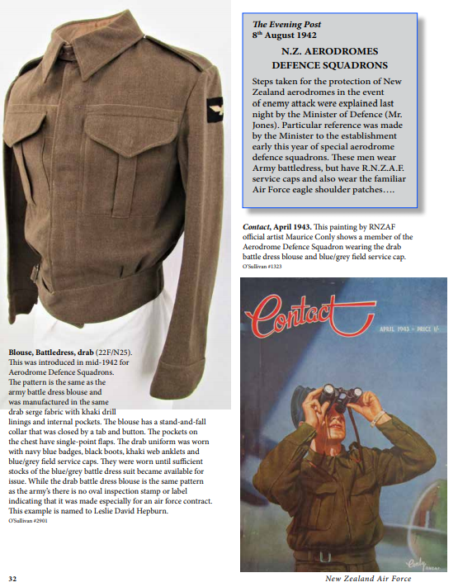

Slide 6
