Slide 1
Drummer’s Pattern
Notes:
Tunic of a drum major with ‘crown an inch lace’
This example is to 2nd North Canterbury Battalion.
The 1st battalion had black facings while the 2nd had yellow facings

Slide 2
Hats and Caps
What is the difference?
Notes:
A hat has a brim that goes all around the crown.
A cap has a peak or no peak at all.

Slide 3
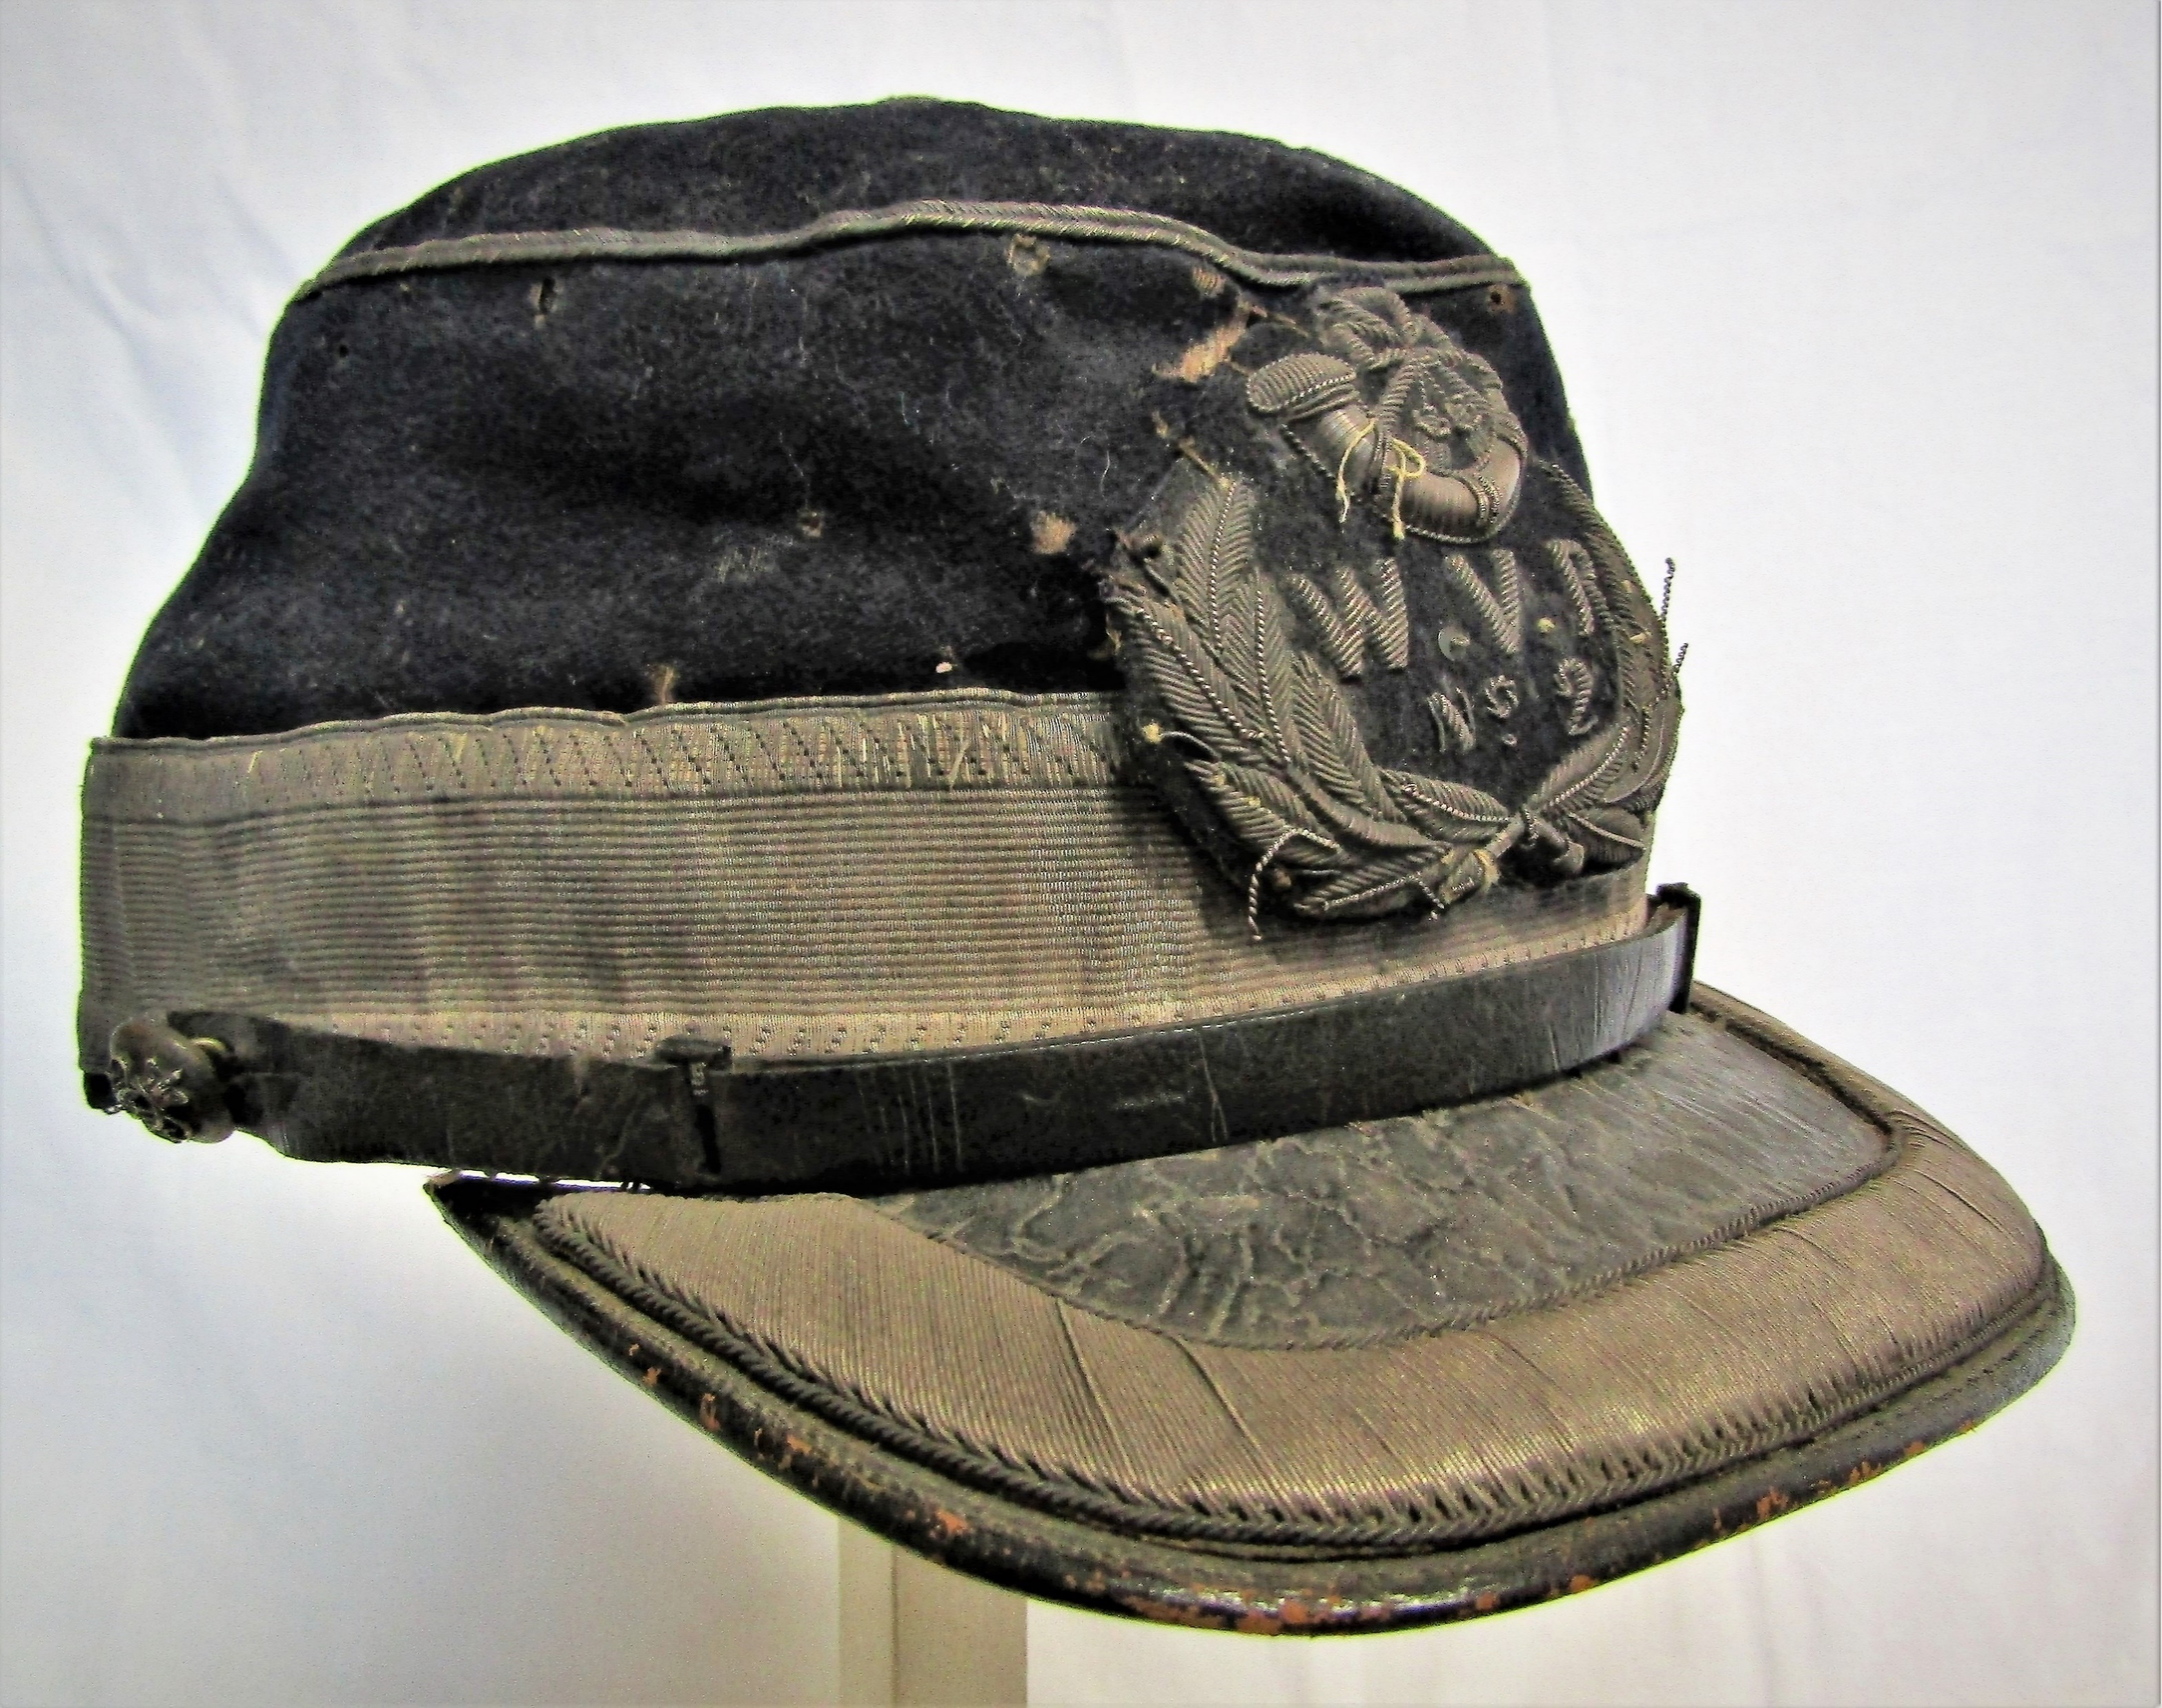
Cap, with French peak
The French peak is identified by the angular nature of the peak
Notes:
This example is to No 2 company of the Westland Rifle Volunteers

Slide 4
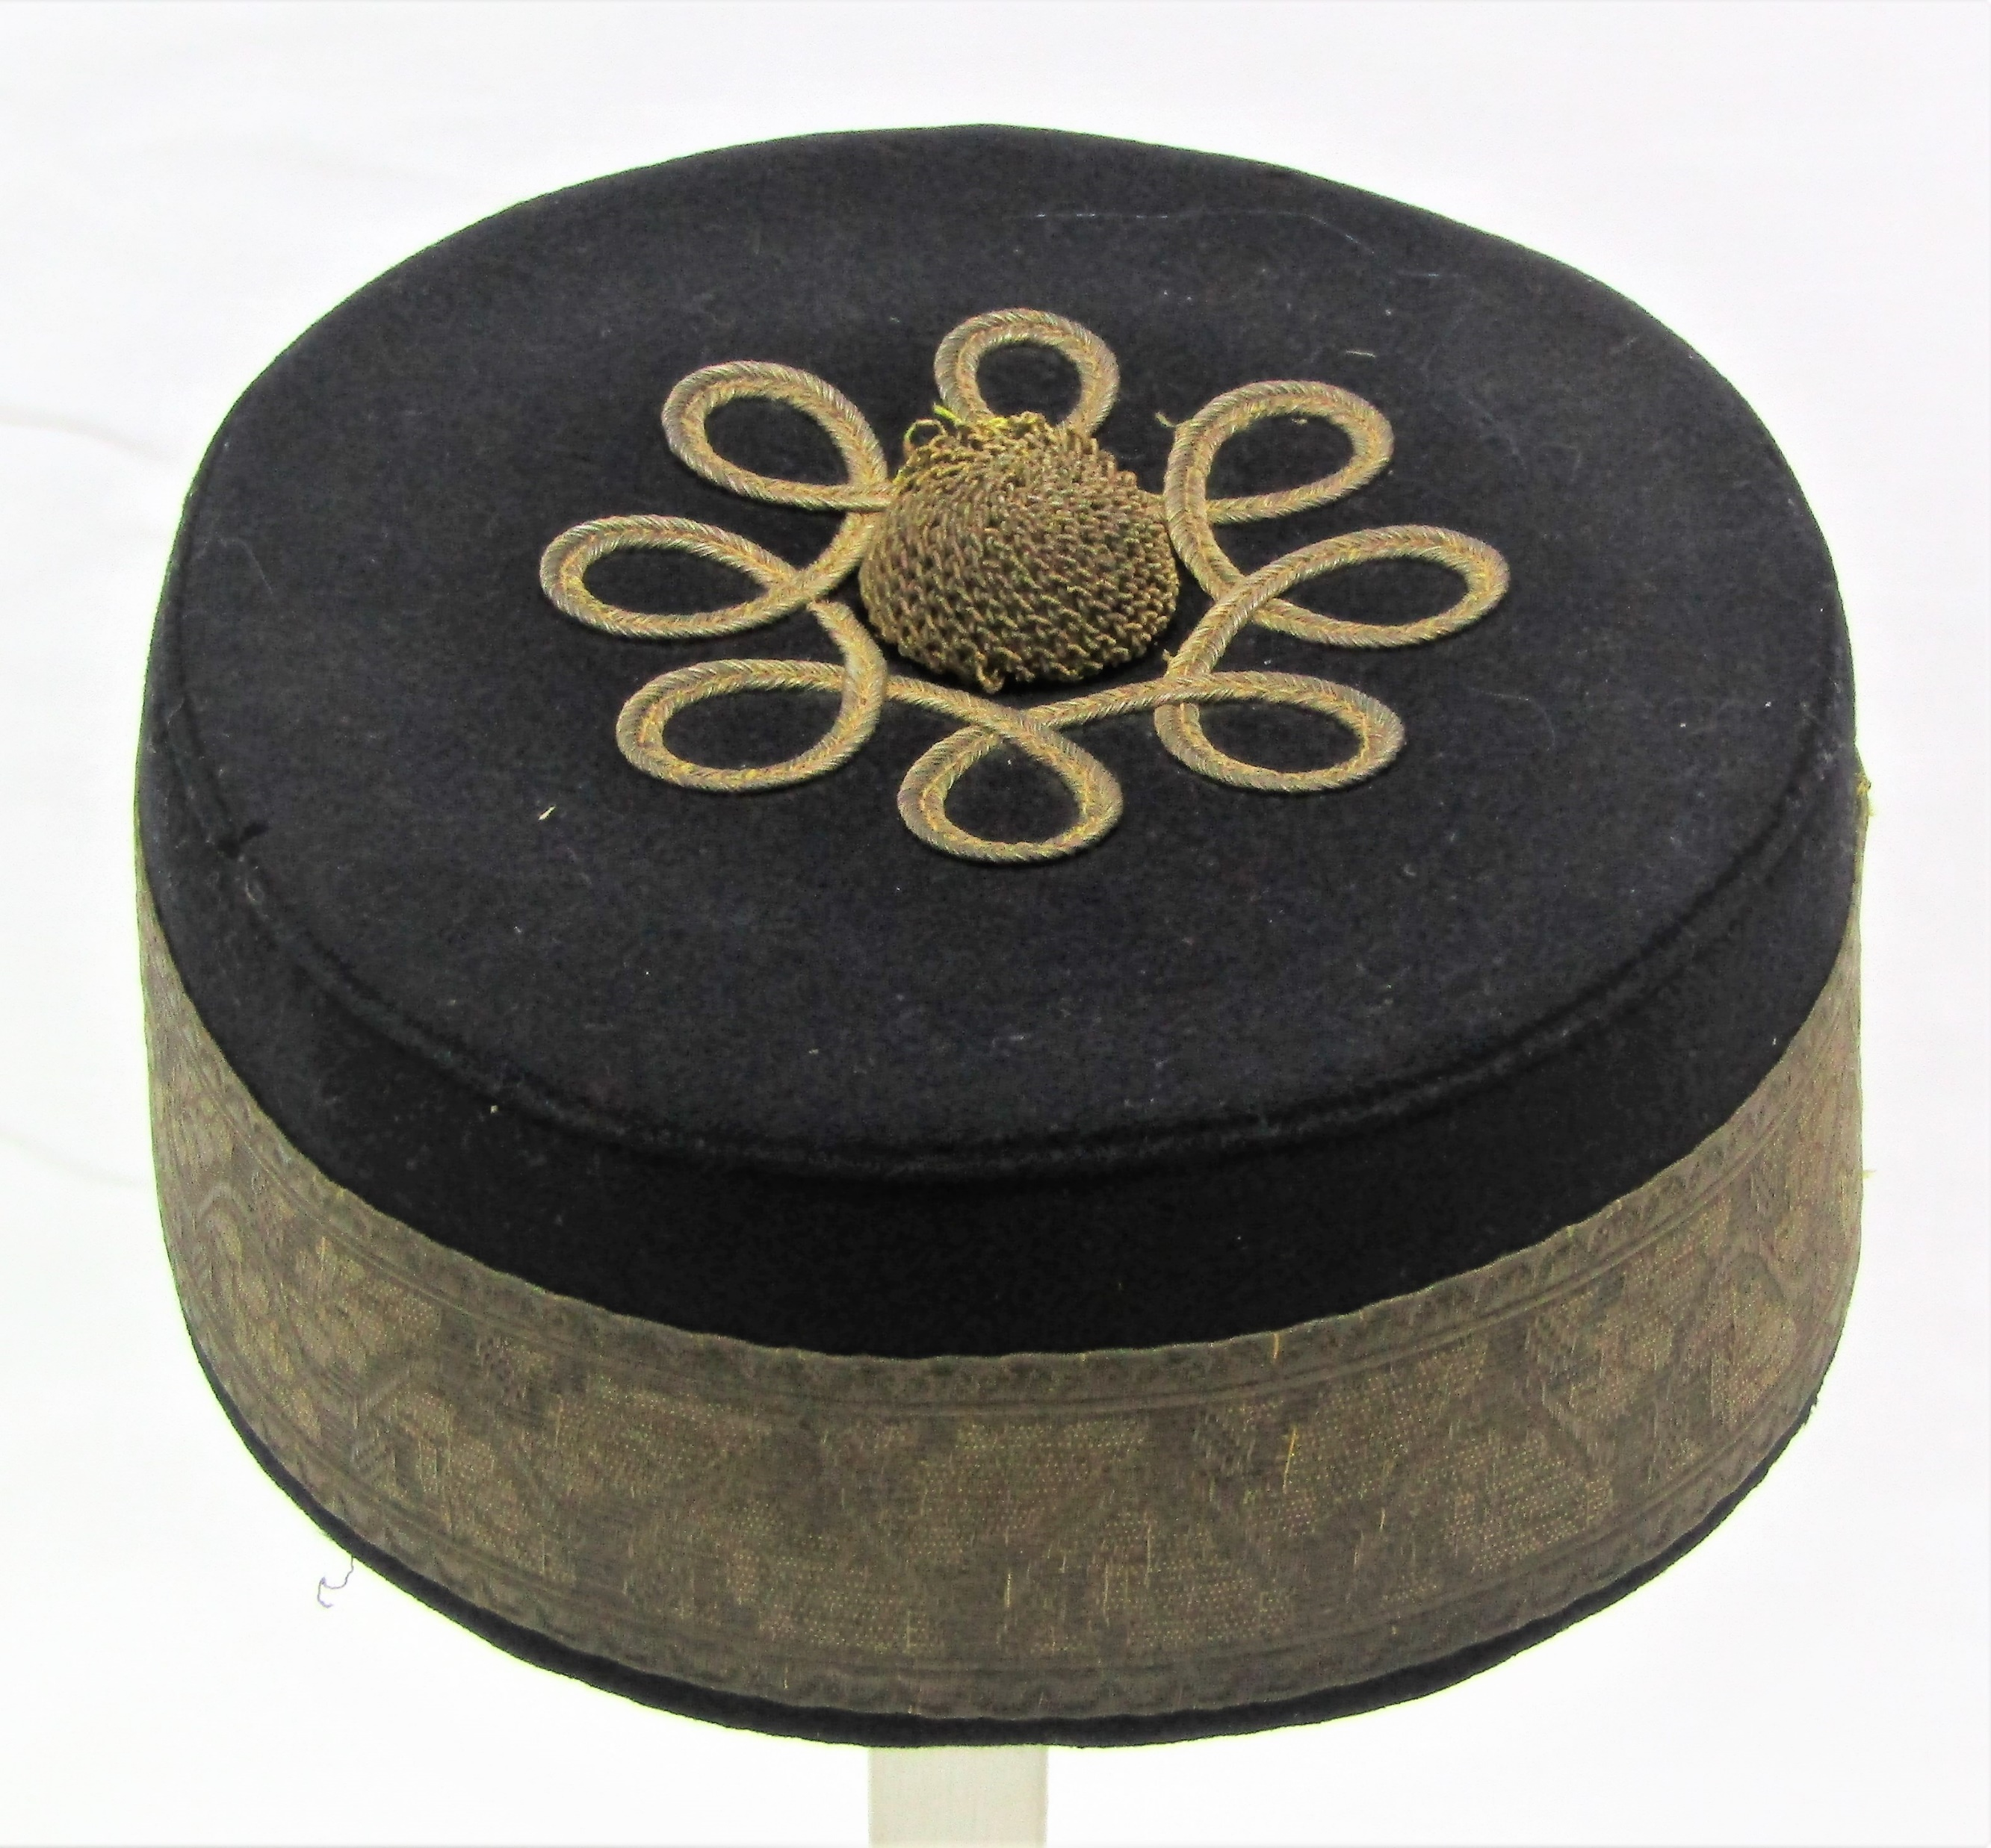
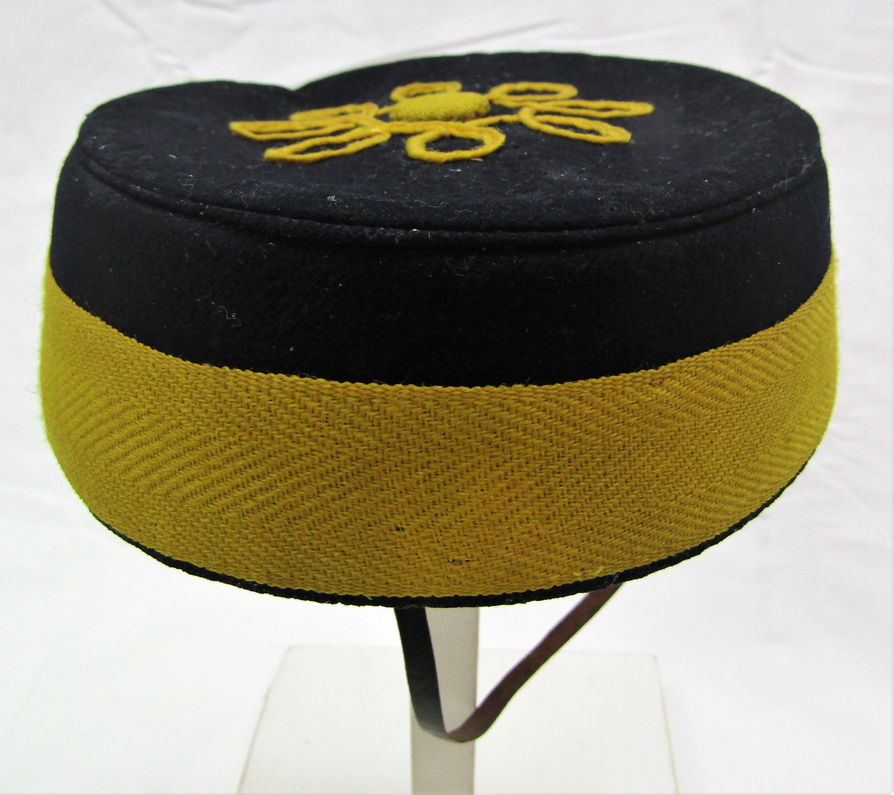
Forage cap
NOT a Pill box cap.
The colour and design of the braid is different between units.
The lace and braid are used to indicate rank.
Notes:
This design of a eight loops around a central button is not found in British units but can be found being worn in Canada, Australia and New Zealand indicating that it is a colonial pattern.

Slide 5
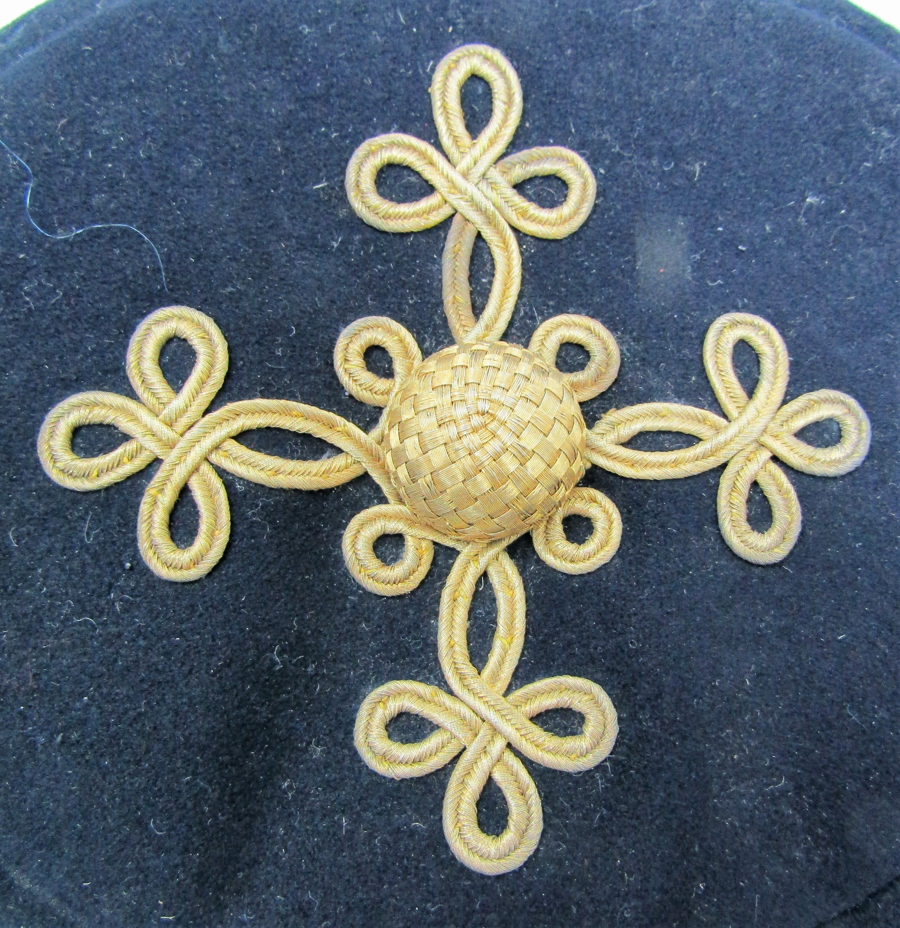
Forage cap figuring
Notes:
On the left is the Royal Artillery Pattern, described as 4 rings of Russia braid with the outside ring forming eight loops and an eye between each loop.
On the ring is the design of one of the many Hussars patterns.

Slide 6
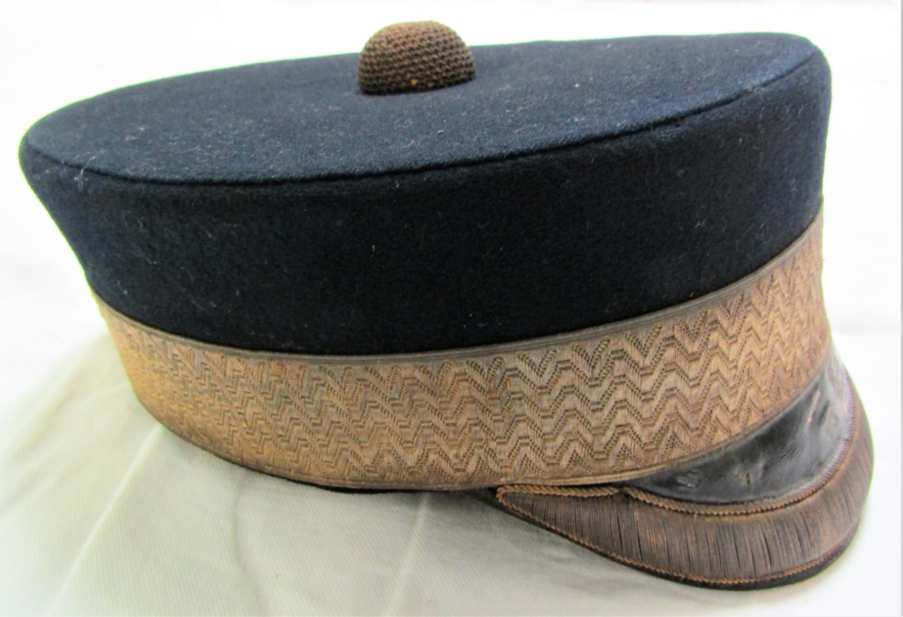
Forage Cap, with drooping peak
Notes:
First mentioned in 1886 in relation to the officers of the Militia
Left -Riversdale Rifle Volunteers August1886-Spetember 1898
Right – Engineers

Slide 7
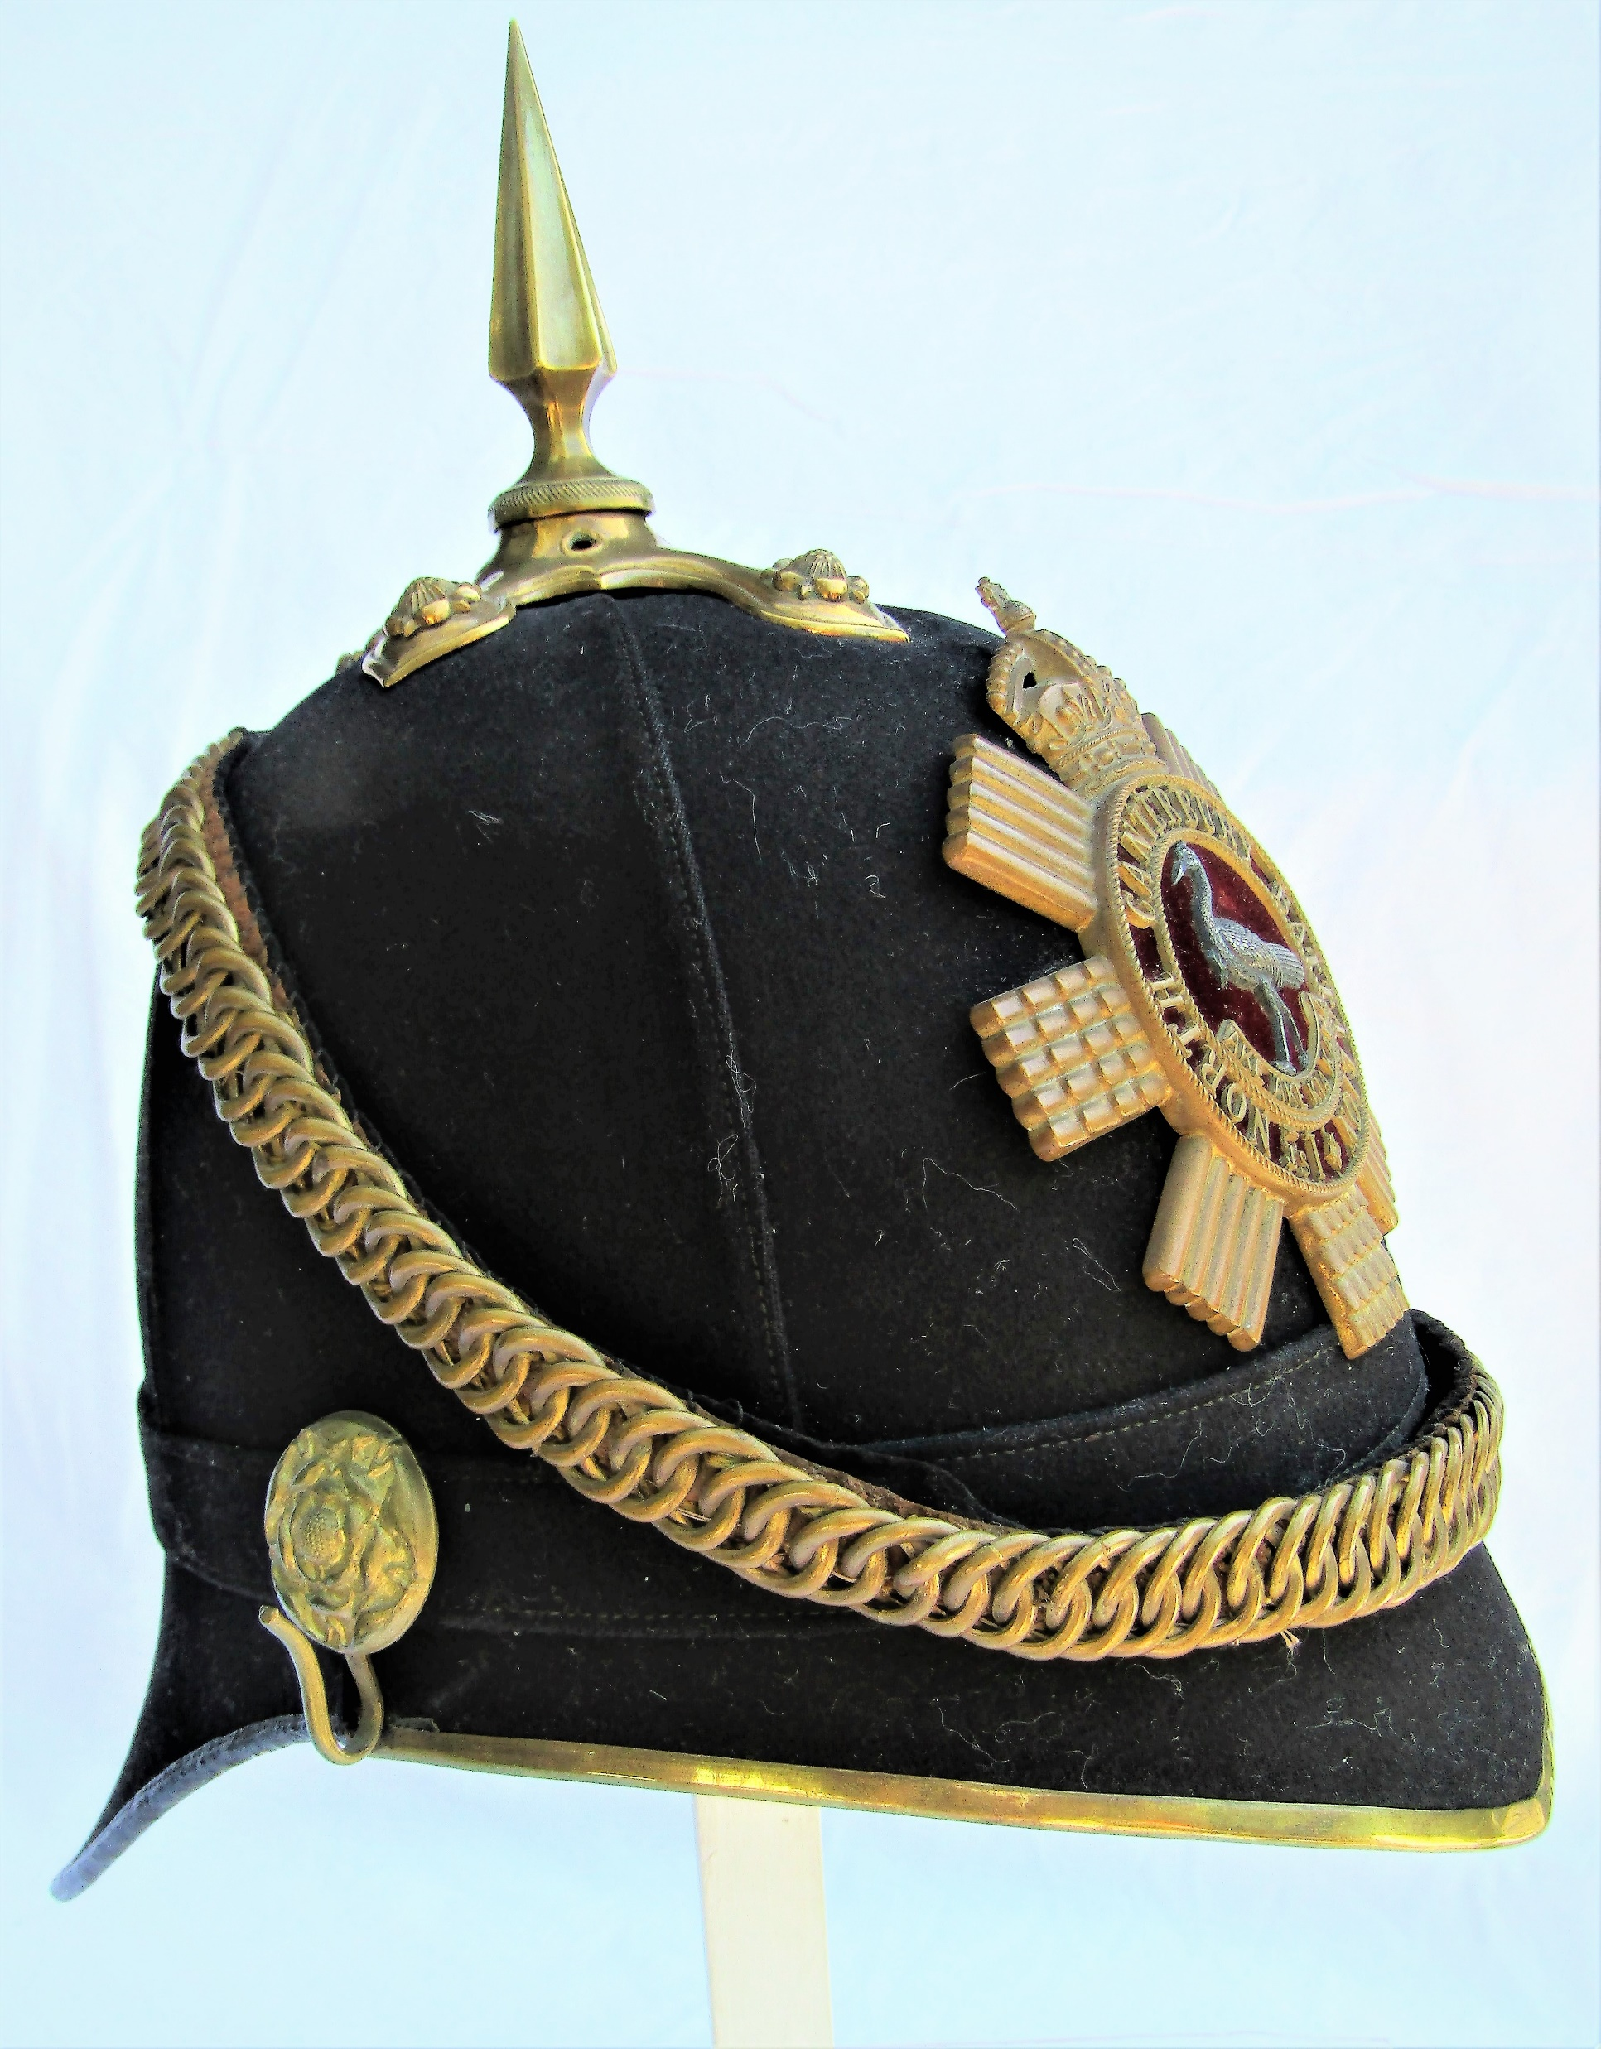
Helmets
Notes:
White helmet introduced in Britain in 1877, first mentioned in NZ DR 1881
Blue helmet introduced in Britain in May 1878, first mentioned in NZ DR 1886
Officers were more ornate with pointed front peaks and square rear peaks

Slide 8
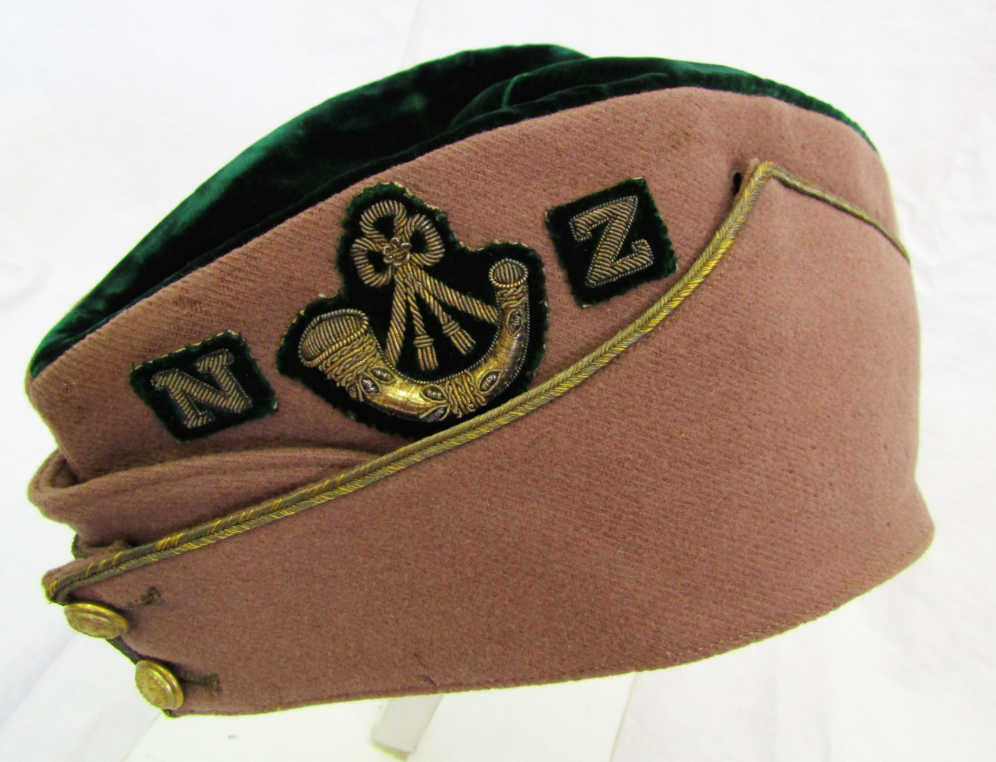
Field Service Cap
Originally known as the Austrian Pattern Field Service cap
Notes:
The central section was used to display unit colours

Slide 9
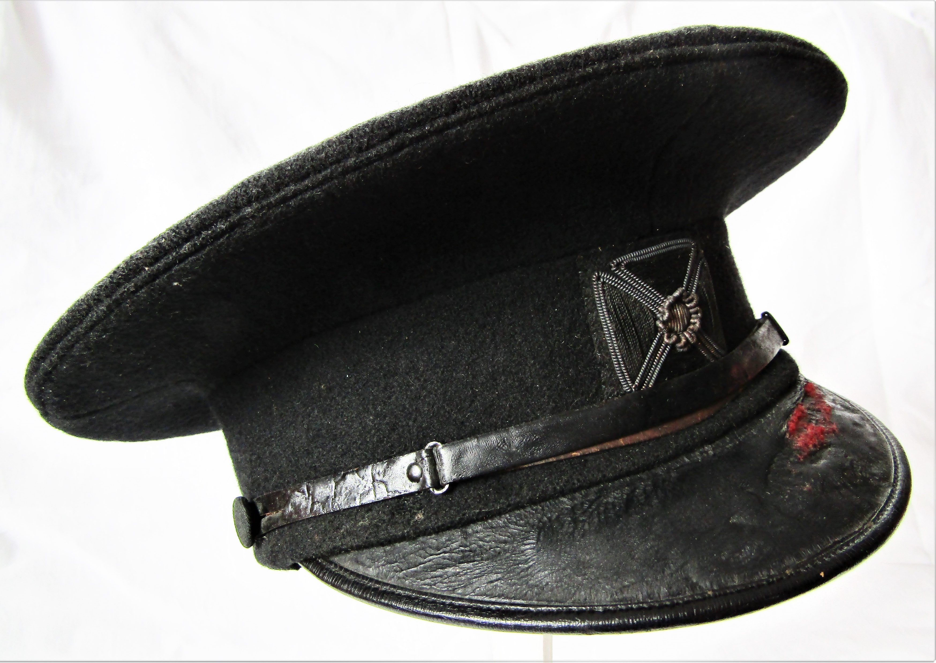
Forage Cap, Naval Pattern
A cap copied from and based on the caps worn by Naval Officers.
Forage caps now came with a peak and a wide flat crown.

Slide 10
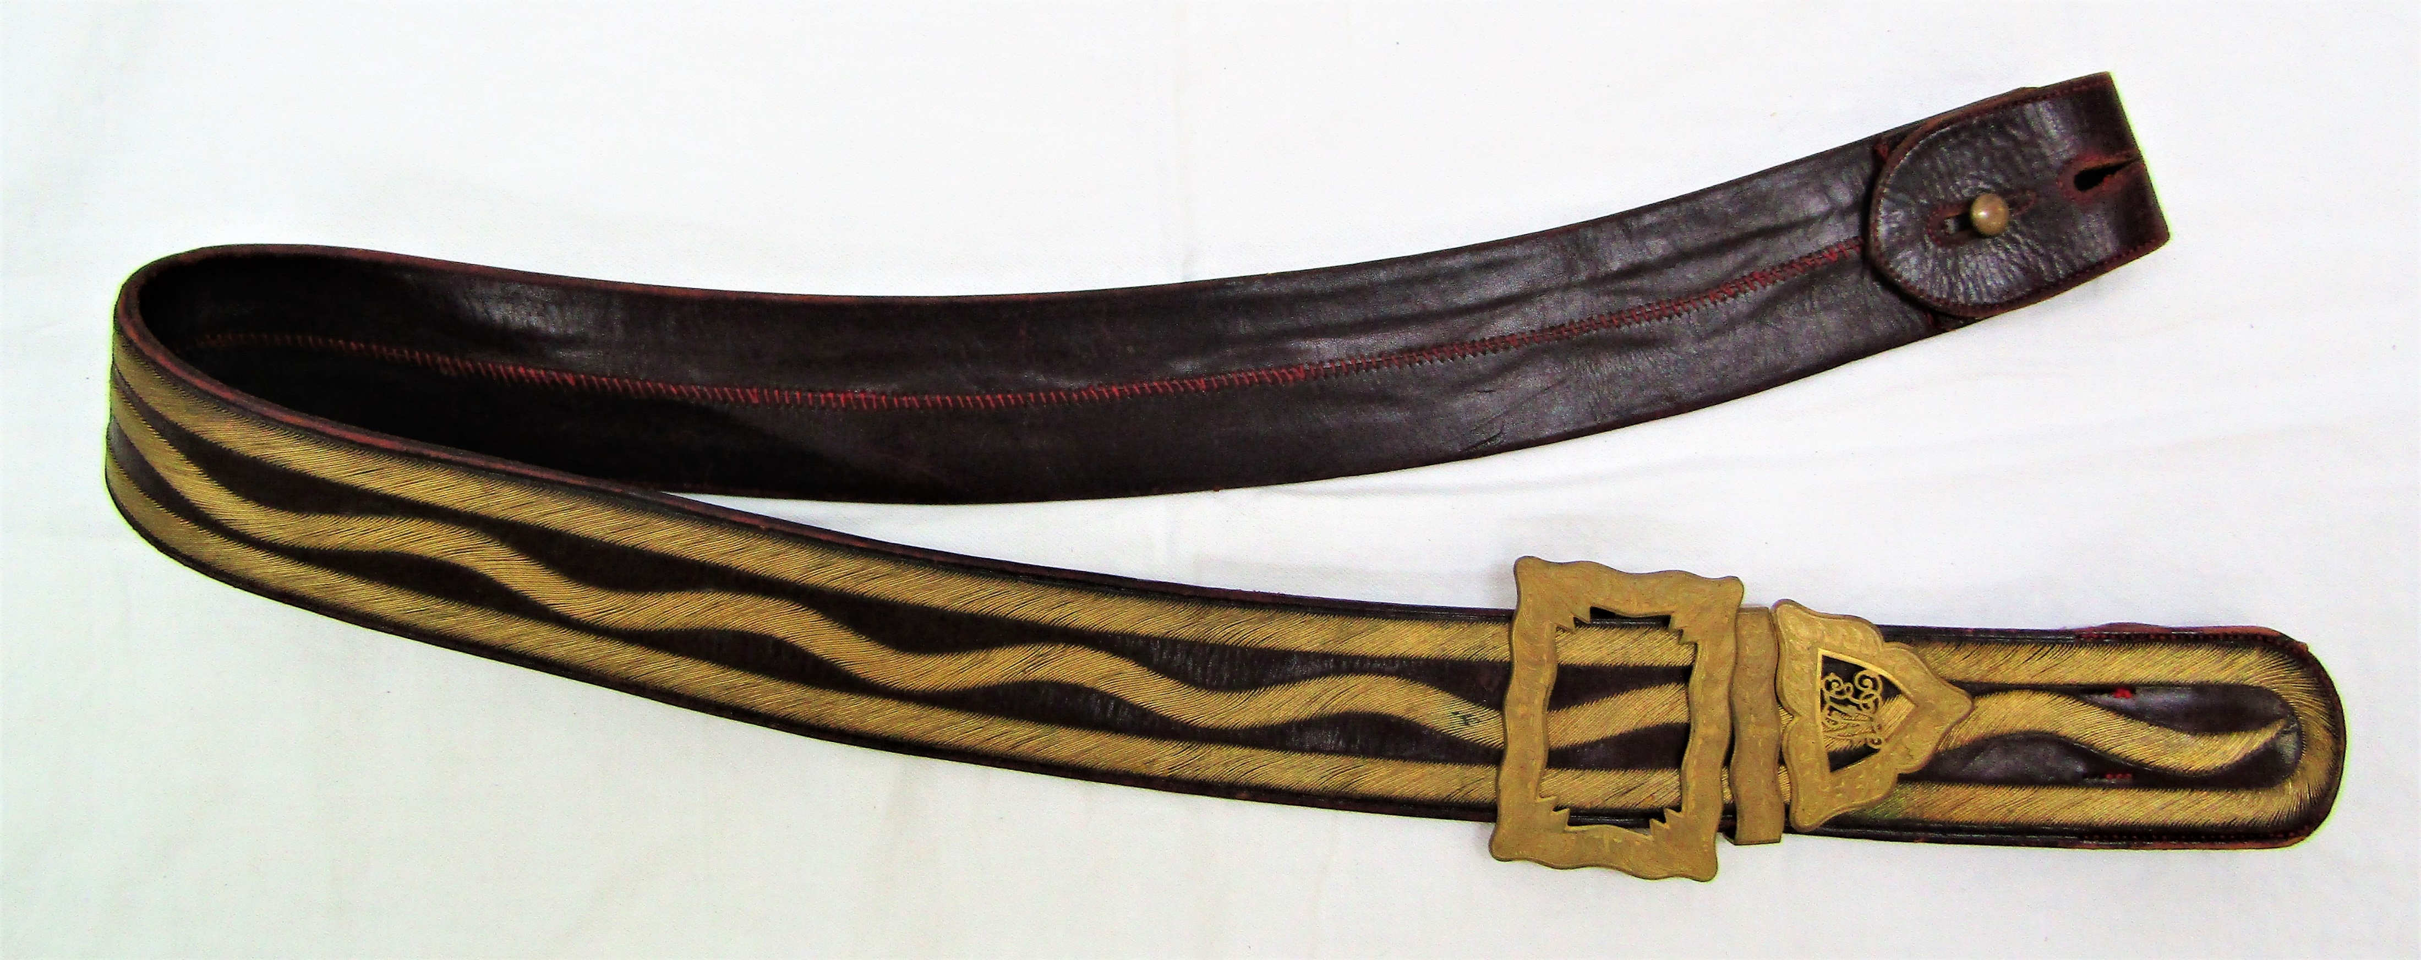
Pouch Belt/Shoulder Belt
Originally they were practical, later they were ornamental and carried unit badges and distinctions.
Notes:
Initially they were called Pouch belts because they held a pouch
Some units had both full and undress shoulder belts
Top- a later 1860’s plain leather pouch belt from 2nd Westland Volunteer Rifles.
Bellow – Full Dress shoulder belt in the Engineers design, this example is NZE

