Slide 1
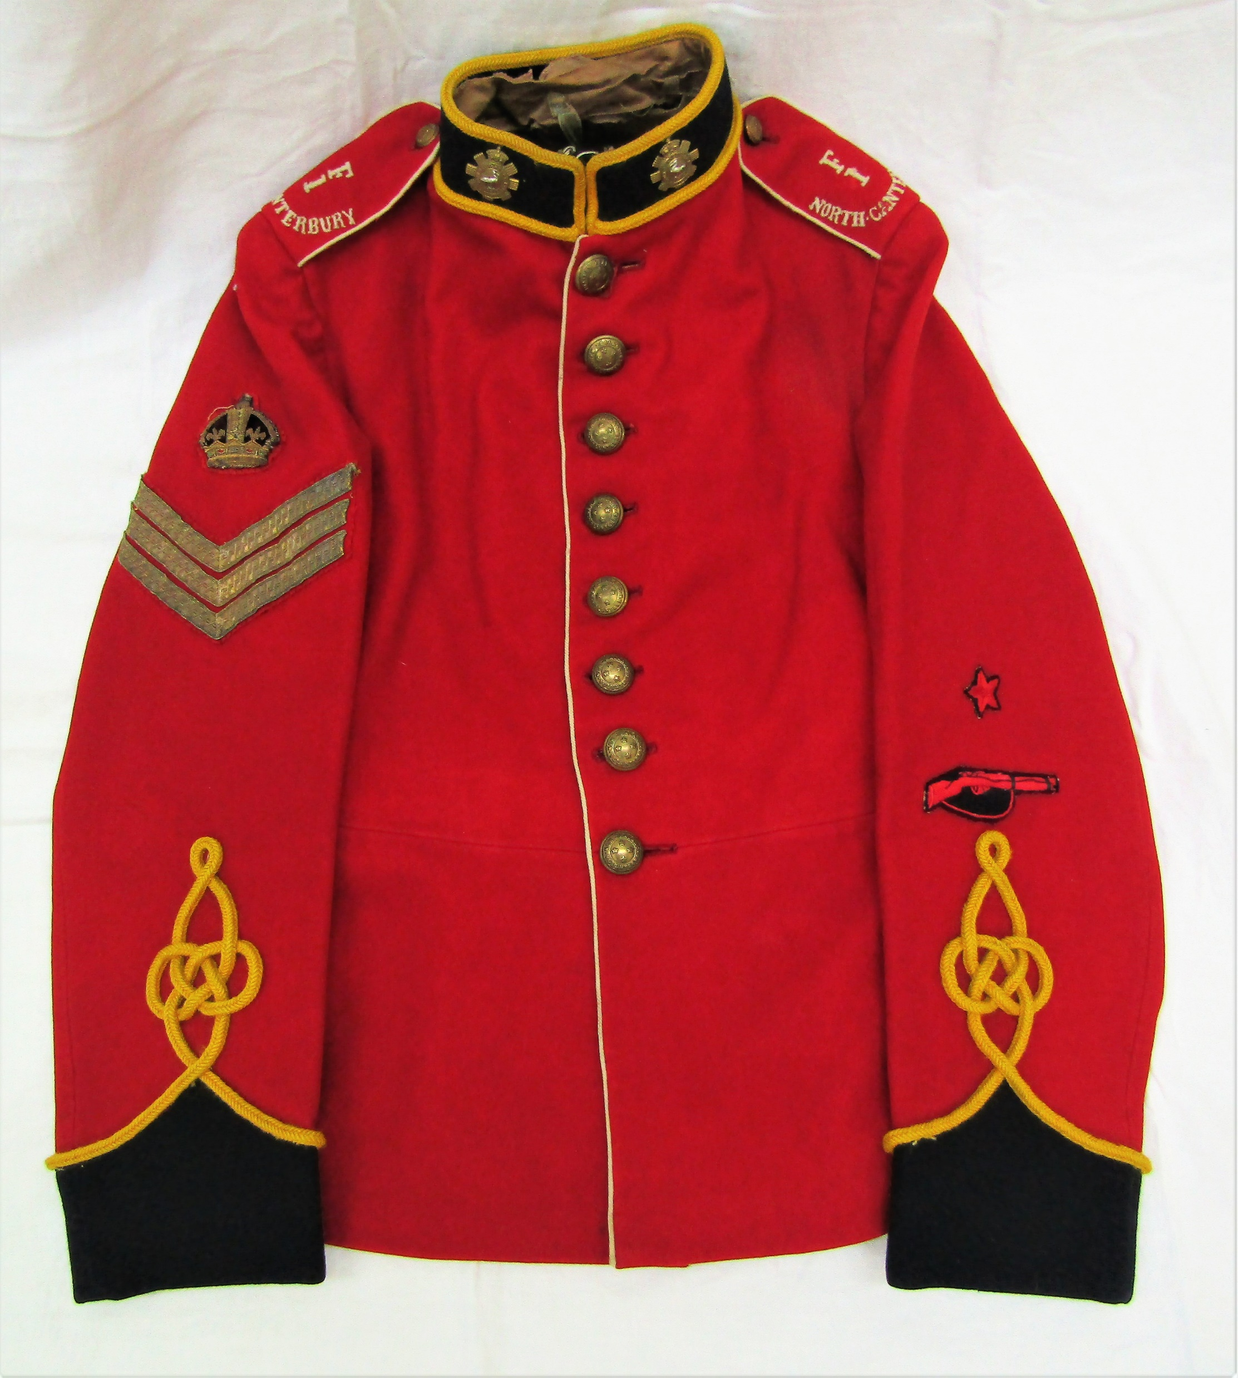
Infantry of the Line, Full Dress
Identified by coloured facings
Pointed cuffs
Notes:
Identified by coloured facings of the collar and cuffs, pointed cuffs.
This is the same for officers but their uniforms had lace instead of braid.
This example is marked to F Company1st North Canterbury battalion

Slide 2
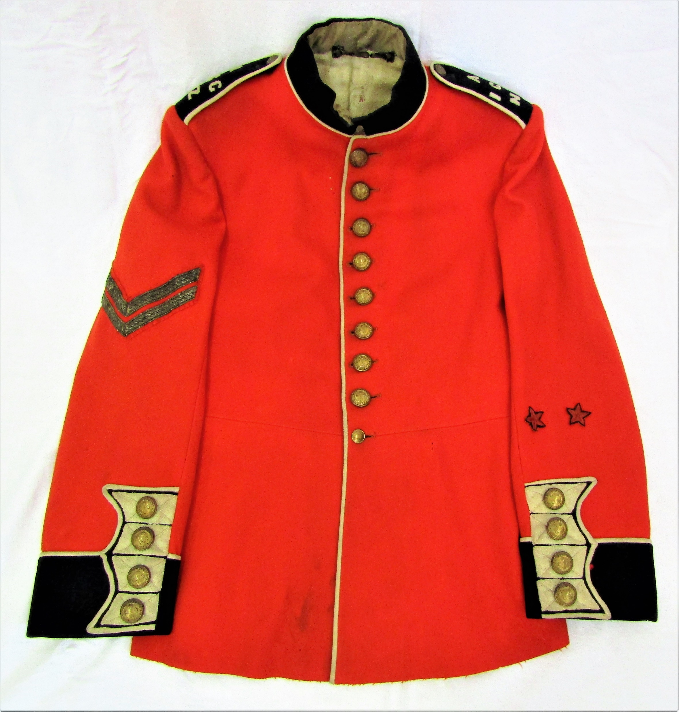
Guards Regiment, Full Dress
Identified by straight cuffs
Three point flaps
Notes:
The white fabric on the cuff are LOOPS
Officers had metal lace and cord instead of worsted braid.

Slide 3
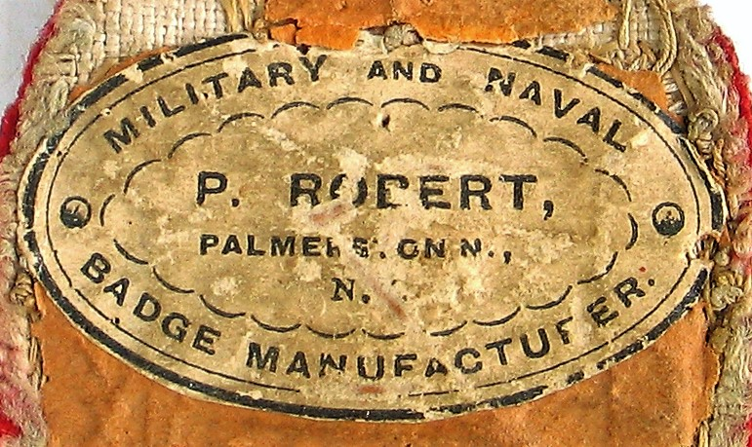
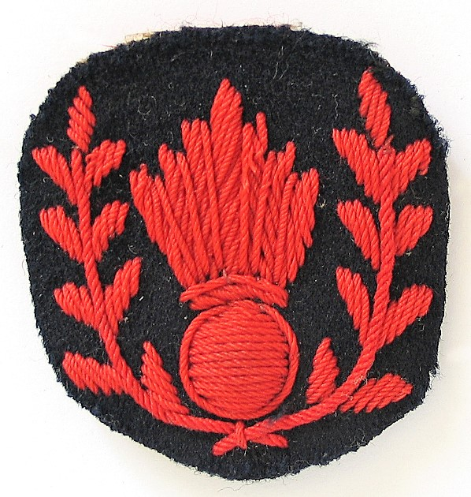
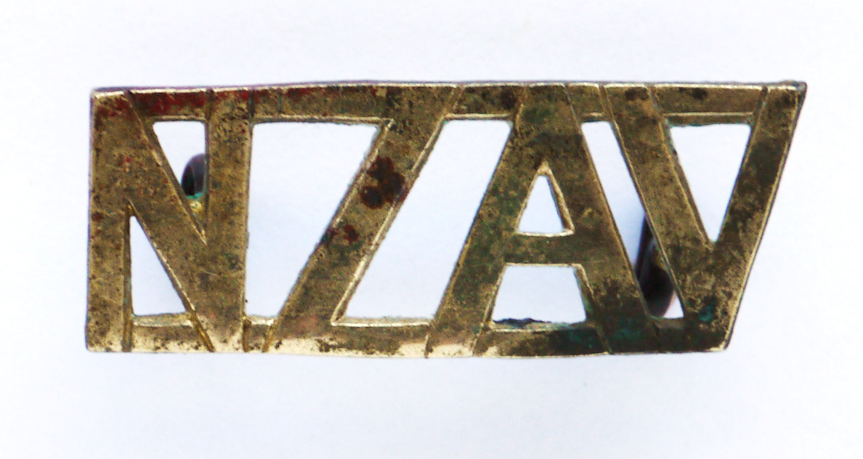
Badges
Badges can be divided into two sections.
Those of a unit design and those for ranks and trades
Large numbers of badges made by Roberts of Palmerston North
Notes:
Unit badges worn on the collar came about from 1881 and usually showed an individual unit design.
Shoulder titles were first mentioned in the 1895 Dress Regulations.
Metal badges have been well researched but there are always new designs being rediscovered.
The top badge is a trade badge for 1st class Company in Heavy Gun
Below New Zealand Artillery Volunteers

Slide 4
Buttons
Both Government supplied and privately purchased.
Limited number of Government supplied button, (not including artillery)
Most buttons were worn on the full dress tunic.
No evidence of metal button making in NZ although some buttons have NZ retailers on the rear.
Notes:
The first government supplied buttons were the same as the British with a crown over VR.
From 1881 the design was not to be used so this is when we see a profliciation of button designs for the full dress uniform.
Because the FULL DRESS was unit supplied and paid for the buttons belonged to the unit and were not Government supplied.

Slide 5
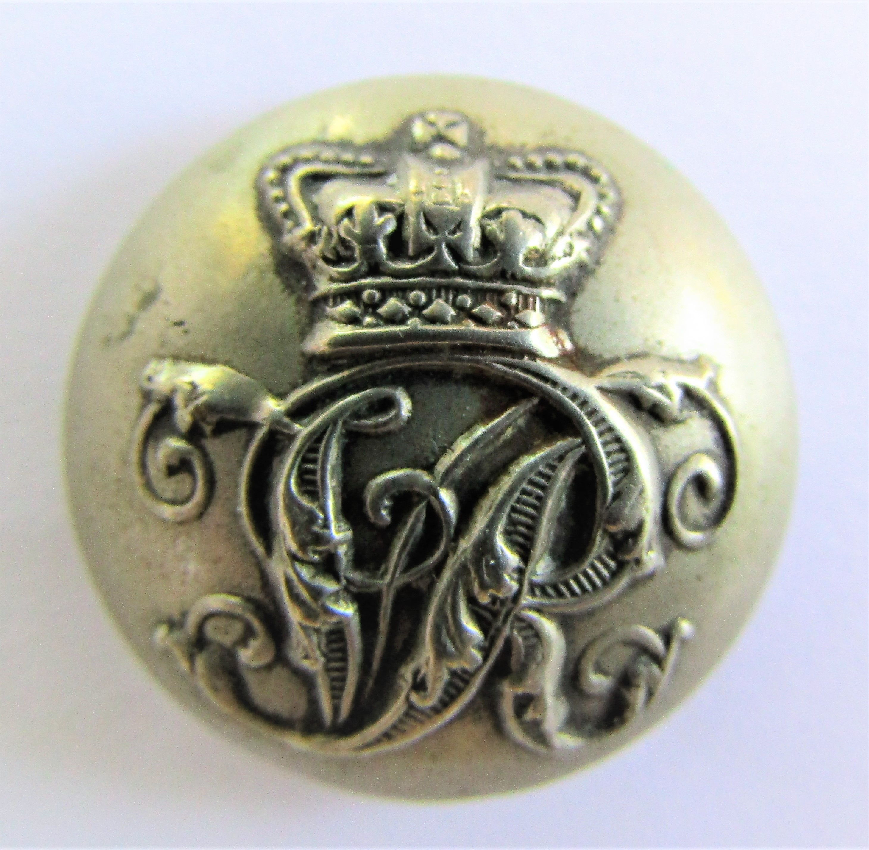
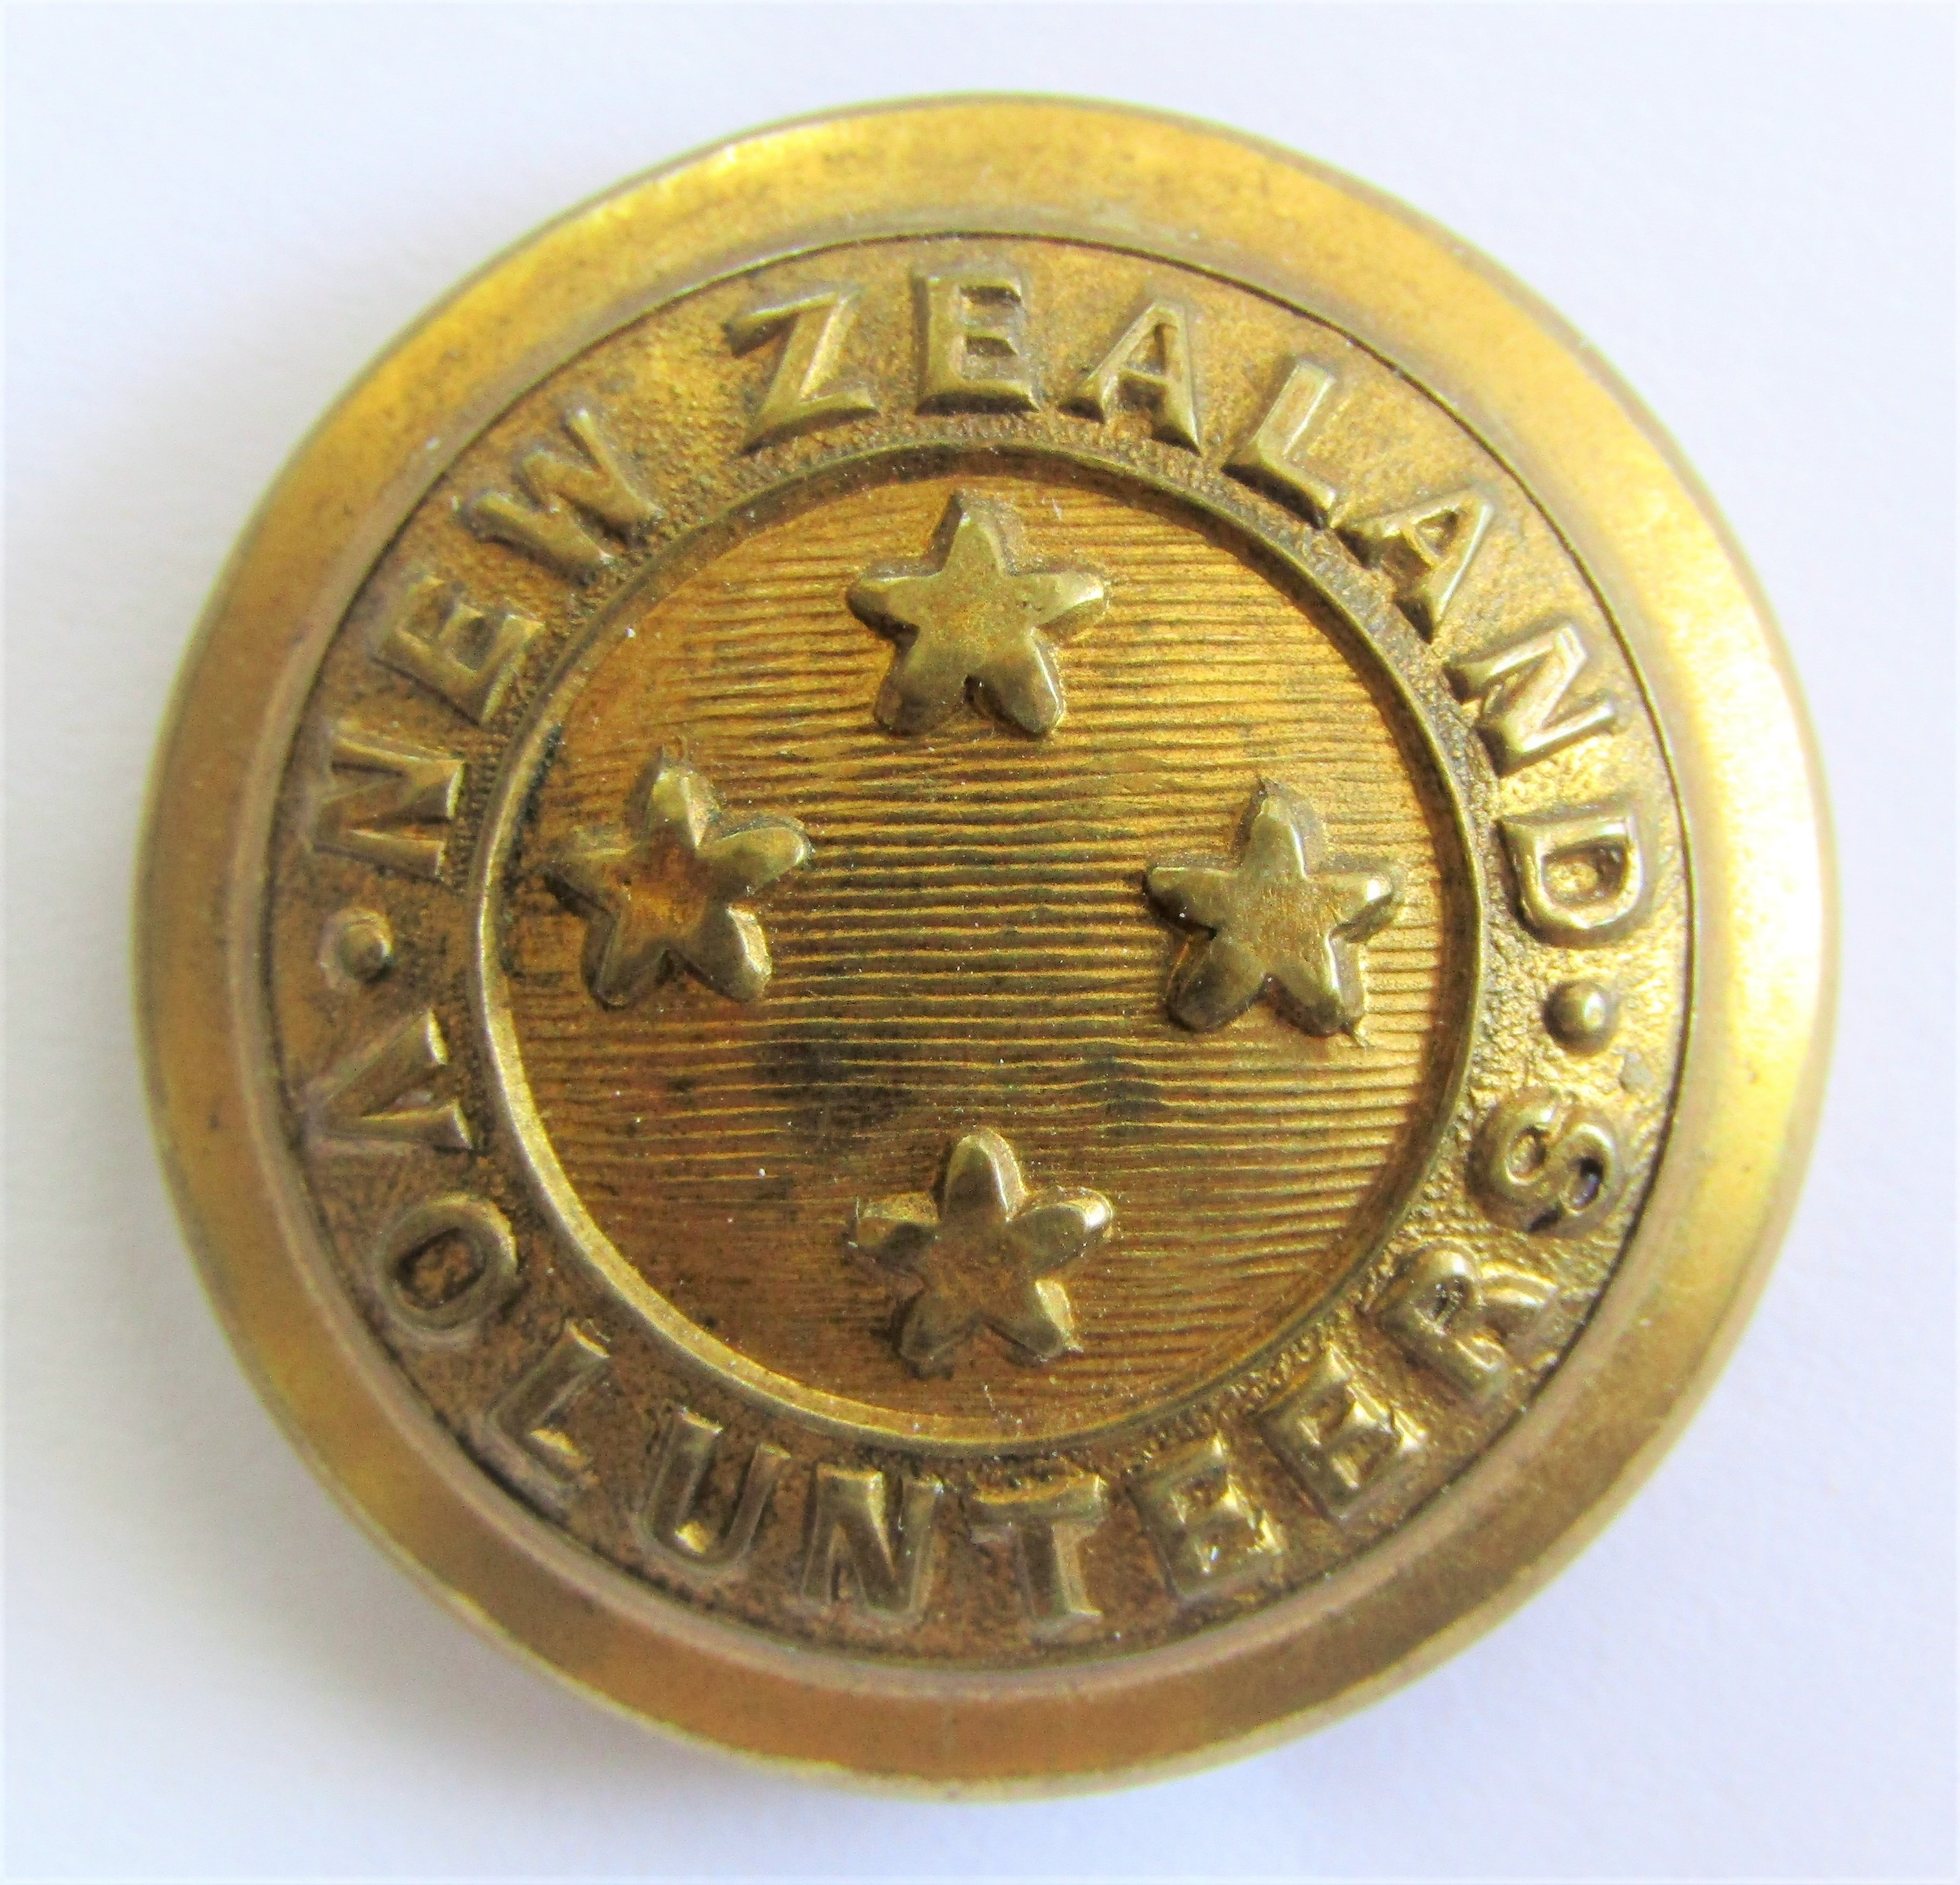
Government Supplied buttons
Notes:
Left- Standard crown over VR
Centre- as mentioned in the NZ Despatch of 1881 which was written 1880
Right- mentioned in detail in the 1895 DR but alluded to in the 1891 regulations

Slide 6
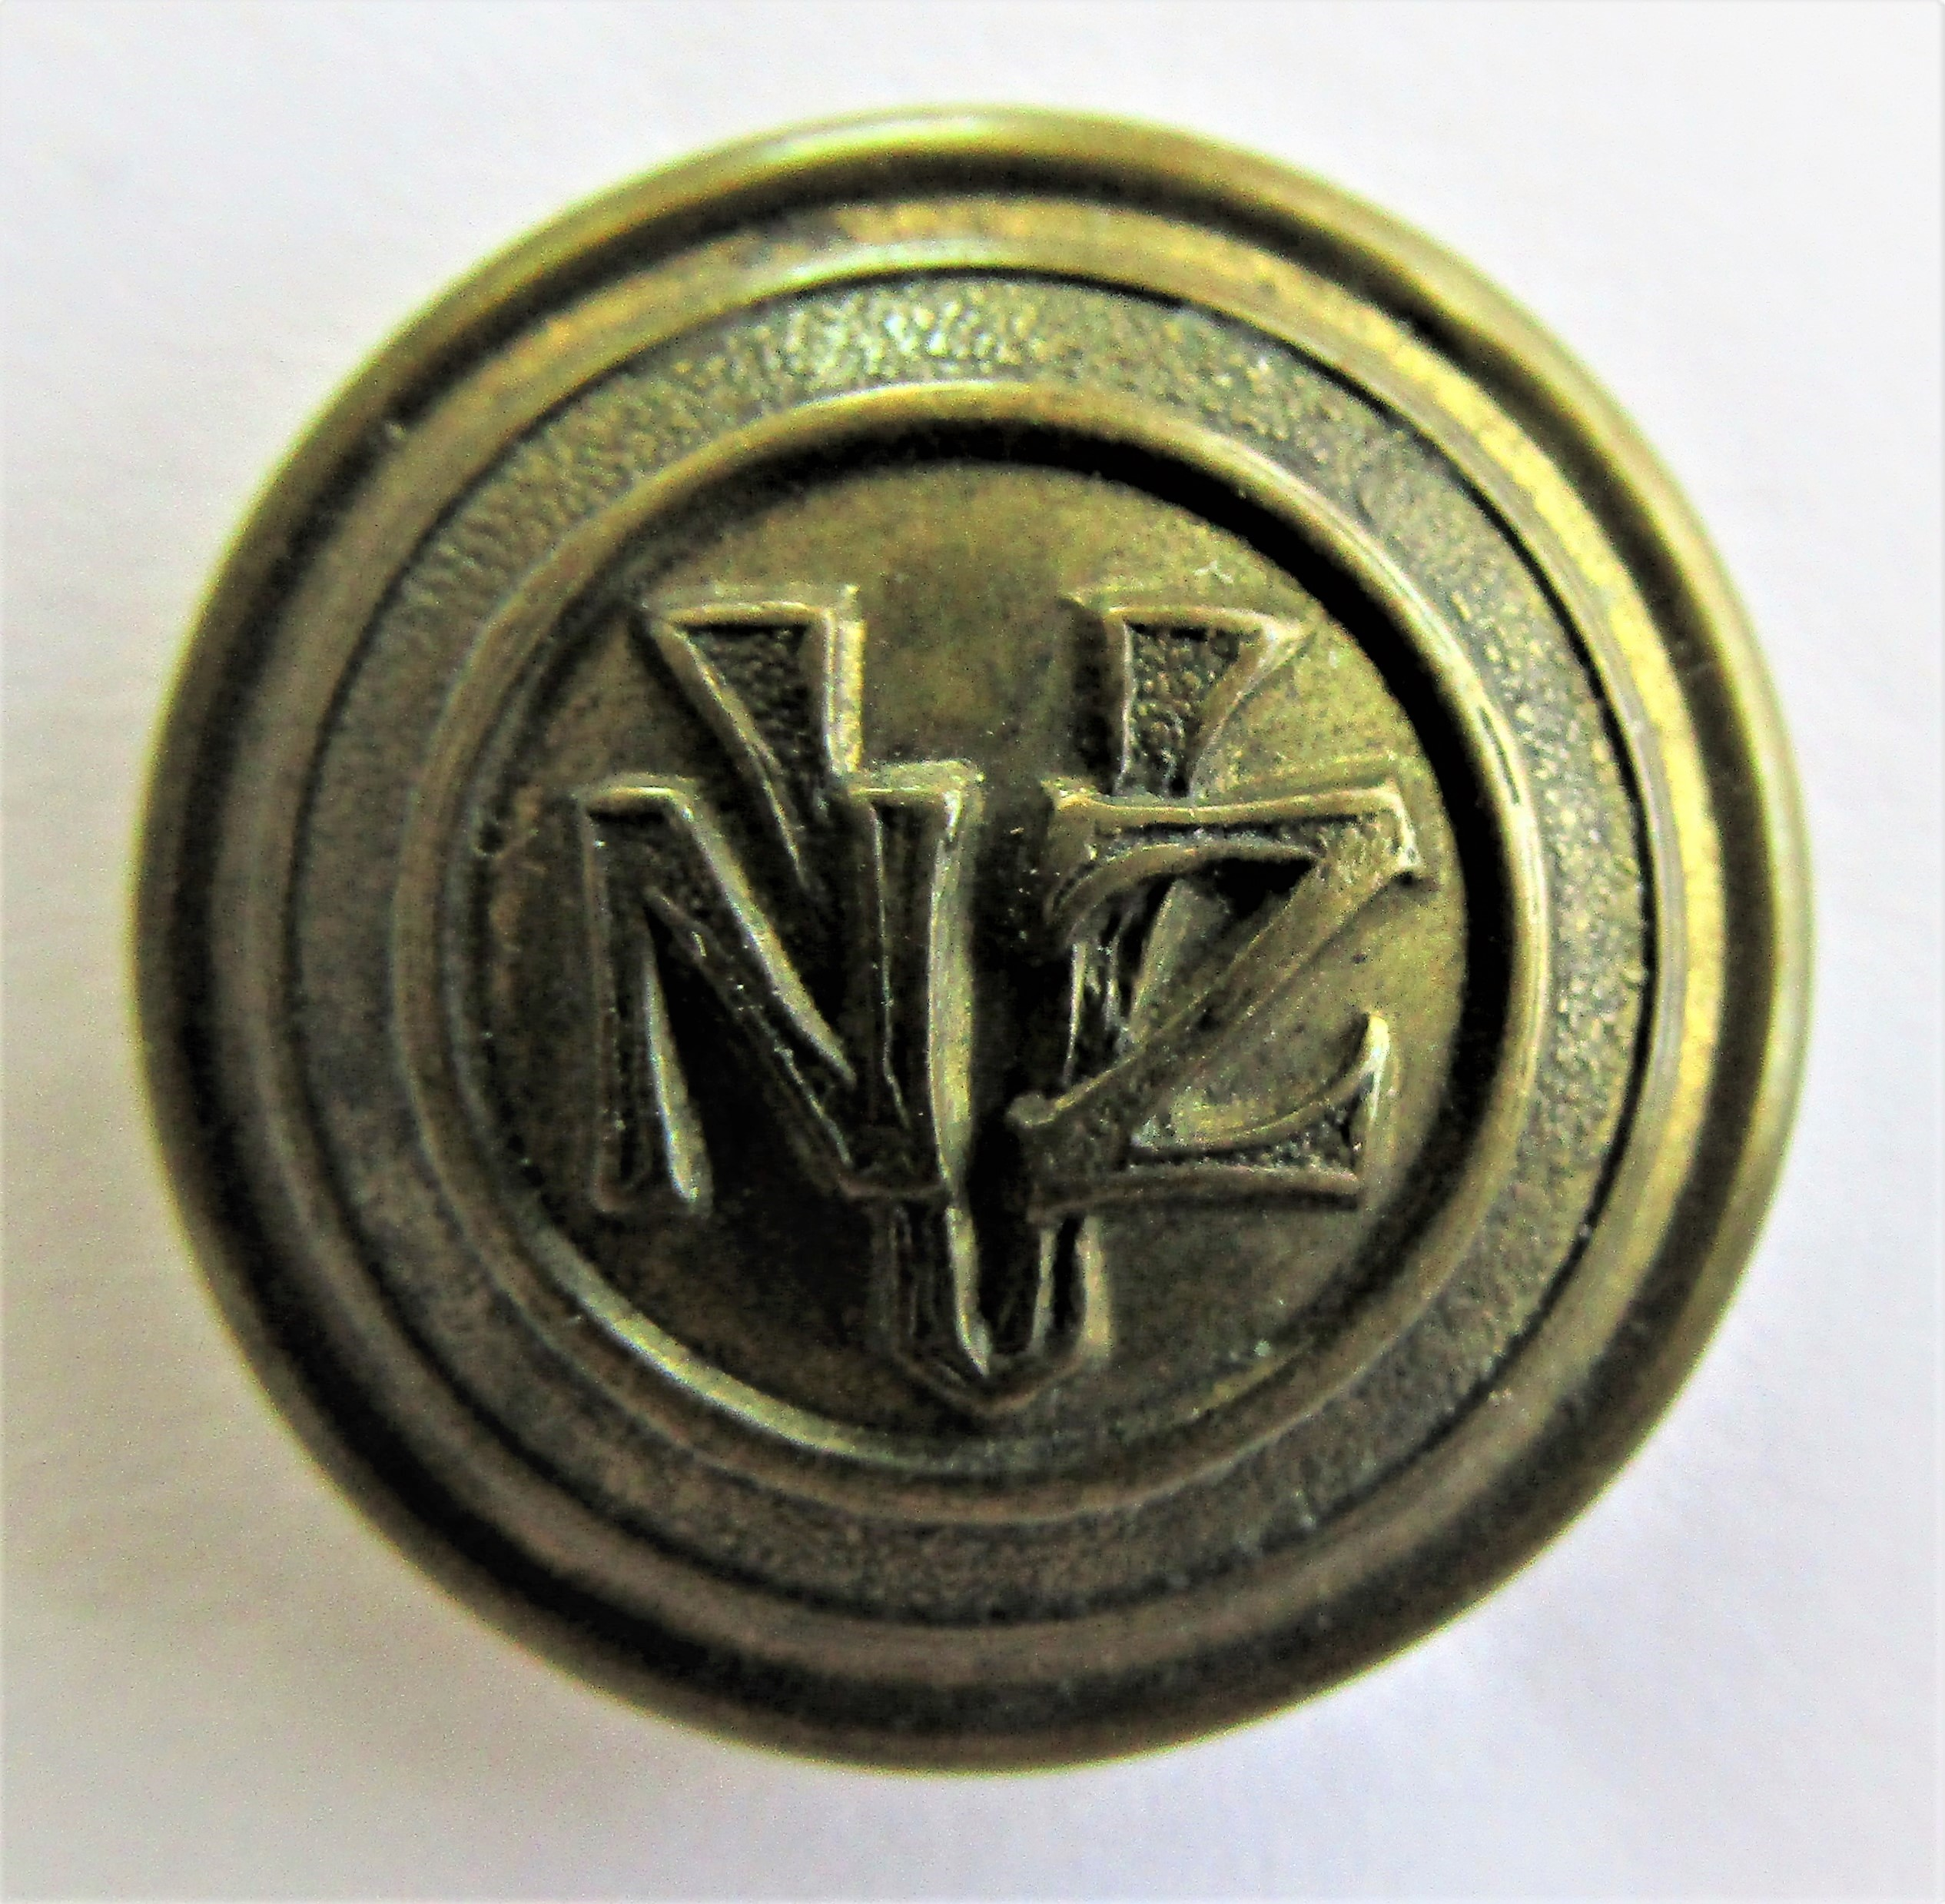
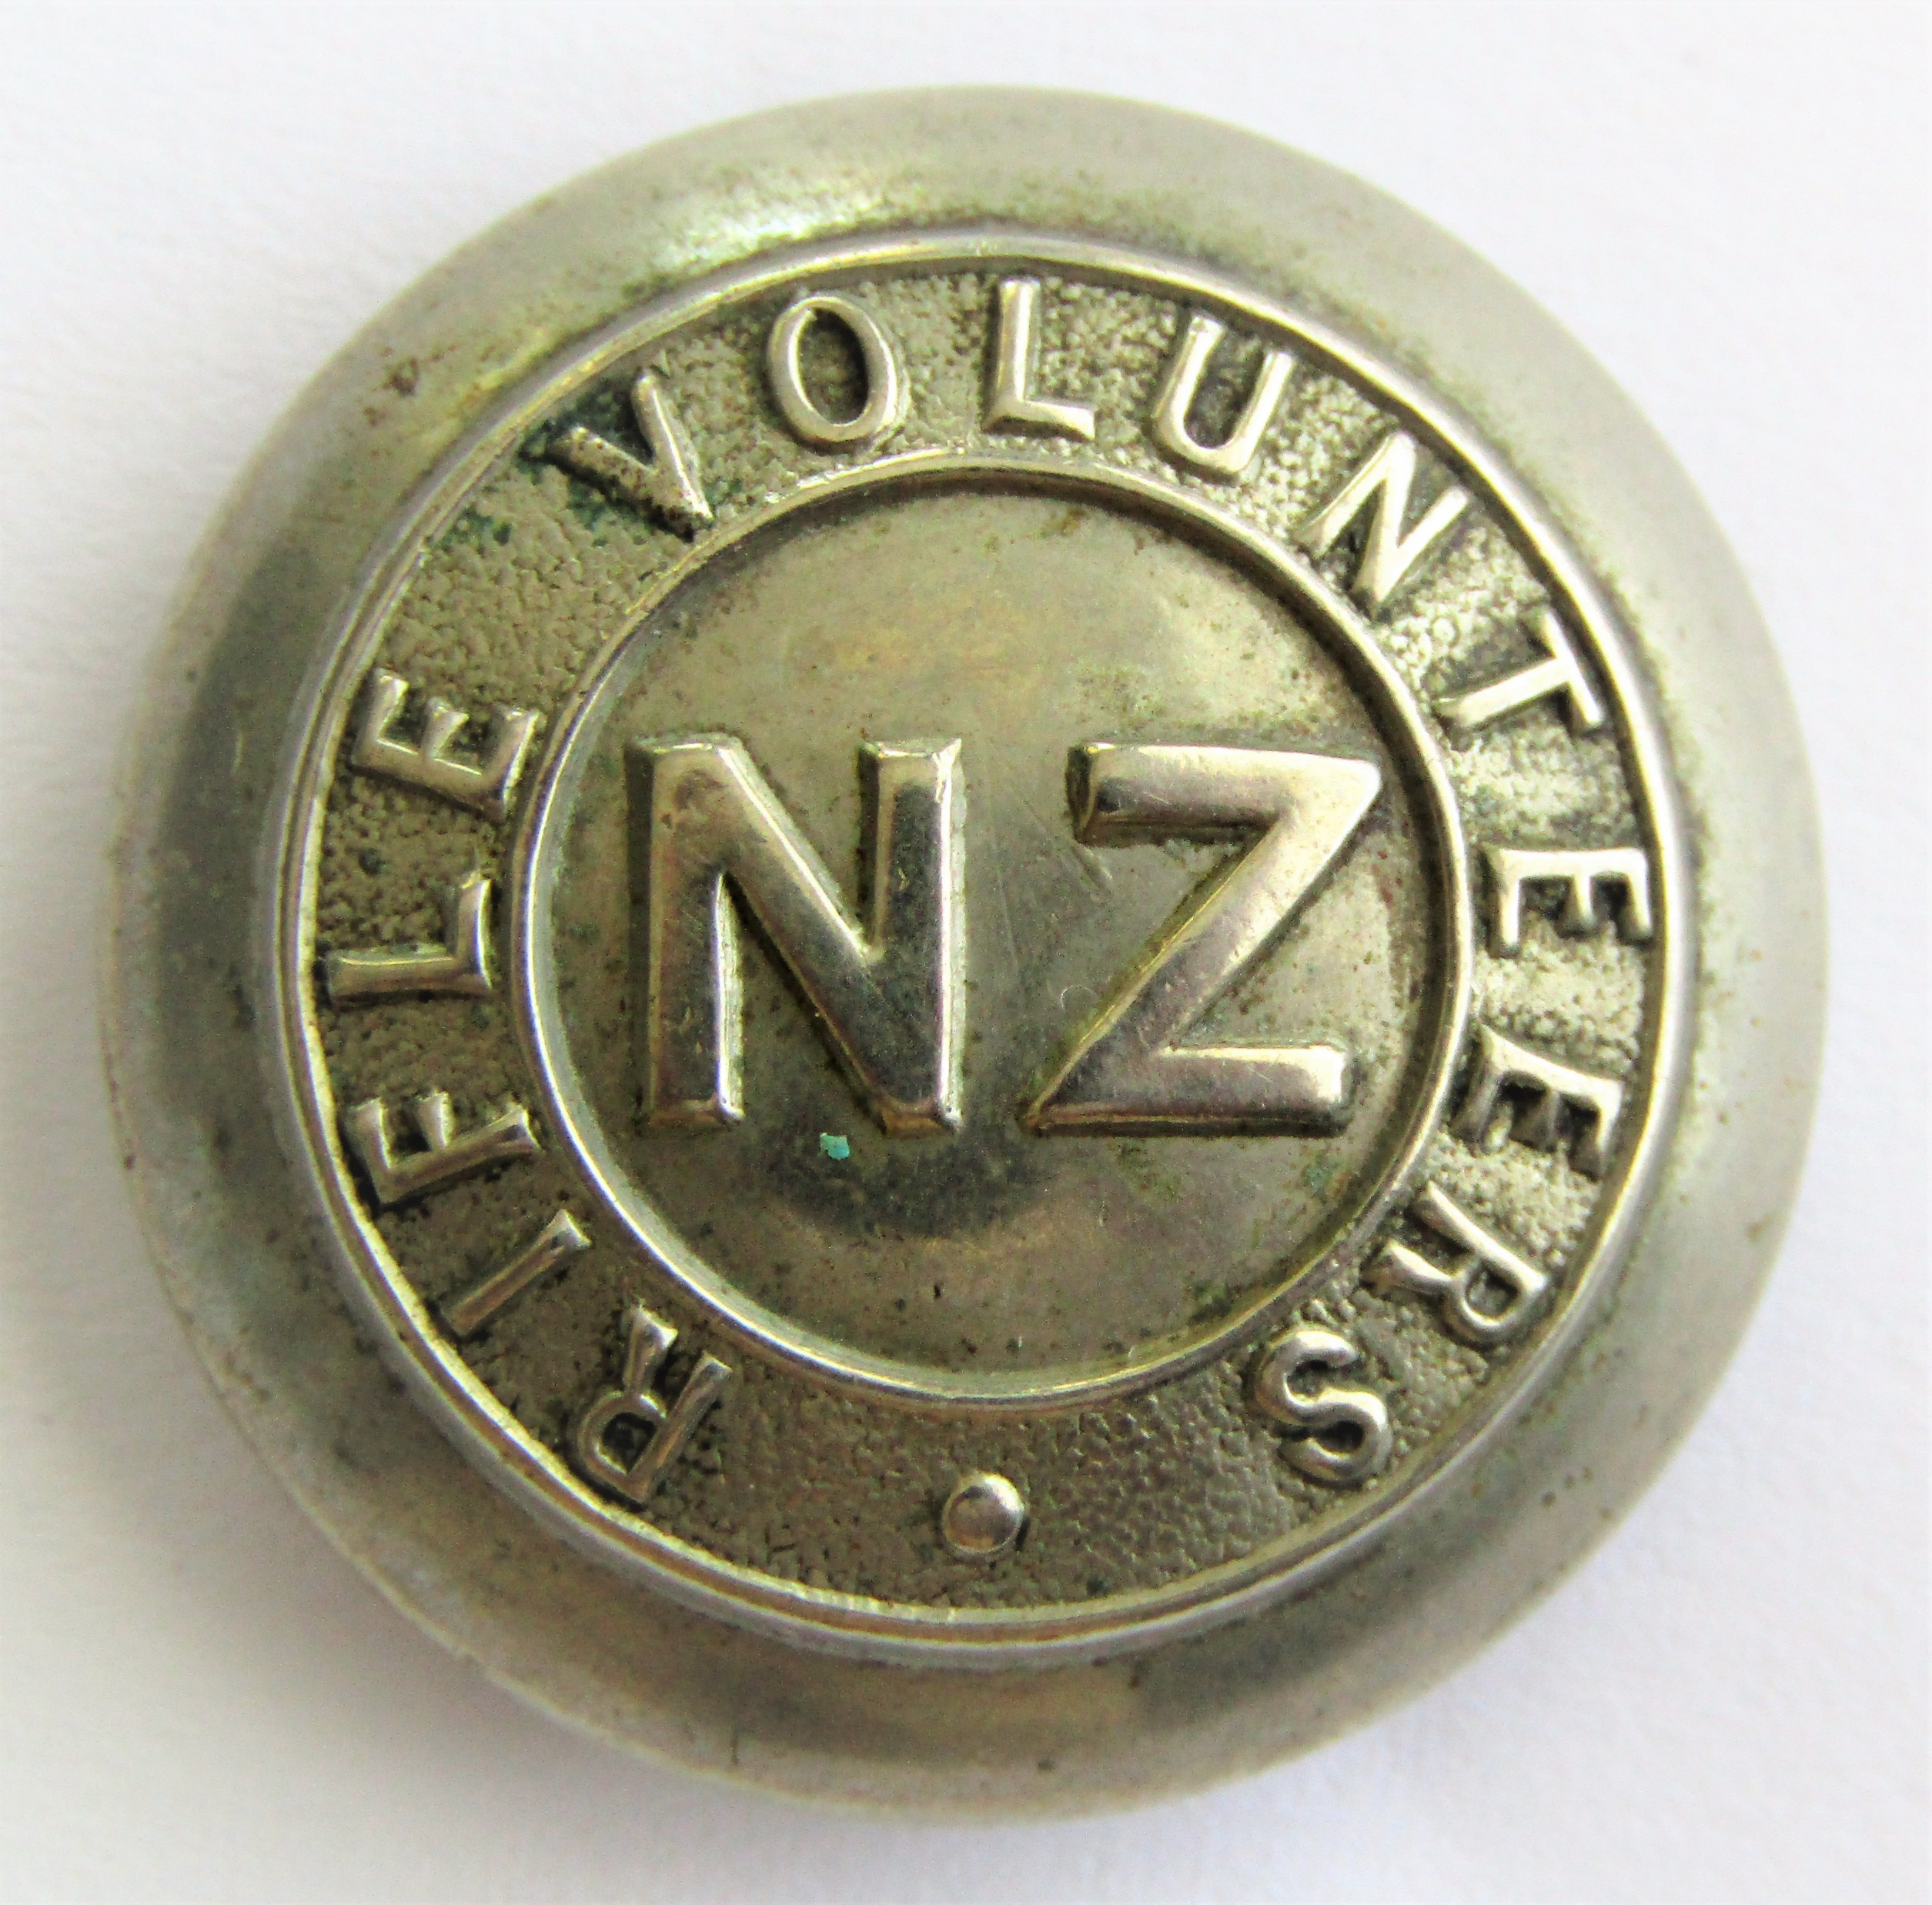
Commercial Buttons
Two main types
Numerous individual unit designs

Slide 7
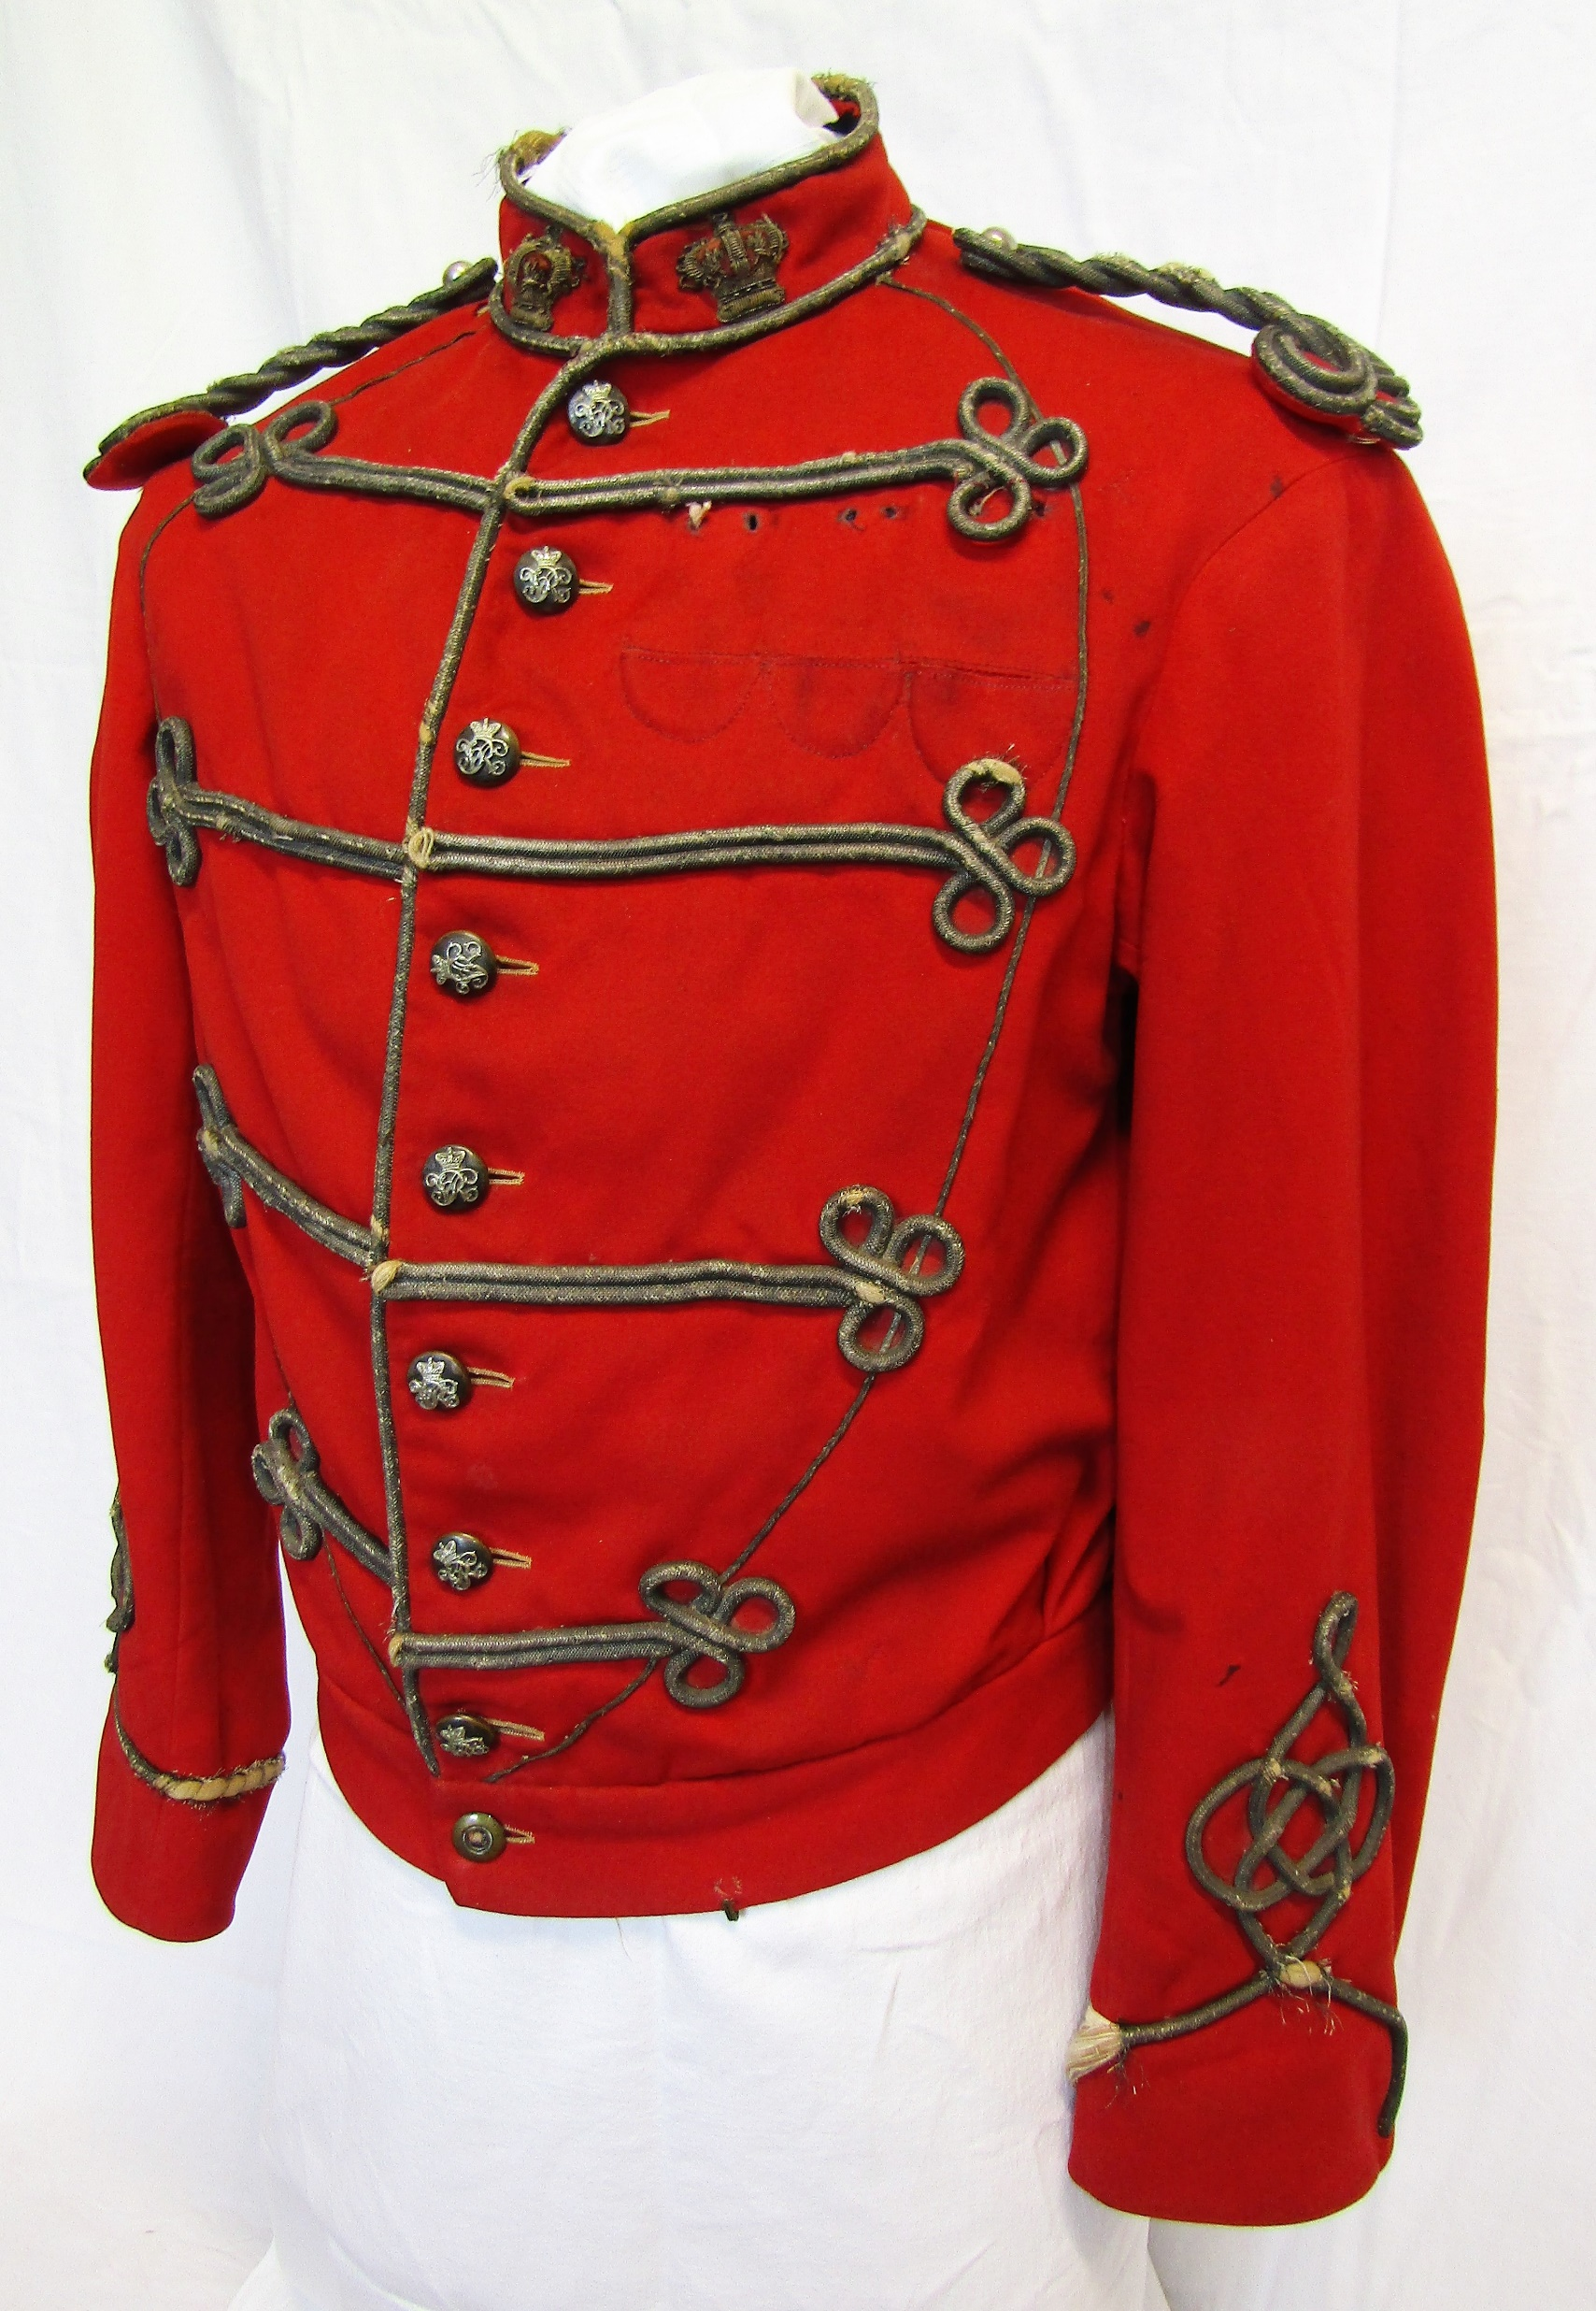
Garibaldi Jacket
Distinctive in design.
Period of use 1860-1870s
75 years later the Battle Dress Blouse would mirror this design.
Notes:
Only 4 known to exist, No. 2 Westland Volunteer Rifles, Dunedin Naval Brigade, Rifle Volunteer and Artillery Volunteer.

Slide 8
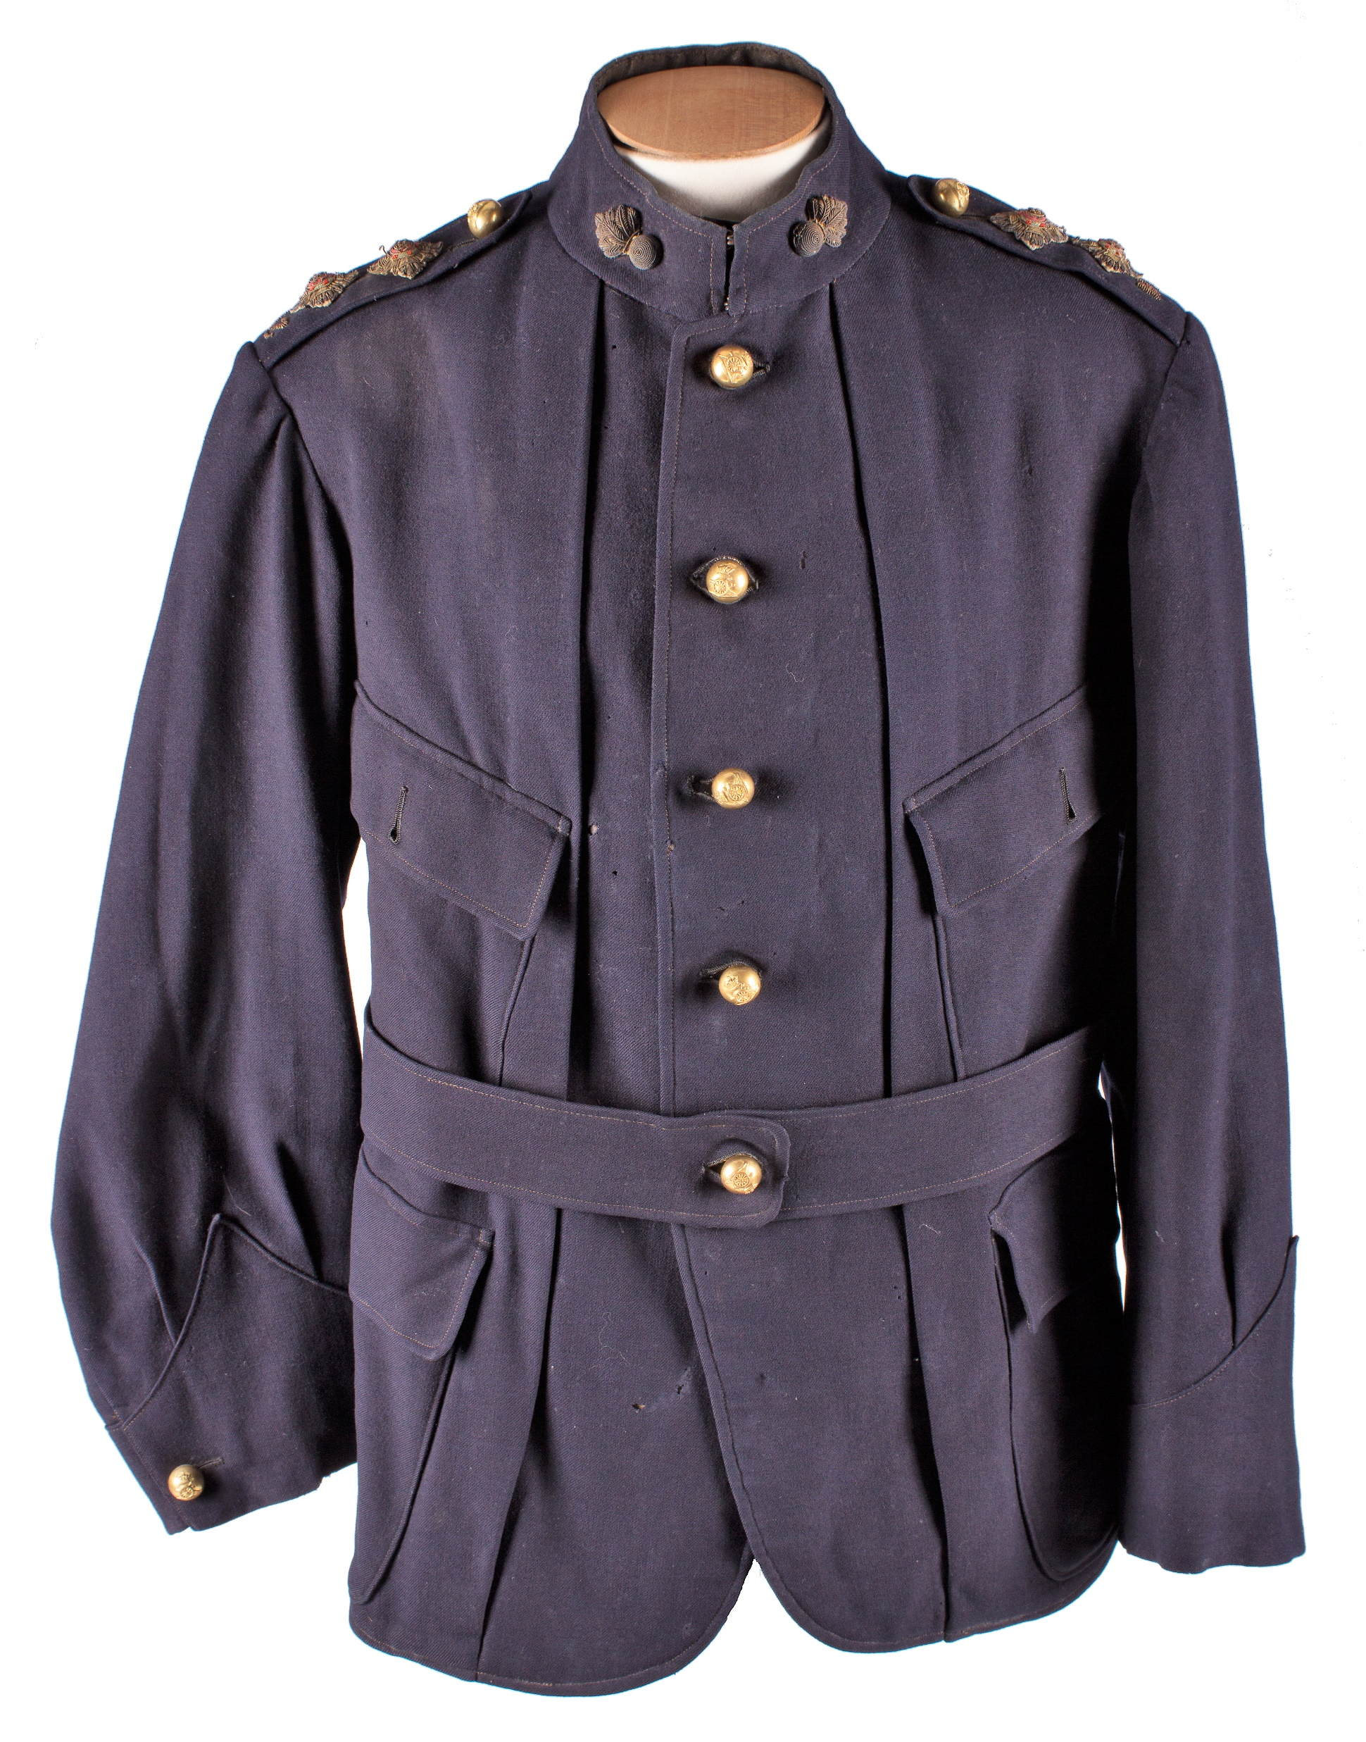
Norfolk Jacket
Distinctive vertical pleats to the front.
Waist belt
Very short lived 1895-1897
Notes:
First mentioned in the 1895 DRs but by 1897 orders were issued to state that the pleats were to be sewn up.
This sewn up design can be found on later jackets as a vertical seam on each side of the front.

Slide 9
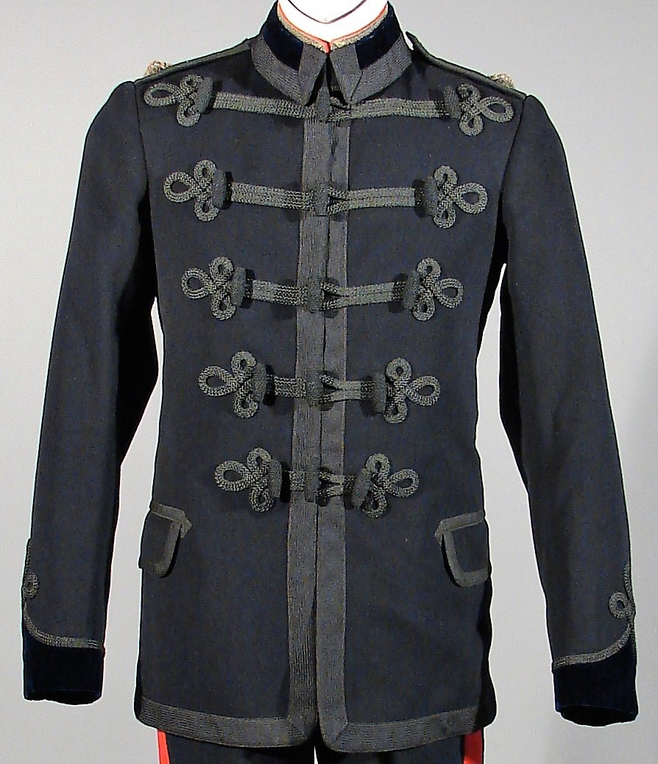
Patrol Jacket
Notes:
Left – Engineers pattern
Right – New Zealand Artillery Volunteers, with false collar
The number of braid loops and the combination of olivets dictates what unit they were designed for.

Slide 10
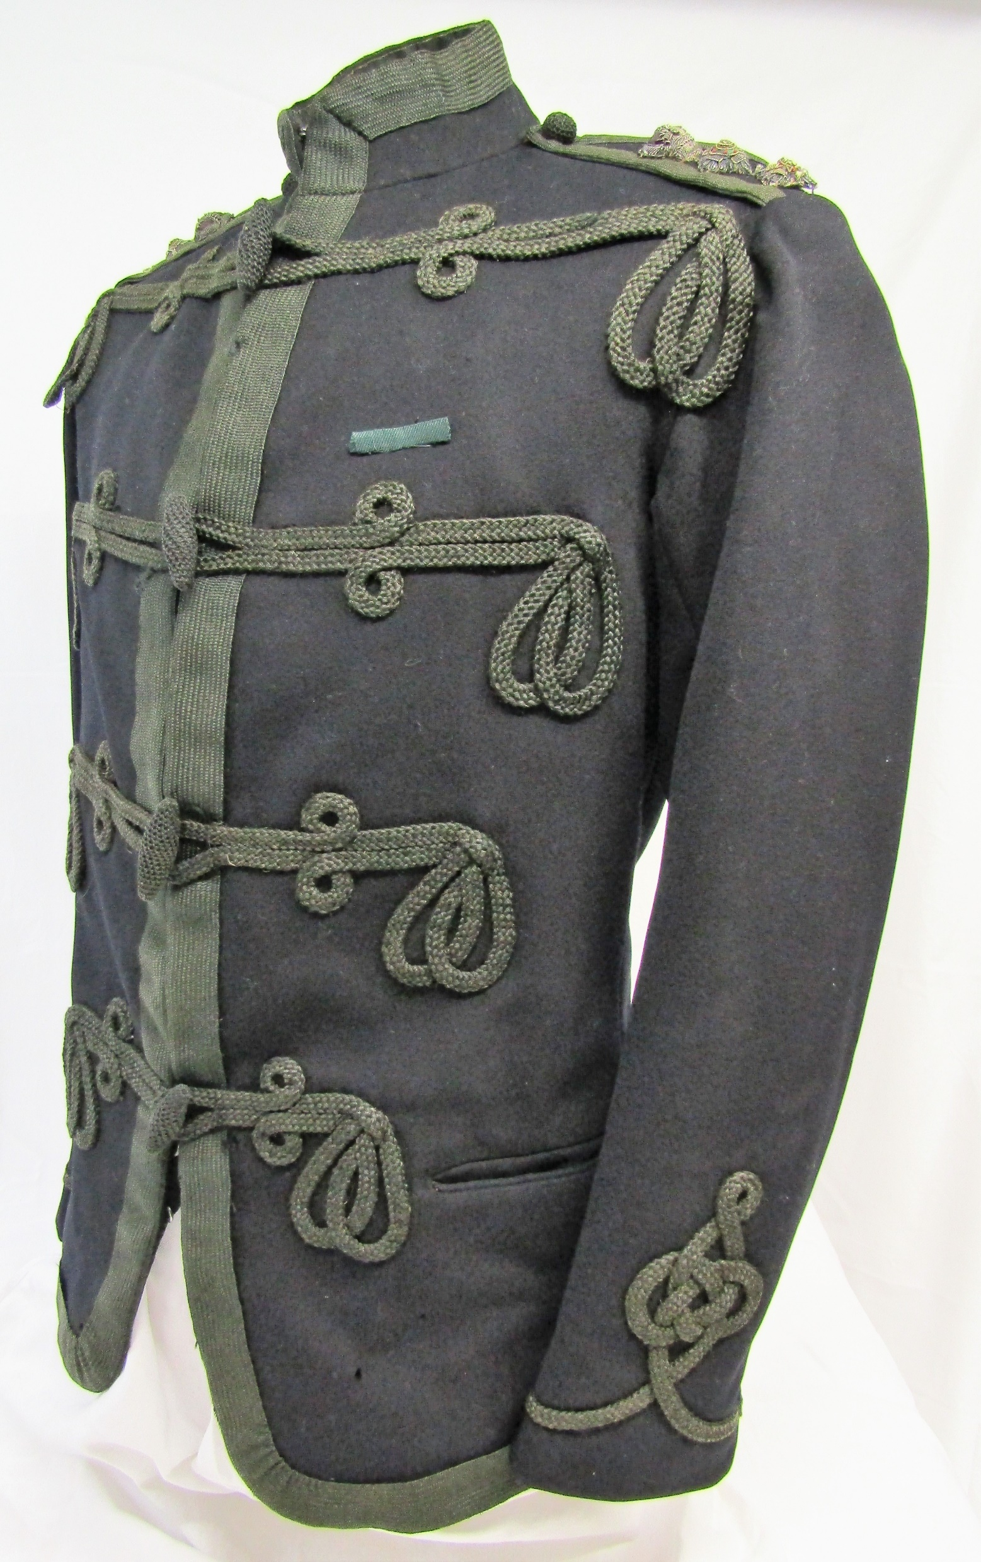
Patrol jackets
Notes:
Left – New Zealand Militia
Right – Volunteers

