Slide 1
The pre 1909 period
This period can be divided in three phases.
Early period 1845 to 1880
Middle period 1881 to 1894
Late period 1895 to 1909
Notes:
Early period growing movement cheaply made uniforms and the Garibaldi.
Middle period large numbers of units, full and undress uniforms and unit buttons and badges.
Late period detailed dress regulations and items that are most likely to have survived today.

Slide 2
Important Date 1881
1881 – The DR of the New Zealand Regiment of Artillery Volunteers.
1881 – Officer’s ranks moved from the collar to the shoulder straps
1881 – The New Zealand Dispatch of 1881 from the Governor to the Secretary of State.
Notes:
First really detailed DRs of what and when to were a uniform
1881 dispatch means that specific NZ designed buttons and badges began to appear in greater numbers.
In conjunction with the British DR.
Lays out that the VR device is no longer to be used in New Zealand.

Slide 3
STYLES
Fashion had a very large influence on uniforms.
Smart uniforms were used as an incentive to recruiting.
European trends of Garibaldi jackets, Zouave trousers, Austrian knots, Russia braid, Astrakhan, Sabretache, Hessian boots.
Notes:
Astrakhan – the fleece of an unborn lamp.
Many of the uniform features were copied from other countries armies.

Slide 4
Different Patterns
Each Corps had their own patterns of Full and Undress uniforms.
Each rifle company copied the British Army style of the uniform to which they were aligned.
Infantry of the Line, Guards Regiment, Scottish or Corps.
Notes:
Units were usually aligned to a British equivalent and took on their distinctions.
The design of full dress uniforms had to be submitted and approved by defence headquarters.

Slide 5
Full and Undress
Undress, usually in the form of a patrol jacket, were worn in the field and was plainer in distinctions and colour. The undress uniform was supplied by the government and as such had to be returned once a unit disbanded.
Full Dress was colourful and worn on parade and for ceremonies. The full dress uniform was owned by the unit and were purchased through fundraising and donations as well as being funded through the yearly government capitation grant.
Because full dress uniforms were owned by the unit they were not required to be given to the government on disbandment and as such they are the most common type of garments held in private and public collections.
Notes:
Capitation grant was money paid by the government to units and based on the number of efficient members. The full dress uniform was a way for the unit to show off its individuality by the use of embossed buttons and badges.

Slide 6
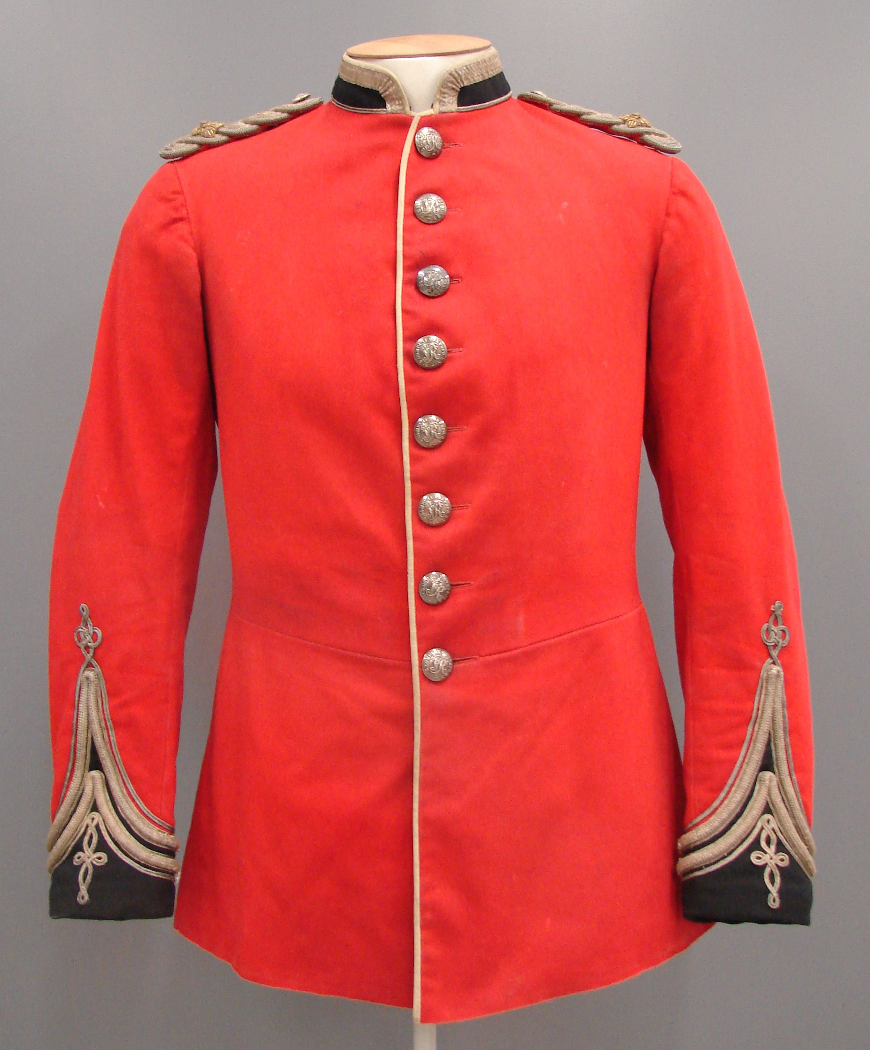
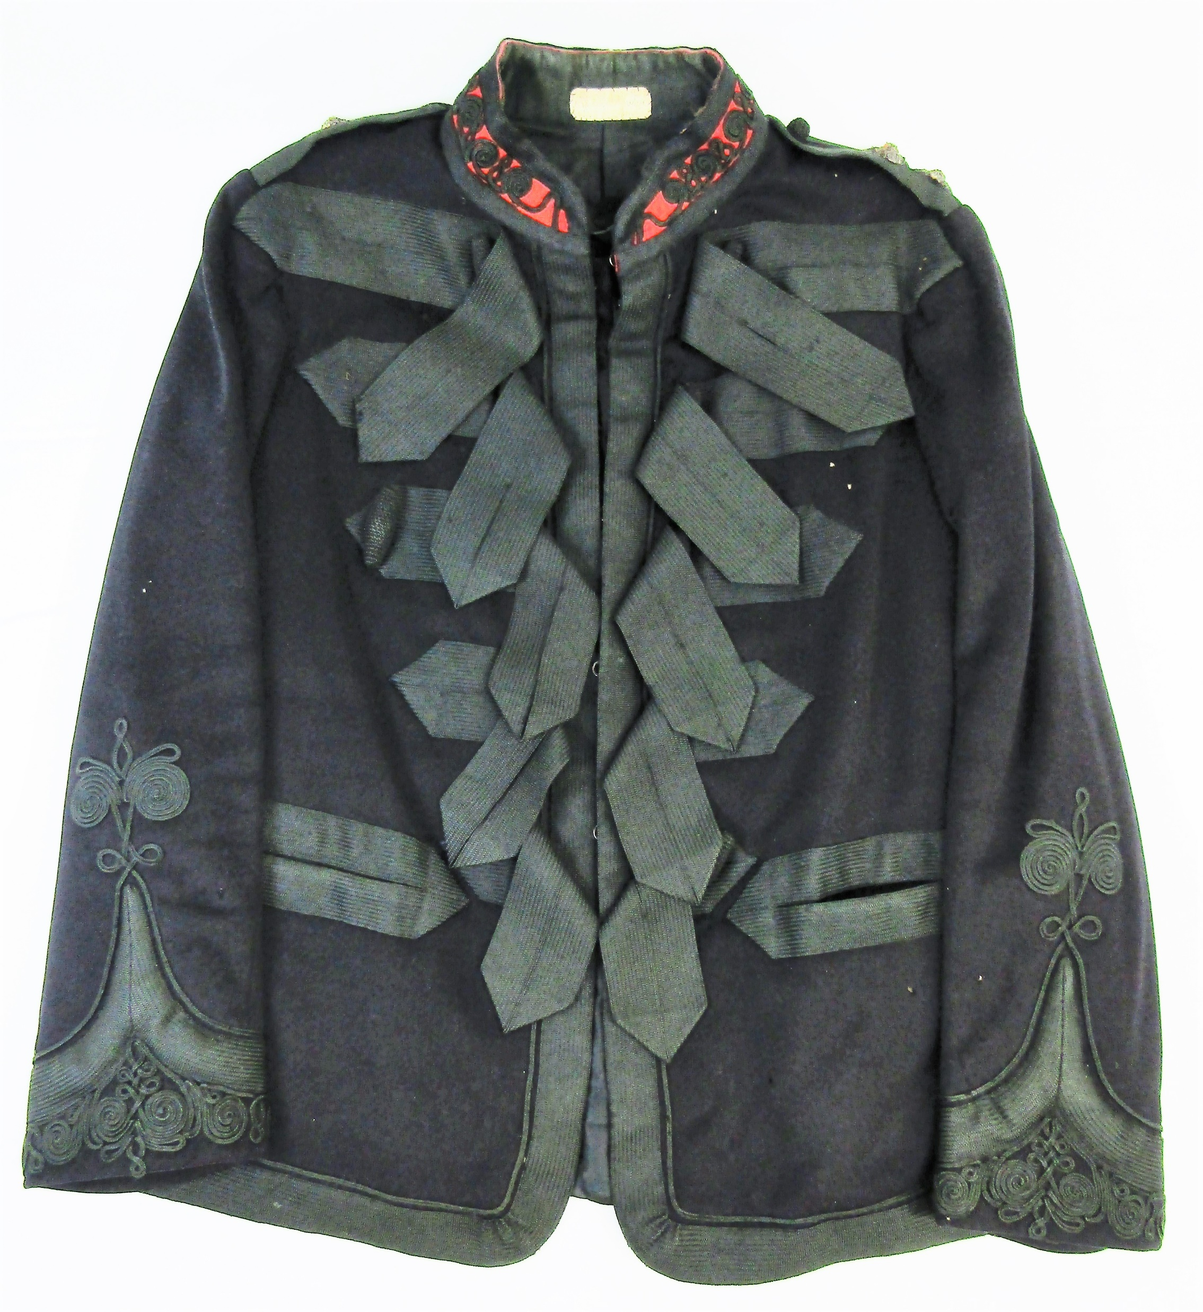
Notes:
Comparison between a typical Full Dress Tunic and a Patrol Jacket
One star is missing form the shoulder strap. The Undress jacket is a Patrol Jacket of the Cavalry and Mounted Infantry

Slide 7
RANK
From 1881 rank for officers was moved from the ends of the collar to the shoulder strap.
The use of stars and crowns was commonly used to tell rank but the combination changed over time.
Stars and crowns were used in combination with the style and amount of lace worn by officers
Until 1902 in the British Army, captains had two stars but this didn’t change in New Zealand until the 1912 Dress Regulations.
NCO rank remained relatively standard throughout the period.
Notes:
The fashion of beards often covered the collar and makes it hard to read images.

Slide 8
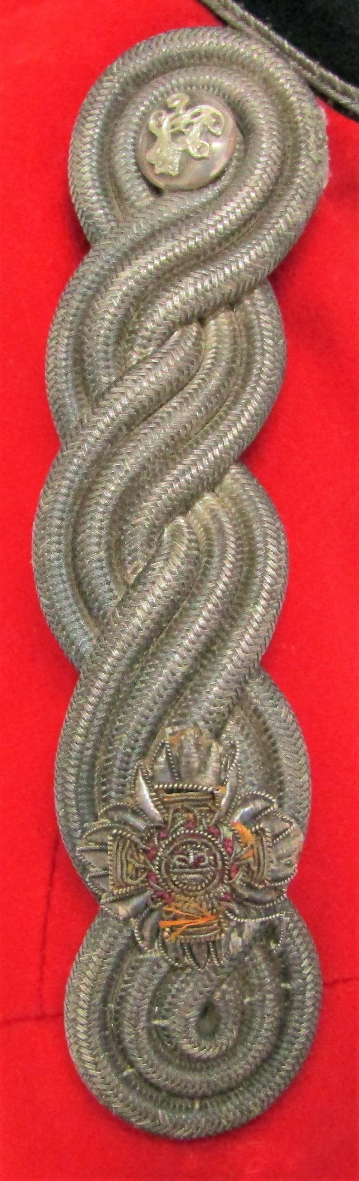
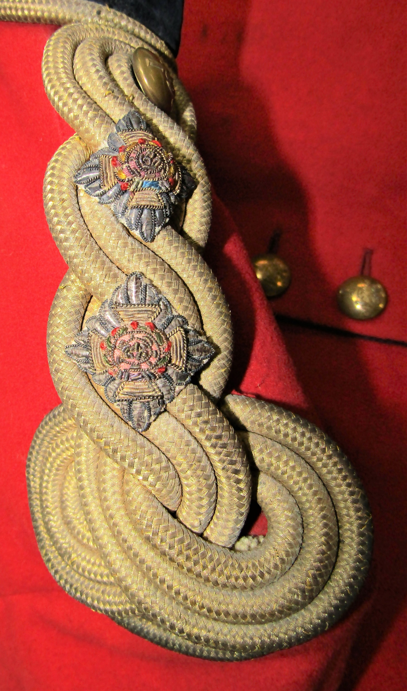
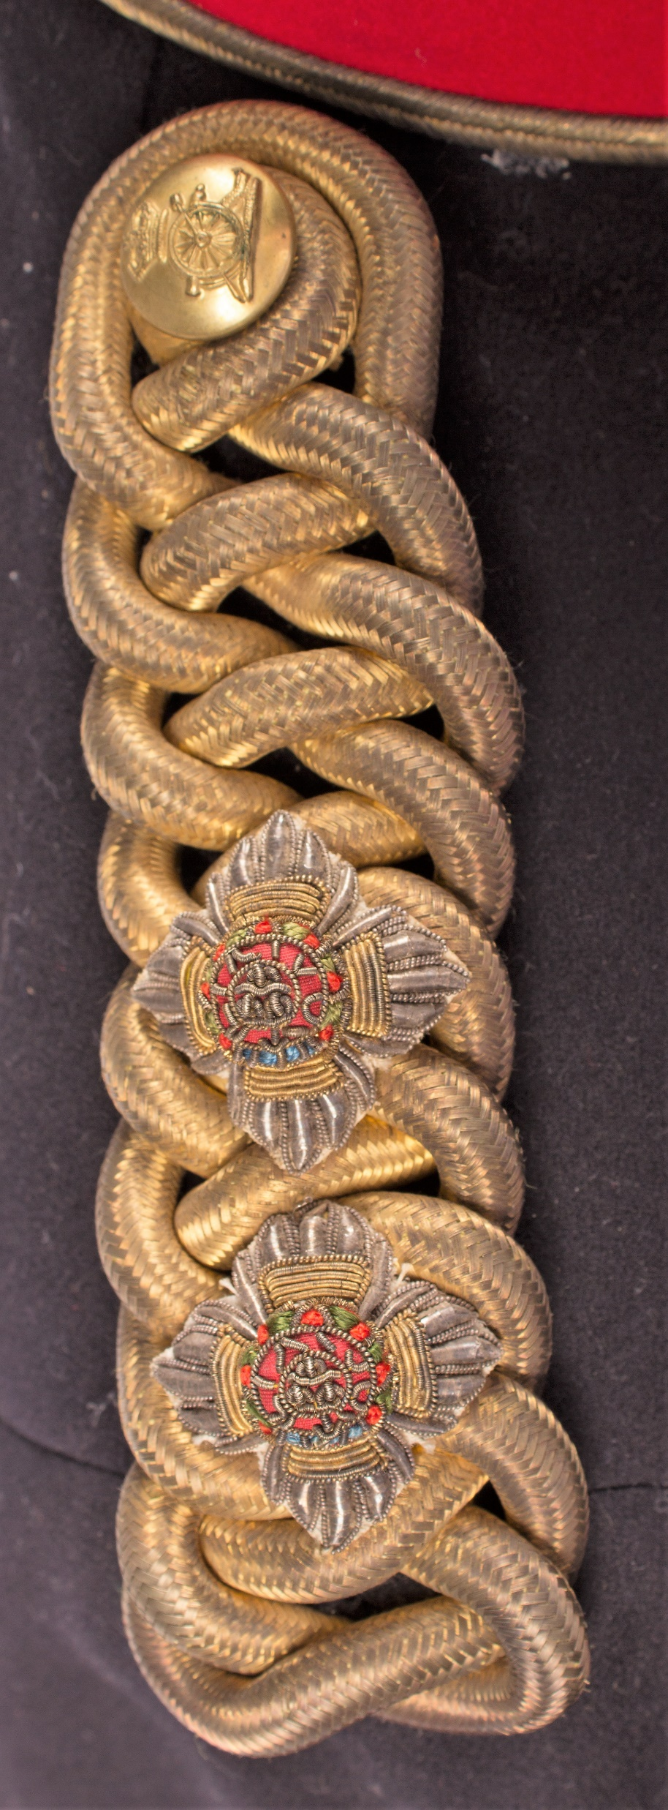
Shoulder Straps and Collars
Notes:
When rank was worn on the collar is it described as being worn on “each end of the collar’. When rank moved to the shoulder straps badges could be worn on the collar.
The design of the full dress shoulder straps differed between each corps.
Left- twisted round cord in a universal pattern
Centre- Treble twisted cord in a Engineers pattern
Right – Plaited cord shoulder strap as worn by Artillery units
Other ranks – had either double cord shoulder straps or “fabric, the same colour as the tunic.

Slide 9
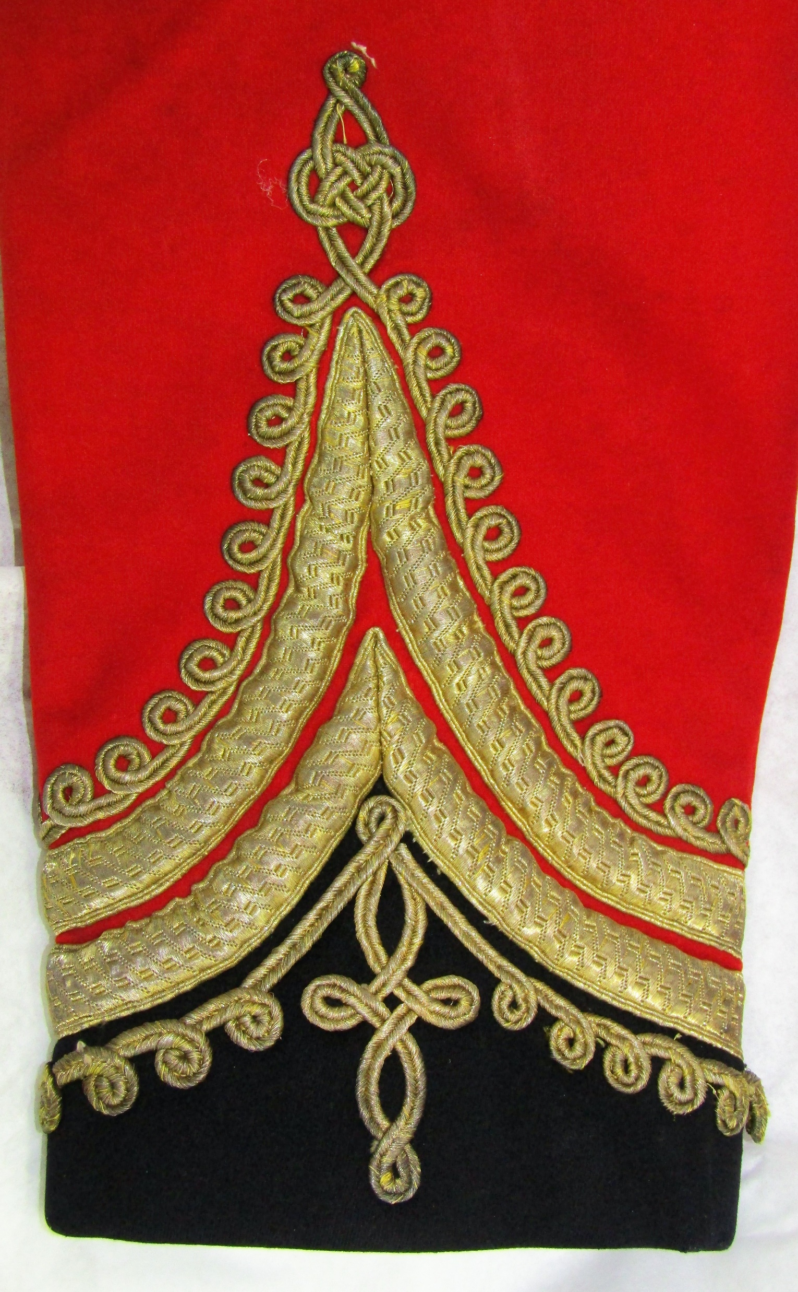
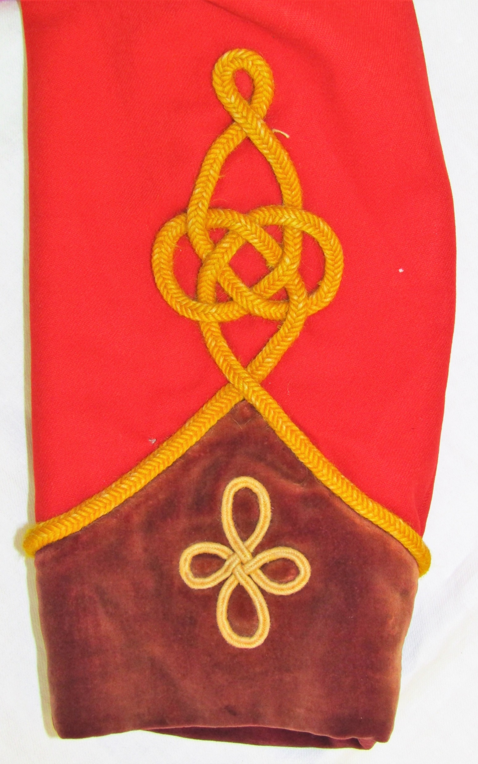
Lace and Braid
Worn to show rank.
The amount worn differs between ranks.
Figuring was often added above and below lace.
The height of the chevrons also indicated rank.
Silver verses Gold lace and braid?
Notes:
Left – the cuff of a Infantry of the Line Field Officer (colonels and Lt Colonels), Majors only had braid above the lace while Captains had plain braid, Lieutents had 1 lace chevron.
Right yellow square worsted cord in an Austrian knot. The eyes at the bottom are add decoration. B company Otago Rifle Volunteers.
Initially silver distinctions were worn to differiciante between Local and British units but by 1881 Gold lace and braid was being worn in New Zealand.
As time progressed gold began to be used more and more by volunteer units. P 17

Slide 10
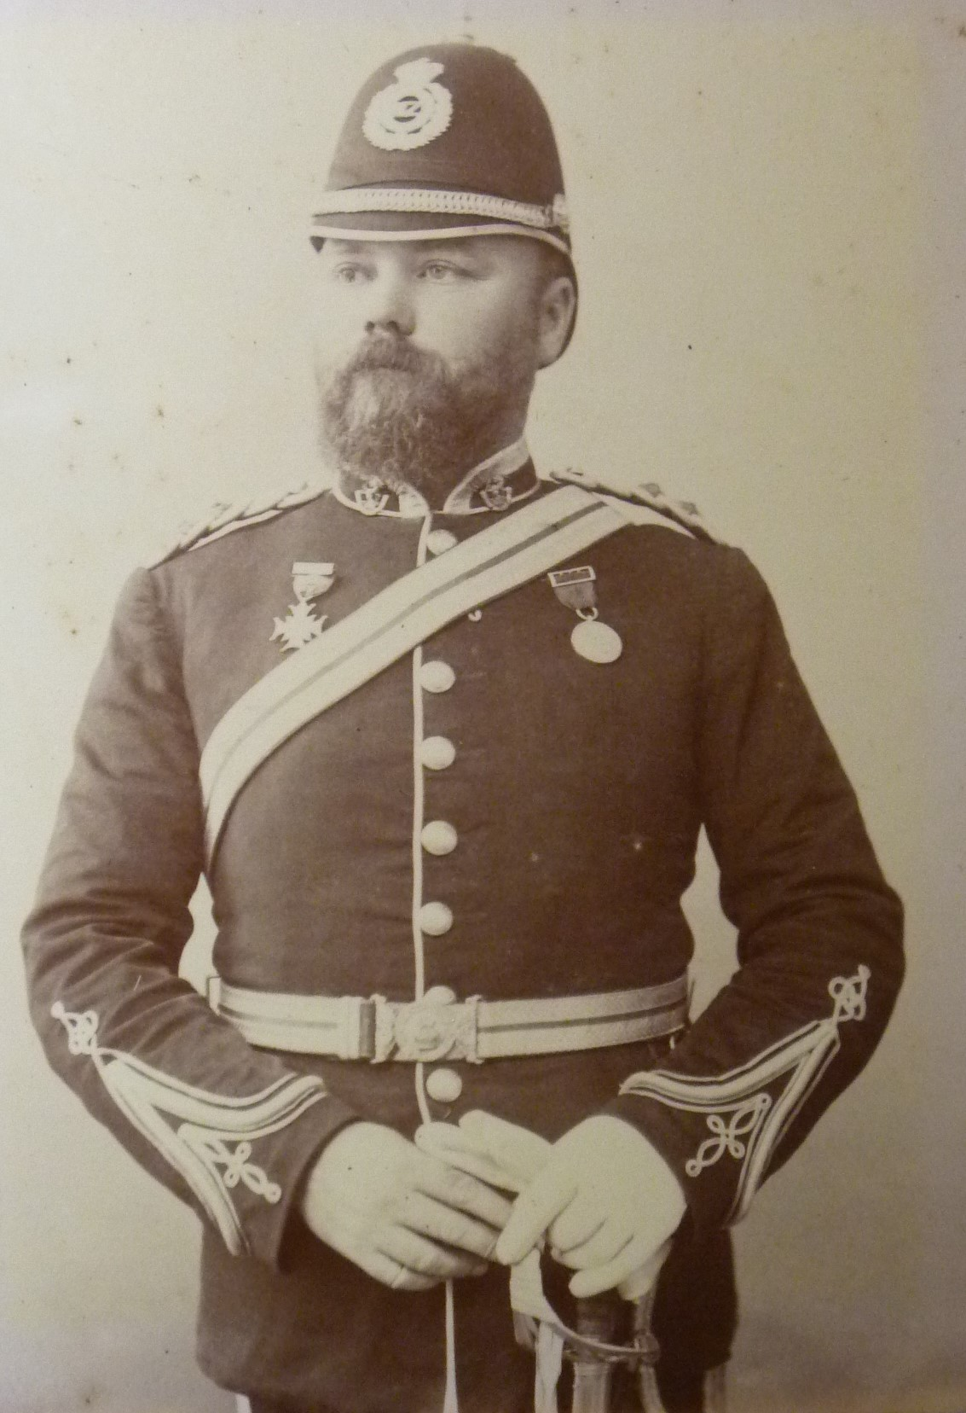
Two Ranks
In this photo we see the rank of Captain on the shoulder straps (two stars), but on the cuff we see the rank lace and braid of a Lieutenant (one chevron).
WHY?
(photo credit ATL)
Notes:
Most likely due to this officer being promoted to the rank of captain but still using his old lieutenants full dress tunic. An extra star is easier to fit to the shoulder straps than to alter the cuff lace.

