Slide 1
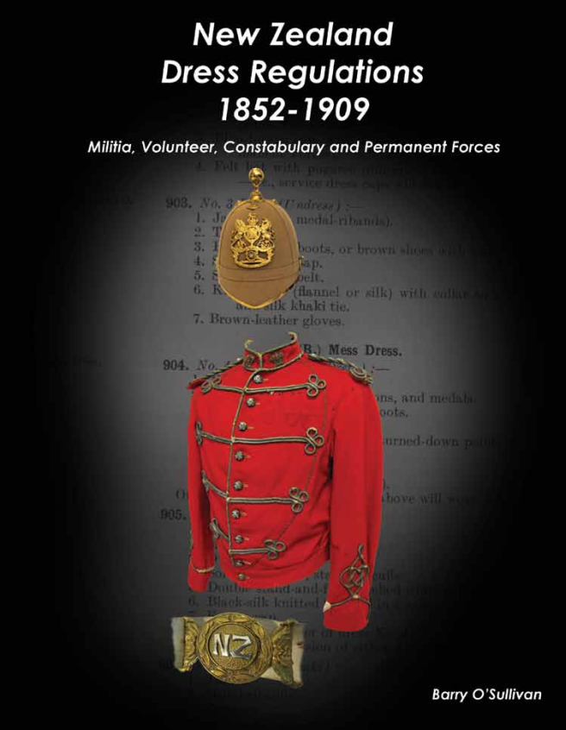
New Zealand Dress Regulations 1852-1909
Barry O’Sullivan

Slide 2
About ME
Researcher, studing New Zealand military history through the medium of uniforms and personal equipment.
Author, Co Author of New Zealand Army Uniforms and Clothing 1910-1945 (with Matthew O’Sullivan)
New Zealand Army Personnel Equipment 1910-1945 (with Matthew O’Sullivan)
The New Zealand Expeditionary Force in World War Two (with Wayne Stack)
Numerous research articles on specific New Zealand militaria subjects.
Collector, Uniforms, Clothing, Equipment, Ephemera, Boots, Badges, etc.

Slide 3
WHY the Dress Regulations?
Officially published material was referenced.
Unit regulations are far too wide ranging and mostly undocumented.
Defined and limited scope.
Others have tried.
The book is not the last word on the subject but the first. The information should be treated as organic and be allowed to grow and shared.
The book is designed to open up discussion , debate and research and to provide a common language and point of reference between interested parties.
Notes:
The first spark came from an enquiry from the North Otago Museum in Oamaru who ask the question, What were the uniforms they held in their collection.
At that time there was very little information, a lot of folk lore and hearsay and hug gaps in our knowledge.
Others have tried to write about the uniforms of the Volunteer period but this is too wide and not well documented to have any real definition. There are well over approximately 600 units, all had slightly different dress.

Slide 4
The book
Brings together all the known DR in one place, one font style and in one format.
The book is divided into
Part 1 which lists the known specific regulations
Part 2 which lists the Imperial Dress regulations, reports, photos of uniform features, 4 quick reference guides and the 600 uniform colour guide.
Part 3 photos of badges, uniforms and accoutrements.
2 weeks to read, two years to comprehend.
Notes:
One Constabulary regulations came to light a week after printing and this regulation is important as it contains the first reference to the white helmet worn by the armed constabulary.
This 1881 dated regulation bridges the gap between the 1876 Armed Constabulary regulations and the new 1887 Police regulations.
If anyone has any more regulations then I would be happy to know about them.

Slide 5
Militia, Volunteer, Constabulary and Permanent Forces
Militia – local militia existed from 1840. Laws to govern Militias came about in1845.
Volunteer – 1858 to 1909 when all volunteers were transferred to the Territorial Force.
Constabulary – Locally from 1840. Laws to govern a Constabulary came about in 1865 with the Armed Constabulary formed in 1867 and disbanded in 1886.
Permanent Force – 1858

Slide 6
Newspaper clippings
The Otago Daily Times
Wednesday 9th March 1864
The Naval Brigade has received from Melbourne a sample suit of uniform, which they have adopted. It consists of dark blue Garibaldi, fitting rather closely to the person, with black facings and gilt uniform button. The trousers are dark blue, with a light blue stripe down the sides. The sword-belt and cartouche box black patent leather. The cap cloth is of the same material as the suit – dark blue and ornamented with a crown and anchor in gold. The uniform is exceedingly neat and suitable for the service.
The Southern Cross
7th April 1900
The sample uniform adopted by the Awarua Rifles worn by Col-Sergt. Mair at last Friday’s parade was the subject of very favourable comment by members and onlookers alike. It differs from that of the Oretis in being darker colour, while pleats on the tunic pockets, and maroon cuffs are added, and certainly improve the appearance of the dress as a whole. The New Zealand Clothing Factory Co. are the makers, and if the fitting of the company is a good as that submitted, members should be satisfied with the result. The corps expects to equip all those attending the Easter camp with the new uniform.
Some note what the unit did.
Some note what the unit is going to do, Did they follow through?
Notes:
All newspaper clippings must be read in the context of the time.
They were a way of communicating to all members.
We must ask if the unit says they are going to, did they carry out the order.

Slide 7
Early New Zealand
Divided up into small centres.
Very few roads outside the town centres.
The towns were still developing their commerce.
Most travel was undertaken by ship.
Sometimes it was easier to travel and trade with Melbourne, Sydney and Hobart.
Notes:
The Australian towns were a lot more developed.
A number of early volunteer units had their uniforms made in Australia and Britain as they had established industries.

Slide 8
The Language of the book
The Dress Regulations were written in a grammar and comprehension style that is foreign to most of us today.
The Dress Regulations were meant for the people of the time.
The Dress Regulations are not a date of introduction of an item but a collection of the latest patterns and ideas from the previous period.
Notes:
Today we have to take time to study and interrupt the grammar and comprehension of the period.

Slide 9
Corruption of the Grammar and meaning
The Dress Regulations have already been written so there is no point re writing them.
The words and language has already been set so there is no point re defining them.
In today society words have crept in and corrupted the language of the Dress Regulations. This leads to confusion and misunderstanding and by some, glamorisation of an item.
Notes:
It is easier to study the existing regulations
Jackets are described as tunics and epaulettes when they should be shoulder straps

Slide 10
Commonly used words that have no place in the Dress Regulations of the time
Epaulette – The correct term is ‘Shoulder strap’ (only referred to in the naval regulations).
Jacket/Tunic – Today most jackets are incorrectly referred to as tunics and visa versa.
Pantaloons/Jodhpurs – Only pantaloons are referred to in the DR.
Cartouche Pouch – There is NO official mention of this in the DR.

