Slide 1
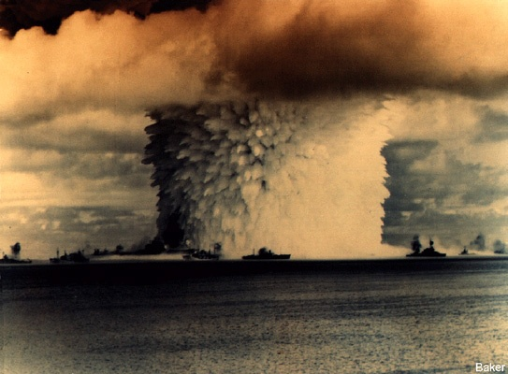


Slide 2
New Zealand Nuclear Test Veterans Study
Al Rowland
Institute of Molecular BioSciences
Massey University
Palmerston North
New Zealand

Slide 3
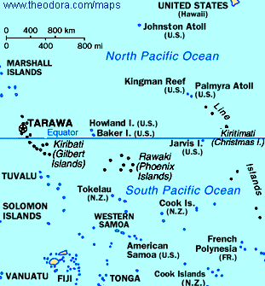
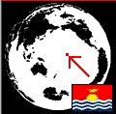
Location of
Christmas Island

Slide 4
United Kingdom nuclear weapons test in the Pacific 1957-1958 in which RNZN ships Participated
Source: Crawford (1989)

Slide 5
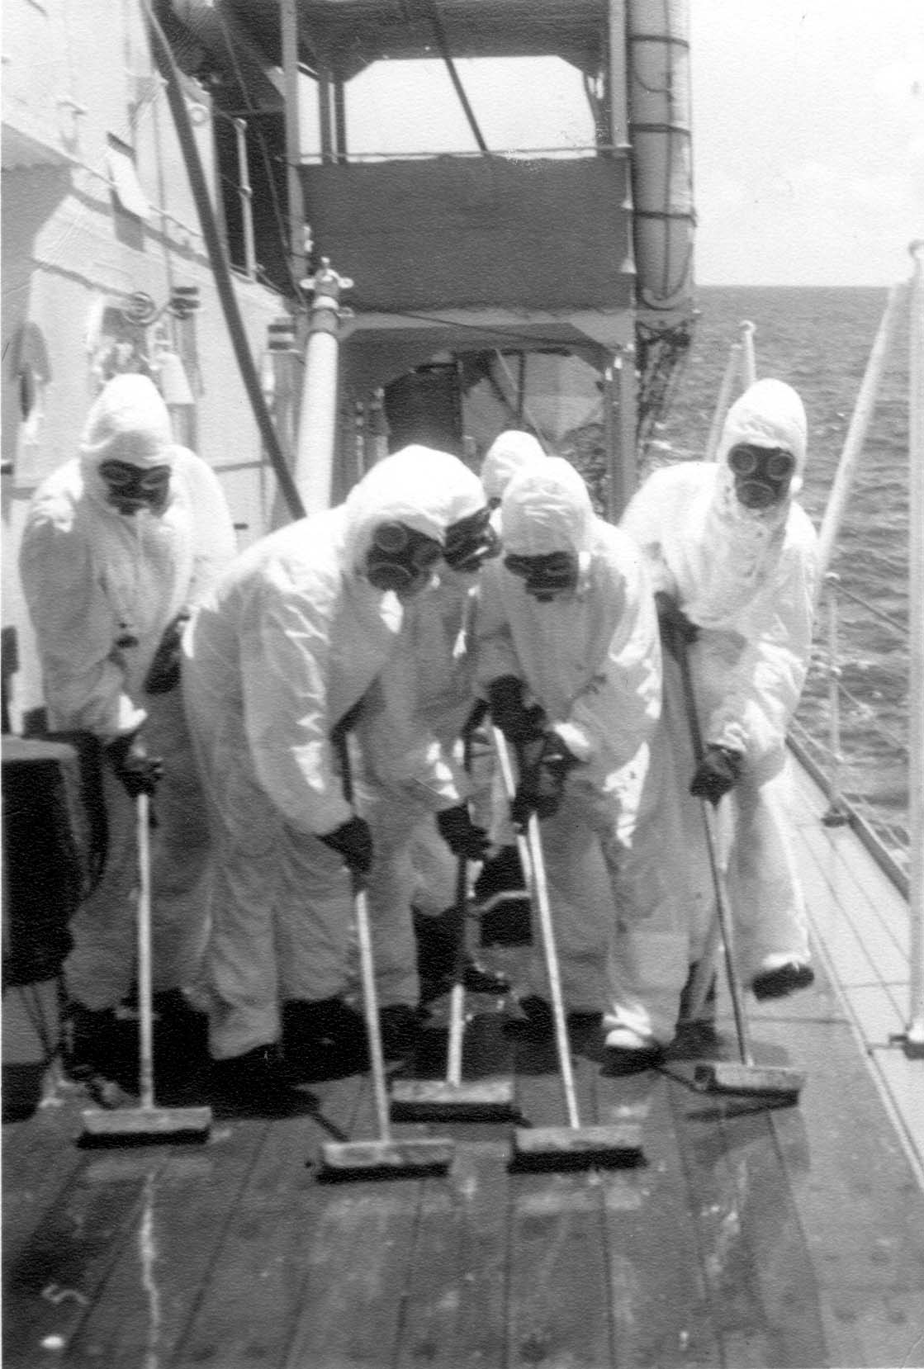
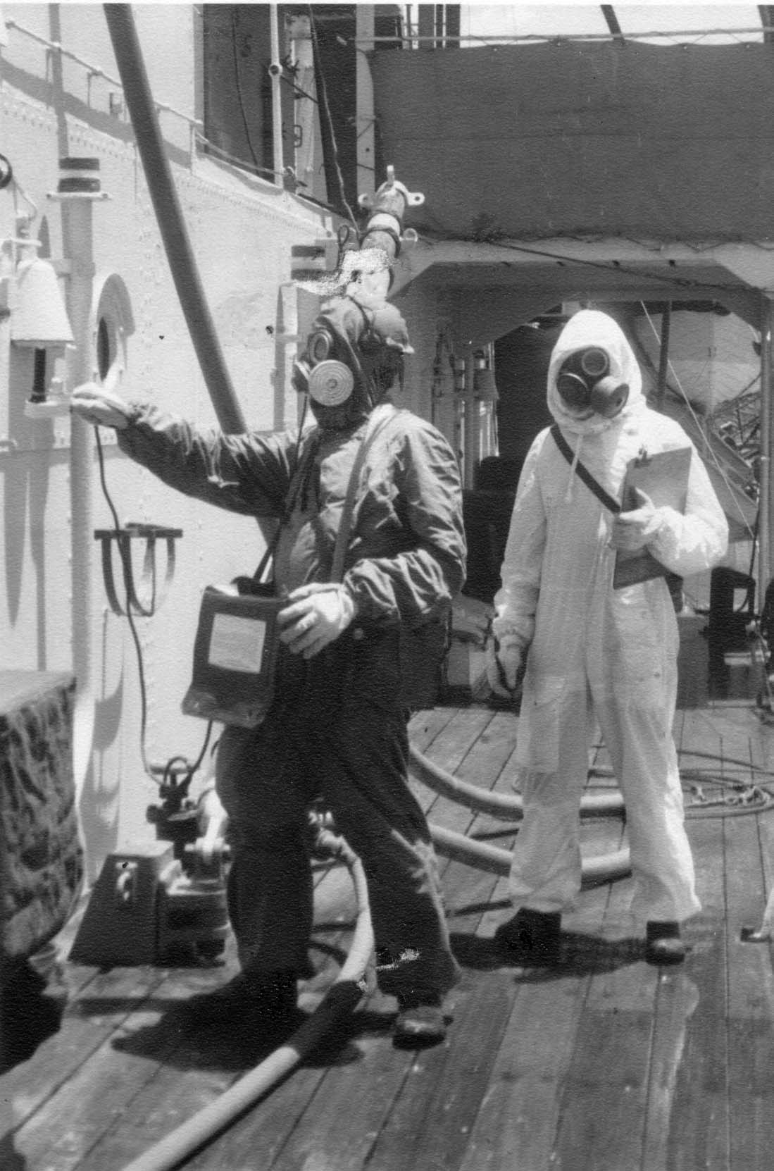

Slide 6
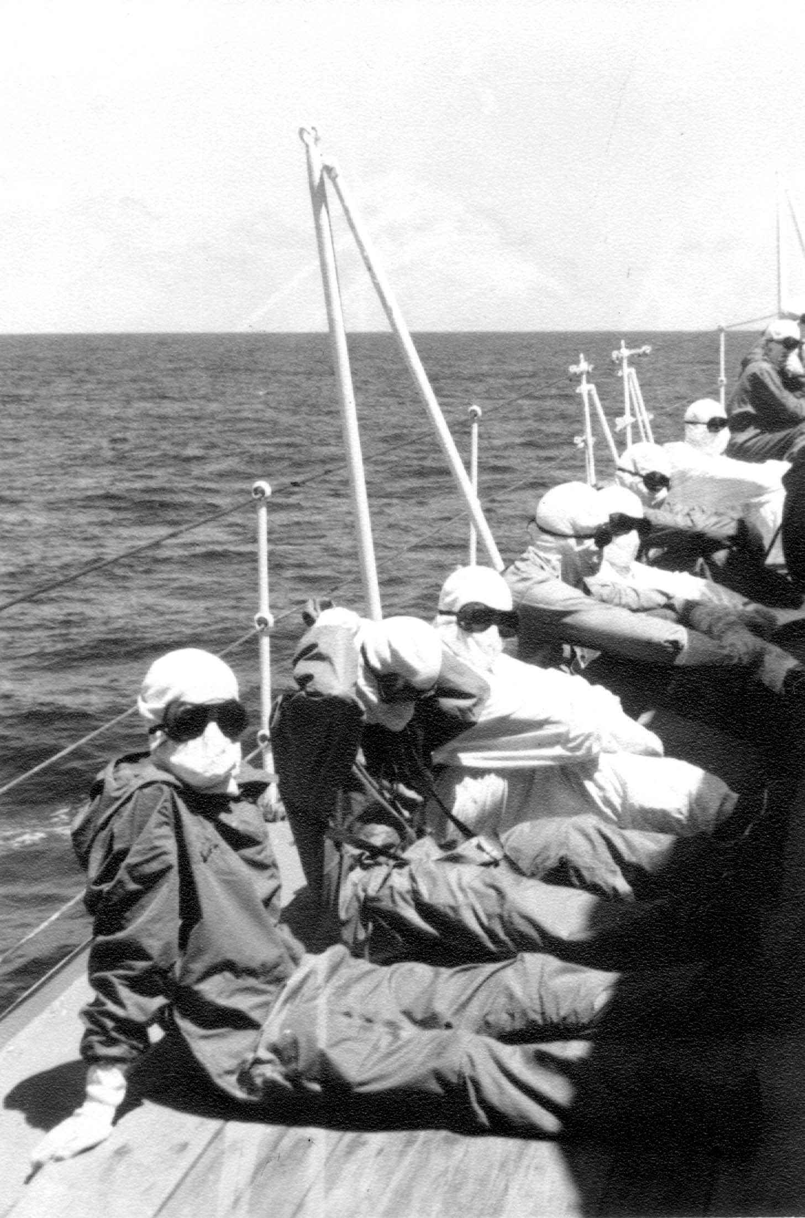
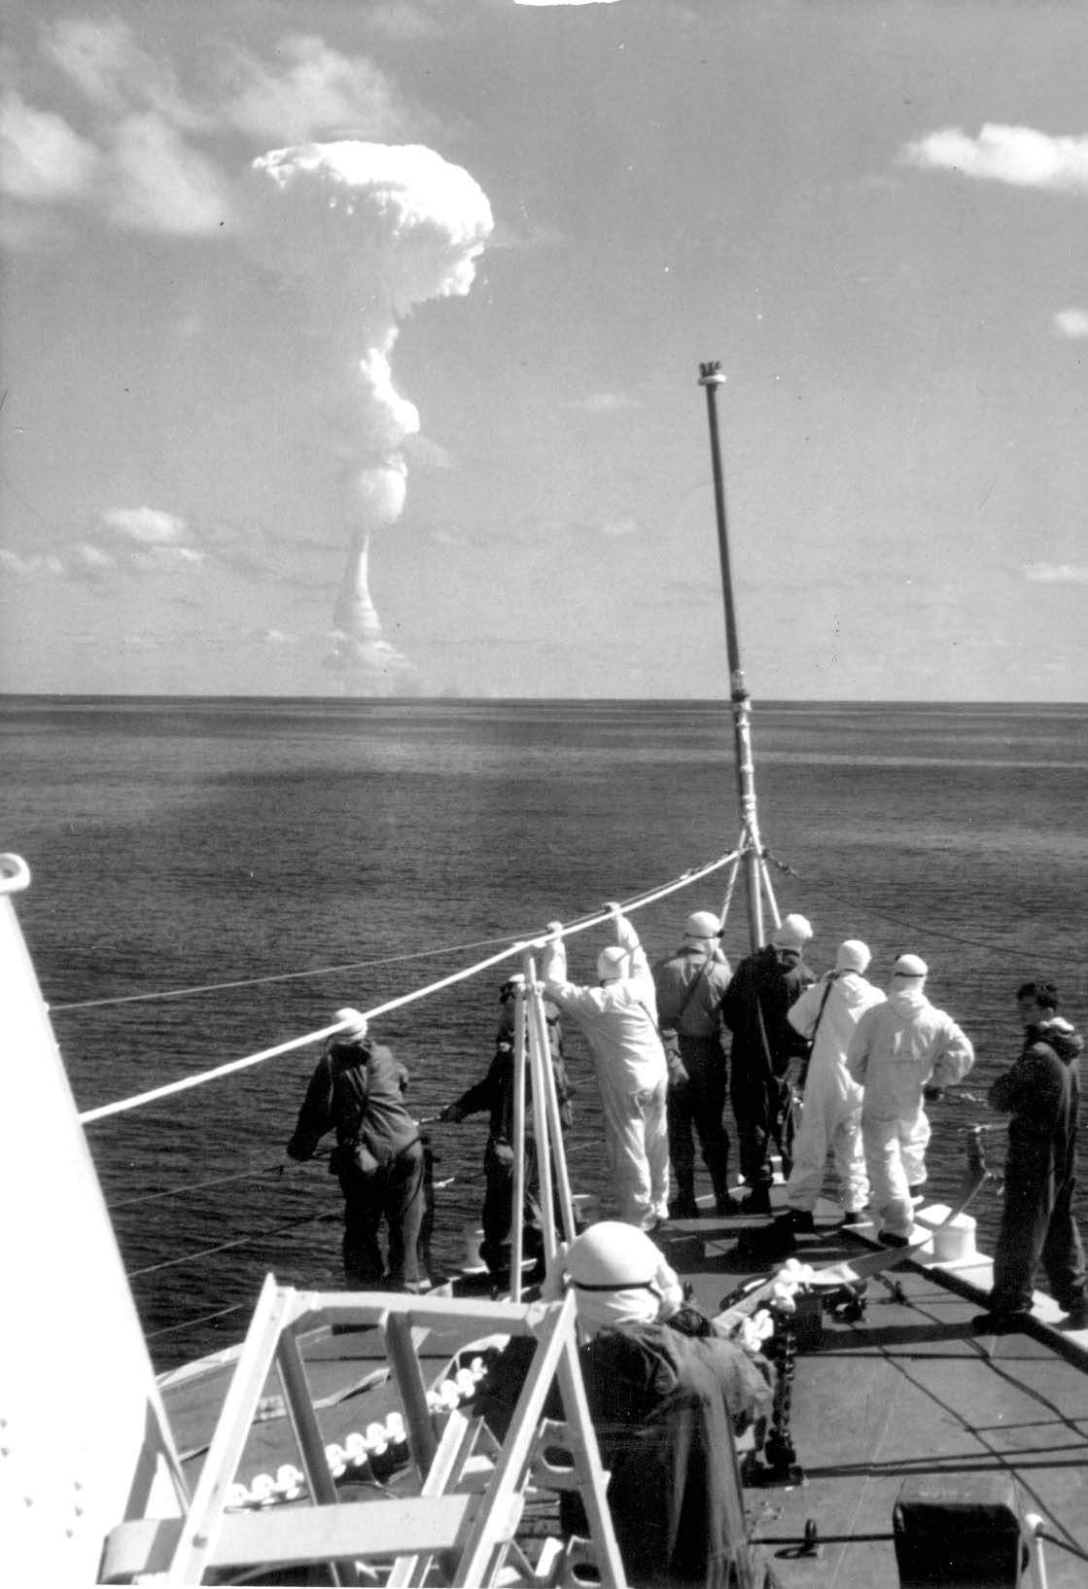

Slide 7
50 veterans and 50 matched controls were studied.
A stratified random sampling procedure was followed.
Selecting the controls was a crucial step in the study and involved the participation of psychologists who specialized in the scientific design of human studies.
A detailed questionnaire was completed by all participants to gather information on possible confounding factors.
The study was conducted blind to remove bias.

Slide 8
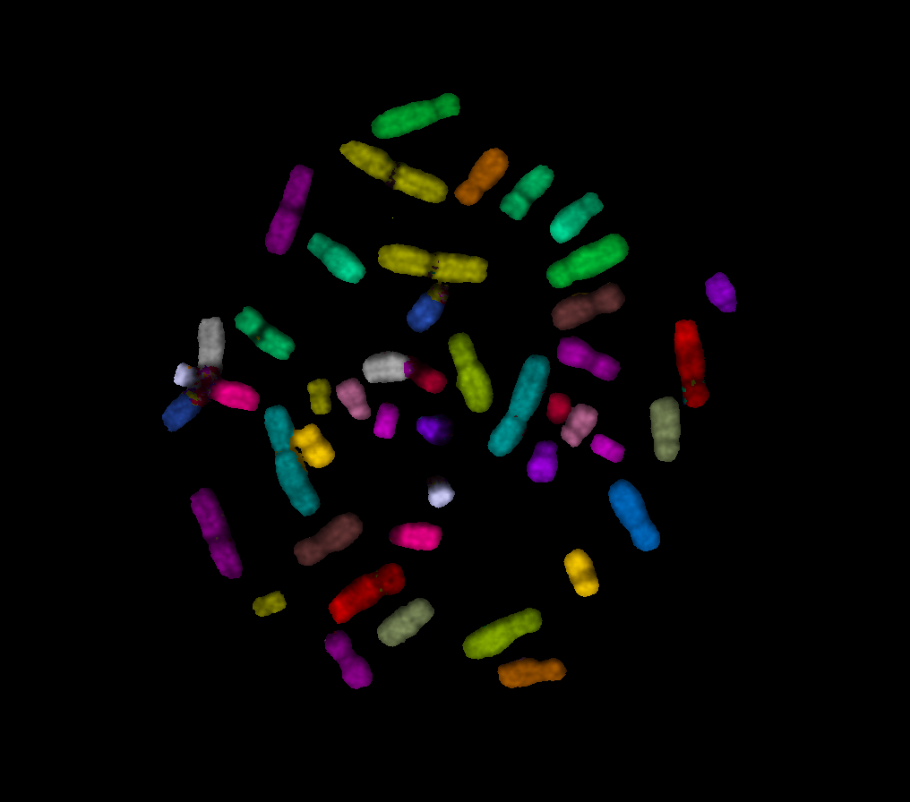
mFISH
Multicolour Fluorescent In Situ Hybridization
Very powerful test for
detecting radiation damage
It is used to score number
of translocations between
chromosomes
Can be used to estimate
amount of past exposure
to radiation

Slide 9
Proto-oncogene
Immunoglobulin
gene

Slide 10
Proto-oncogene
BREAK
Immunoglobulin gene
BREAK

Slide 11
RECIPROCAL TRANSLOCATION
Immunoglobulin
gene
Active oncogene

Slide 12
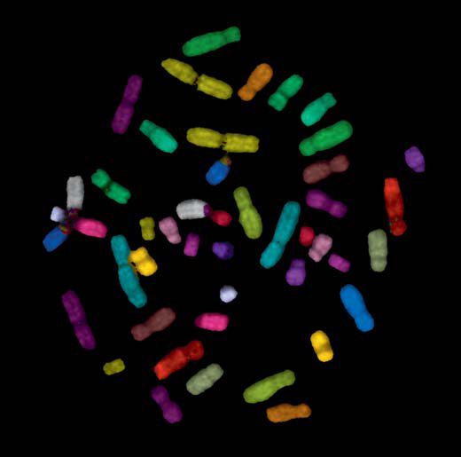
Fig. 1. C-metaphase spread of a normal karyotype from a dividing human peripheral blood lymphocyte, painted via mFISH.

Slide 13
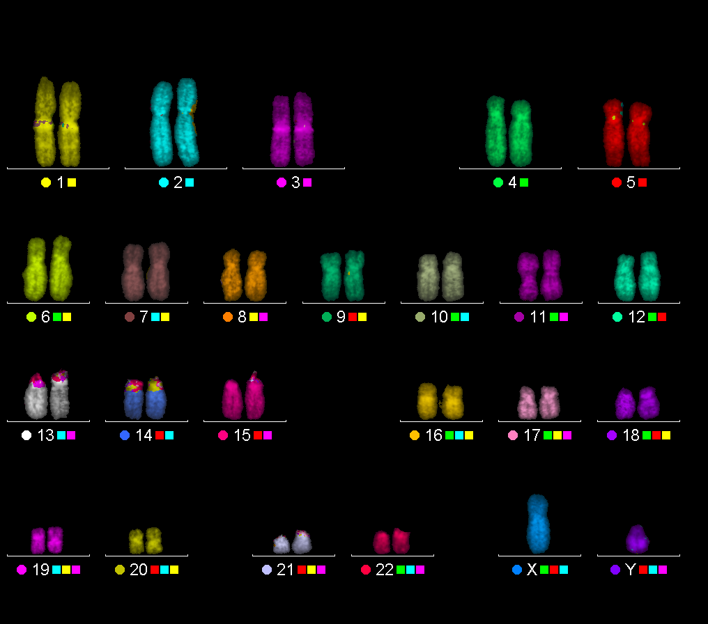

Slide 14
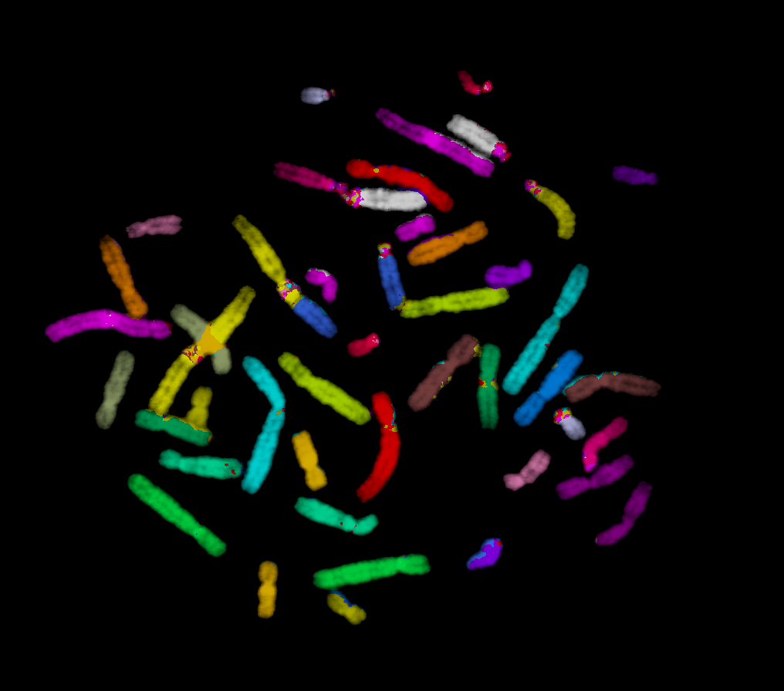

Slide 15
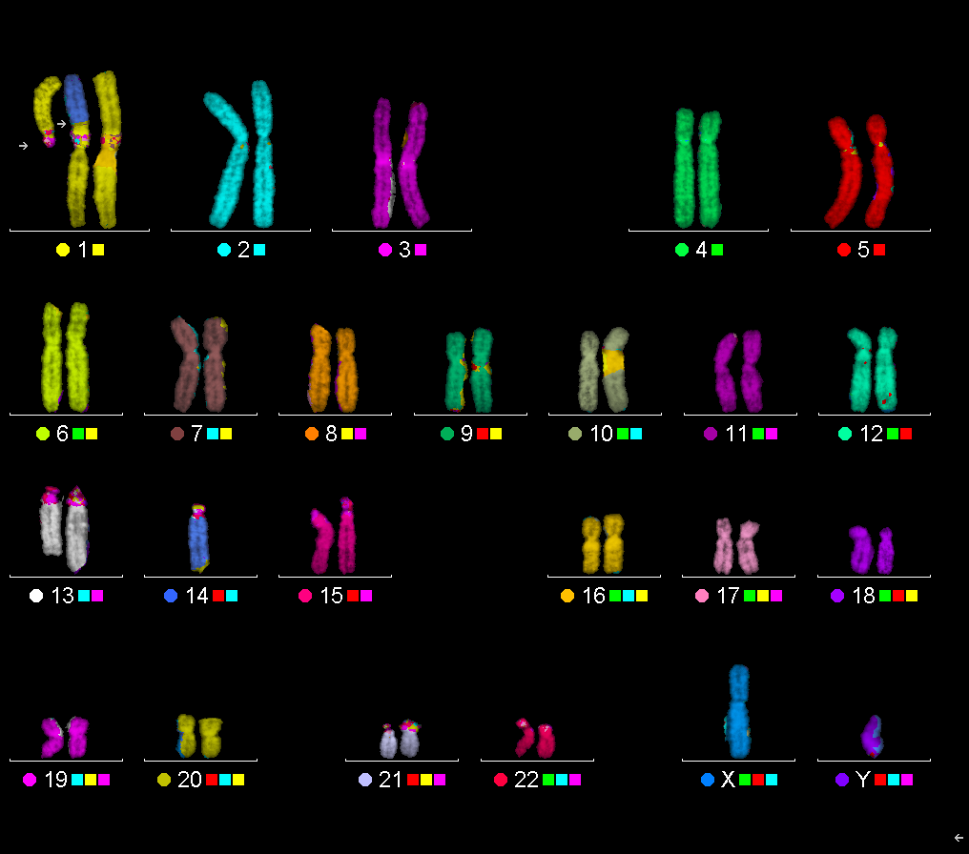

Slide 16
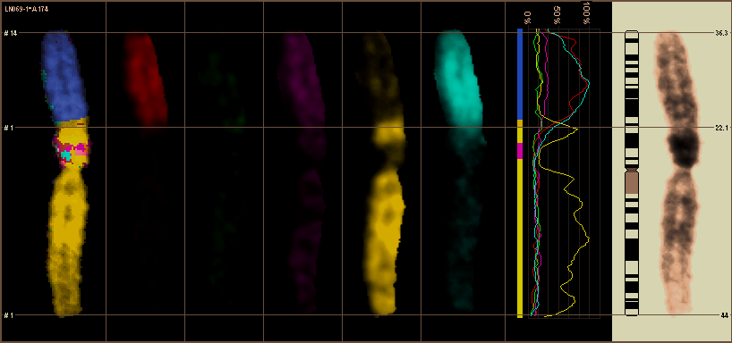

Slide 17
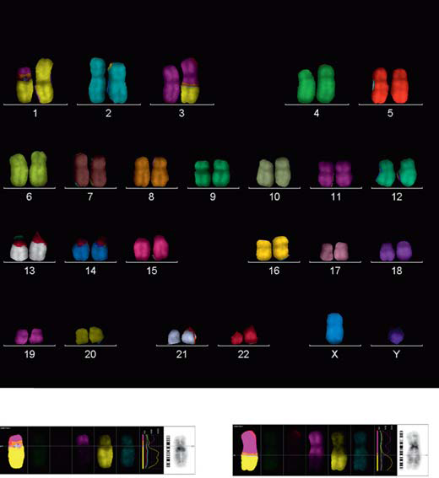

Slide 18
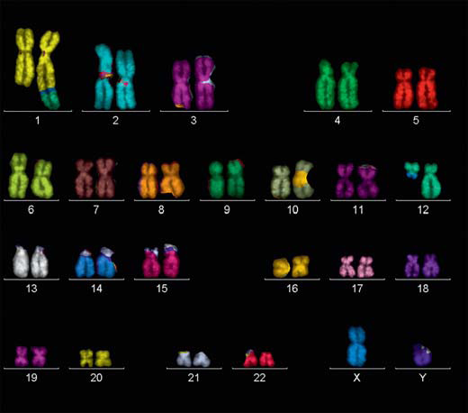

Slide 19
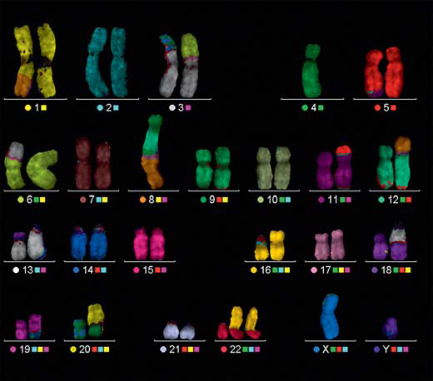

Slide 20
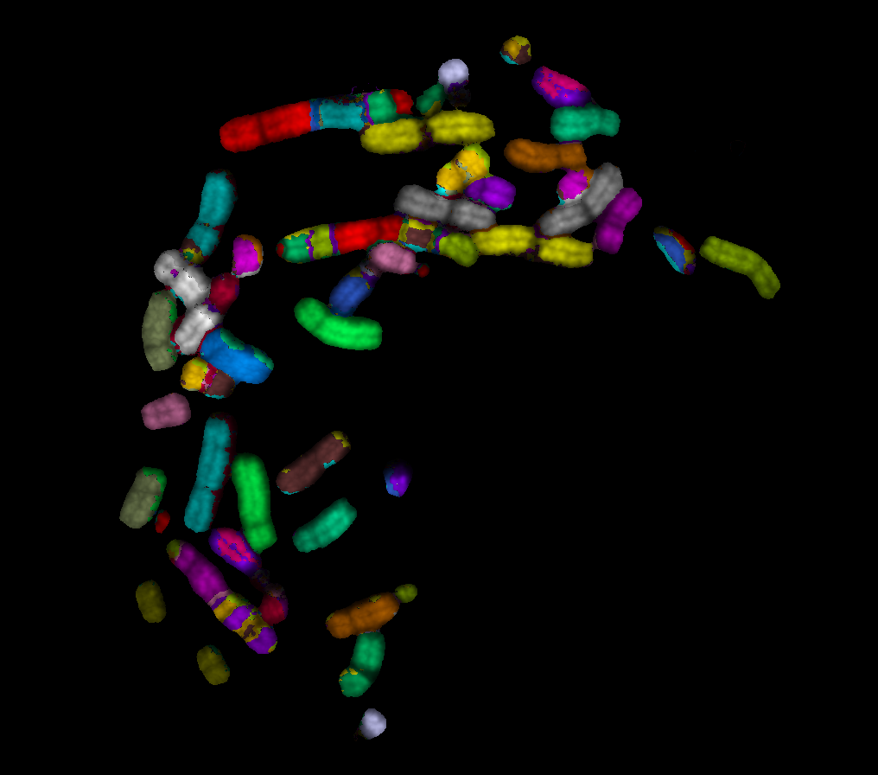

Slide 21
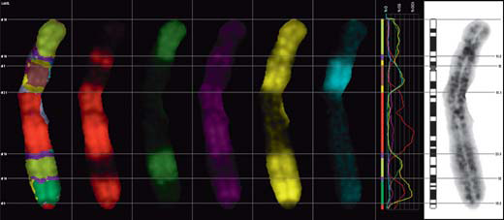
Fig. 5. Profile of a multitranslocated chromosome comprising material from chromosomes 5, 6, 7 and 9.

Slide 22
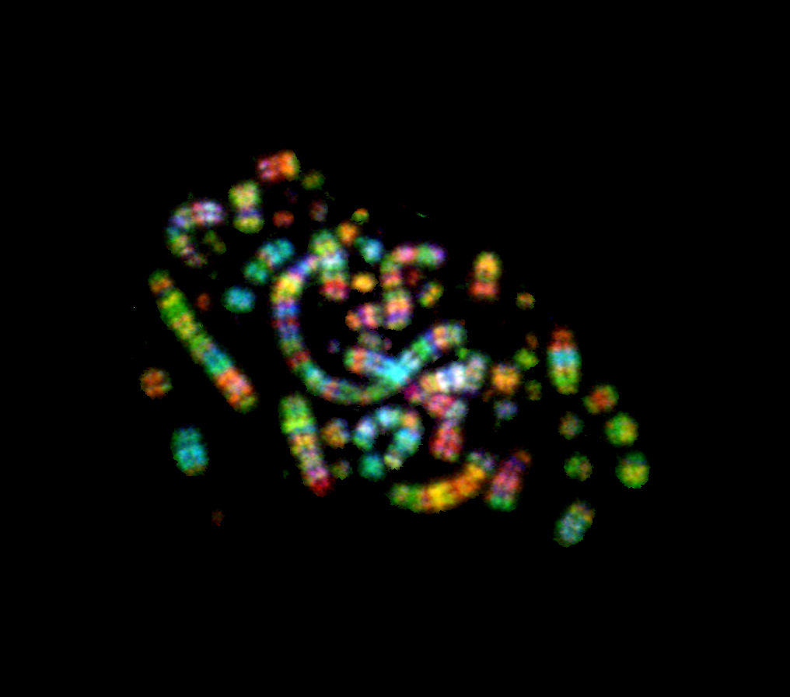

Slide 23
OVERALL RESULT OF mFISH ASSAY
From a total of 9,360 cells scored in the veterans, 226 cells were observed with one or more translocations.
A total of 275 translocations were recorded.
From a total of 9,548 cells scored in the controls, 88 cells were observed with one or more translocations.
A total of 96 translocations were recorded.
A highly significant increase in the number of translocations per 1,000 cells in the veterans
(mean = 29.38) compared to the controls (mean = 10.05),
W = 385, P less than 0.0001

Slide 24

Conclusion
New Zealand naval personnel who participated
in Operation Grapple have incurred long term
genetic damage as shown by the mFISH assay

