Slide 1
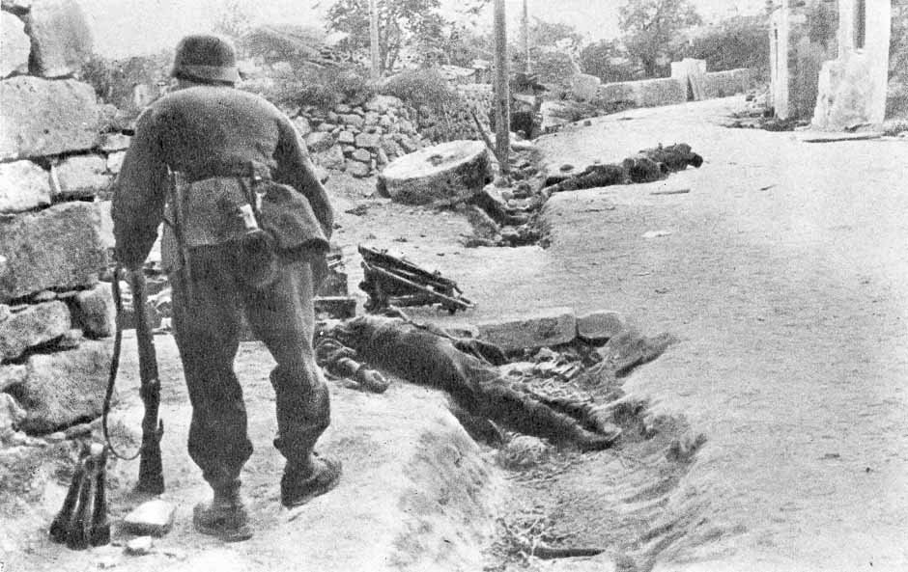
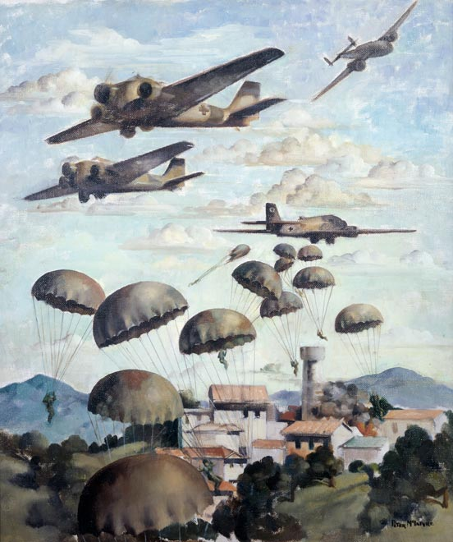
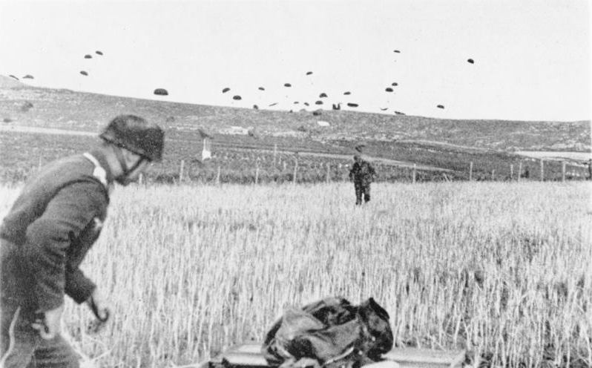
The Knife Edge – The Battle of Crete 1941

Slide 2
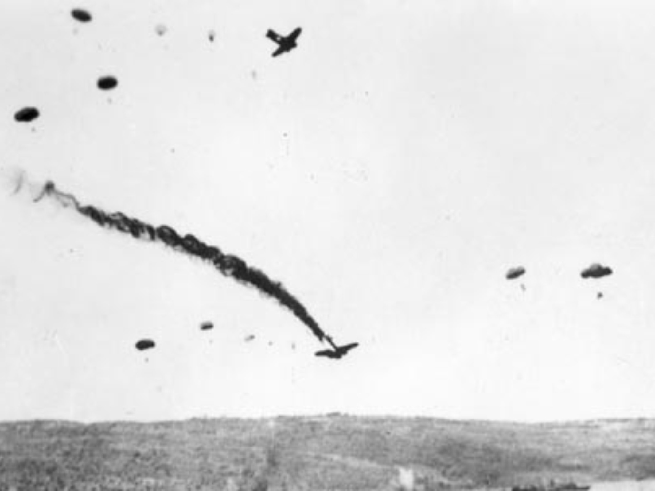
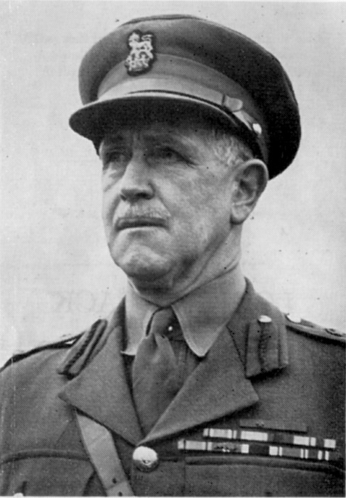
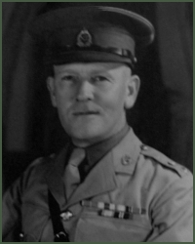
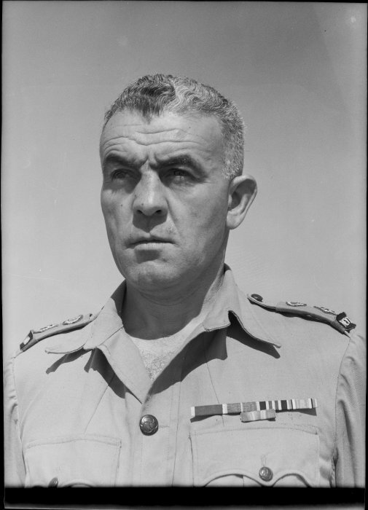
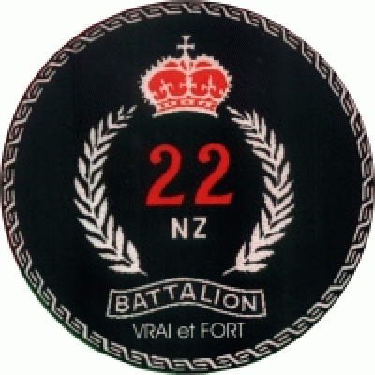
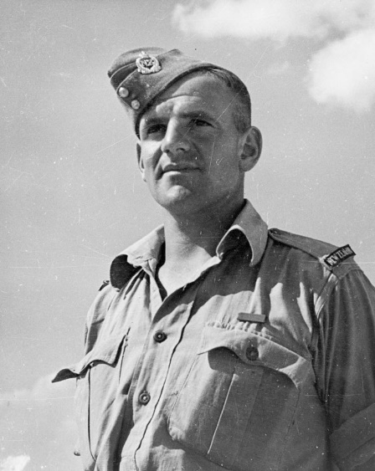
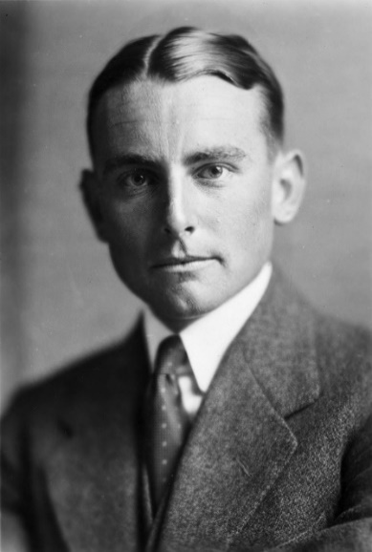
Manawatu and Crete 1941

Slide 3
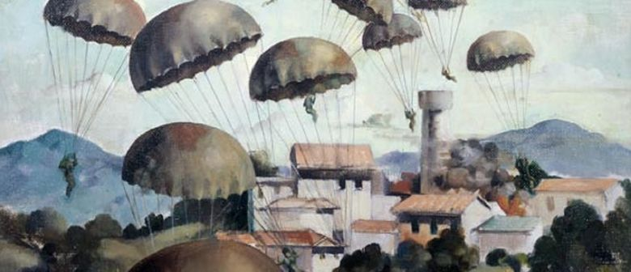
Crete May 1942 – the Knife Edge

Slide 4
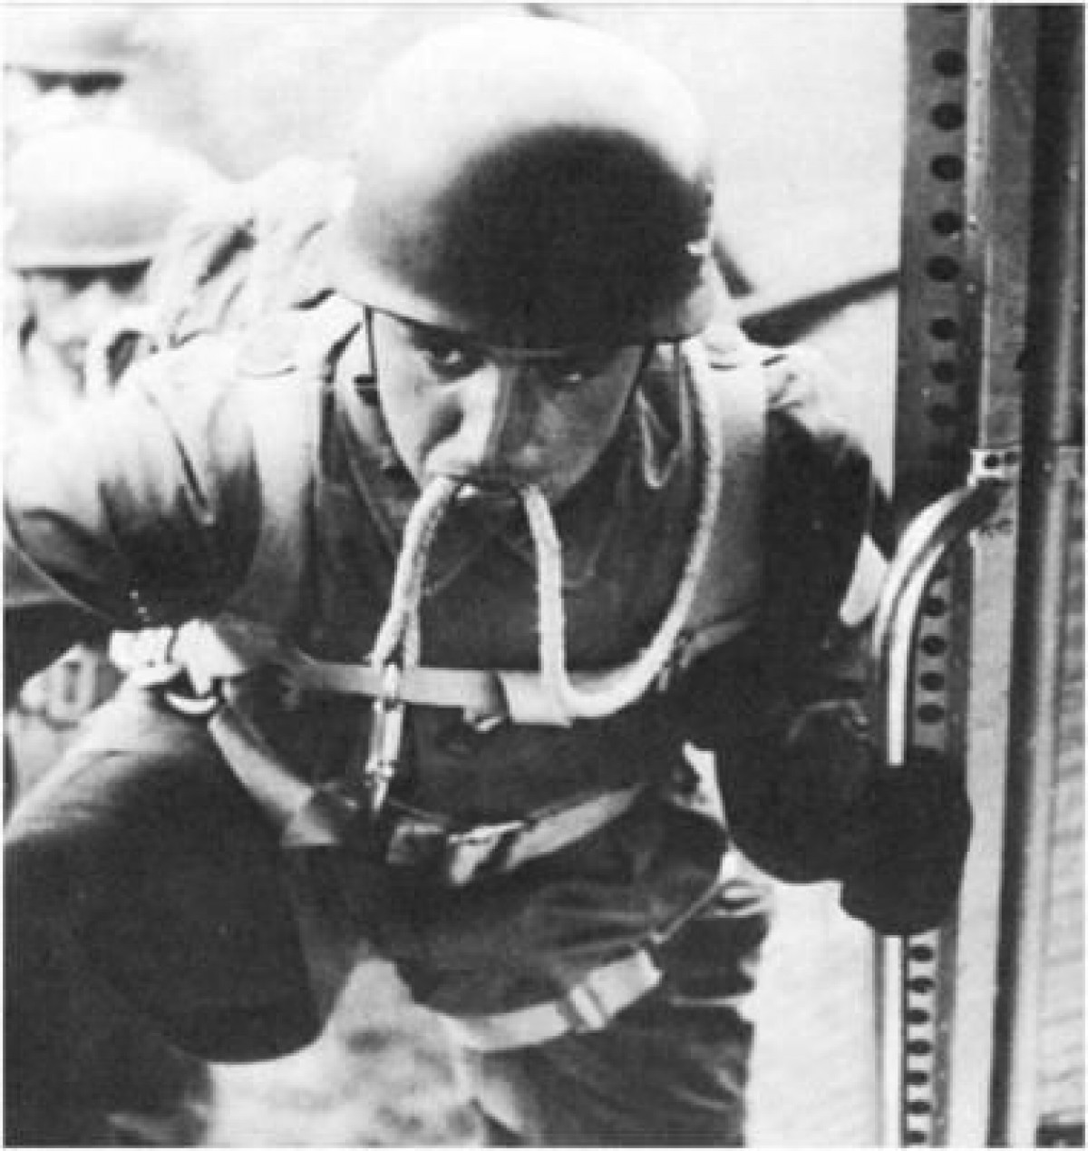
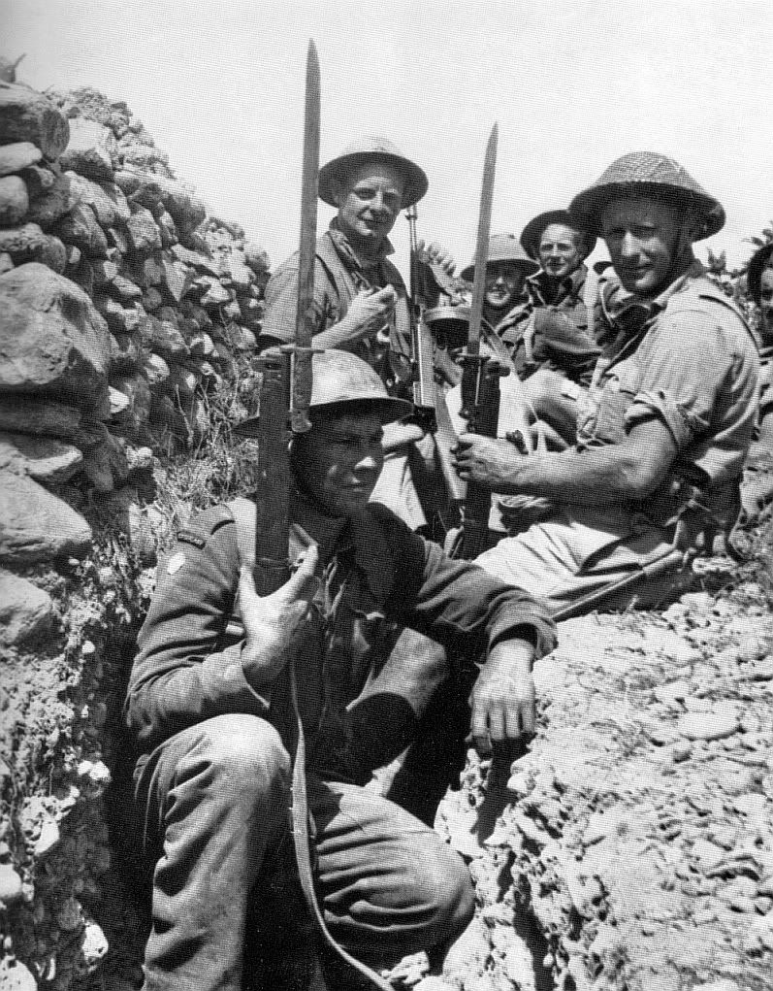
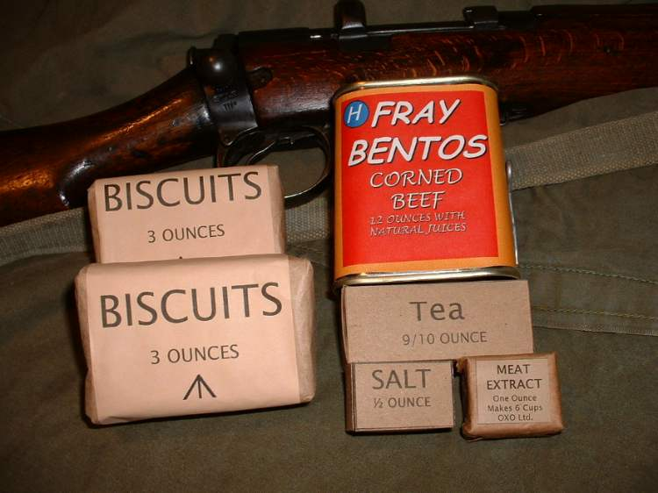
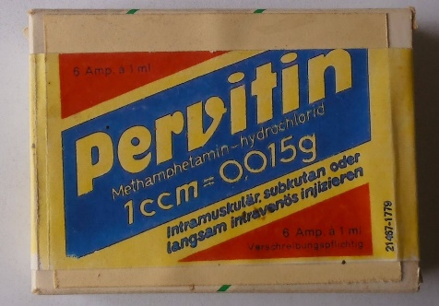
Irresistible Force versus Immoveable Object

Slide 5
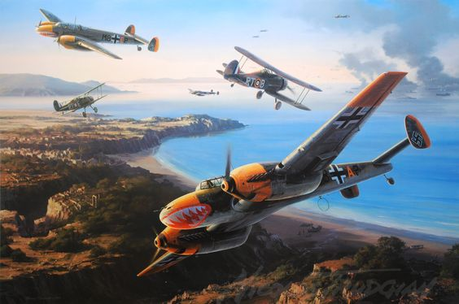
Me 110 Zerstörern versus Gloster Gladiators

Slide 6
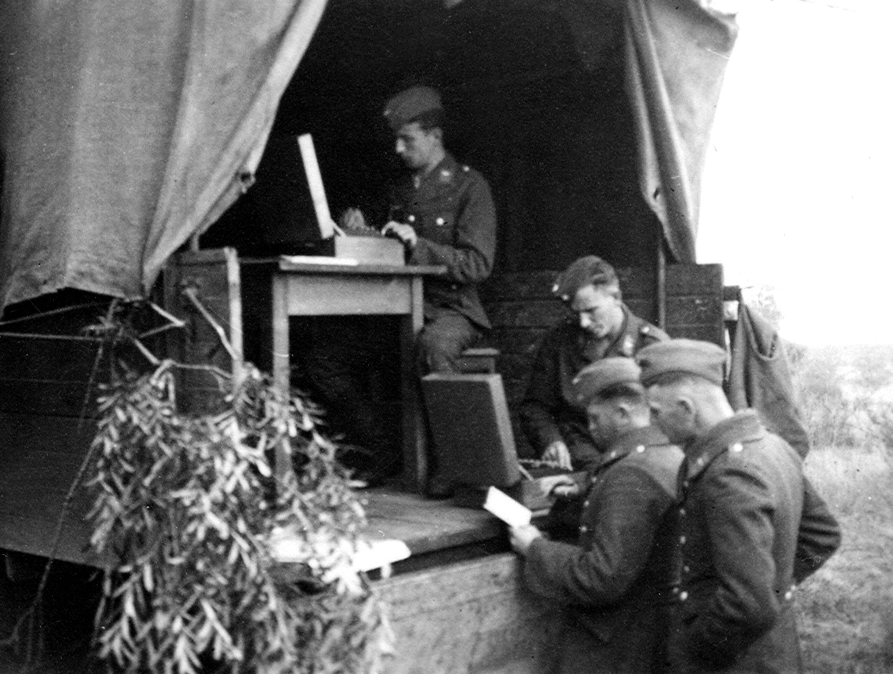
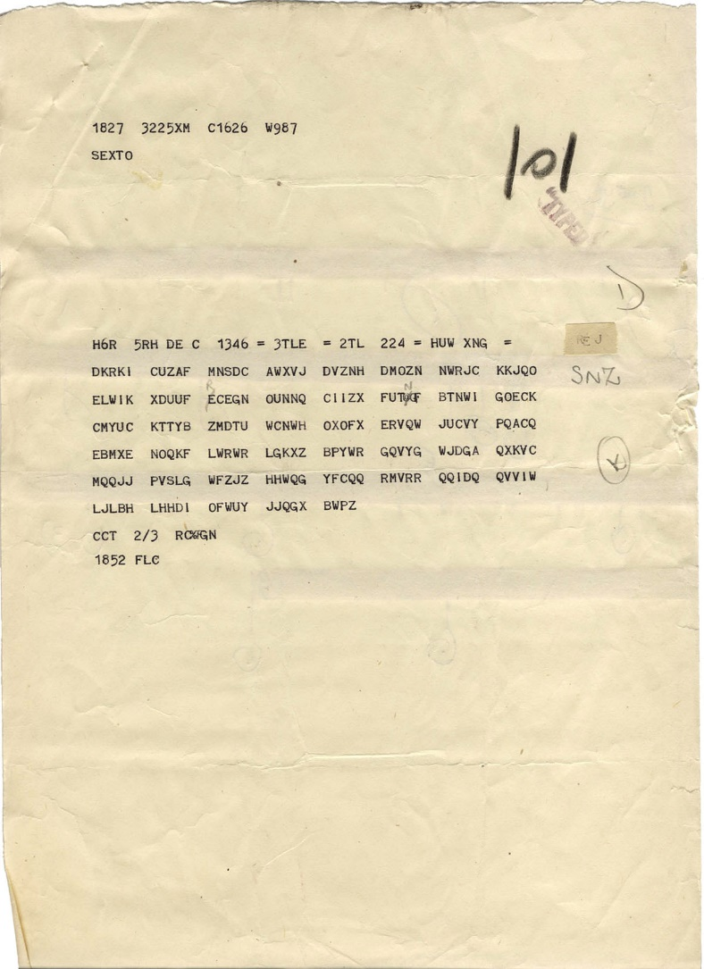
Enigma and Ultra

Slide 7
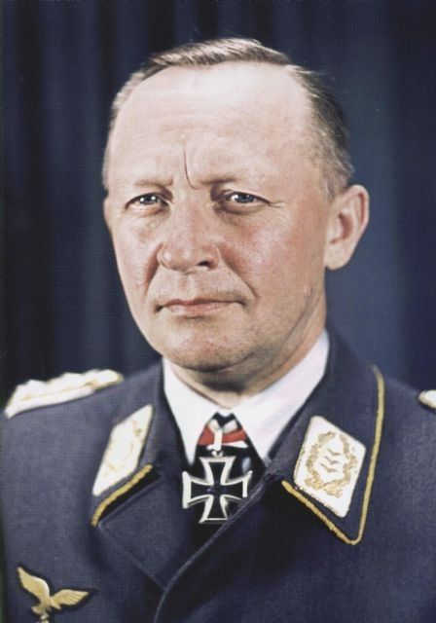
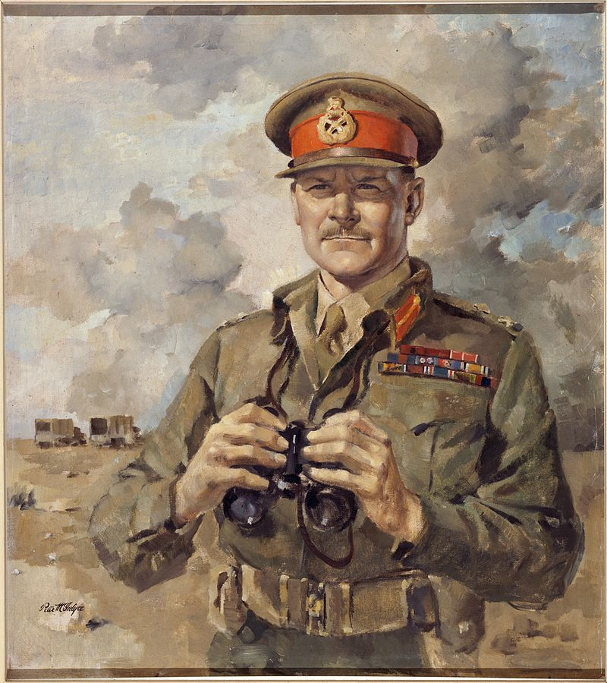
Kurt Student
Bernard Freyberg

Slide 8
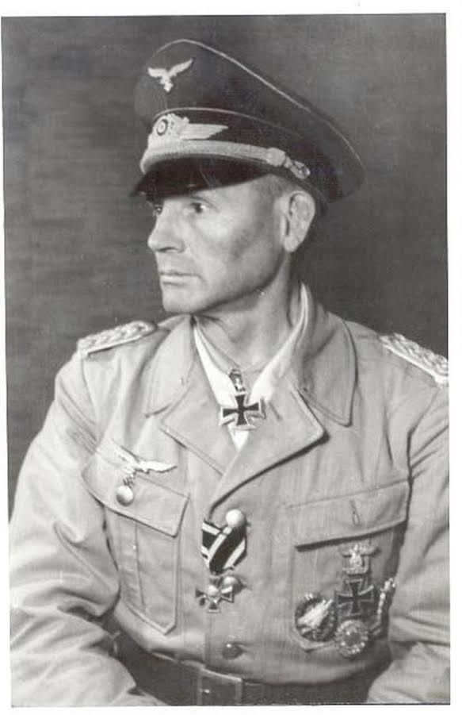
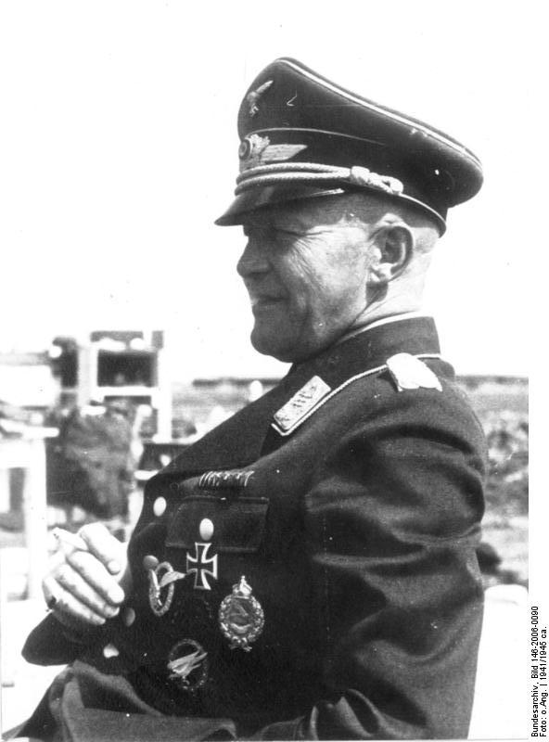
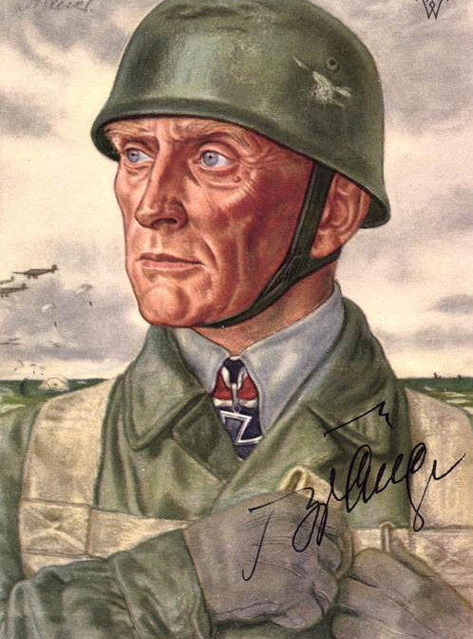
Hermann-Bernard Ramcke
Alfred Sturm
Bruno Brauer

Slide 9
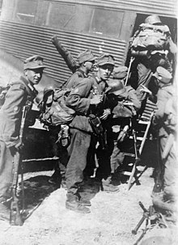
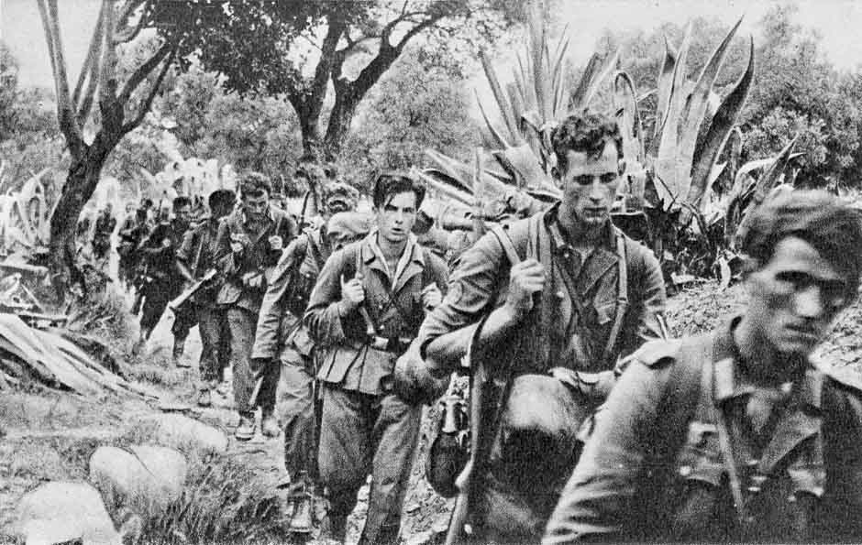
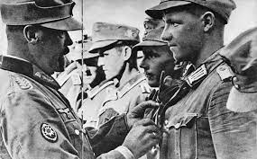

Julius Ringel
‘Sweat Saves Blood’

Slide 10
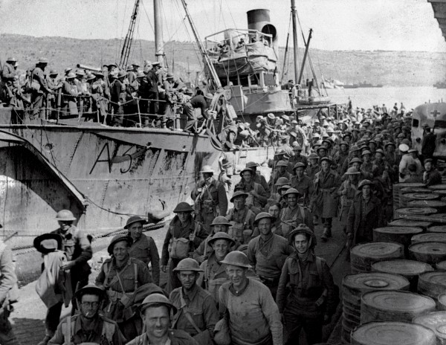
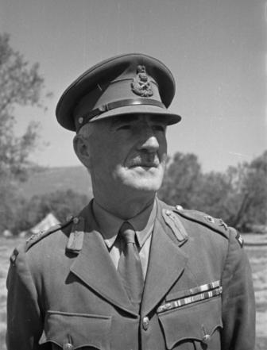

Edward Puttick

Slide 11
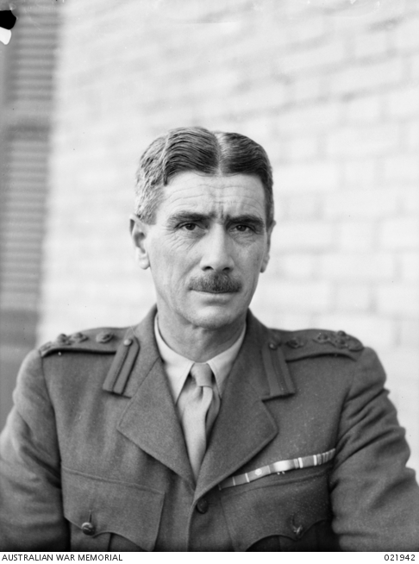
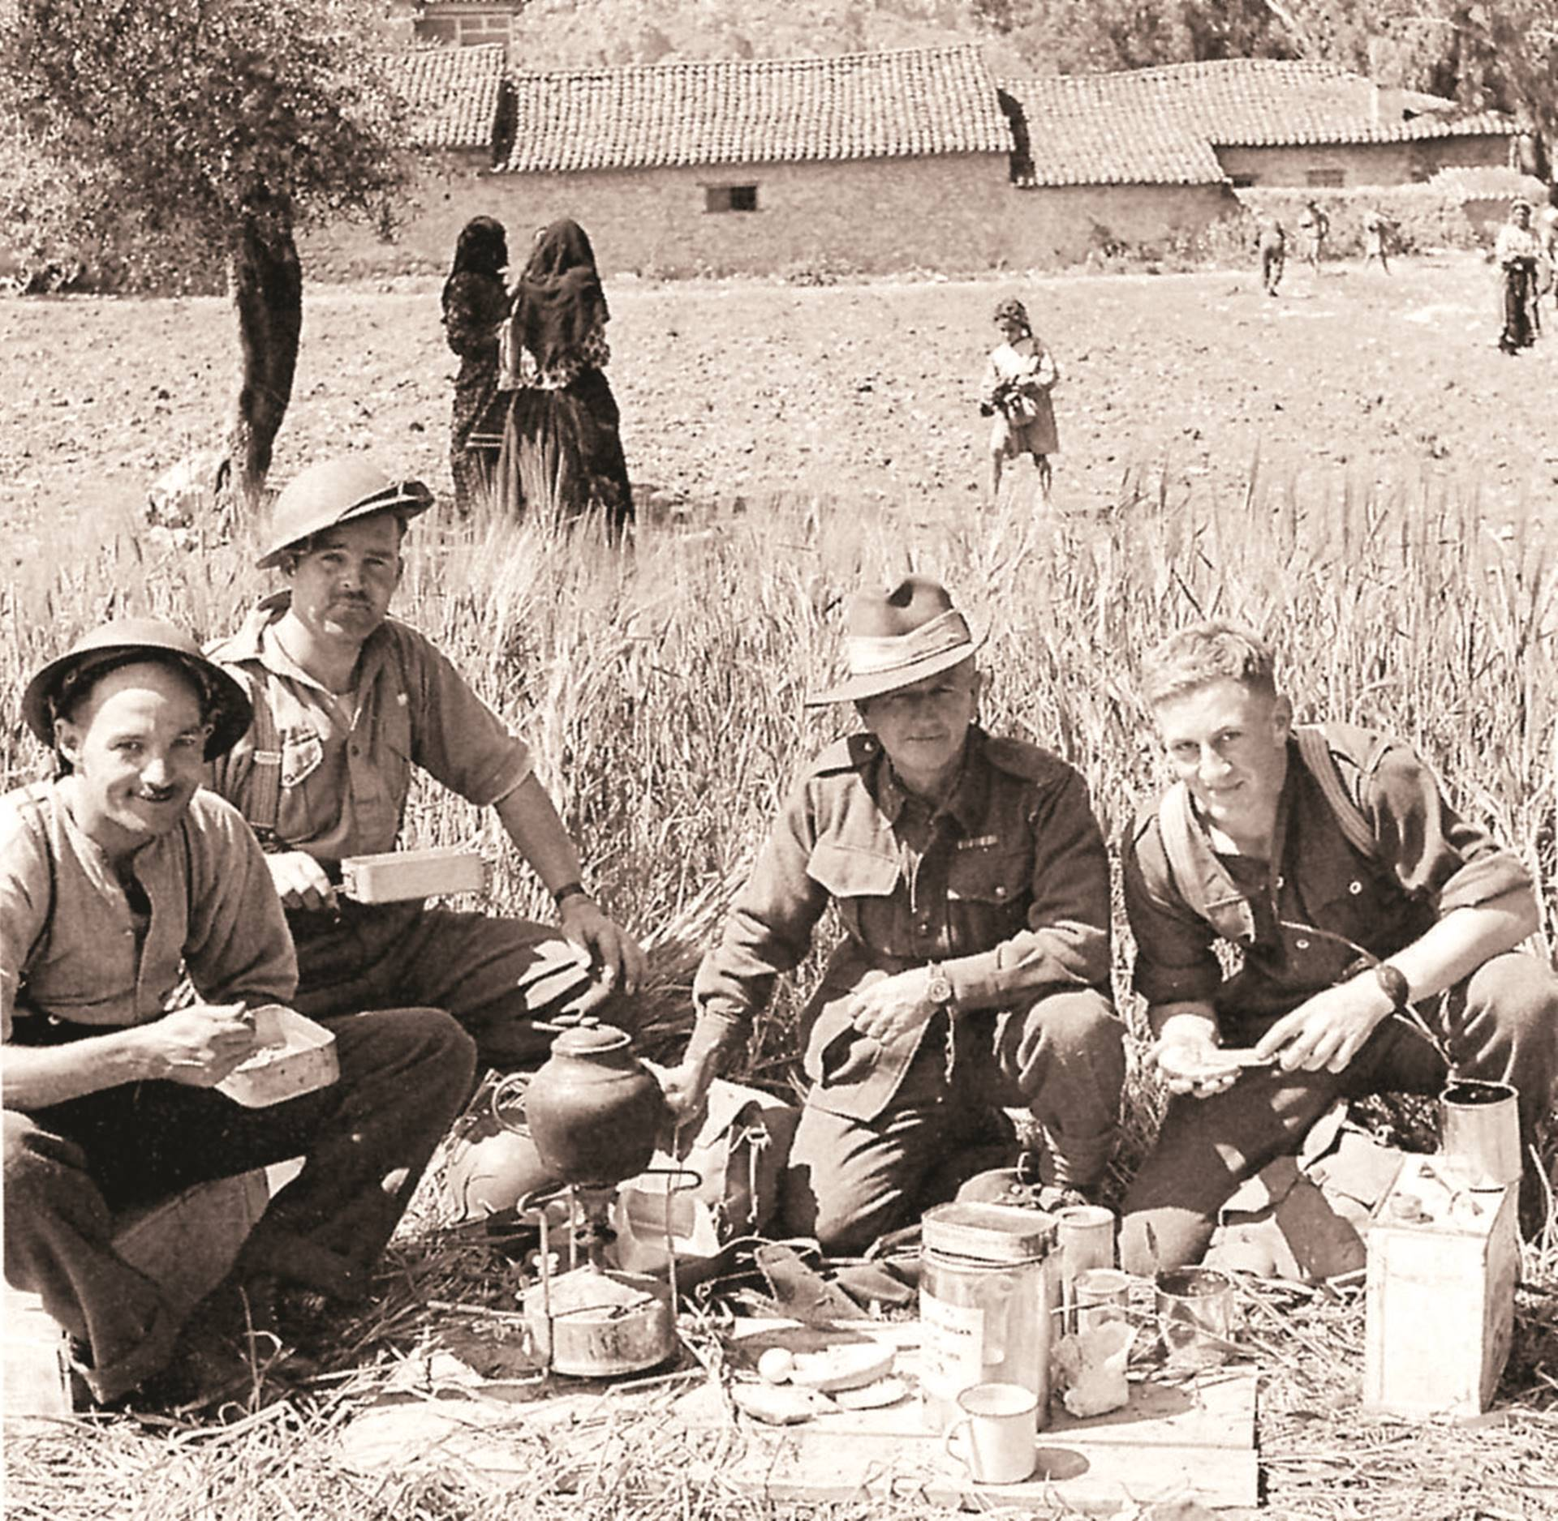
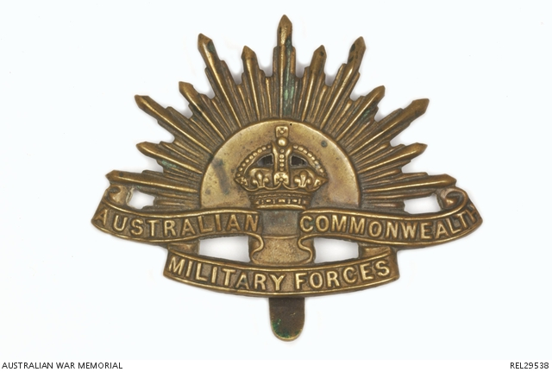
Brigadier George Vasey 19th Infantry Brigade

Slide 12
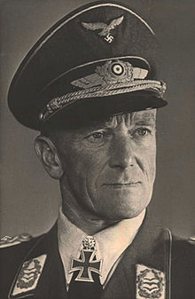
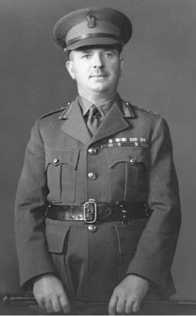
Eugen Meindl
James Hargest

Slide 13
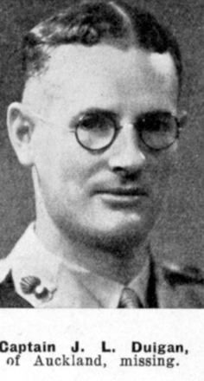
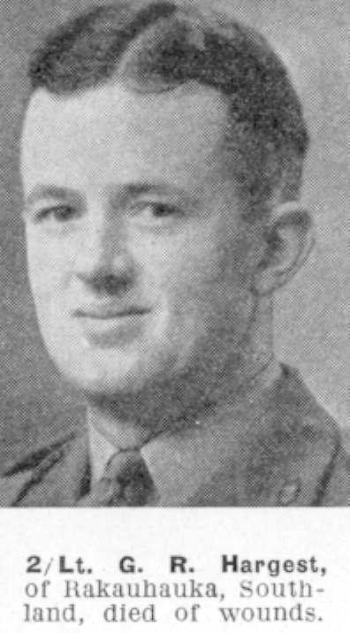
Military Fathers and Sons

Slide 14
Why Crete?

Slide 15
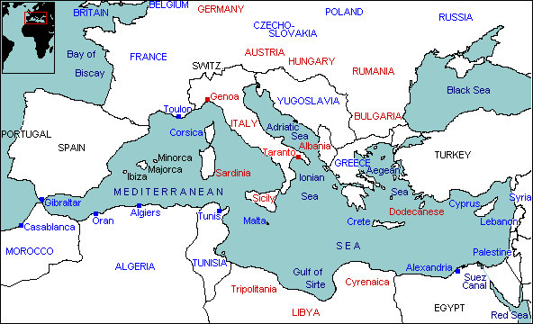

Slide 16

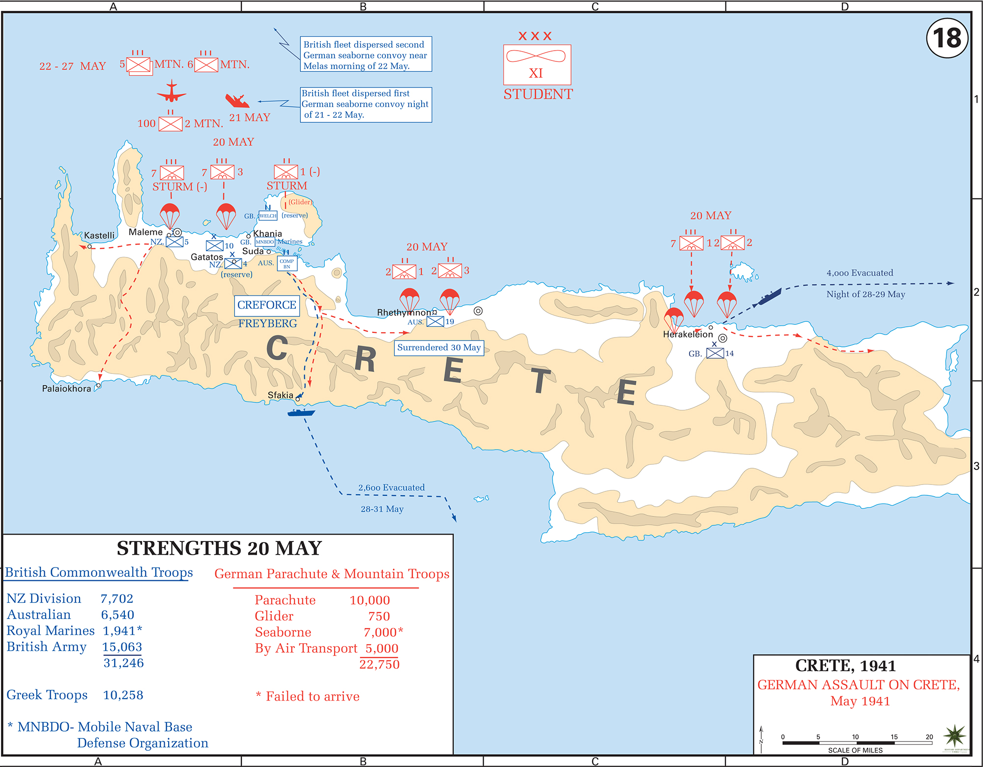

Slide 17
Battle Plans

Slide 18
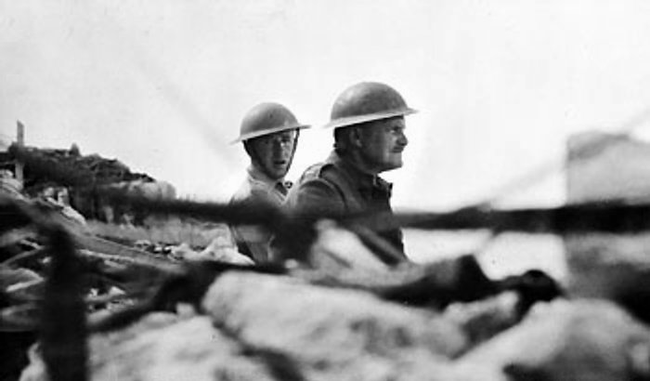
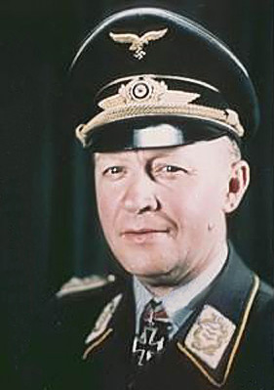
Freyberg - Akrotiri
Student - Athens

Slide 19
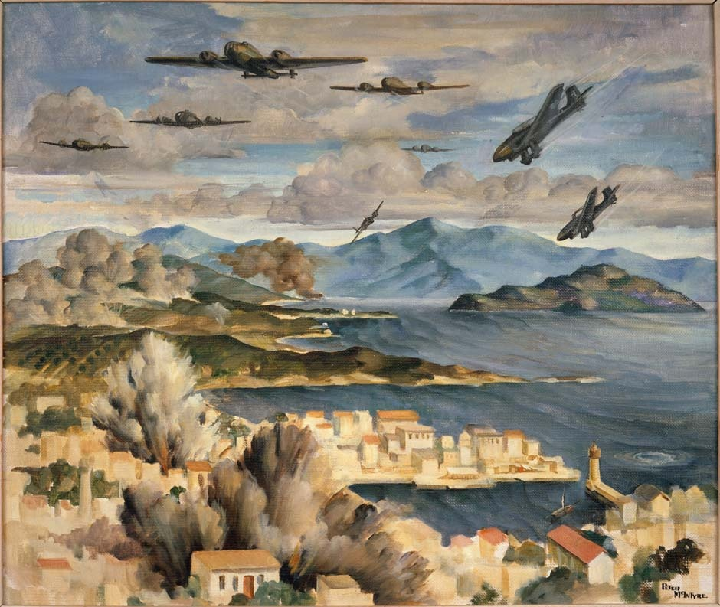

Slide 20
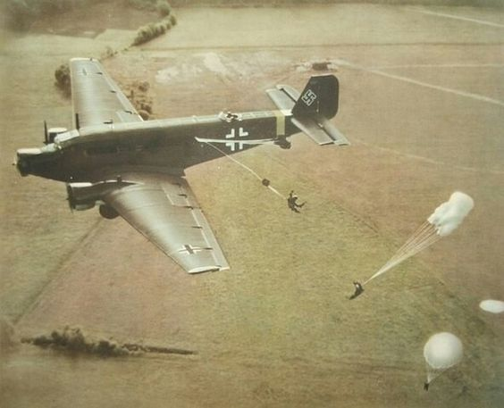
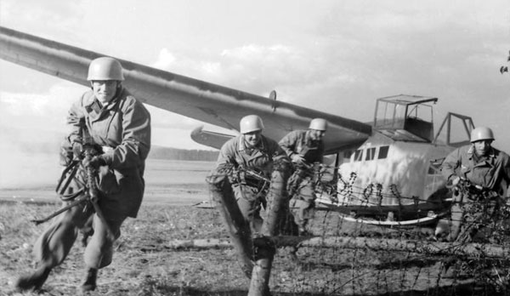
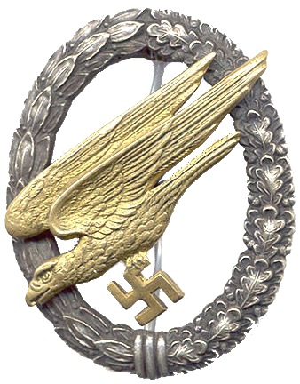
Ju52/3m Transport – ‘Tante Ju or Iron Annie
Crew – 2
Up to 13 troops
Weapons carried in containers
on the external bomb racks
DFS 230 Glider
Crew – 1
Carried 9 troops

Slide 21
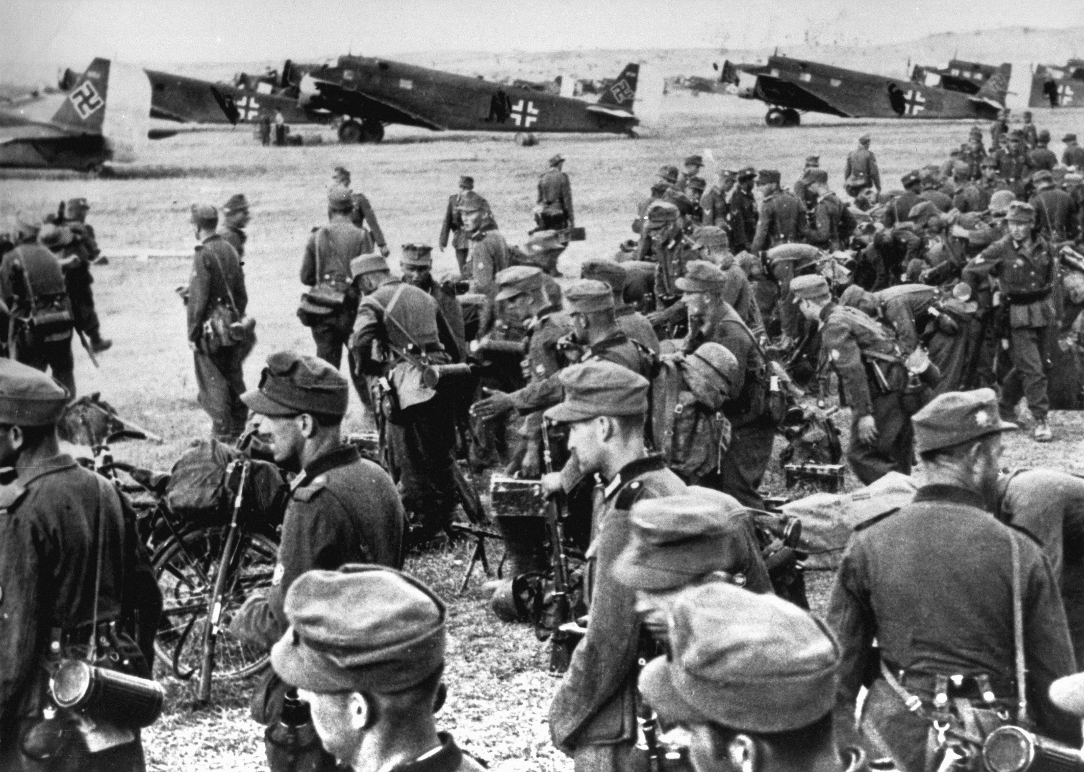

Slide 23
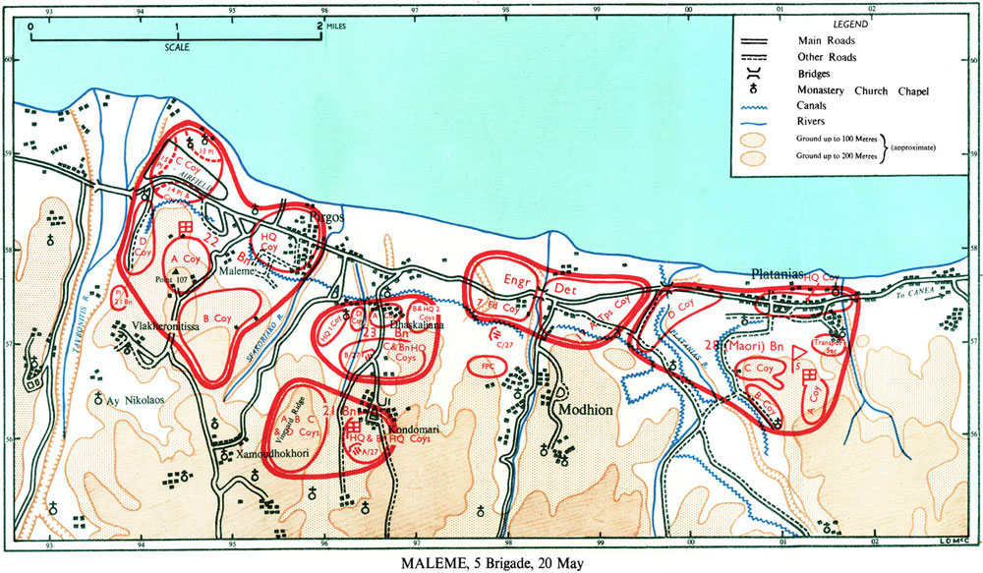

Slide 24
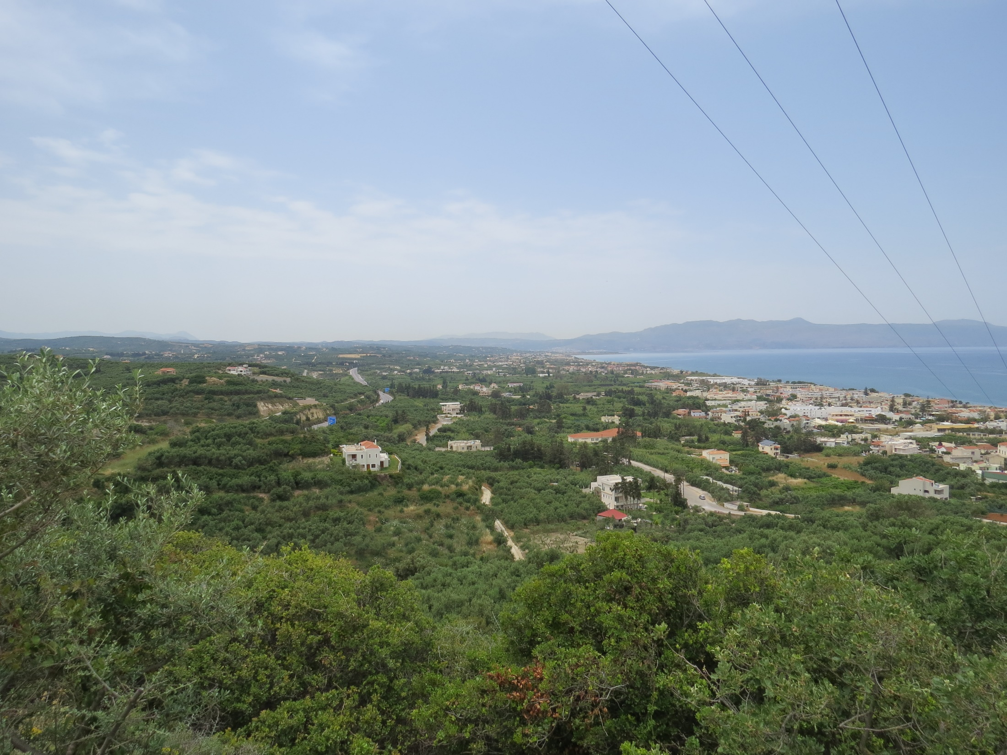

Slide 25
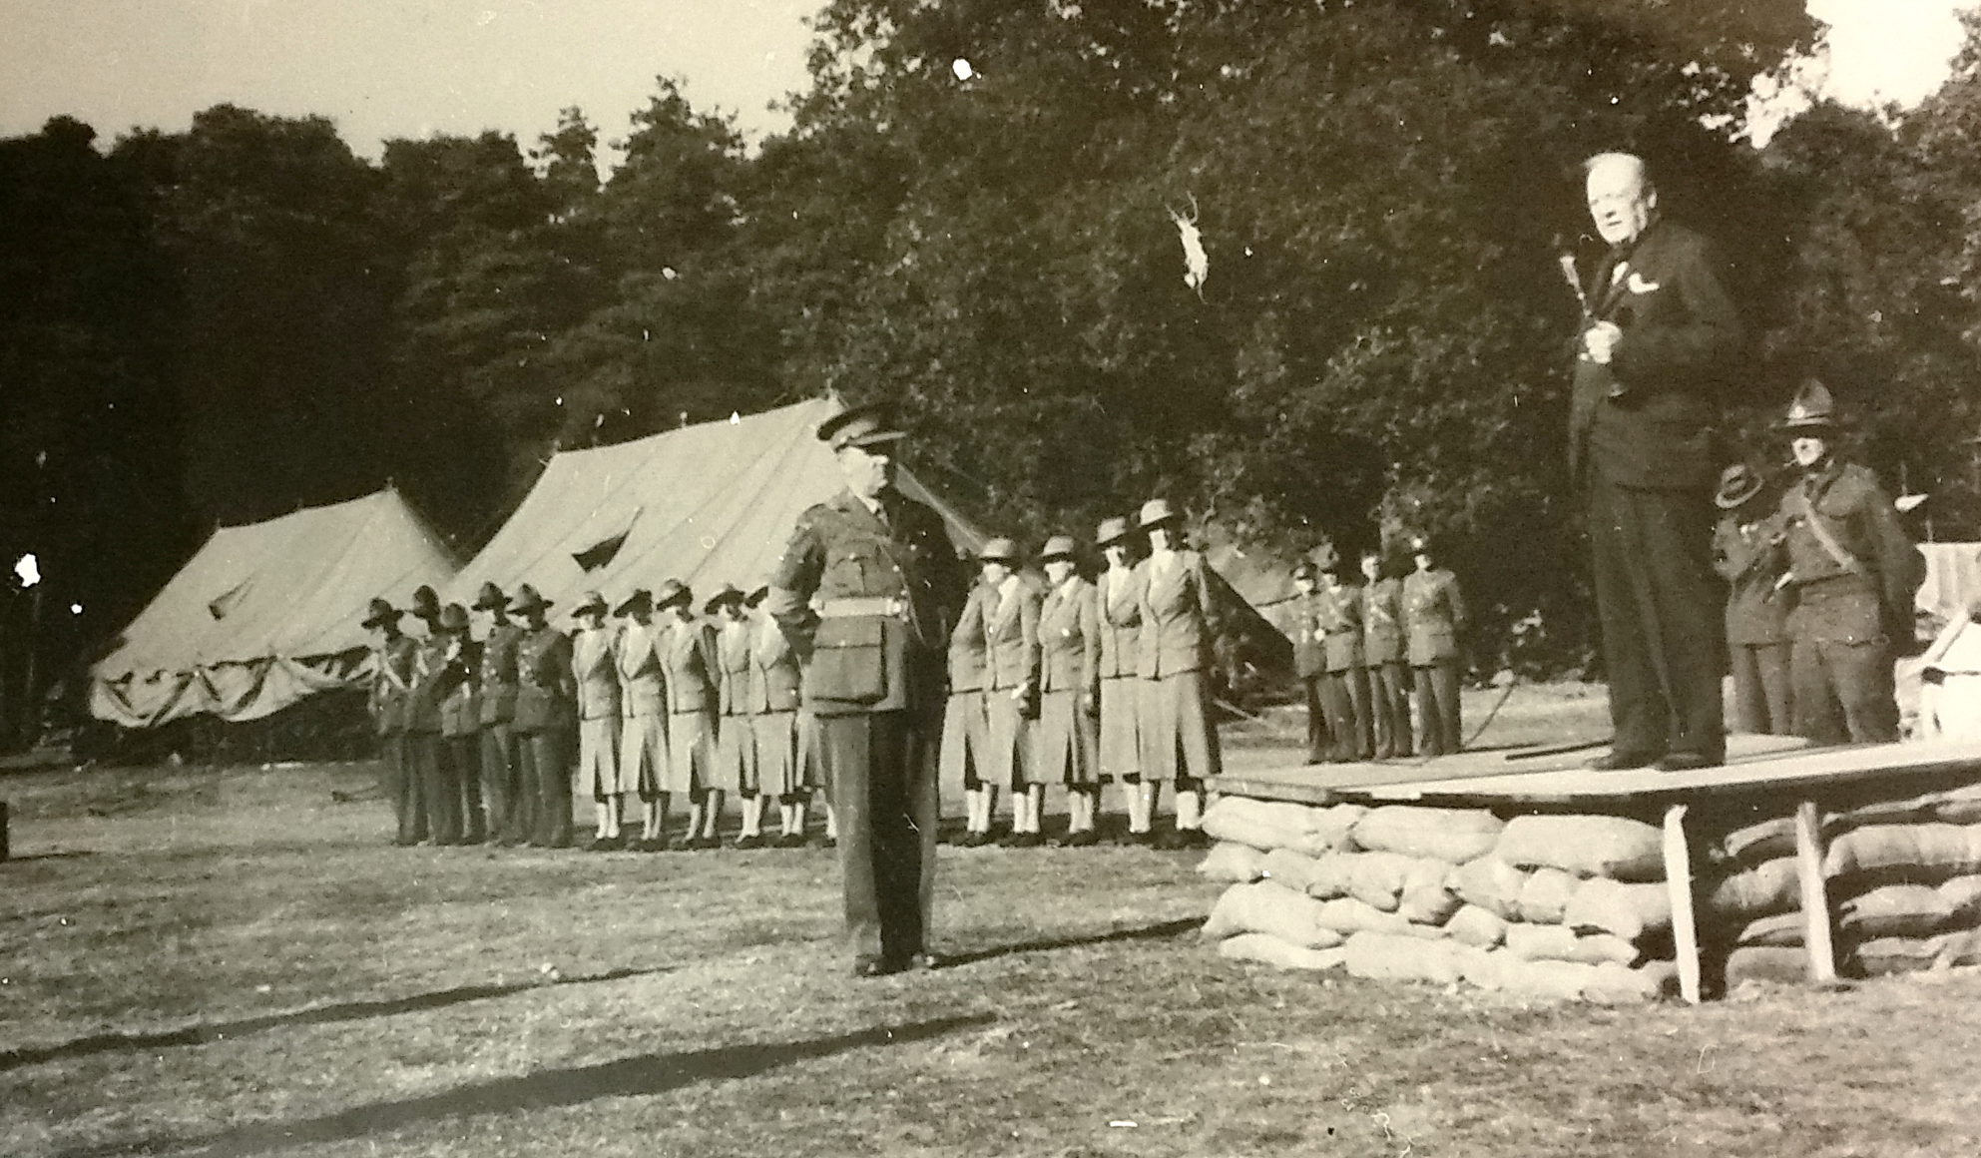
Brigadier James Hargest and 5 NZ Brigade, England, 1940

Slide 26
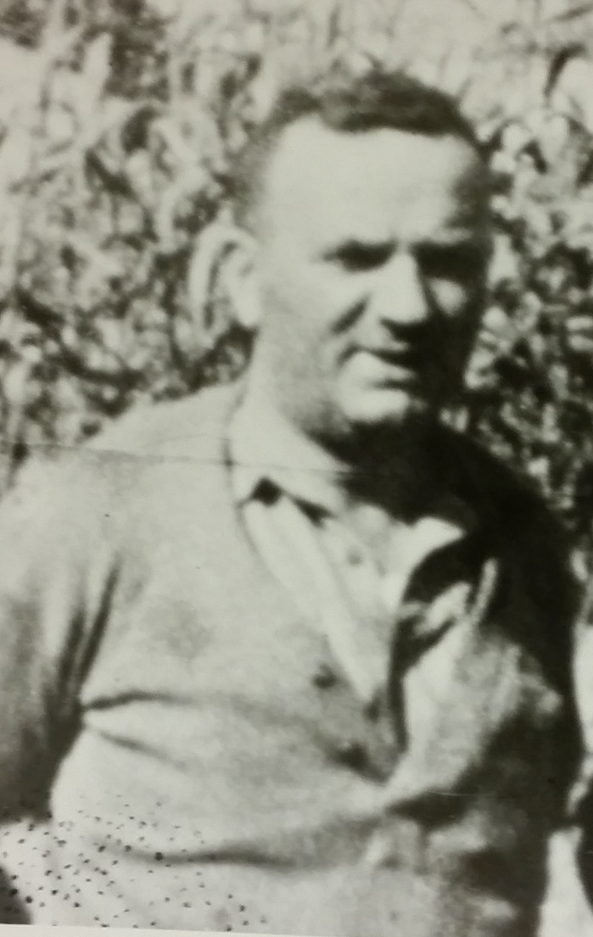
I don’t know what lies ahead.
I know only that it produces in me
a sensation I never knew in the last war.
It is not fear.
It is something quite different,
something I can only describe as dread.
Brigadier James Hargest to Geoffrey Cox
Platanias
19 May 1941

Slide 27
Command

Slide 28
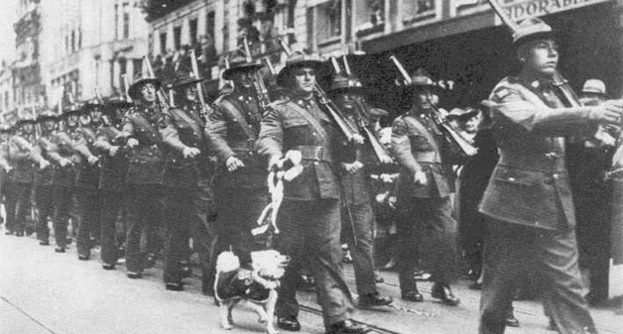
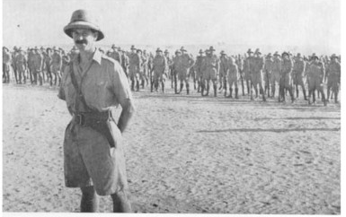


21 Bn
22 Bn
‘Like a mother defending her young’ –
Brigadier James Hargest on the reputation of 5 NZ Brigade, 3 June 1941
23 Bn
28 (Maori)Bn

Slide 29




Andrew – 22 Bn
Leckie 23 Bn
Allen – 21 Bn
Dittmer 28 (Maori) Bn

Slide 30

5 NZ Brigade Headquarters, Platanias, May 1940

Slide 31

Hargest - Platanias
Puttick - Chania

Slide 33
Control

Slide 35

22 Battalion
Royal Air Force
Royal Marines
Hill 107/Kavkaszia Hill
May 1941

Slide 36


Slide 37

Tavronitis Bridge 1941 – DFS 230 Glider

Slide 38
Communicate

Slide 39



Wireless Set No 18

Slide 40




Slide 41
Battle for Crete

Slide 43




Slide 44






Slide 45



Slide 46




Slide 47



42nd Street

Slide 48



Slide 49


Hora Sfakion

Slide 51
Crete in retrospect

Slide 52

‘The memory of two days ago will never leave me this side of the grave – its heroism, its fearful tragedy.’
Brigadier James Hargest, letter to his wife Marie 2 June 1941

Slide 53





Slide 54

Σ' ευχαριστώ!

