Slide 1
Military History of Palmerston North
Leanne Hickman

Slide 3
Manawatu Mounted Rifles C.1900

Slide 4
Wellington Engineers at Military Tournament c. 1908

Slide 5
Major General Sir Edward Chaytor

Slide 8
New Zealand Medical Corps
Back row: Captain Grant, Captain Simpson, Captain Harvey, Lieutenant Finlayson, Captain Venables;
Front row: Major Guthrie, Lieut.-Colonel Hardie Nell and Major A.A. Martin.
The last-named, who was a well-known member of the medical profession in Palmerston North before going overseas, died of wounds during the Battle of the Somme when treating wounded soldiers close to the firing line

Slide 11
Doctors and staff of the NZMC with volunteer nurses and Boy Scouts who assisted caring for patients at the Soldiers’ Club temporary hospital

Slide 14
Military group at the Showgrounds Mid-1940s.

Slide 15
28th (Maori) Battalion
Palmerston North
A&P Showgrounds

Slide 16
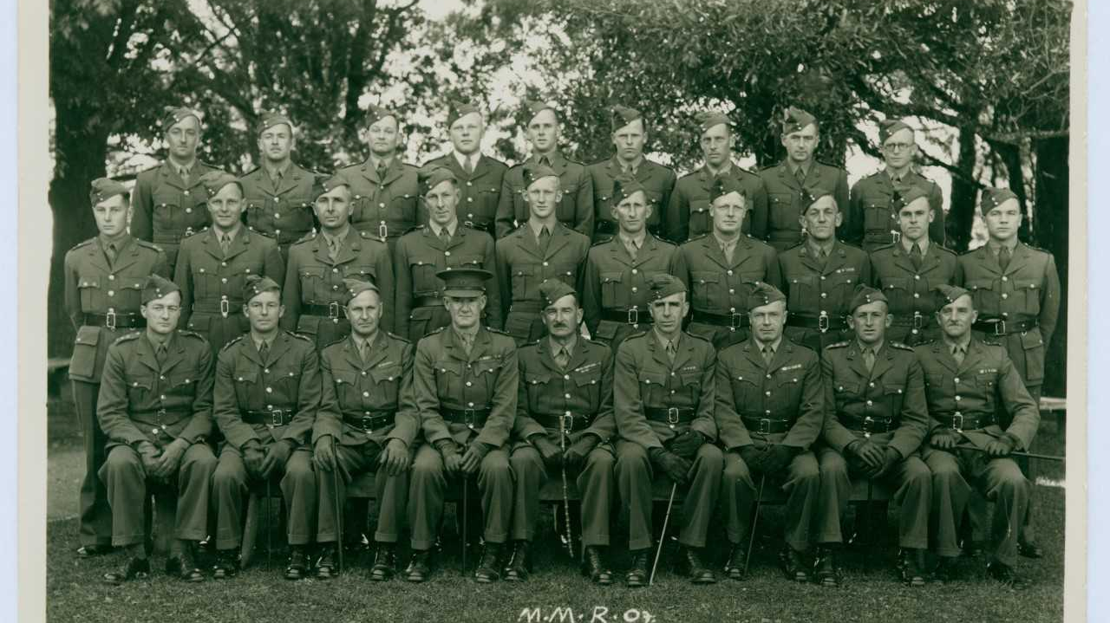

Slide 17
Million Pound loss in Palmerston North military store, Showgrounds

