Slide 1
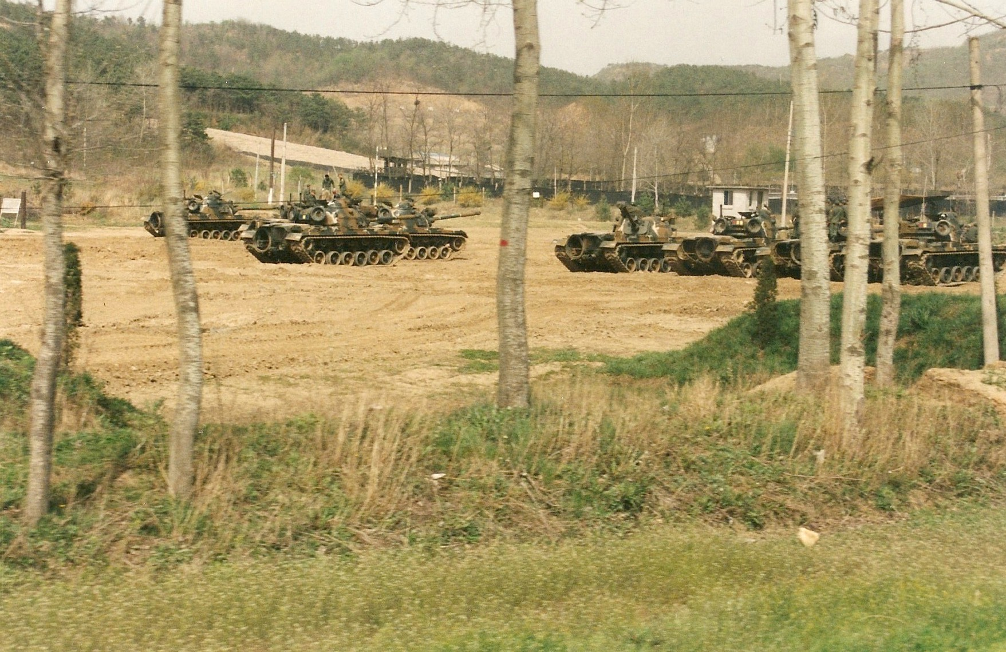
Korea: Perspectives on a 70-year War

Slide 2
70th ANNIVERSARY
70th anniversary of the outbreak of the Korean War on 25 June
* Why did it happen?
* What was its course?
* What was its outcome?
The state of the war today (based on my trip to Korea in April last year). 47th anniversary of the armistice on 27 July but still no peace settlement

Slide 3
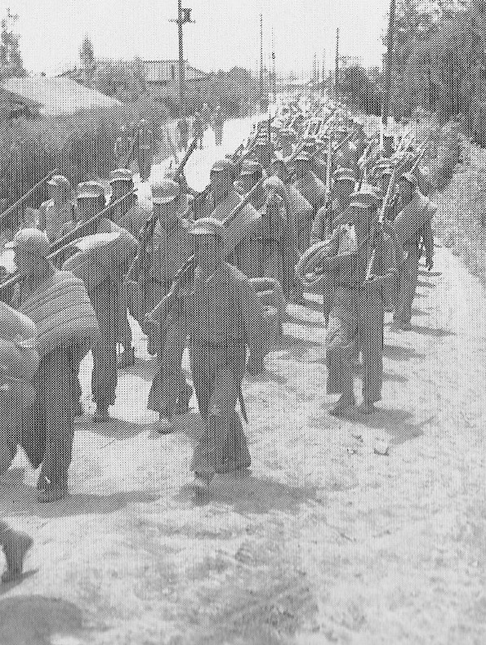
A TALE OF THREE ATTEMPTS
The Korean War comprised three attempts to unify the peninsula by force:
North Korean
United States
Chinese
The conflict began as a war between two small states and ended as a proxy contest between two great powers.

Slide 4
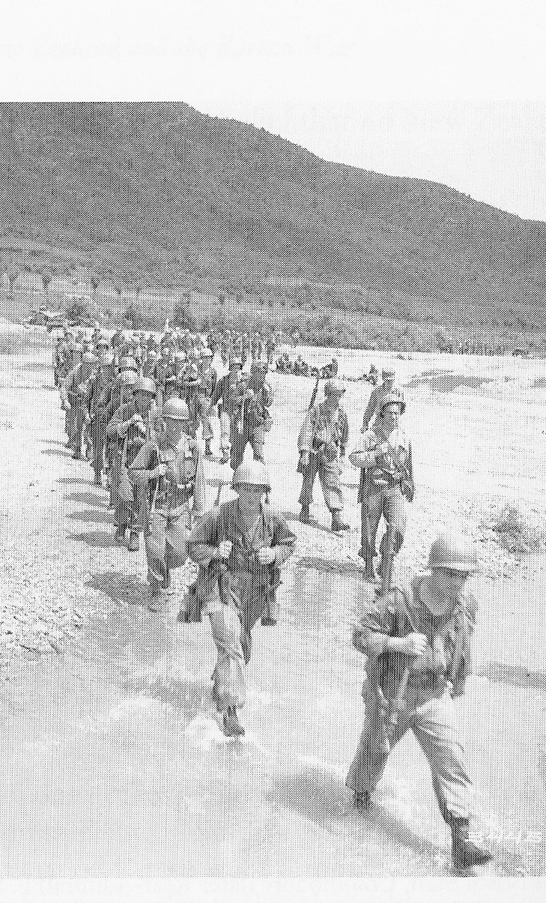
WHY WAS THERE A WAR IN KOREA?
The outbreak of war in 1950 arose from three fundamental causes:
Arrangements made at the end of the Second World War
Decolonisation
The Cold War

Slide 5
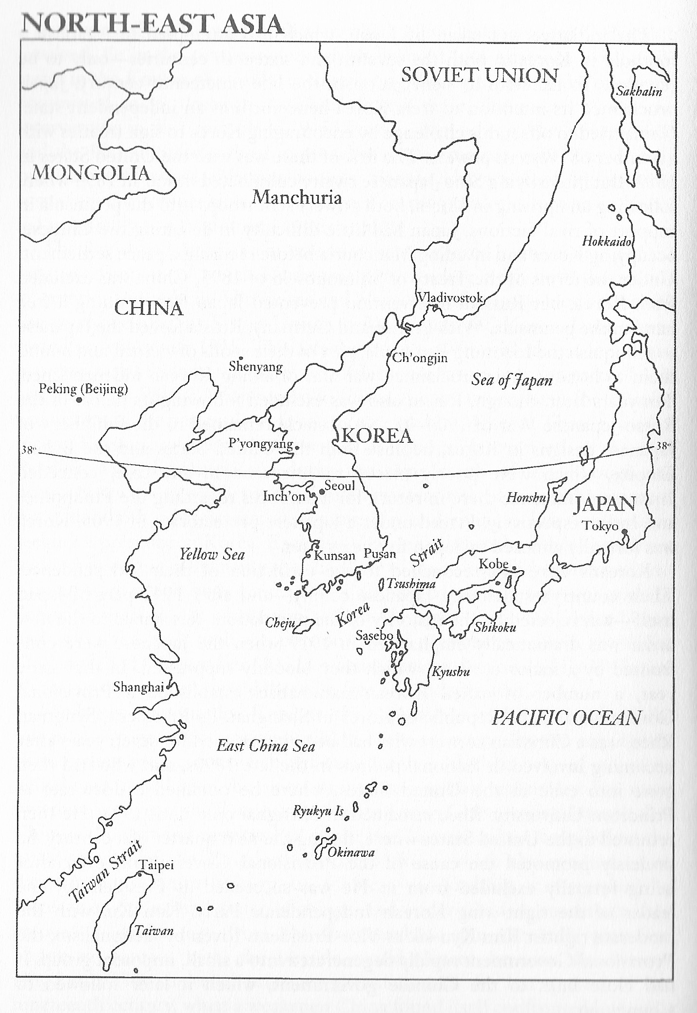
END OF WAR ARRANGEMENTS
Korea a Japanese colony from 1910-45
Japanese defeated on 14 August 1945
Agreement by Russians and Americans to their joint occupation of the peninsula to disarm and repatriate Japanese troops there
Soviet Union agreed to stop its advance into Korea from the north at the 38th Parallel. Soviet hopes of getting a footing in the Japanese islands as part of the occupation there)
US troops occupied the peninsula south of the 38th Parallel
The 38th Parallel was a line on the map.

Slide 6
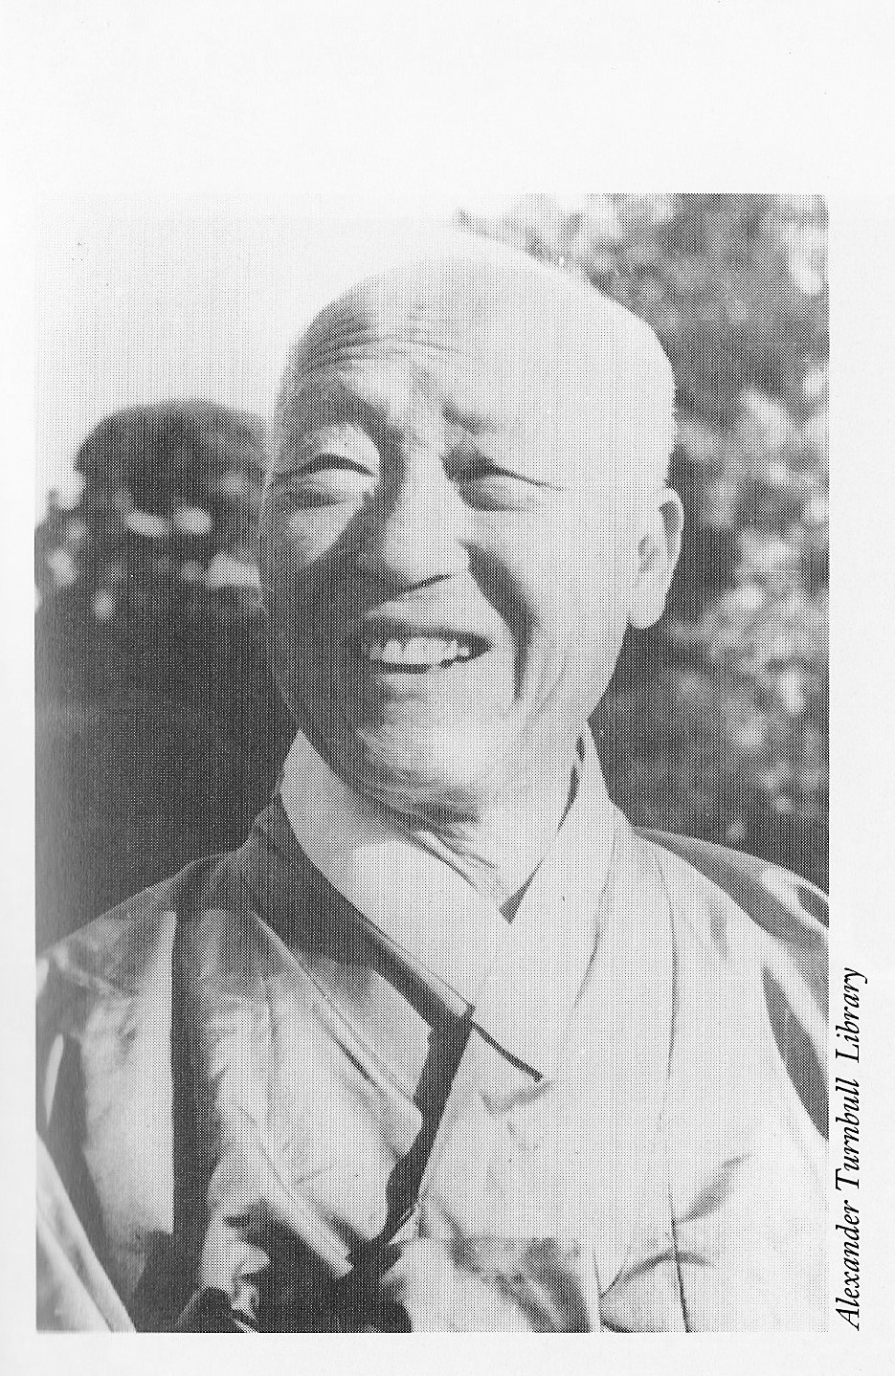
DECOLONISATION
Korean nationalism: desire to be independent
Anti-Japanese efforts
Kim Il-sung, shadowy background, but appeared in Korea with Soviet armies. Claimed to have fought the Japanese
Other Koreans in the south with anti-Japanese credentials, and also an expatriate, Syngman Rhee
Demands to be able to set up own state. Opposition to being placed under the UN trusteeship arrangements agreed at the San Francisco Conference (antagonism to being placed on same level as African colonies)

Slide 7
COLD WAR
Cold War ensured division
No agreement on unification
US and Soviets established administrations in their zones. North Korea was led by Kim, South Korea by Rhee
Two antagonistic regimes were brought into existence, both claiming jurisdiction over the whole of the peninsula
Uneasy stalemate. Many clashes
Belief that both were restrained by their respective mentors reduced the fears of outright war on the peninsula

Slide 8
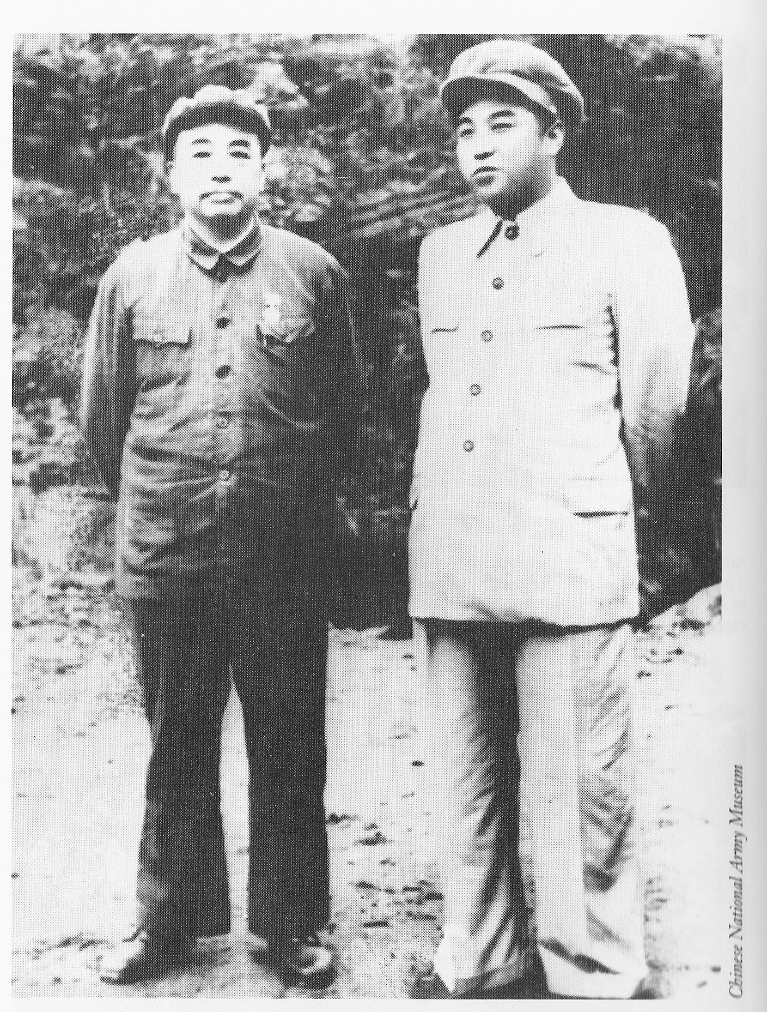
DECISION FOR WAR
Kim Il Sung’s determination to reunify Korea (time seemed right: Soviet atom bomb, People’s Republic)
Agreement of Josef Stalin and Mao Zedong
Communist miscalculation:
* Not expect US reaction (Acheson
speech)
* Belief that US could be presented
with a fait accompli
No truth in assertions at the time that the invasion was a response to a South Korean attack on North Korea (Nazi tactic)

Slide 9
US RESPONSE
US responded immediately both militarily and diplomatically
Forces in Japan rapidly deployed to Korea
Action at the United Nations
* Soviet Union was boycotting over the failure to seat the new
communist regime in Beijing
* Resolutions calling on North Korea to withdraw and then for all
members to assist in defending South Korea
* Formation of the UN Command, delegated to the US
(General Douglas MacArthur as C-in-C)
Diplomatic triumph for the United States

Slide 11
NEW ZEALAND’s RESPONSE
Sixteen members agreed to send forces to Korea
New Zealand decided to send two frigates on 28 June (left on 3 July)
New Zealand offered a 1000-strong ground force on 26 July (Kayforce left on 10 December)
Importance of British decisions to New Zealand’s response
Frigates became part of a British frigate squadron and the ground force (mainly an artillery regiment) became part of a British Commonwealth brigade

Slide 13
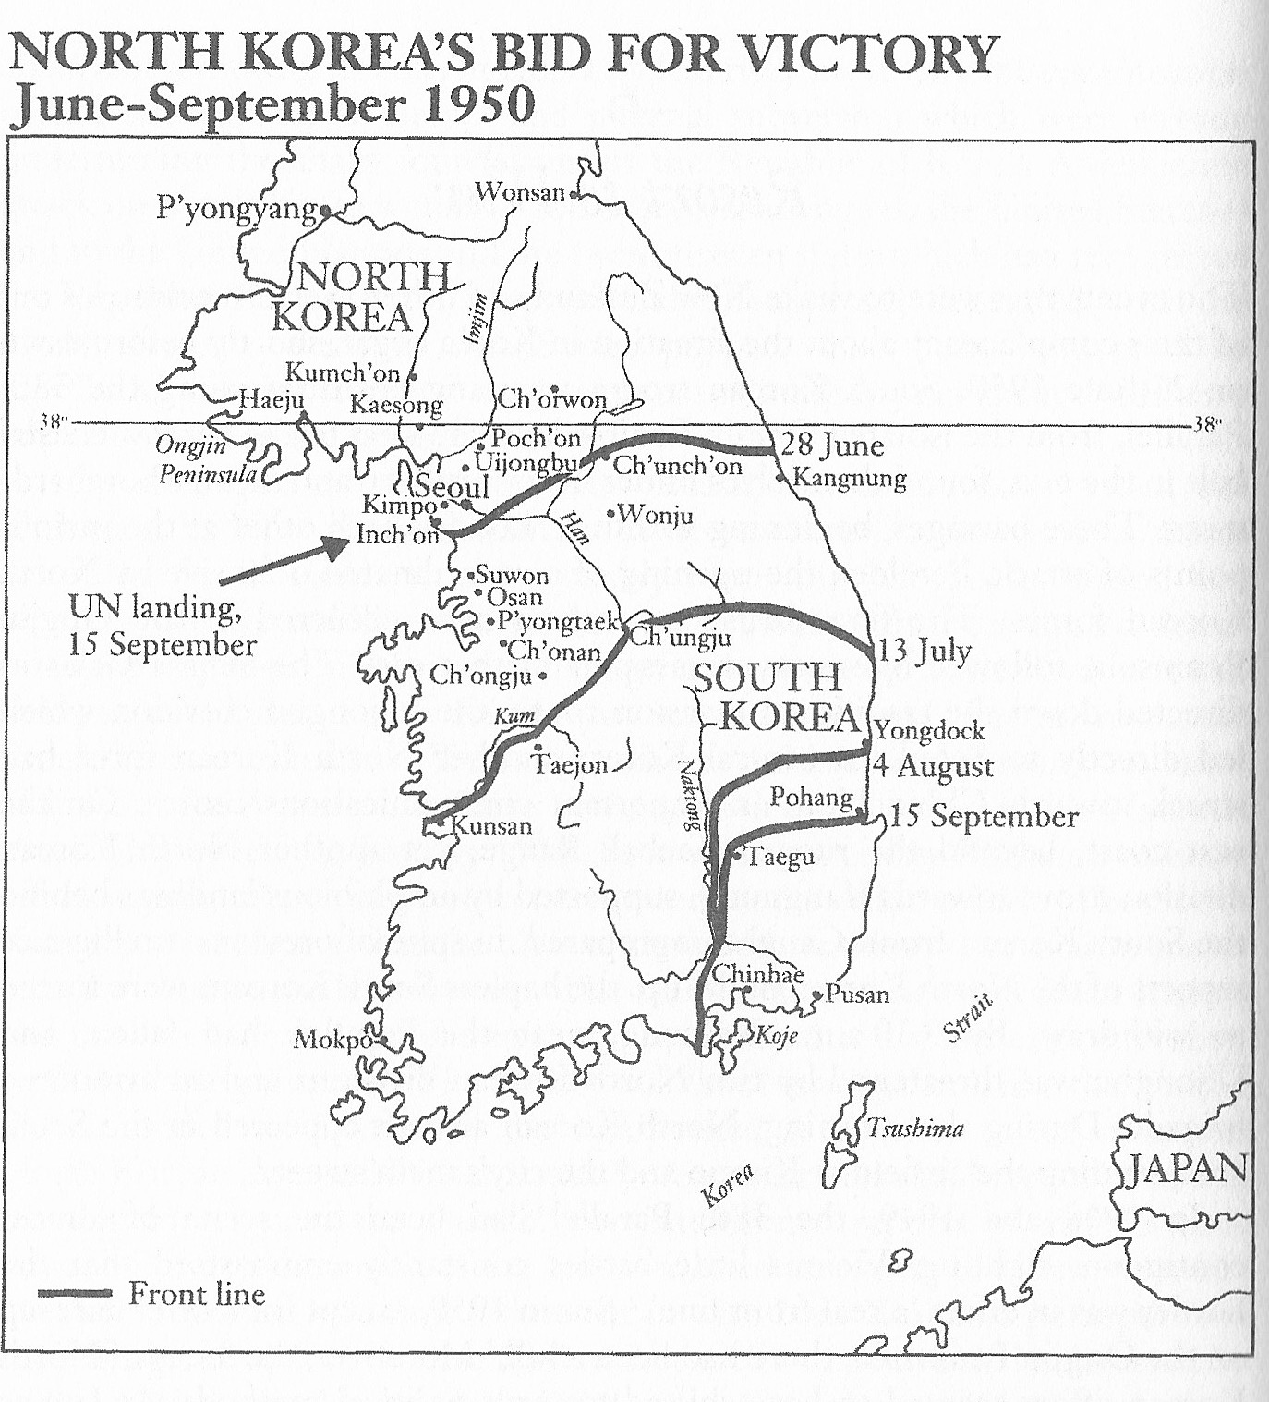
COURSE OF THE WAR
Pusan Perimeter
Inchon Landing (NZ frigates involvement)
Recapture of Seoul
Disintegration of the North Korean Army
South Korea liberated after three months
The war should have been over before Kayforce even finished training.
North Korea’s attempt to reunify the peninsula by force had failed.

Slide 17
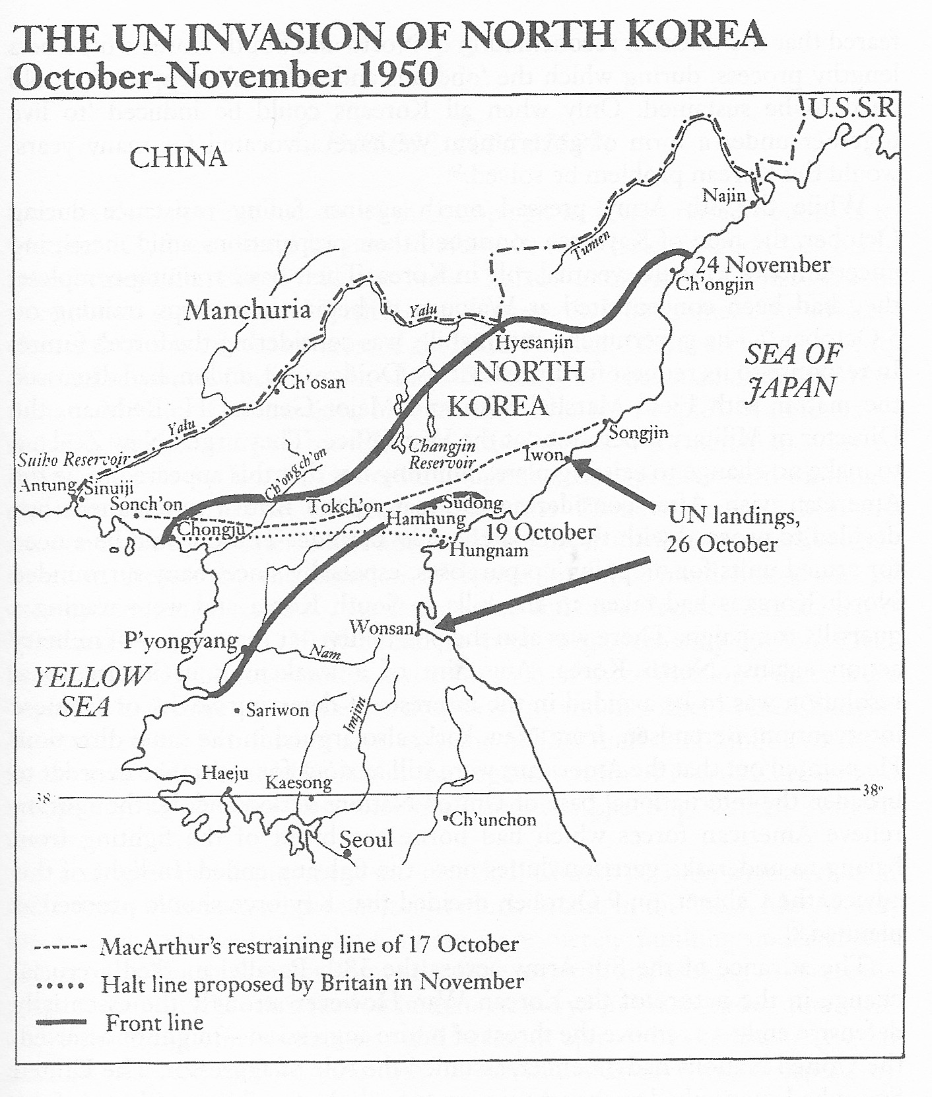
CONSEQUENCES OF TEMPTATION
With North Korean Army in disarray, the US tempted to unify the peninsula by force (UN resolution of 9 October 1950)
US miscalculation that there would be no opposition. Ignored Chinese warnings
UN Command invasion of North Korea
MacArthur’s home by Christmas offensive on 24 November
300,000 Chinese People’s Volunteers in North Korea mount counter-offensive
UN bug out. Front stabilised south of Seoul
The US attempt to reunify the peninsula by force had failed.

Slide 19
TOWARDS STALEMATE
Chinese attempt to unify the peninsula by force (North Koreans now bit players)
Communist Fifth Phase Offensive in April–May 1951 designed to drive the UN Commands into the sea
Offensive failed (NZ gunners played a valuable part in blunting one dangerous thrust, at Kapyong in April 1951)
After the failure of the offensive’s second phase in May the UN pushed forward again. Crossed the parallel again in east
Acceptance by communists that unification not possible
China’s attempt to reunify the peninsula by force had failed
The war was now a proxy contest between two great powers — China and the United States

Slide 20
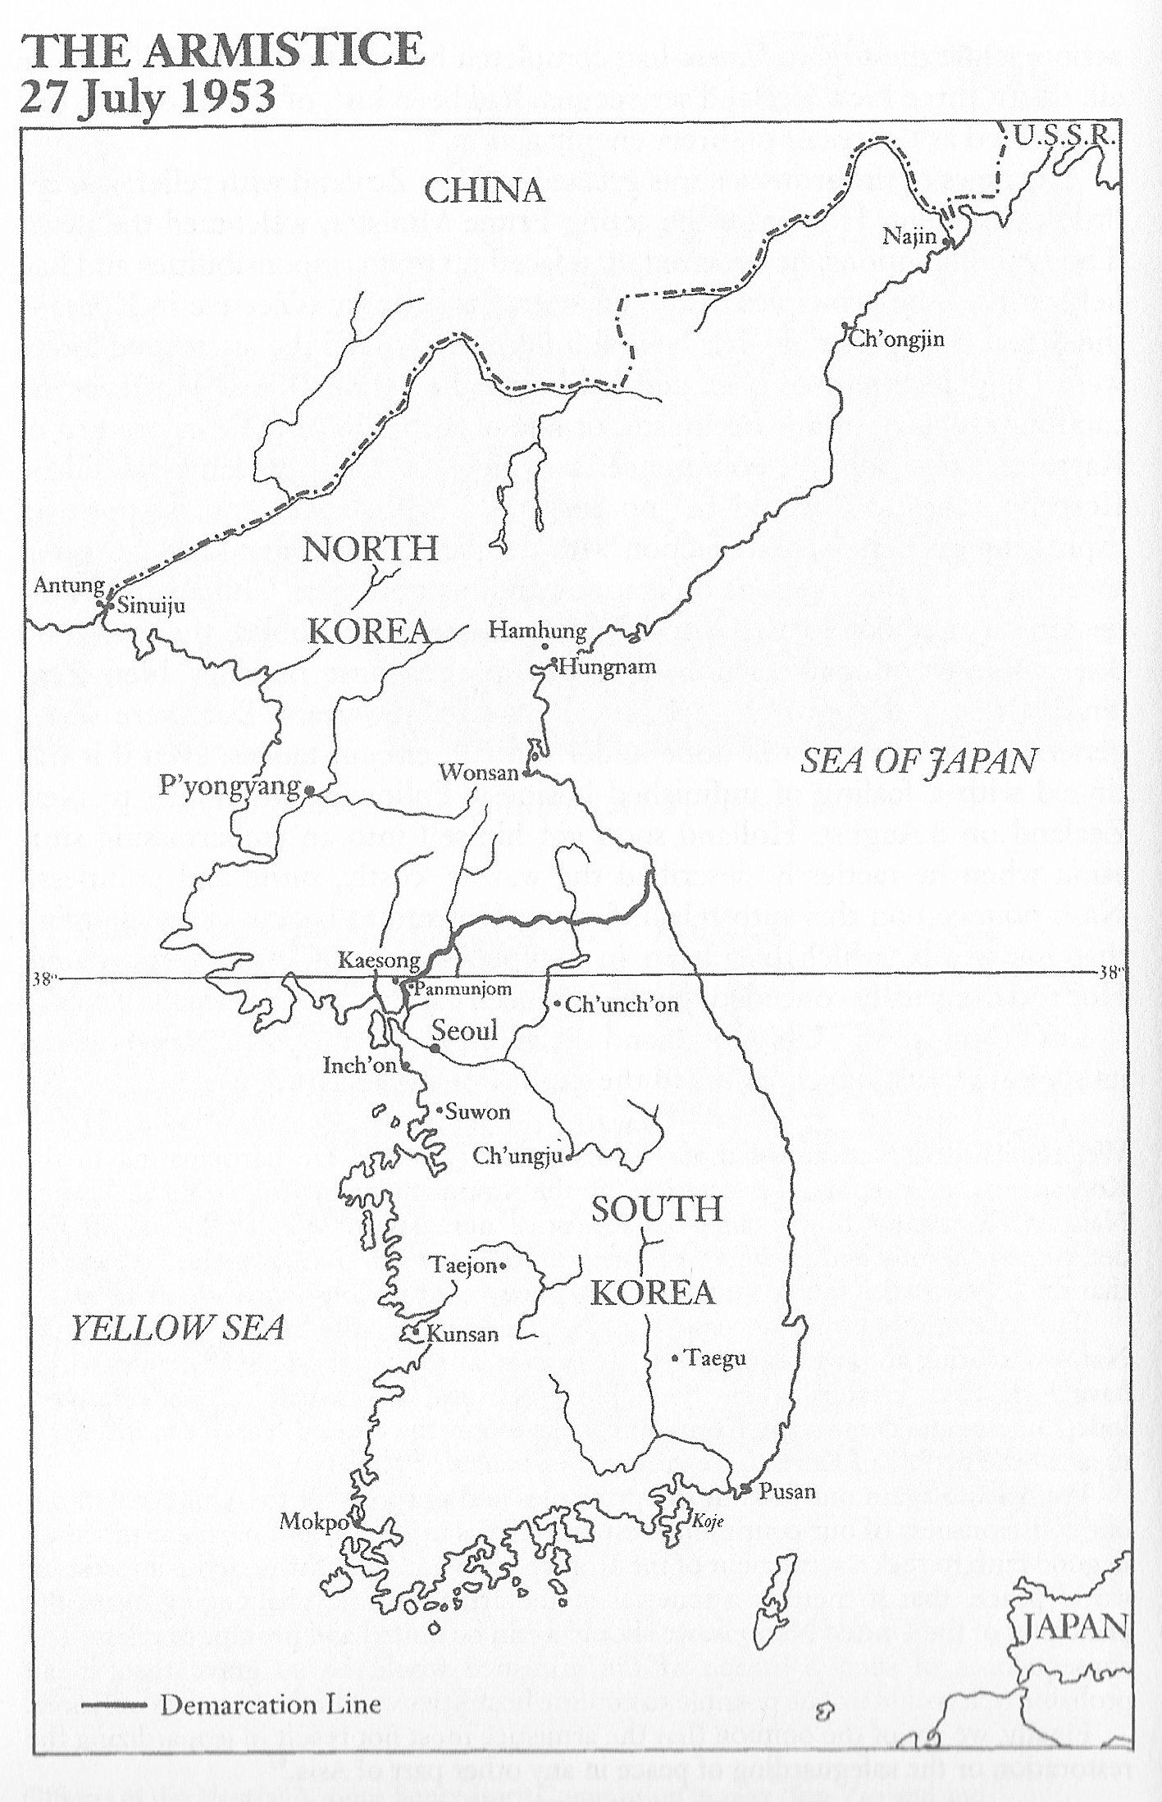
ARMISTICE
Armistice talks began in July 1951
Military stalemate on the line that essentially forms the border today
Talks drag on into 1953 (future of POWs the issue)
Logjam broken following Stalin’s death and veiled threats by Eisenhower to use nuclear weapons
Armistice on 27 July 1953 created a 4-kilometre wide demilitarised zone (DMZ) on the existing line of contact
In contrast to the 38th Parallel, the line of contact is a defensible line.
North and South Korea remain much the size as they were before the war.

Slide 21
OUTCOME
Four main outcomes of the war:
Both Korean states survived and continued their opposition to each other
China had demonstrated its determination to prevent a unified non-communist Korea (600,000 lives lost in preventing this outcome)
UN Command remained in place. No way to terminate it without another UN Security Council resolution
Most US and foreign troops withdrawn but ongoing presence
No peace settlement has been achieved. The question of a peace settlement is still the subject of diplomatic manoeuvring

Slide 22
KOREA TODAY
I went to Seoul last year as part of the Korea Foundation’s Distinguished Visitor programme
This programme is designed to give people from a range of countries briefings on current South Korean policy
There were eighteen of us from countries ranging from Mongolia and Kazakhstan to Columbia, Ecuador and Austria
The week-long programme included a trip to the DMZ

Slide 23
PEACEFUL COEXISTENCE AND CO-PROSPERITY
The briefings focused on South Korea’s President Moon Jae-in’s policy of engagement and rapprochement — the revived Sunshine Policy
Essentially the Sunshine Policy aims at a rapprochement with the North, now led by Kim Jong Un, the grandson of Kim Il Sung
The Moon Jae-in administration has three main goals in pursuit of its vision of ‘Peaceful Coexistence and Co-Prosperity’:
* to resolve Korean nuclear issue;
* to develop sustainable inter-Korean relations;
* and to realise a new economic community on the
peninsula

Slide 24
PANMUNJOM DECLARATION
Kim Jong Un–Moon Jae-in Summit on 27 April 2018 signed the “Panmumjom Declaration for the Peace, Prosperity and Reunification of the Korean Peninsula”
No more war
Cease all hostile acts
Establish a peace zone in western part of the west coast
Cooperate for a peace treaty
Arrange denuclearization
Establish a joint liaison office in Kaesong

Slide 25
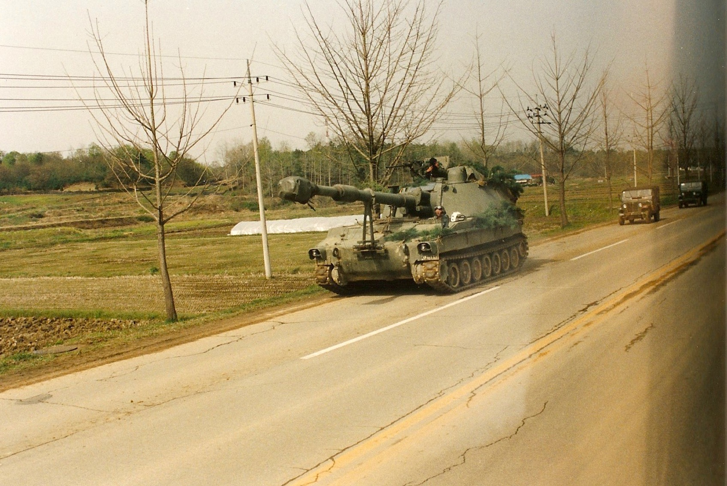
PEACE ZONE
The Panmunjom Declaration included a commitment to establish a peace zone
Confidence-building measures included the demilitarisation of the area of the DMZ. Previous visits to DMZ — in 1991 and 2001
Military presence everywhere
Tension

Slide 29
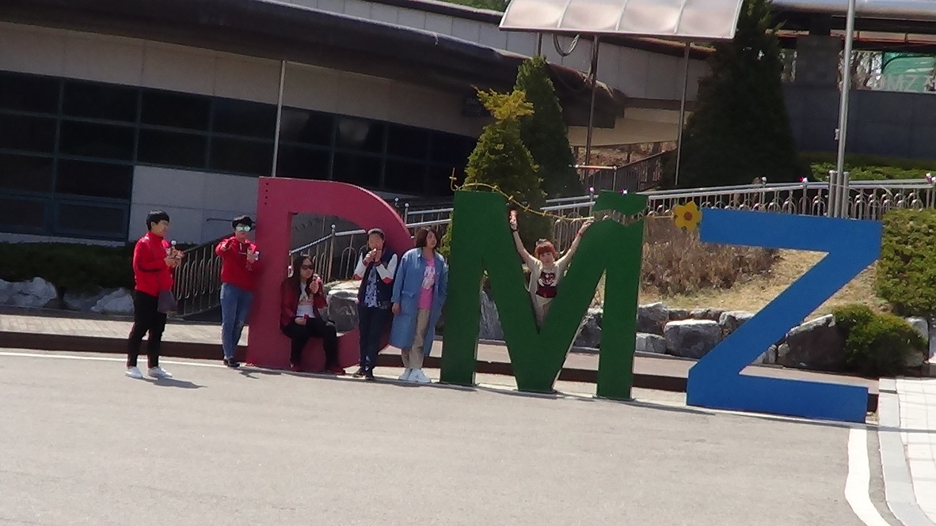
THE DMZ TODAY
Before I left for Korea the Korean ambassador warned me that I would find it very different, and he was right
I struggled to see any sign of military
Watchtowers along the Imjin River alongside which we drove north had no guards
The only machine guns I saw were a couple of grunts patrolling south of the southern fence of the DMZ
DMZ has become a tourist area (Observation Point Dora, tunnel, Dorason station).

Slide 32
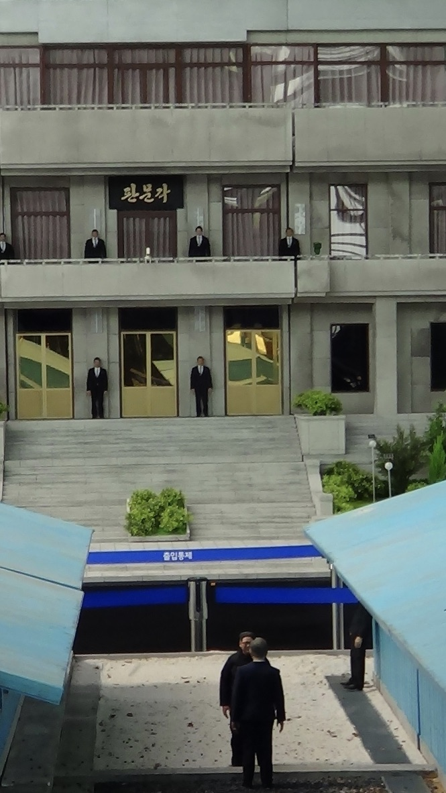
THE FUTURE
Failure of the Trump wooing of Kim Jong Un
Question marks over Sunshine Policy (June 2020 destruction of liaison office in Kaesong)
No early peace settlement is likely because of likely complications (it would need agreement of four powers and, arguably, the United Nations)
A peace declaration by the two Koreas is possible but rising tensions make it unlikely in the immediate future

