Slide 1
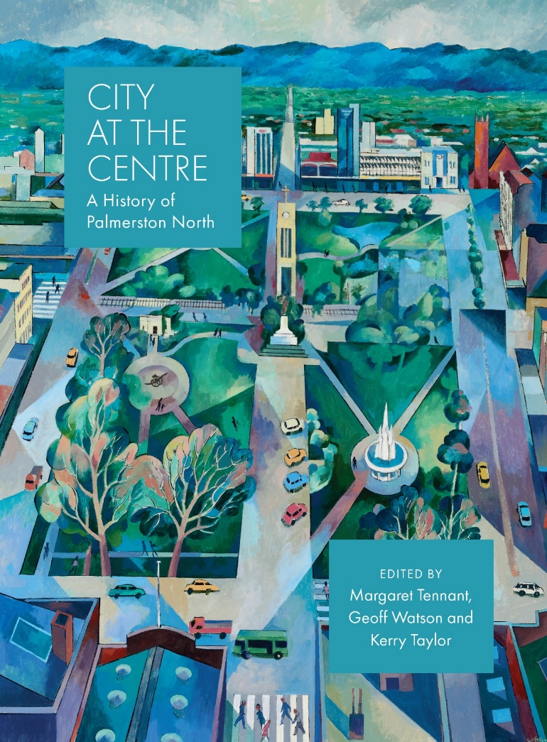
City at the Centre
A City at War?
Notes:
Hundreds of people from in and around Palmerston North feature in City at the Centre – but who to include, who to exclude – difficult decisions

Slide 2
A thematic history, multiple authors
1. Stories of a city (naming, how presented itself)
2. Tangata whenua
3. An environmental history
4. Building the city
5. A city at work
6. Towards a political biography
7. Educating the city
8. Sport and Leisure
9. An organised city
10. Conclusion – chronological overview
(Other possibilities!)

Slide 3
Wartime tales – threads in current book
Tangata Whenua – Rangitane battles; Rangi Mawhete, Maori Battalion Hall
Environment: Memorial Park
Building the city: Hokowhitu transit camp from end of WW2; Linton
City at work: importance of public sector employment – Linton Camp, Maori workforce
Politics: Mayors in wartime: Nash and Mansford – patriotic activity, WW2 EPS
Education: schools commandeered, student protest against Vietnam

Slide 4
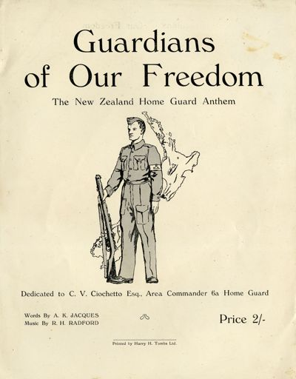
Organisations: Effect of war on membership of organisations, Patriotic societies, assertion of ethnic identity in face of conflict in homeland eg Chinese Association 1937, Home Guard, wartime organisations, Overseas Ladies’ Club.

Slide 5
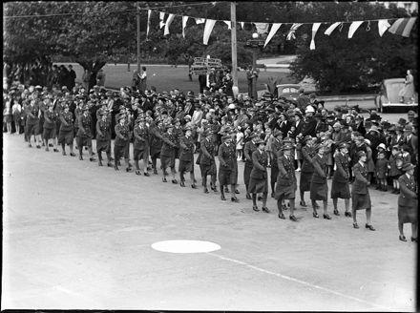
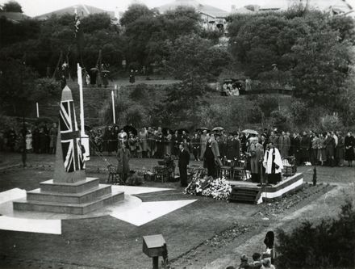
Images in book are part of the story

Slide 6
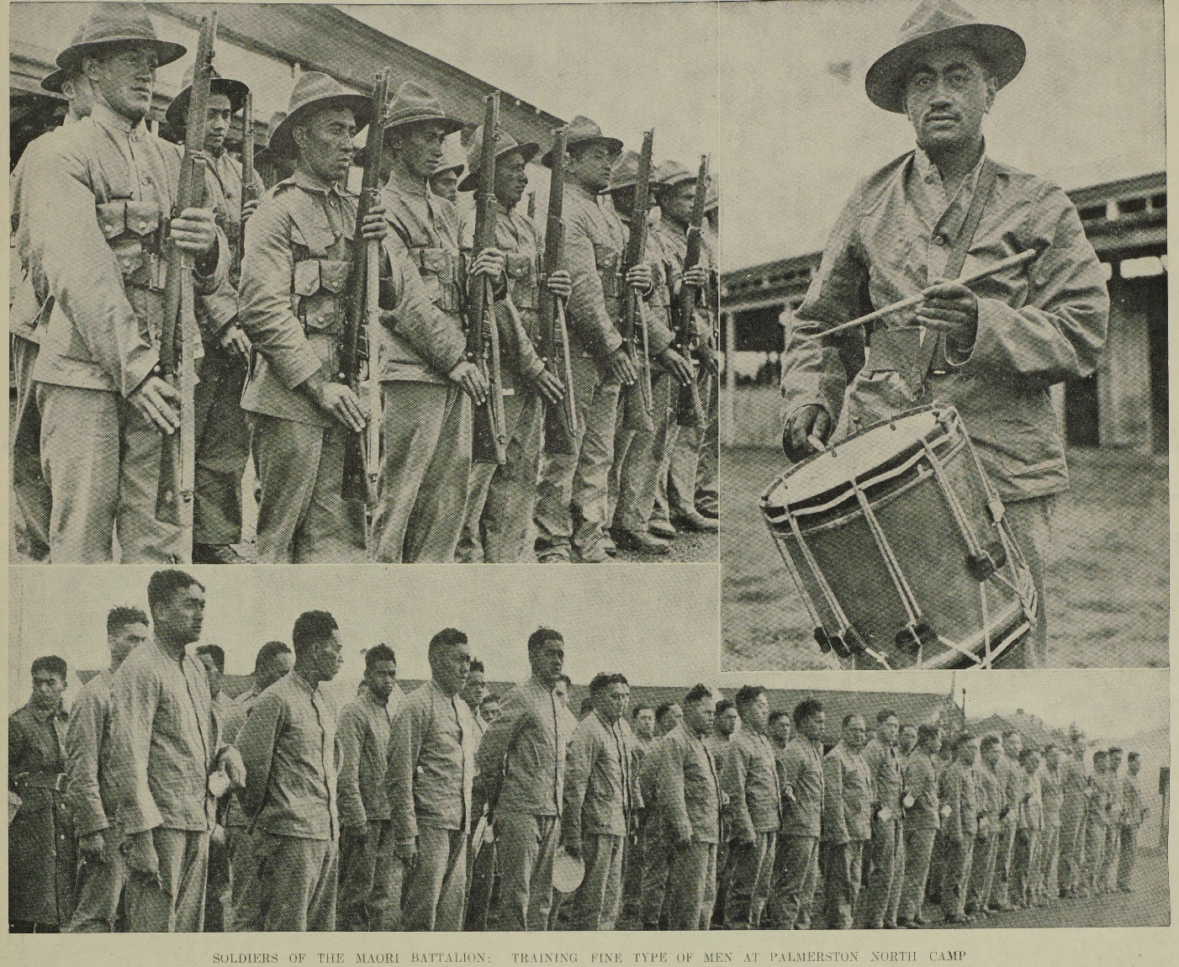
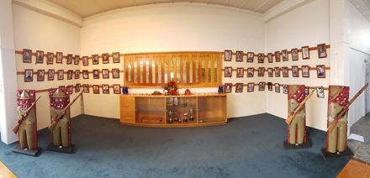
Maori Battalion

Slide 7
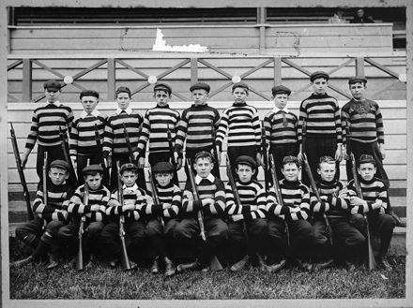
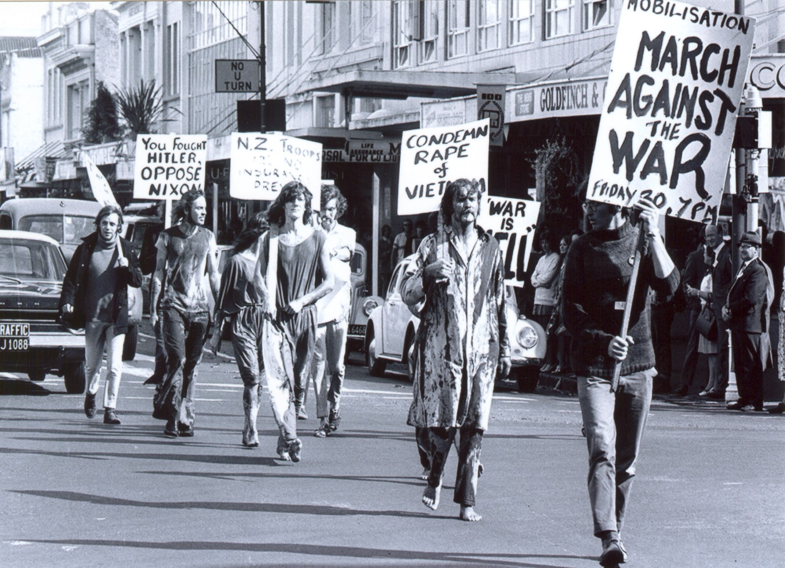

Slide 8
City at War or Military History of the City
Home front and civilian activity
Patriotism/xenophobia
Pacifism/protest
Economic impact/activities
Government policies and how played out in PN – manpowering, restrictions, blackouts
Longer term - Impact of military bases on economics, employment, demographics
Basis from Hickman chronology
Early militia/rifle corps
Recruitment/appeal processes in wartime
Soldiers, death rates, stories
Military training/camps
Defence sector/ ‘Defence city’
Inscription upon the landscape
Relations of bases with Council and city – positive and negative interactions

