Slide 1
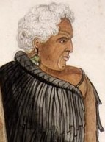
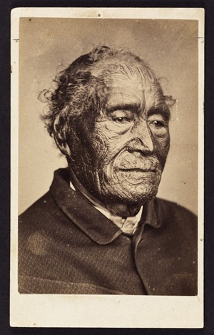
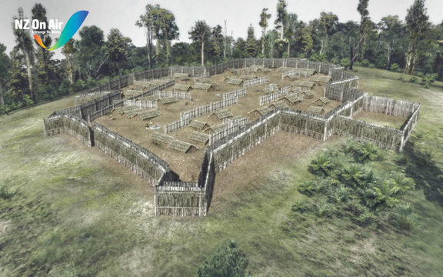
Ruapekapeka: Māori victory but for who? Te Ruki Kawiti or Tāmate Wāka Nene?

Slide 3
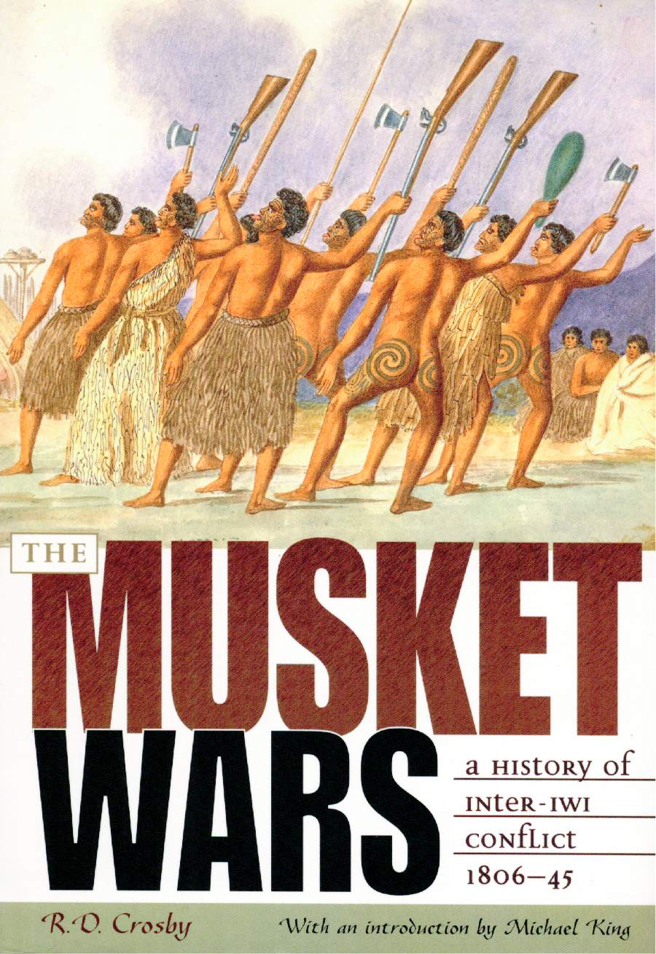
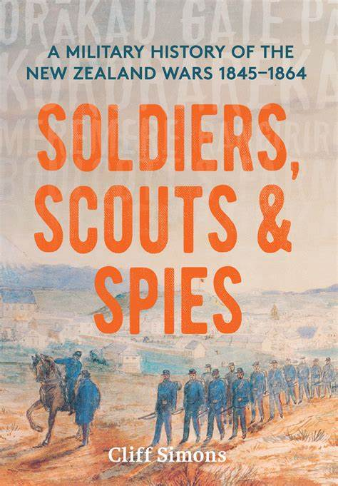
The Shadow of the Land

Slide 4
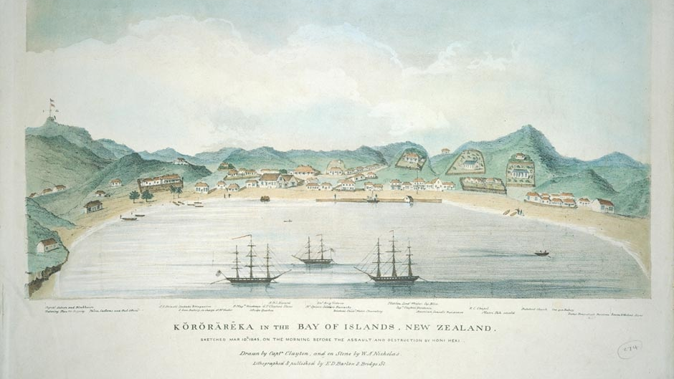
Kororāreka: 11 March 1845.
The spark to a war between the Pākehā allied with Tāmati Wāka Nene in fighting different hapu of the Ngāpuhi over the economic consequences of Hōne Heke and Te Ruki Kawiti’s actions.

Slide 5
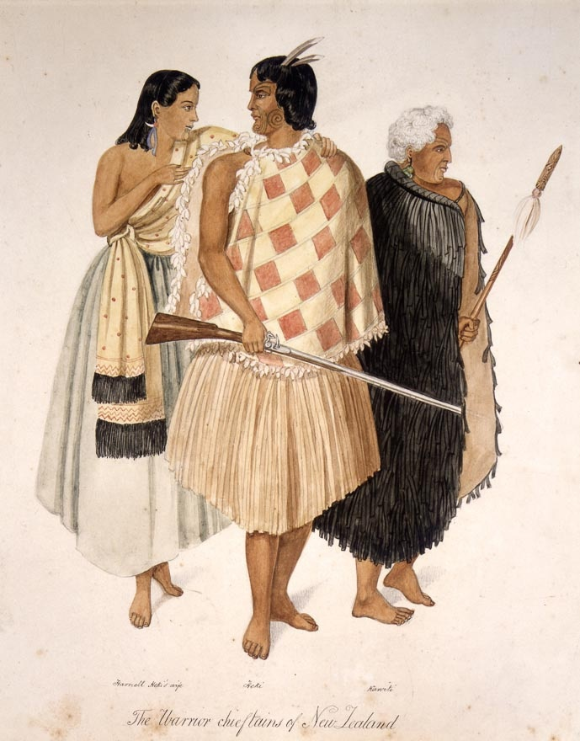
Te Rongo, Hōne Heke, and Te Ruki Kawiti, of the Ngāpuhi

Slide 6
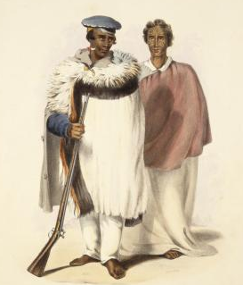
Hōne Heke
(?–1850)
Charismatic Ngāpuhi War Leader.
First of Northern chiefs to sign Treaty.
Felling the flagstaff triggers war with Tāmati Wāka Nene. Defeats British at Puketutu. Defeated and seriously wounded at Te Ahuahu. Plays secondary role in the war that bears his name.

Slide 7
Te Ruki Kawiti
“The Duke”
(1770s-1854) Fighting chief of the Ngati Hine. Sided with Heke at Kororareka Declared that the war would end if he could no longer see his ancestral lands from Ruapekapeka. Defeated Despard at Ōhaeawai but outfoxed and outfought by Nene at Ruapekapeka.

Slide 8
Tāmati Wāka Nene: (1780s – 1871)
The Puppet Master of the Northern War.
Fighting chief of the Ngāti Hau of the Hokianga.
Took the war to Heke at Okaihau. Defeated him at Te Ahuahu and engineered his defeat at Ruapekapeka. Negotiated peace talks.

Slide 9
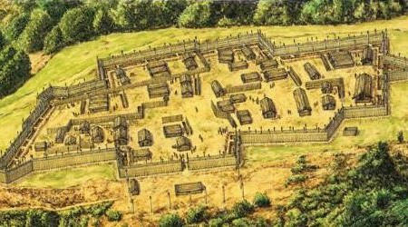
Beyond Ruapekapeka Kawiti’s selected pa for the decisive battle

Slide 10
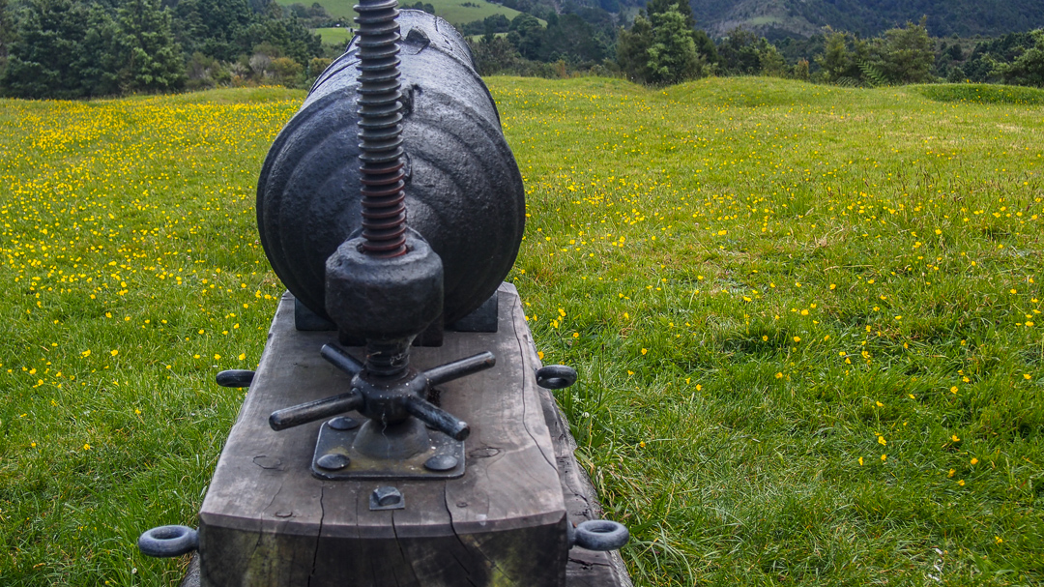

Slide 11
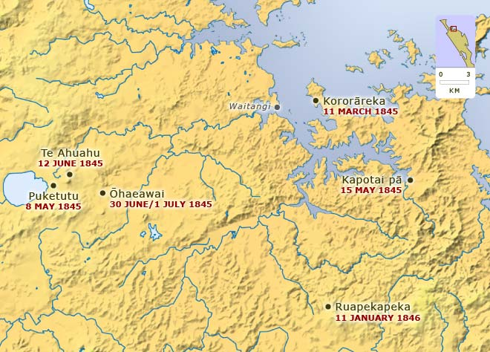
HEARTLAND BATTLES
HEKE
KAWITI

Slide 12
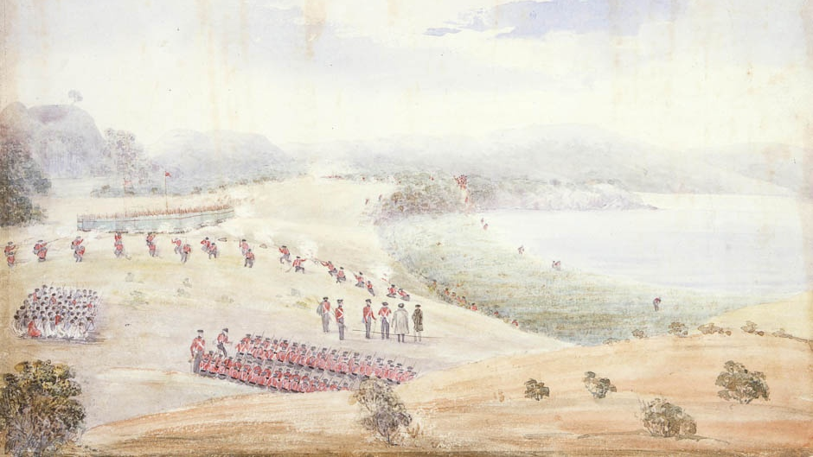
The Battle of Puketutu 8 May 1845

Slide 13
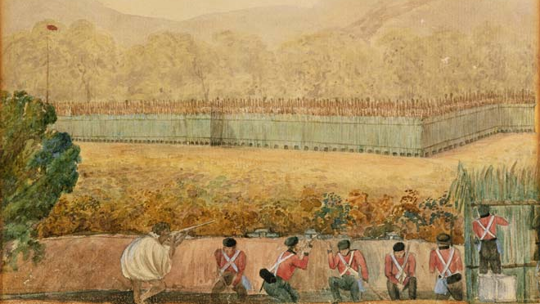
The Siege of Ōhaeawai 30 June/1 July 1845

Slide 14
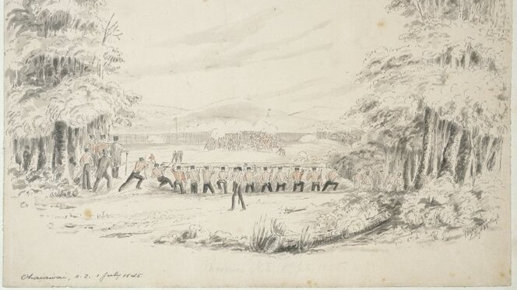
‘We just went at a strong stockade front under orders from a Colonel who did not know his business and who had a contempt for the Maori’
Colonel Despard
‘When I want the help of savages I will ask for it.’

Slide 15
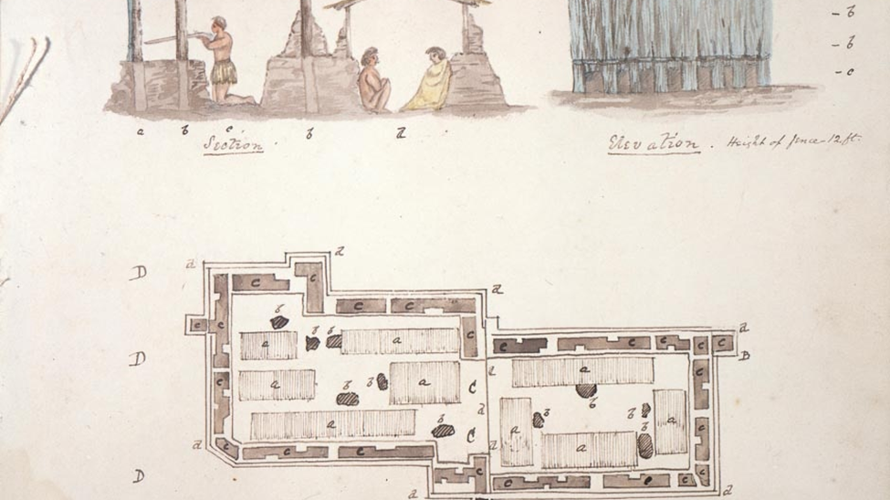
Four cannon firing parallel to the walls: two 9-pounders; one 4-pounder and one 2-inxh swivel gun.

Slide 16
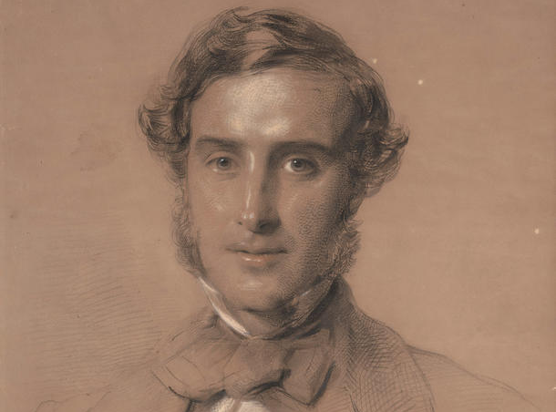

Slide 17
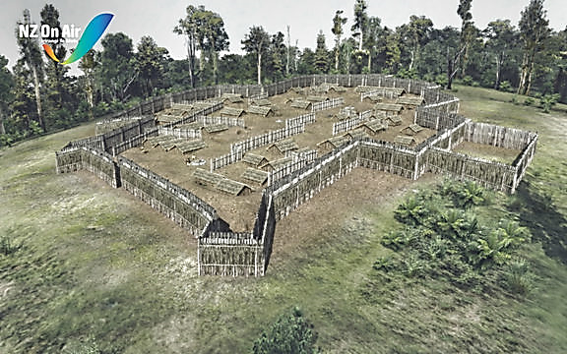

Slide 18
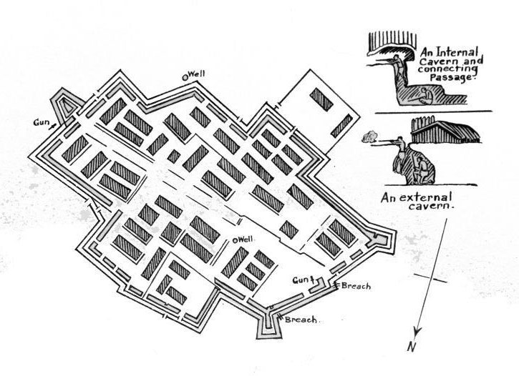

Slide 19
400 Naval
730 Army
50 Vols
450 Native Allies
1500 in total
2 x32 pdrs
1x18pdr
2 x12 pdrs
1x6 pdr
4x5 ½ mors
2x rocket tubes

Slide 20
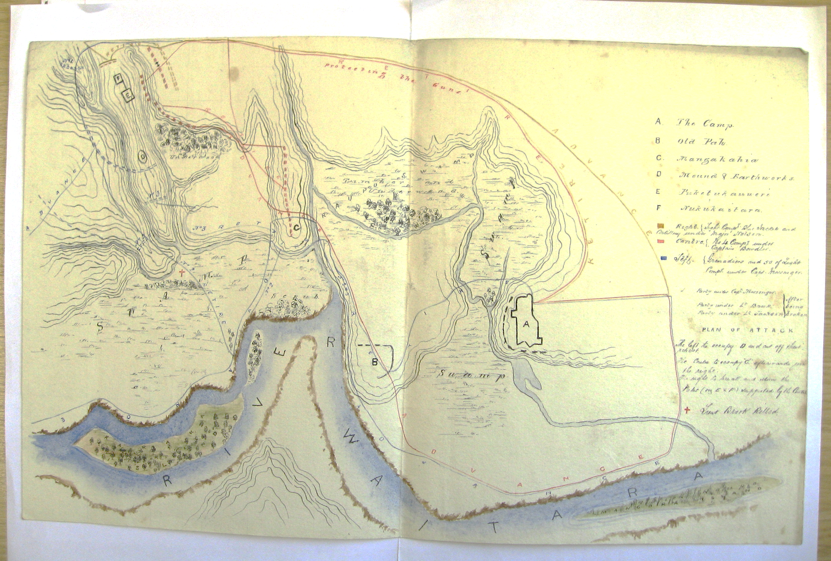
Enormous logistic effort – Security provided by Nene and his ‘Native Allies’.

Slide 21
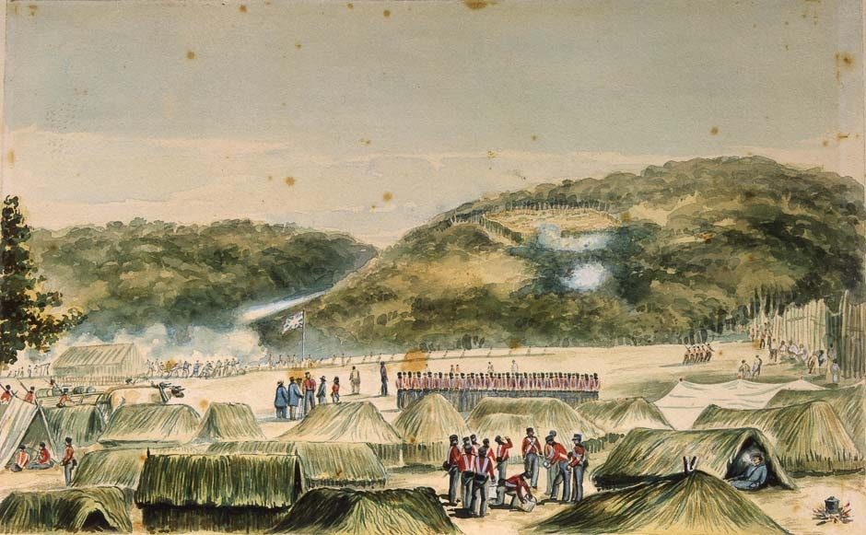
Despard prevented from attacking on10 Jan 1846

Slide 22
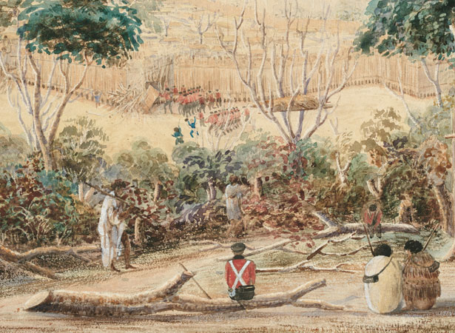
10 am, Sunday ,11 January 1846 – Mohi Tawhai leads the way

Slide 23
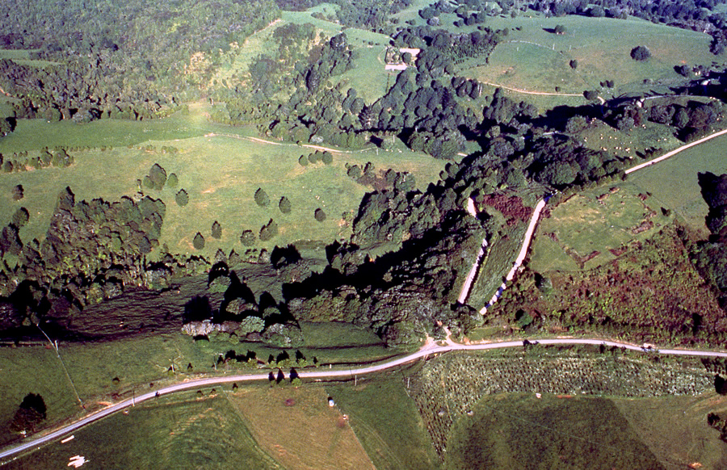

Slide 24
Only Tāmati Wāka Nene expected Battle this day - He understood the daily routine after stand down.
‘Neither the force outside the pa, nor the enemy inside, calculated on this being the last day of fighting.’ Rev. Burrows

Slide 25
The Sketches of the Battle tell the story
Wynard’s 58th Regt ‘was just turning out for Church parade when Captain Graham pointed at the friendly natives crossing into the Breach and immediately heard the advance sound – two parties entered the two breaches, one under my boy George and the other under Captain Denny.’

Slide 26
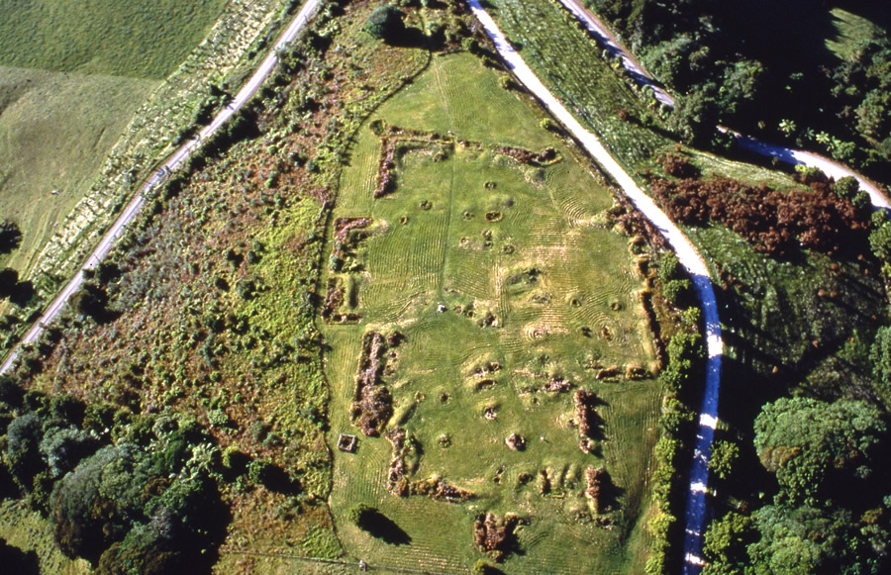
Kawiti surprised fights to retake his pa.
Not abandoned. Treasures inside
Heavy naval casualties. Rush in unarmed for loot.

Slide 27
Friendly Fire?
‘many of the soldiers entered the pa, and took advantage of the loopholes to fire indiscriminately, not knowing that “Jack” had made his way round to the rear; so it was very generally stated among the sailors themselves that they suffered more from their friends than from their enemies’
Rev Burrows
Seamen, marines
9 killed, 18 wounded
58th Regt
2 killed, 10 wounded
99th Regt
1 killed and 1 wounded
Volunteer Pioneers
1 wounded
TOTAL 12 killed and 30 wounded

Slide 28
‘Native Allies’ - Tāmati Wāka Nene’s Victory
‘I ought also, perhaps state to Your Lordship, that in many of the operations in the field, such as occupying a wood, lining the banks of a river, Etc, these native troops afford the most essential assistance to her Majesty’s forces: indeed I do not think that our operations could be successfully conducted without their co-operation.’
Grey to Stanley
‘The Colonel cannot conclude this order without expressing his admiration at the brave and intrepid conduct displayed by our native allies, on every occasion since our operations commenced, and more particularly during the assault on the pa, on which occasion their bravery was fully equal to what might be expected from the bravest of her Majesty’s troops.’
Despard to Grey 12 January 1846

Slide 29
Tāmati Wāka Nene: (1780s – 1871)
The Puppet Master of the Northern War.
Fighting chief of the Ngāti Hau of the Hokianga.
Took the war to Heke at Okaihau. Defeated him at Te Ahuahu and engineered his defeat at Ruapekapeka. Negotiated peace talks.

Slide 30
The land remains yet historians and writers treat it as if it were some imaginary land or one whose story is dictated by its current guardians and ignores that which the land will tell us?

Slide 31
