Slide 1
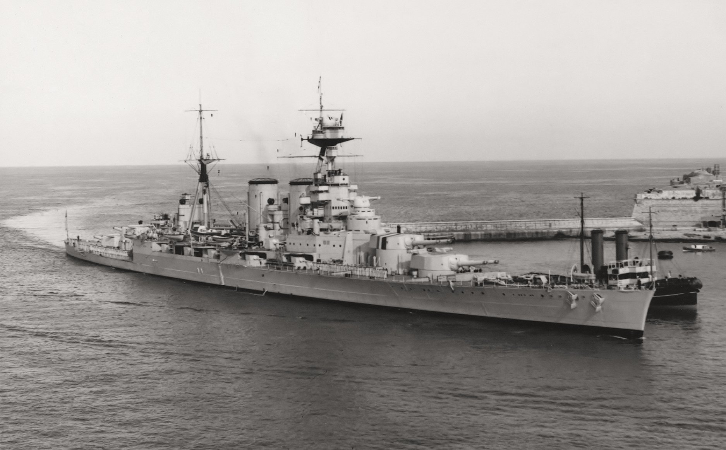
The Singapore Strategy 1922-42
The British Empire’s contingency plan against Japan.

Slide 2
The structure of this talk:
This is the naval perspective (it is not about the Malayan Campaign)
The naval lessons of the Great War
The Jellicoe Reports/the concept of the Singapore base
USN/Japan/UK arms race - the Washington Treaty
The Special Service Squadron
Politics and the Singapore Base
The London Naval Agreement 1930
The Japanese threat grows – Deploying the fleet
1935: a turning point year - the Base defences
War in Europe & the Admiralty’s changing plans

Slide 3
The Navies of the victorious powers 1919
Britain (and Empire): 30 battleships + 11 (+1) battlecruisers
United States 17 (+2 and 4)
Japan 10 (+2)
France 7
Italy 5
USSR 7
Argentina, Chile, Brazil: 1 each
Turkey 1 (flagship until 1950; scrapped 1973)
Netherlands (Coast defence and cruisers only)

Slide 4
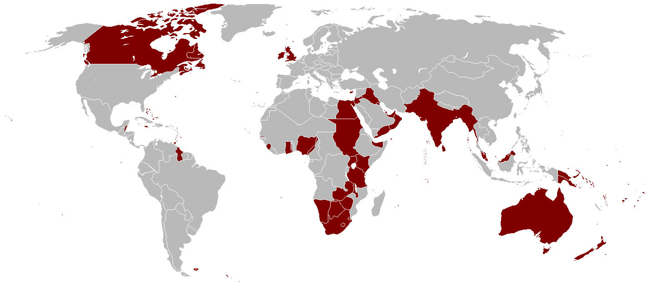
The British Empire after WWI

Slide 5
Naval Lessons of the Great War
Mahanian navies: The importance of the main battle fleet
Submarines – The advantage of Asdic (sonar)
To be controlled by international law
The importance of cruisers – for trade protection and scouting
Aircraft over the sea: reconnaissance; defence of the fleet; torpedo attack (overlooked…land-based long-range patrol in support of convoys)
Ships against the shore – England-East Coast Raids 1914 &1916; the Dardanelles March 1915; the Belgian Coast 1917 & 18.

Slide 6
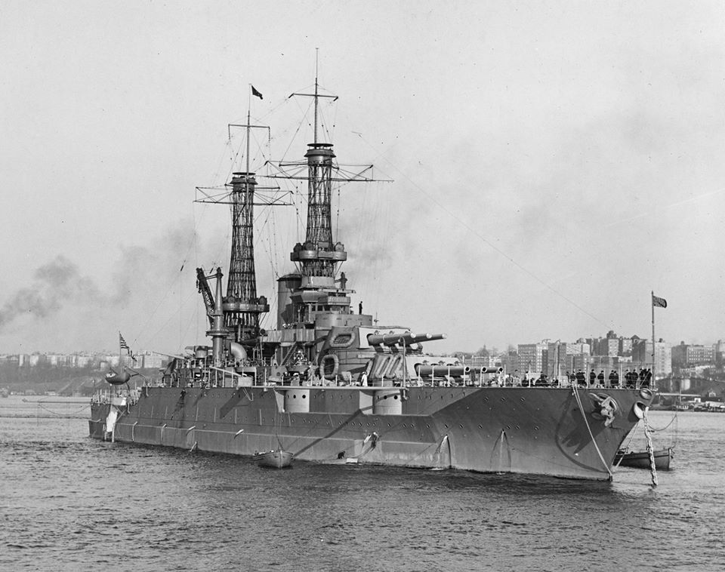
Mahanian navies: the importance of the main battle fleet.
USS Mississippi
12 x 14” guns
(completed 1917)

Slide 7
The Jellicoe Mission, 1919
Defence advice to India, Malay States, Australia, New Zealand and Canada: voluminous reports!
Identified Japan as the only likely opponent – at that time
Proposed an Imperial Pacific Fleet centred on 8 battleships and 6 battlecruisers
Encouraged Dominions to share the burden
Australian fleet centred on two battlecruisers (including HMAS Australia)
NZ: 3 light cruisers, 6 submarines, 1 depot ship, 1 small aircraft carrier
Factored in the impact of submarines and aircraft; concerned for fuel supplies.
Jellicoe’s advice was consistent with the Admiralty’s thinking.

Slide 8
The Singapore Base
Conceived: 1920-21
  (Debate between Sydney, Hong Kong, Singapore or Ceylon)
Concept – a base big enough for a fleet centred on 7 battleships
  and protected so as to resist (sea-borne) attack for 42 days.
Singapore base approved June 1921
[Washington Treaty: Dec 1921 – Feb 1922]
Site – Sembawang - agreed December 1922
  (War Office called for a 30 mile [48km] defence perimeter on the mainland)
Public announcement: 1923

Slide 9
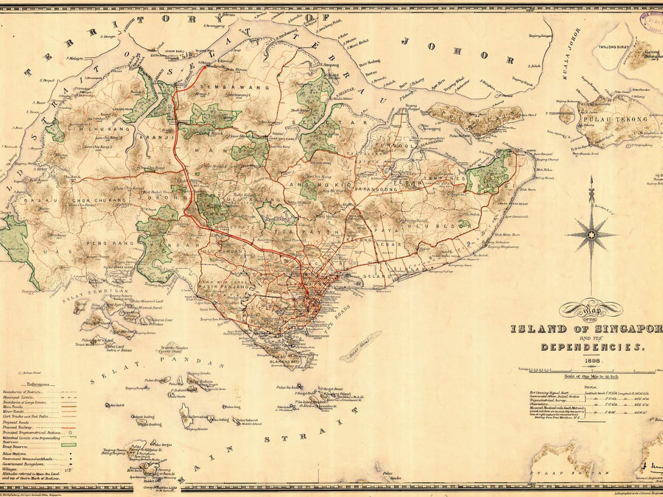

Slide 10
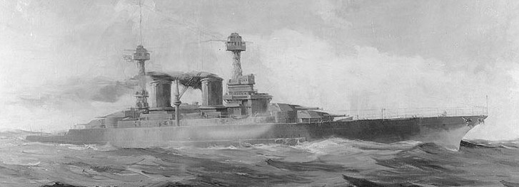
The US Naval Act 1916 - To build a Navy second to none
1919: 17 (+2) dreadnought battleships
‘ 4 x Colorado class battleships: 32,000 tons, 8 x 16” guns
6 x South Dakota class battleships 43,000 tons, 12 x 16” guns
6 x Lexington class battlecruisers 43,000 tons, 8 x 16” guns

Slide 11
The Japanese Response
1919:
4 x Kongo-class battlecruisers
  (Vickers UK design)
5 dreadnought battleships
  (1 lost in 1918 to magazine explosion)
Eight-Eight Fleet programme:
    2 x Nagato class battleships: 32,000 tons, 8 x 16” guns
  4 x Amagi class battlecruisers 42,000tons, 10 x 16” guns
    2 x Tosa class battleships 40,000 tons, 10 x 16” guns

Slide 12
The Royal Navy in 1919
Battleships: 25 in service/reserve
35 dreadnoughts built: 2 lost during the war; 1 sold to Chile; 7 scrapped 1920-21
Battlecruisers: 6 in service/reserve (Hood completed 1920)
( + RAN: HMAS Australia)
13 battlecruisers built: 3 lost in action; 2 scrapped 1920-21
3 ‘large light cruisers’: Furious, Glorious, Courageous.
The challenge: apart from Hood, all were pre-1916.

Slide 13
Summary: The Naval Arms Race 1916 - 1921
USN: ‘Big Navy’ Act of 1916: 10 Battleships; 6 battlecruisers
4 x Colorado class battleships: 32,000 tons, 8 x 16” guns
6 x South Dakota class battleships 43,000 tons, 12 x 16” guns
    6 x Lexington class battlecruisers 43,000 tons, 8 x 16” guns
IJN: Eight-Eight Fleet programme:
    2 x Nagato class battleships: 32,000 tons, 8 x 16” guns
  4 x Amagi class battlecruisers 42,000 tons, 10 x 16” guns
    2 x Tosa class battleships 40,000 tons, 10 x 16” guns
RN: 4 x G3 design battlecruisers: 48,000 tons, 9 x 16” guns
4 x N3 design battleships: 48,000 tons, 9 x 18” guns

Slide 14
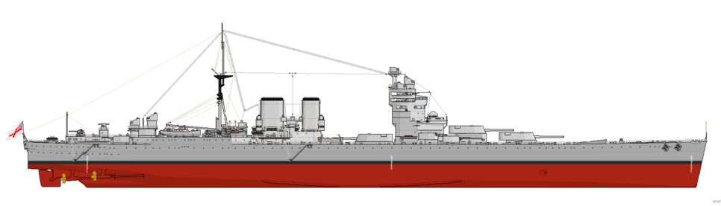
RN: G3 Battlecruisers: 48,000 tons, 9 x 16”

Slide 15
The Washington Treaty: signed February 1922
Battleship ratio: UK 5: US 5: Jap 3: Fr 1.75: It 1.75
Battleship building holiday: 10 years (until 1932)
Battleship size limit: 35,000 tons and 16” guns
Carriers: limits: 10.000-27,000 tons, 8” guns
                2 x conversions (US, Jap, UK)
Cruisers: 10,000 tons and 8” guns
Destroyers & Submarines: size constraints
UK could build 2 x 16” battleships, convert two hulls as carriers
HMS Hood therefore the largest warship in the world.
US to scrap one Colorado class, convert two Lexingtons
Japan to scrap Amagi and Tosa classes, convert two as carriers.

Slide 16
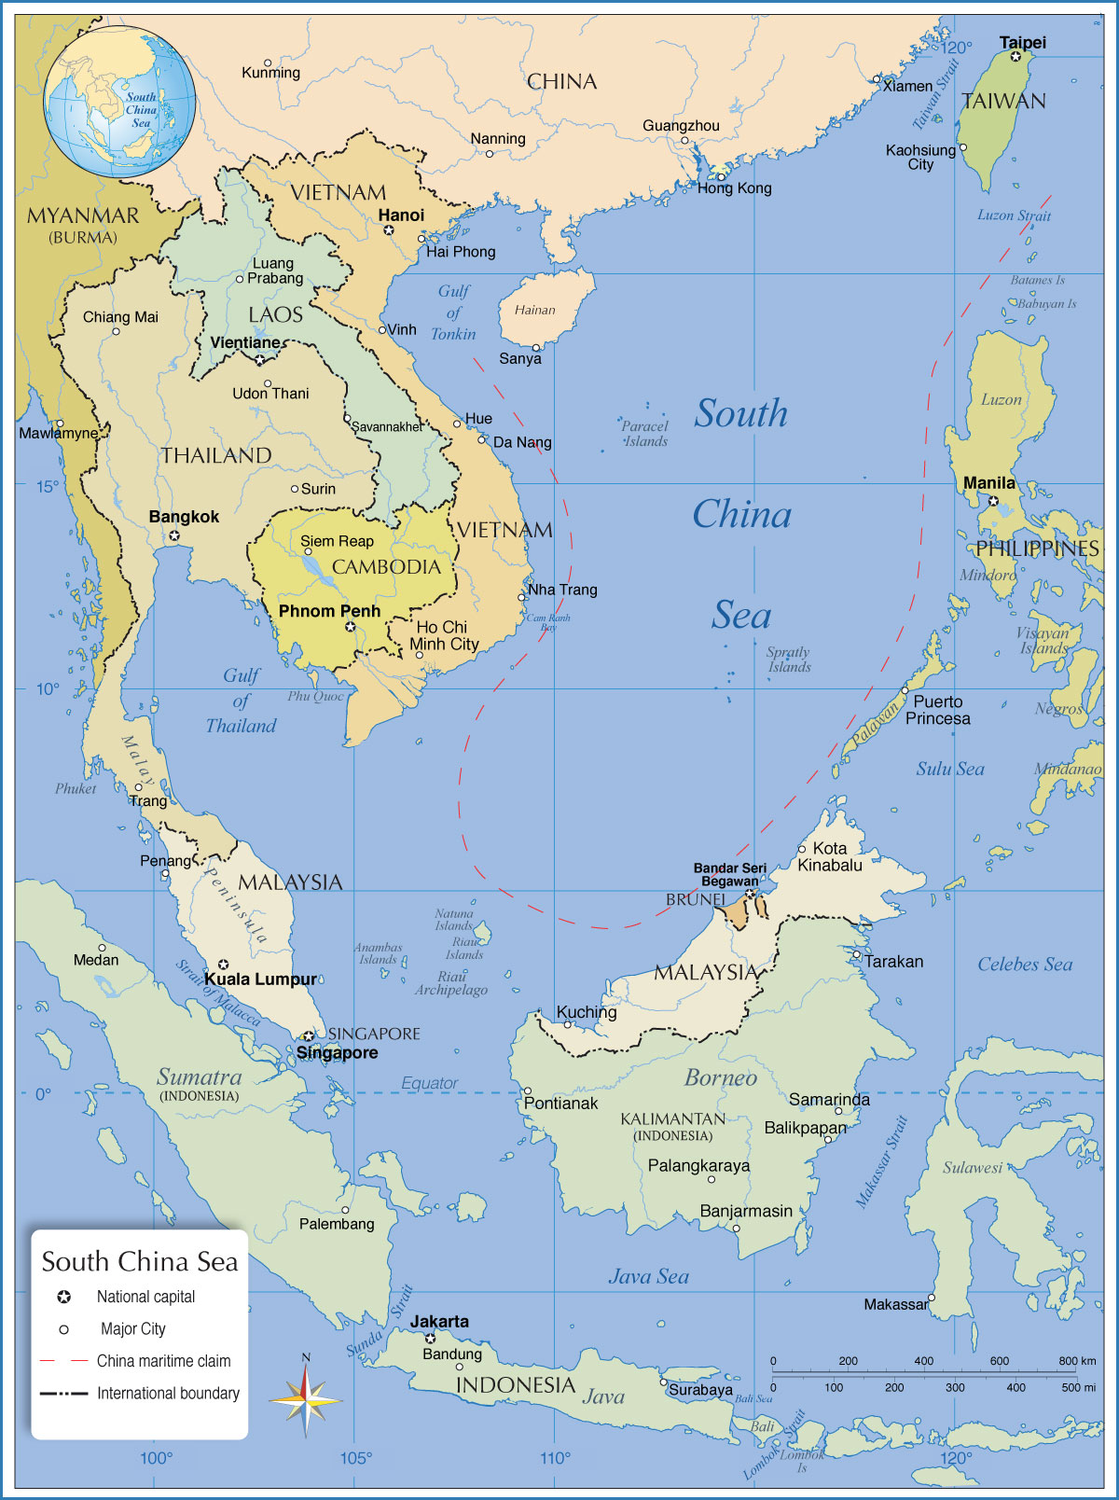
Treaty results:
Longitude 110E
No fortifications to the east of that line:
Hong Kong, Manila, Guam, Wake Island…or Japanese Mandates.
Saigon to Singapore: 774nm
*3.5 days at 10 kts
*5 flying hrs at 150mph

Slide 17
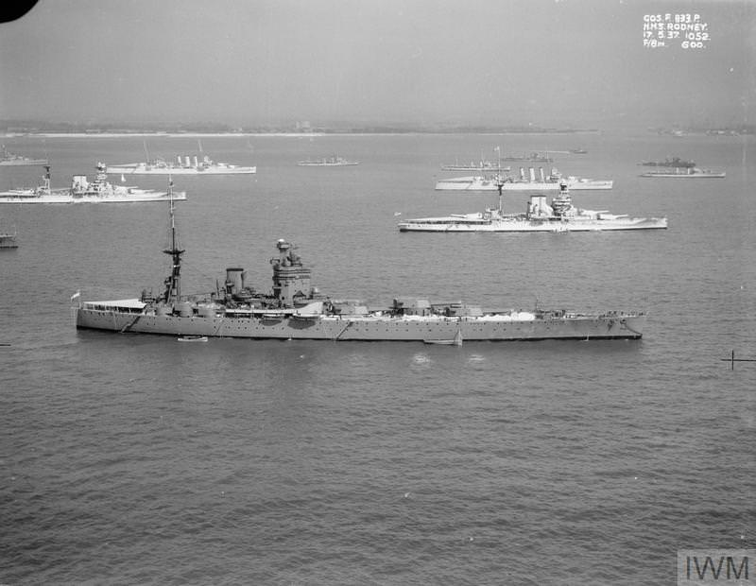
Treaty results: HMS Rodney & Nelson
1927, 33,000 tons, 9 x 16”, 23 knots

Slide 18
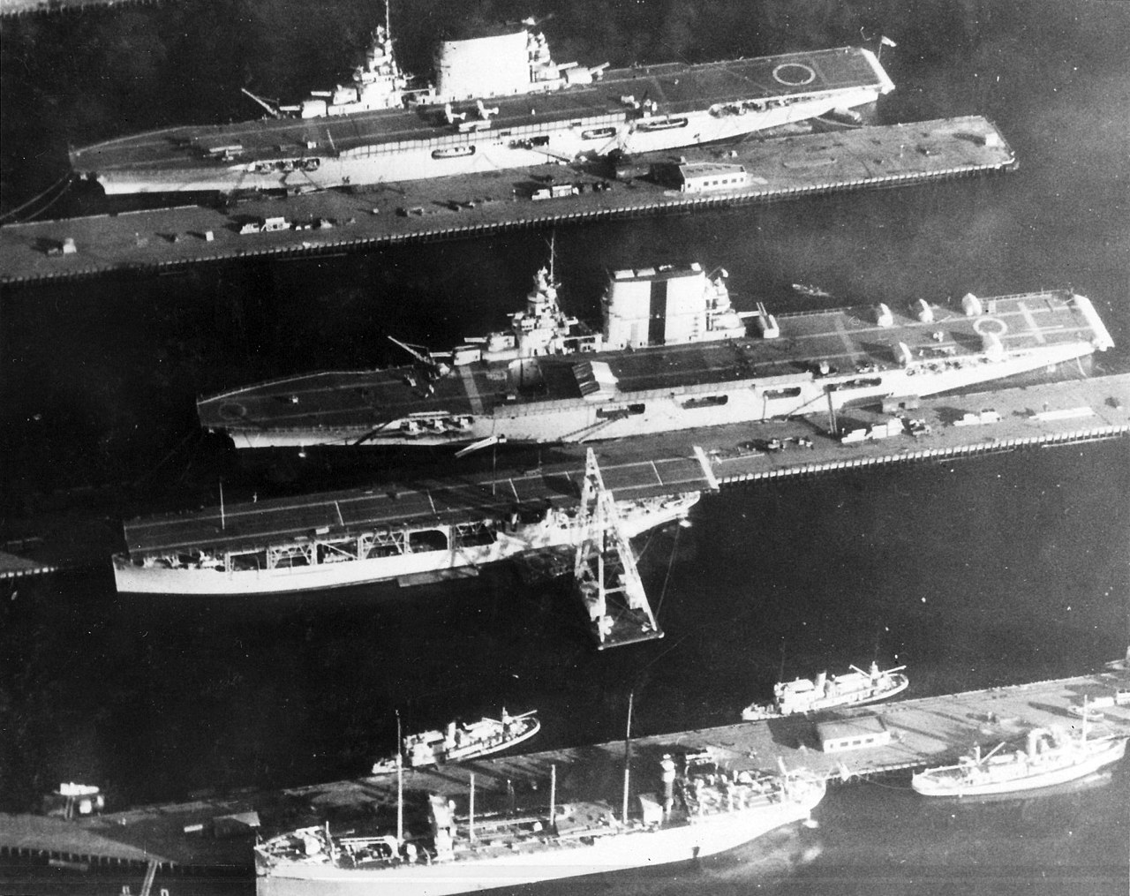
Treaty results: USN carriers, 1929:
Lexington,
Saratoga,
& Langley.
Lex and Sara:
36,000 tons,
78 aircraft.

Slide 19
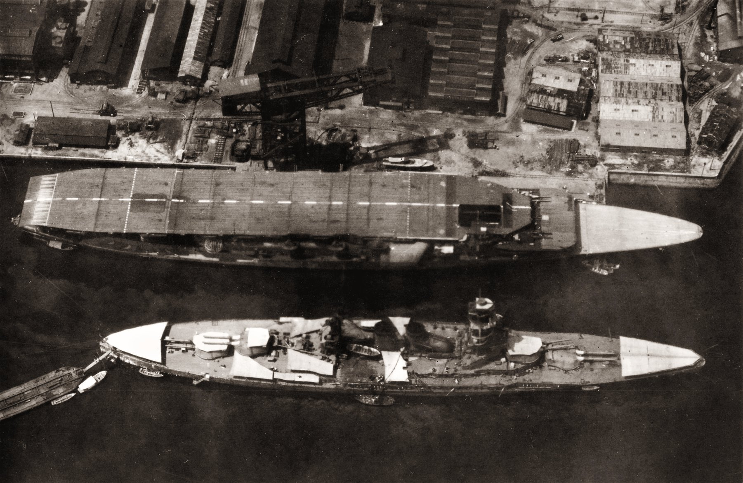
Treaty results: Imperial Japanese Navy
Carrier (conversion) Akagi and battleship Nagato, 1927.
Akagi: 27,000 tons,
60 aircraft

Slide 20
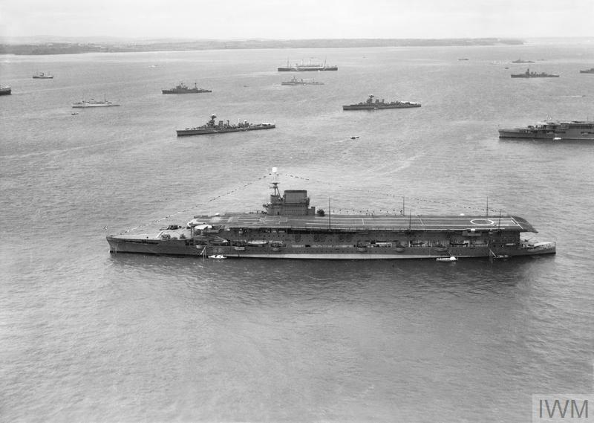
Treaty results: HMS Glorious Converted 1924-30,
24000 tons,
48 aircraft.

Slide 21
Treaty results: RN - large, long-range patrol submarines
19 O, P and R class boats built between 1925 and 1931.
Surface displacement of about 1400 tons,
1 x 4” gun and 8 x 21" torpedo tubes.
Surface range over 10,000 miles.
An excellent design for their time, for Pacific warfare.
2 x O-boats delivered to RAN in 1929
  (Returned to UK in 1931 due to cost.)
4th Flotilla (15 boats) withdrawn in June 1940 to the Mediterranean.

Slide 22
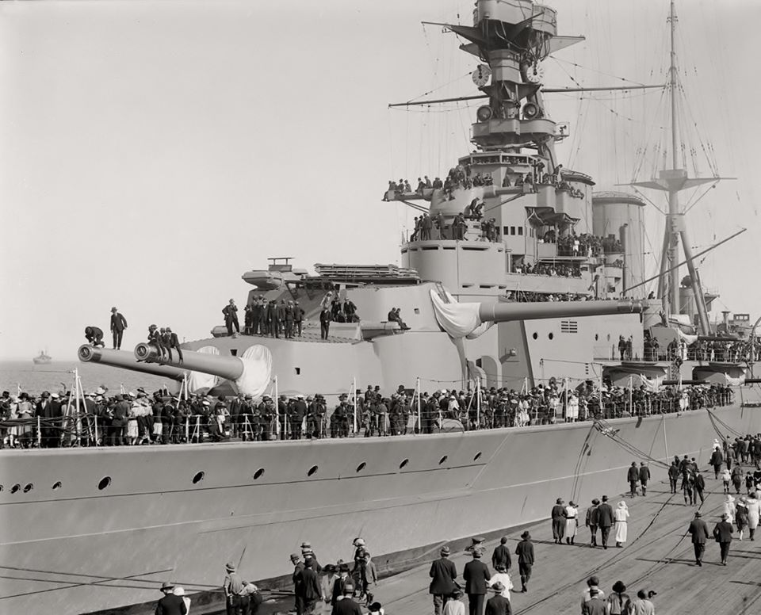
RN: world cruise of the Special Service Squadron, 1924.

Slide 23
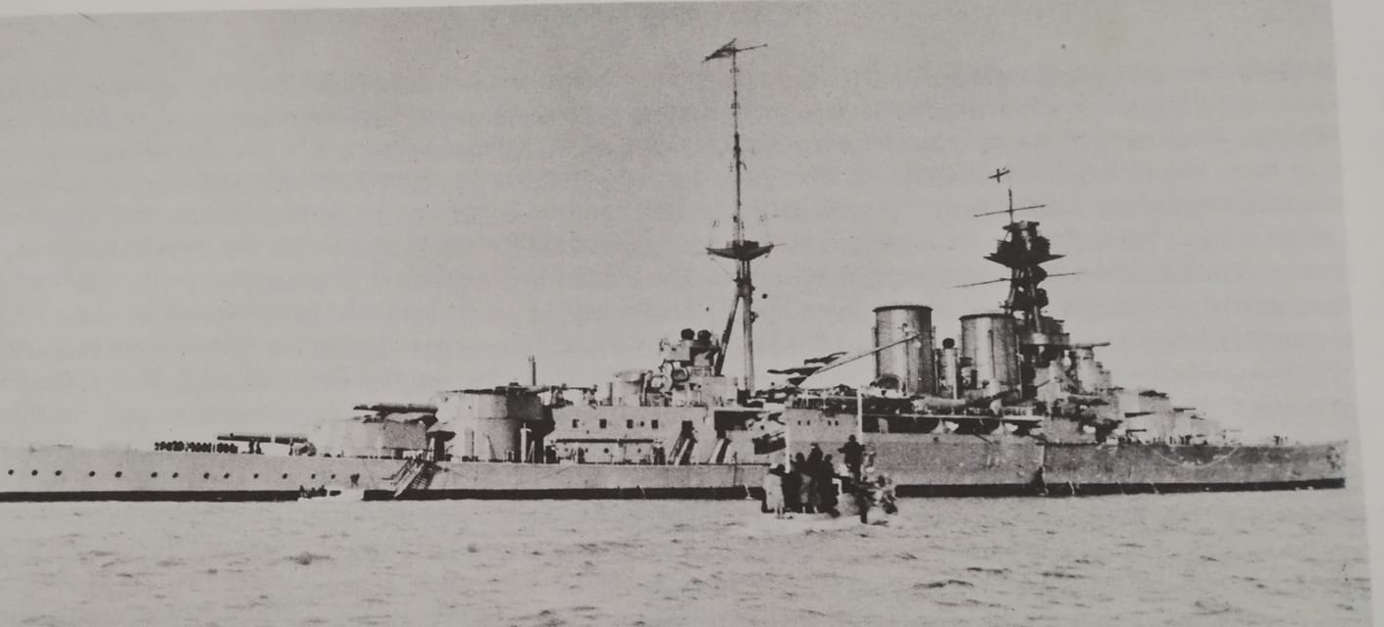
Hood anchored off Napier, 9 May 1924.
(Napier Harbour Board launch taking local dignitaries to the ship.)

Slide 24
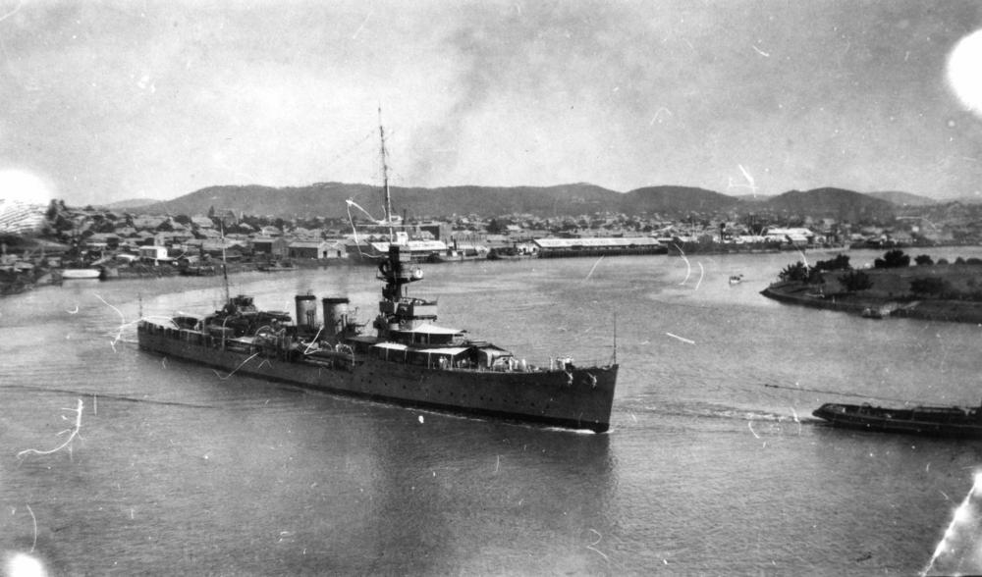
Special Service Squadron: HMS Dunedin

Slide 25
Politics and the base 1924- 1930
1923: the project approved by UK Conservative Government
March 1924: First British Labour Government – cancelled the project
December 1924: Conservative Govt re-elected – proceeded with the project
New Zealand: committed 1 Million pounds to the project
Australia: building 2 County-class cruisers
June 1929: Labour Govt elected
The base’s floating dock (capacity 50,000 tons) delivered
October 1929: Wall Street crash
1930: London Naval Conference
Work on defences suspended; then work on the base suspended also.

Slide 26
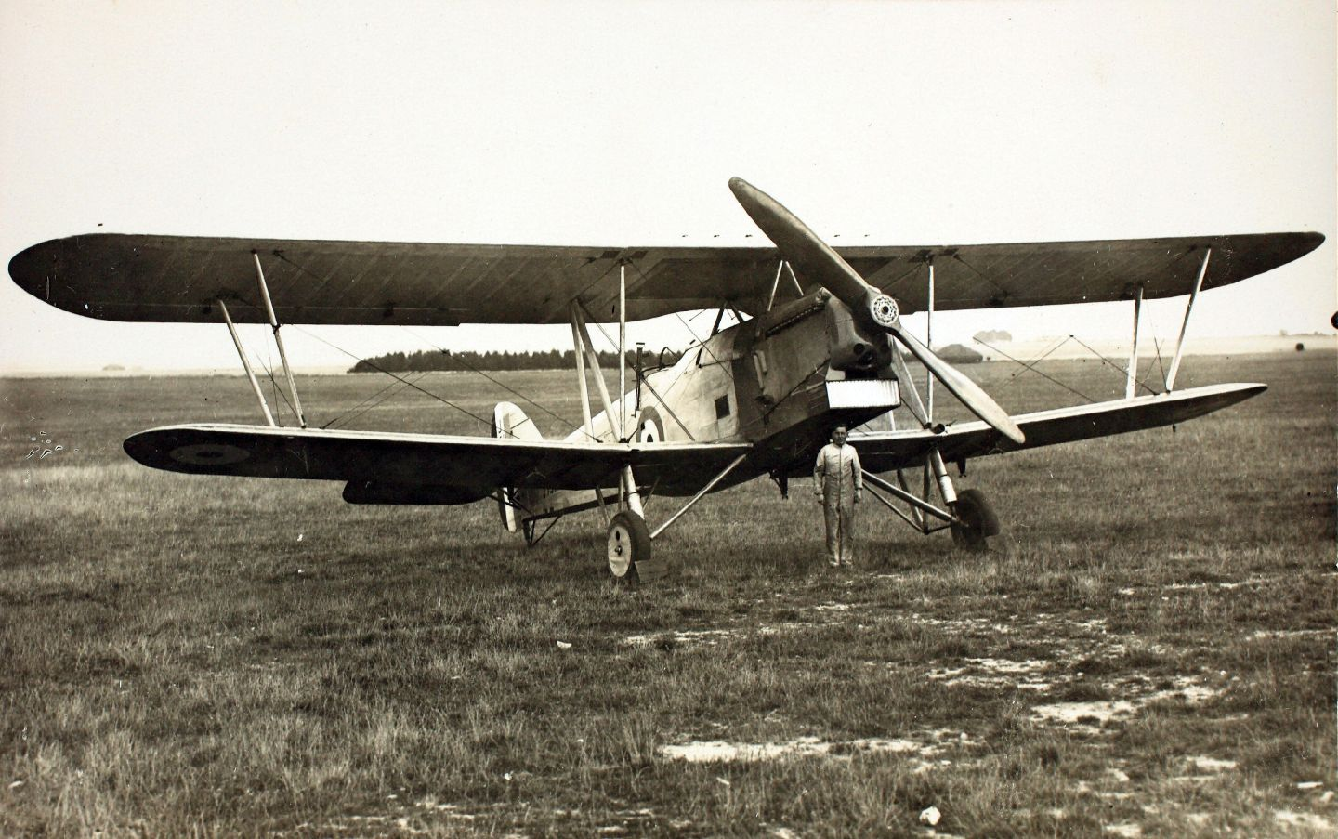
Hawker Horsley torpedo bomber
660hp, 120mph,
1500nm
2 RAF squadrons at
Singapore from 1928

Slide 27
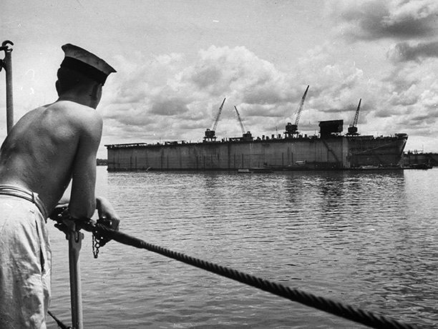
The 50,000 ton capacity floating dock.
1929

Slide 28
The London Naval Treaty 1930
Battleship ‘holiday’ extended until end of 1936
Capital ship numbers reduced: 15, 15, 9
Gunnery training ships: HMS Iron Duke, USS Wyoming, IJN Hiei
  (USS Utah converted as a target ship).
New category of cruisers:
      (a) = 10,000 ton and 8” guns (heavy cruisers)
      (b) = up to 10,000 tons and 6” guns (light cruisers)
Submarine size constrained
– France the main advocate of submarines

Slide 29
The Japanese threat materialises, 1931-41
Sept 1931 – March 1932: The Manchuria ‘Incident’
Jan – March 1932: Shanghai Incident
October 1932: League of Nations report critical of Japan
Feb 1933 League of Nations votes for Japan to withdraw; Japan walks out of League.
1934 Japan gives notice to withdraw from London Naval Treaty
1937: Sino-Japanese War begins
1939: Japan occupies Hainan Island and south coast of China
1941: Japan moves into French Indochina

Slide 30
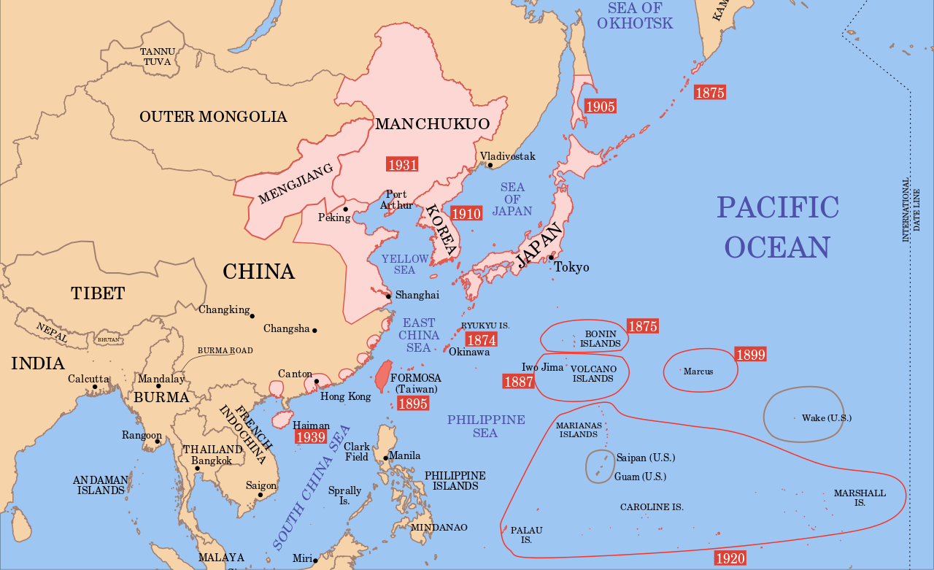
Japan’s Expansion 1874 - 1939

Slide 31
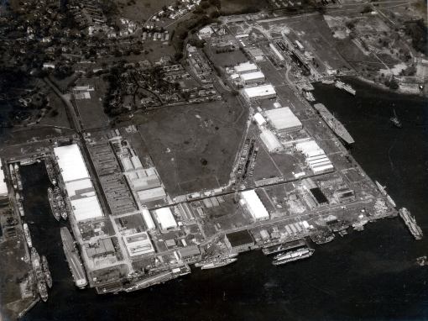
1939-41
The Base Completed
1934: UK Cabinet approves completion of the Base
1938: King George VI dry dock opened (then the largest in the world)
A second, small, floating dock purchased
1939: the base declared operational
1941: work shops and shore facilities finally completed
Overall cost 60 million pounds

Slide 32
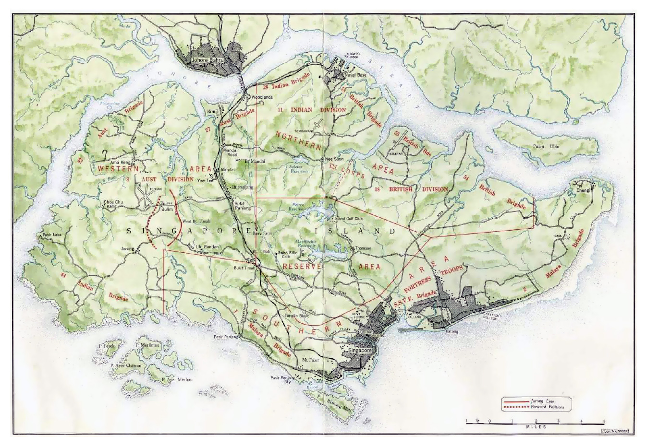

Slide 33
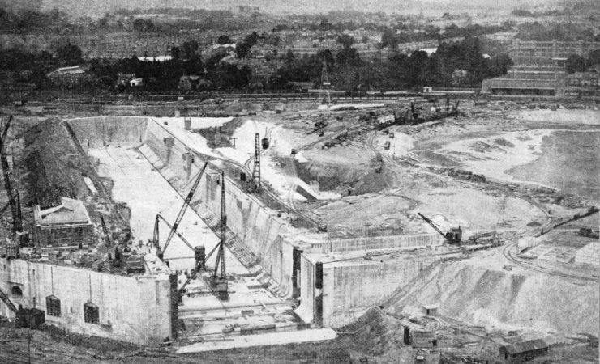
Building the dry dock, 1930s

Slide 34
Slow progress with the Island’s defences
1921 - Time for fleet to arrive: 42 days
4 x 15” proposed
1923 – Admiralty wants 6 x 15”
1924 – Air Ministry proposes RAF as principal defence
2 sqns of torpedo bombers, 1 Sqn Fighters, 1 Flight of Seaplanes
July 1925 CAS agrees to 3 x 15” guns being mounted
1926 – three 15” formally approved, ex RN stocks, to be mounted by 1932
Also 24 x 3” AA approved.
1928 – trials in UK and Malta showed that air spotting was essential for long range coastal defence (9.2” and 15” guns).
1932 – first mounting for one 15” gun completed
1937 – Monitor HMS Terror ( 2 x 15” guns) moored off Pulau Ubin to defend Eastern end Johore Strait (until land-based guns are mounted).

Slide 35
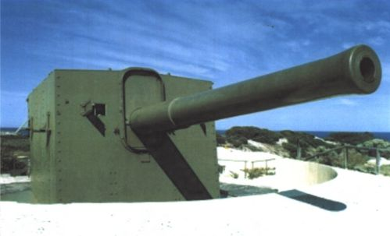
British 9.2” coast defence gun
(at Rottnest Is, Fremantle, WA)

Slide 36
1935 – a turning point: Europe becomes the focus..
Hitler renounces Treaty of Versailles
Anglo-German naval agreement
  (implies one third of RN must stay in home waters)
Italy invades Abyssinia (Ethiopia)
  (Italy now a likely enemy; RN must cooperate with France in Mediterranean – fleet moves from Malta to Alexandria)
Sultan of Johore gives 500,000 pounds – allocated to Singapore’s defences
Also: MGEN Dobbie appointed as Fortress Commander
– assesses that an enemy could invade from the North

Slide 37
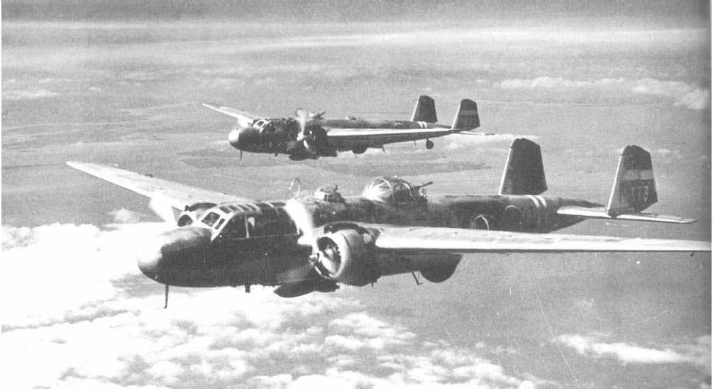
Mitsubishi G3M
‘Nell’ shore-based torpedo bomber, 1935-43
2 x 1000hp
233mph
2400nm

Slide 38
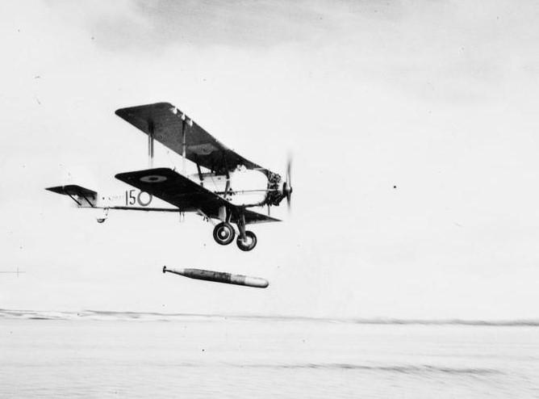
Vickers Vildebeest
1933-42
635hp
143mph
1000nm

Slide 39
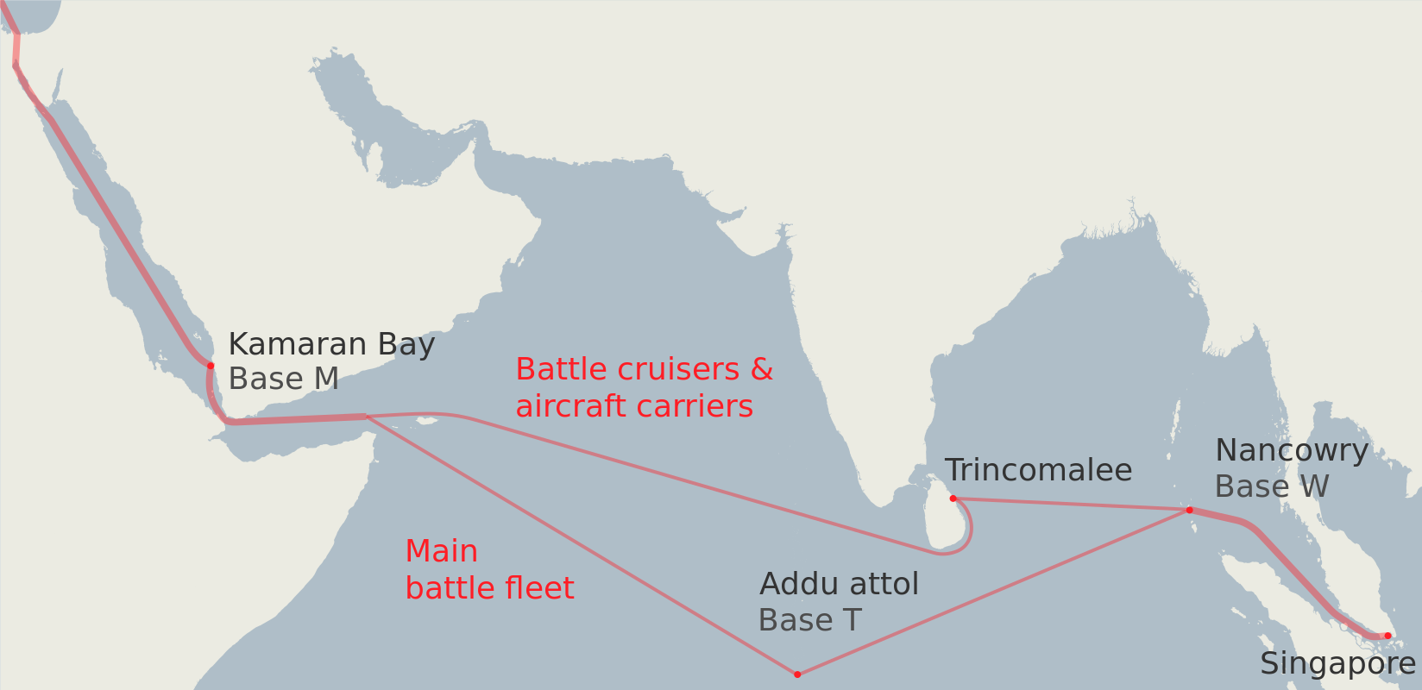
Deploying the fleet to Singapore – the plan
Port T: afloat support and mobile base defence organisation.

Slide 40
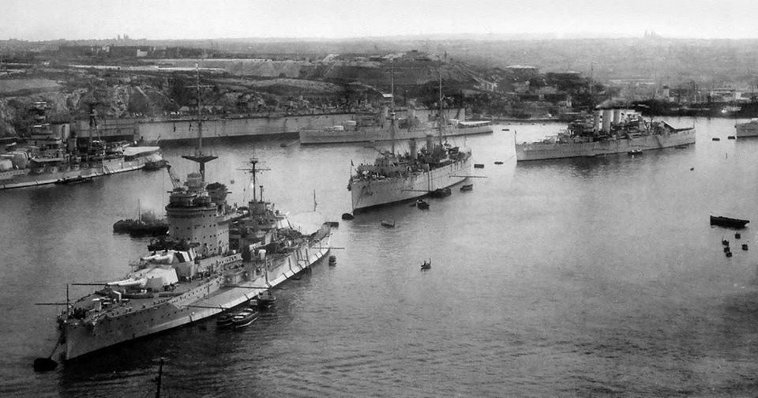
RN: afloat support – the fleet at Malta

Slide 41
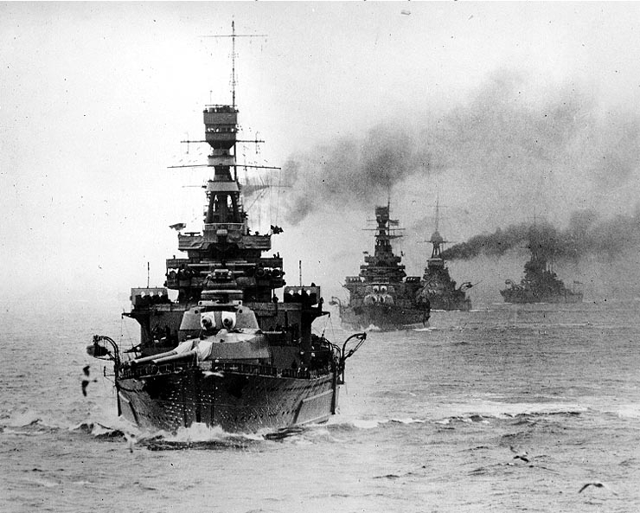
HMS Repulse leads the fleet (1920s)

Slide 42
The Far East Combined Bureau
British Tri-Service intelligence organisation
Set up 1936: Hong Kong then Singapore; evacuated to Ceylon
Led by the Navy
All-source intelligence:
  Sigint – traffic analysis
  Direction finding
  Code breaking
  Humint (via China)
  Defence Attaches
After 1940, links with the Dutch
Close links with US (Station Cast in Philippines)

Slide 43
Singapore’s coastal defences 1936
West Fire command
2 x 15”, 3 x 9.2”, 10 x 6”
East Fire Command (Changi)
3 x 15”, 3 x 9.2”, 8 x 6”
16 fighting lights (narrow beam search lights)
All operational by 1939
1937: Anti-MTB defences approved: 19 x twin 6pdr;
33 lights (some fighting, some fixed)
1937 Admiralty extends time for fleet to reach Singapore as 90 days
1939 Time for relief by the fleet now extended to 180 days.

Slide 44
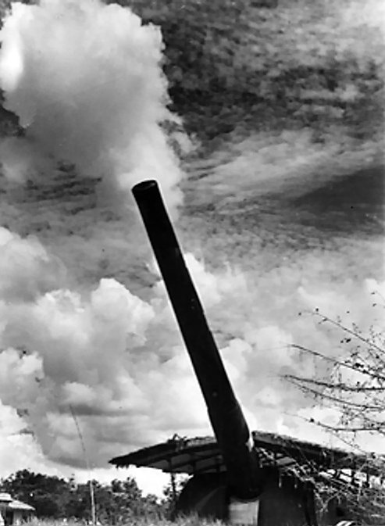
Singapore:
15” mounting at max elevation.

Slide 45
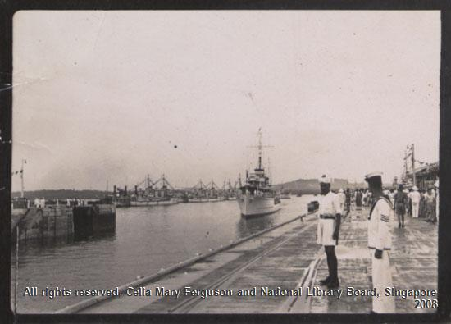
The Opening of the Dry Dock, 1938

Slide 46
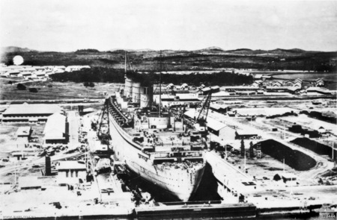
RMS Queen Mary in the Singapore Dry dock 1940.

Slide 47
The Naval Base, 1966

Slide 48
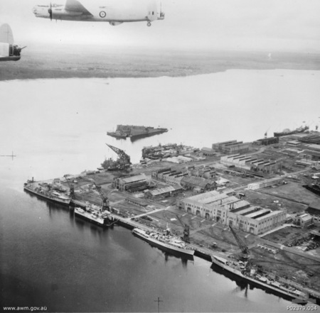
The west and north walls of the Base, 1953.
(Note sunken floating dock)

Slide 49
Singapore: Anti-MTB and AA defences 1942 (actual)
East: 4 x twin 6pdr, 1 x 12 pdr (3”), 1 x 18pdr field gun
West: 6 x twin 6pdr, 1 x 12pdr (3”),
Plus controlled minefields laid in 1941
AA:
2 x 4.5” heavy AA, 41 x 3.7” HAA, 20 x 3” AA
34 x Bofors 40mm LAA
4 x AA searchlight batteries.

Slide 50
1937: End of the ‘battleship holiday’
Battleships
RN: 1 Jan – July: 5 x KGVs laid down; 35,000 tons, 10 X 14” guns
USN: October: 1 x North Carolina-class: 35,000 tons, 9 x 16”
IJN: November: 1 x Yamato: 65,000 tons, 9 x 18”
Carriers
RN: April – Nov: 4 x Illustrious-class; 23,000 tons, 36 a/c
Note: carriers already building under Washington/London constraints
RN: 1935: Ark Royal; 22,000 tons, 54 aircraft
USN: 1934: 2 x Yorktown-class; 25,000 tons, 80 a/c (max)
IJN: 1934 & 36: Soryu & Hiryu; 19,000 tons, 63 a/c

Slide 51
War! 1939 - 1941
Sept 1939: Germany invades Poland; Britain & France declare war
June 1940: Italy joins Germany; France capitulates
June 1941: Germany invades USSR ( Op Barbarossa)
August 1941: Russian Convoys start
          (& Persian Gulf route prepared)
Nov 1941: Japanese forces deploy for war.
8 December: Pacific war begins.

Slide 52
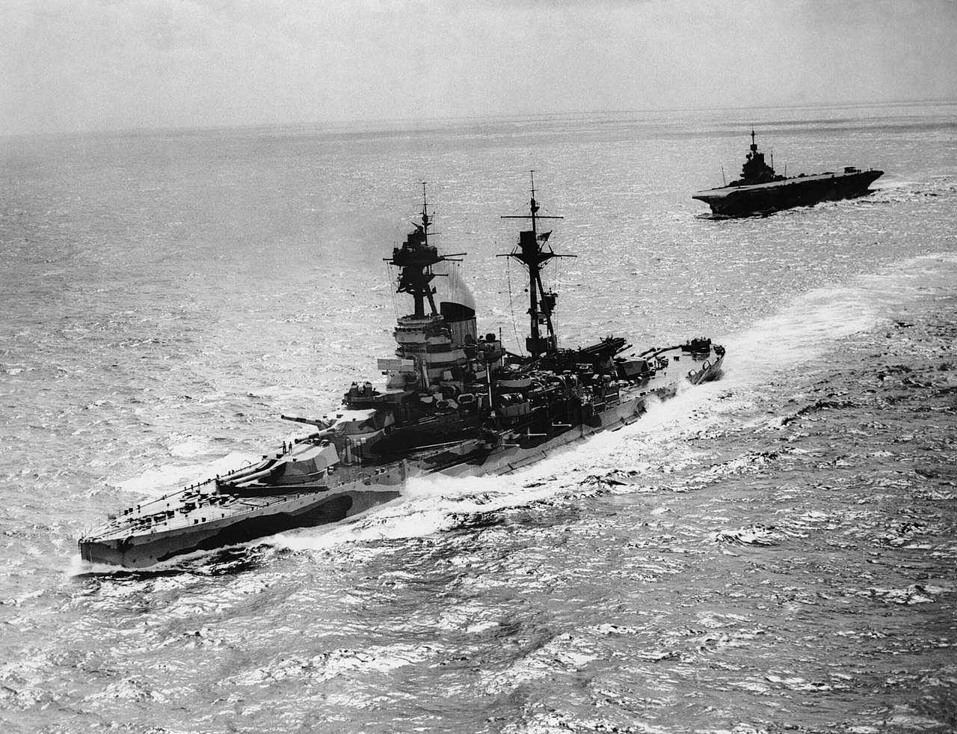
August 1940:
Britain recognises:
Defence of all Malaya
Dependent on air power
The RN’s plan…
HMS Hood plus
2 x R-class battleships
3 x County-class heavy cruisers
12 x destroyers
Resolution and Formidable, 1942

Slide 53
August 1941: The Admiralty’s plan for early 1942…
Trincomalee: 2 x Nelsons & Renown
3 carriers: Hermes,* Indomitable plus Ark Royal*
(after refit)
Indian Ocean Troop Convoys: 4 x R-class battleships
        To defeat raids by Japanese cruisers
Ceylon: Repulse* to arrive as convoy escort, Oct 41
Eastern Mediterranean: 4 x QE-class battleships (3*)
plus 2 x armoured carriers
Home Fleet & Force H: 3 x KGV-class battleships (1*)
plus 1 x QE-class (HMS Malaya)
& 2 x carriers (Victorious and Furious)
* Ships sunk between Nov 41 and April 42

Slide 54
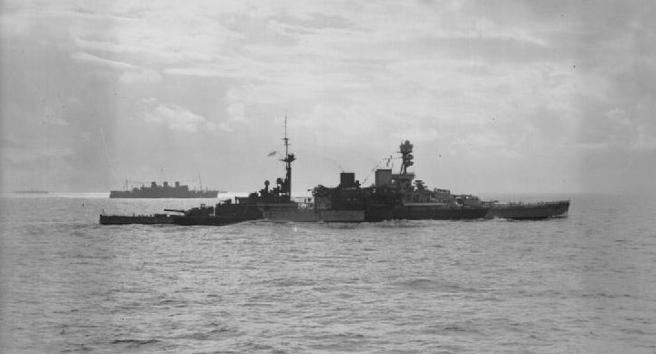
HMS Repulse, October 1941

Slide 55
November 1941: IJN Southern Force
S China Sea
2 x battleships Kongo & Haruna
8 x heavy cruisers
1 x light cruiser
12 x destroyers
At Saigon:
Genzan Air Group 33 Nell torpedo bombers (+ 25 Zero fighters)
Kanoya Air Group 26 G4M Betty torpedo bombers
Mihoro Air Group 30 G3M Nell high-level bombers

Slide 56
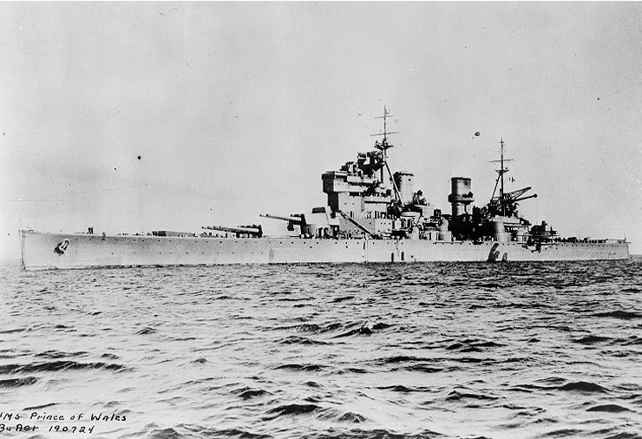
HMS Prince of Wales, 1941

Slide 57
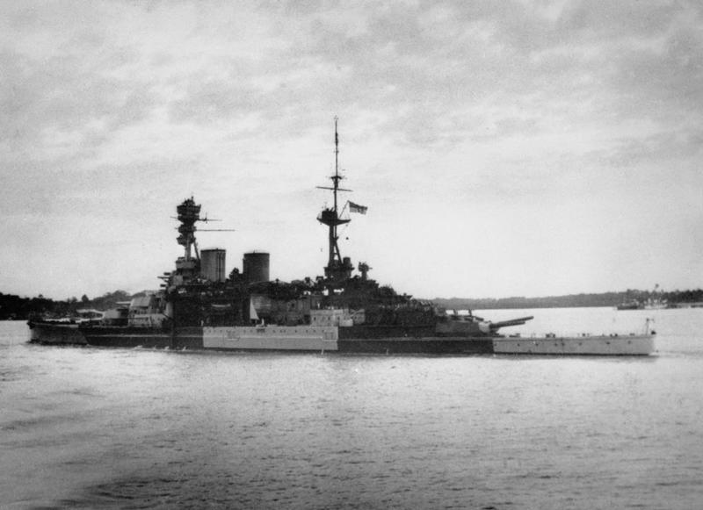
HMS Repulse departing Singapore
8 December 1941.

Slide 58
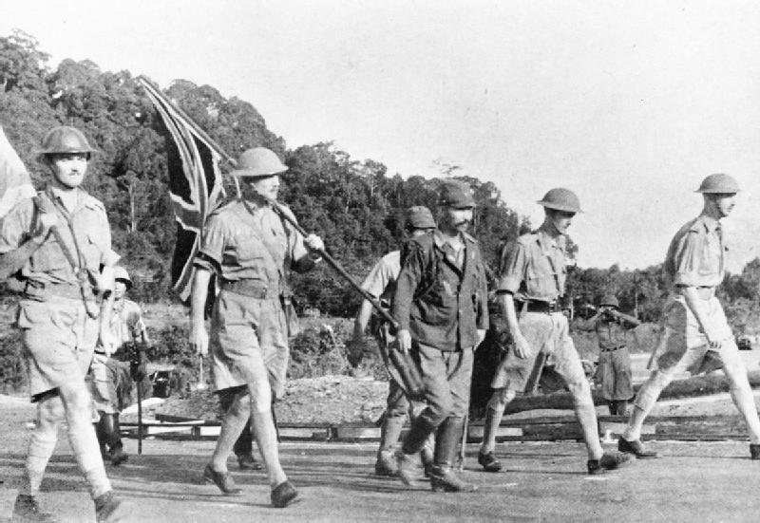
15 February 1942: the British Surrender

Slide 59
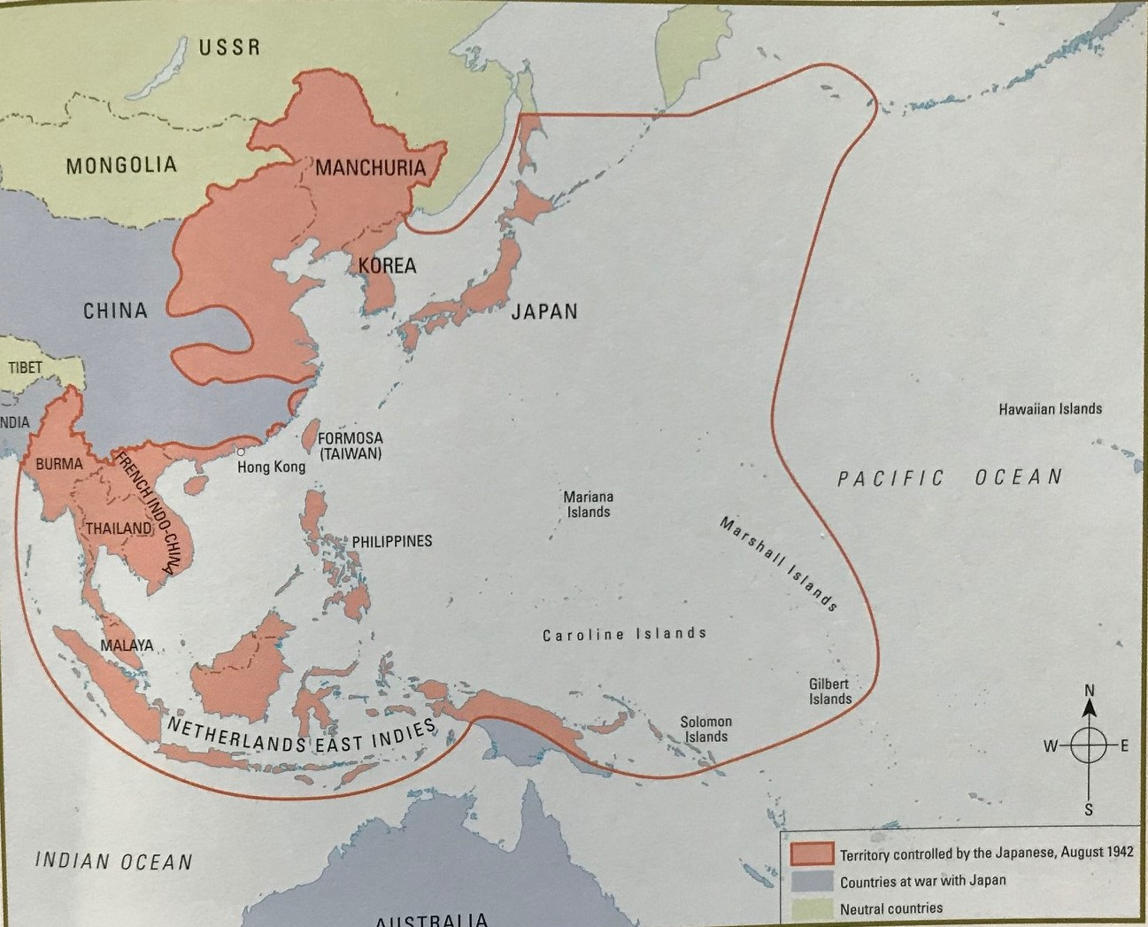
1942: the extent of Japan’s conquests.

