Slide 2
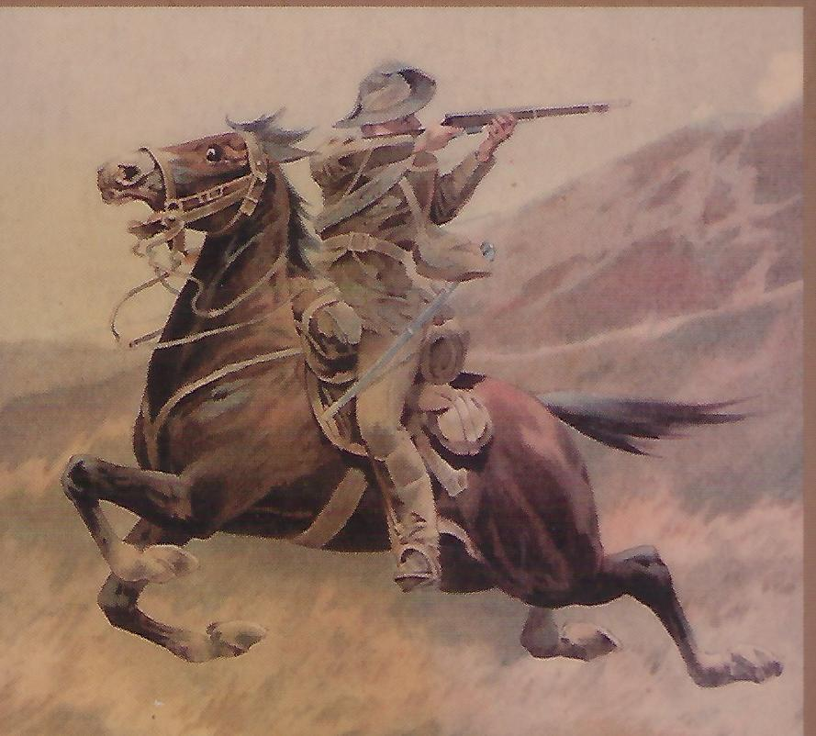
The South African War
(Boer War)
1899 to 1902
Boer Farmers Against the British Empire
New Zealand’s contribution to an Imperial War

Slide 3
Hard to understand this war without a context!!
Let us go right back to the 15th Century in order to put the early 20th Century into perspective.
Let us go back to the start of the Colonial Era – back 500 years

Slide 4
The Doctrine of Discovery
Papal Bull "Inter Caetera"
Pope Alexander VI on May 4, 1493
(Last Papal Bull April 11, 2015)
The Doctrine of Discovery established a spiritual, political, and legal justification for colonization and seizure of land not inhabited by Christians.
Provided a framework for Christian explorers, in the name of their sovereign, to lay claim to territories uninhabited by Christians. If the lands were vacant of Christians, they could be defined as “discovered” and sovereignty claimed.
Established a demarcation line one hundred leagues (550 Kms) west of the Azores and Cape Verde Islands. Aids the expansion of the Spanish Empire into the New World.
US Supreme Court in the 1823 case Johnson v. McIntosh upheld the doctrine – "that the principle of discovery gave European nations an absolute right to New World lands."
American Indians had only a right of occupancy, which could be abolished.
This “doctrine of discovery” became the basis for the claims of all European nations in the New World – and ultimately in other lands including Africa, India, Australia, Canada & NZ.

Slide 5
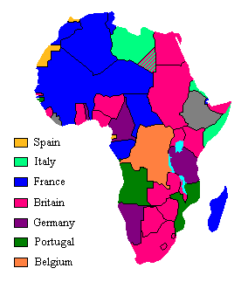
The Scramble for Africa – The New Imperialism
1881 - 1914

Slide 6
In the Beginning
1652 – Dutch, German and French Huguenots arrive in Cape of Good Hope, refugees from religious persecution in Europe.
1657 - Dutch East India Company establishes Cape Town as a victualling stop for ships on way to Dutch East Indies (Indonesia).
Two Colonies established in 1657 – Harman’s Colony and Stephens Colony.
Almost immediate conflict with original Afrikaans (Boers) settlers.
Boers move inland to avoid the Dutch. “Great Trek” begins.

Slide 7
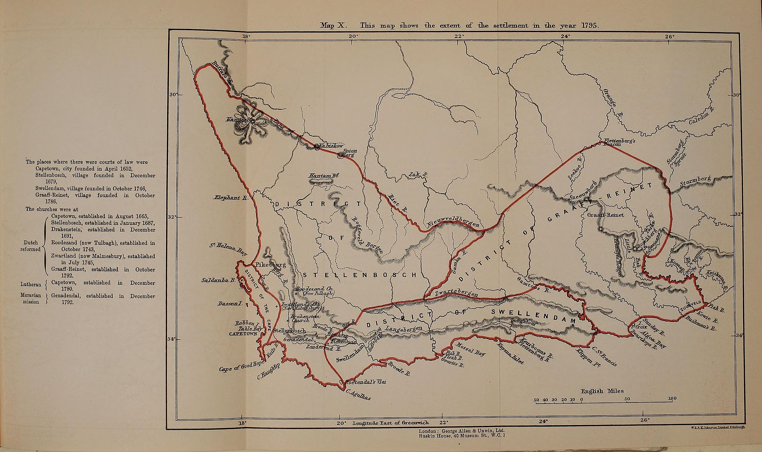
Dutch Cape Colony 1785

Slide 8
British Strategic Concerns
Cape of Good Hope 1803 - 1815
Napoleon’s ambitions turn to Egypt and India. French invade Egypt. Napoleon’s navy beaten by Nelson in Battle of the Nile (Aug 1798). Napoleon cut off in Egypt by British control of the Mediterranean.
Napoleon limps back to France overland, leaves French Army of the Nile in Egypt and captivity.
Strategic value of the Cape of Good Hope – route to India, Dutch East Indies (Indonesia) and Far East
Britain cannot afford for the Cape to fall into French hands
1806 – Britain invades the Dutch Colony of the Cape – defeats weak Dutch forces.
1814 – Dutch cede Cape Colony to Britain.

Slide 9
Early Boer Republics
Republic of Swellendam - 1795
Republic of Graafft-Reinet - 1795
Zootpansberg – 1835
Natalia Republic - 1837
Orange Free State - 1852
New Republic - 1884
Goosen - 1882
Griqualand – 1873
NB – With the exception of Orange Free State none of these Republics was a viable entitiy.

Slide 10
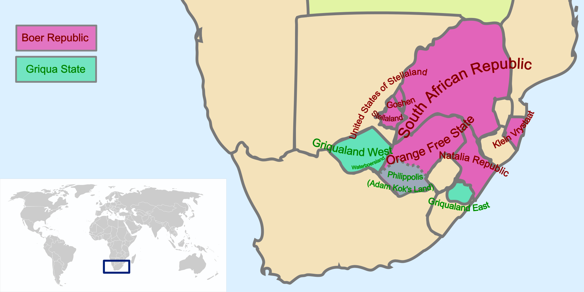
Boer Republics in Southern Africa
19th century

Slide 11
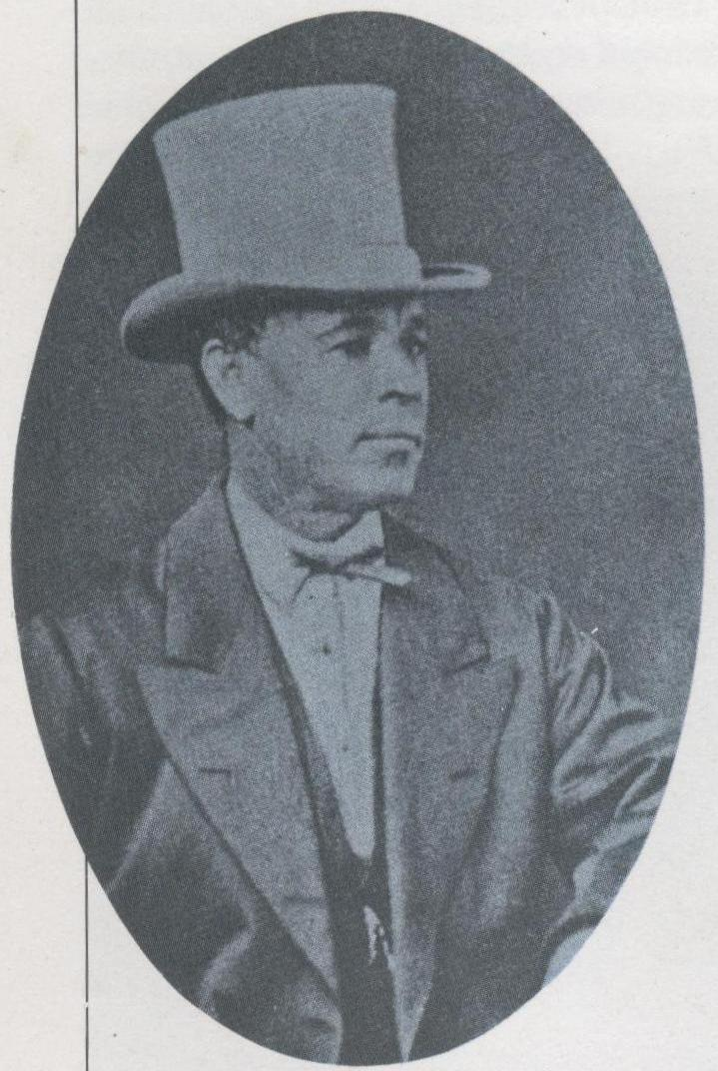
Who Are the Griqua?
The mixed-race groups that developed in the intermarriage of Dutch men and local women adopted various names for themselves – Bastaards, Basters, and Griqua. Many of these groups migrated inland to escape British colonial rule.
David Arnot, a 19th-century Griqua lawyer and diplomat

Slide 12
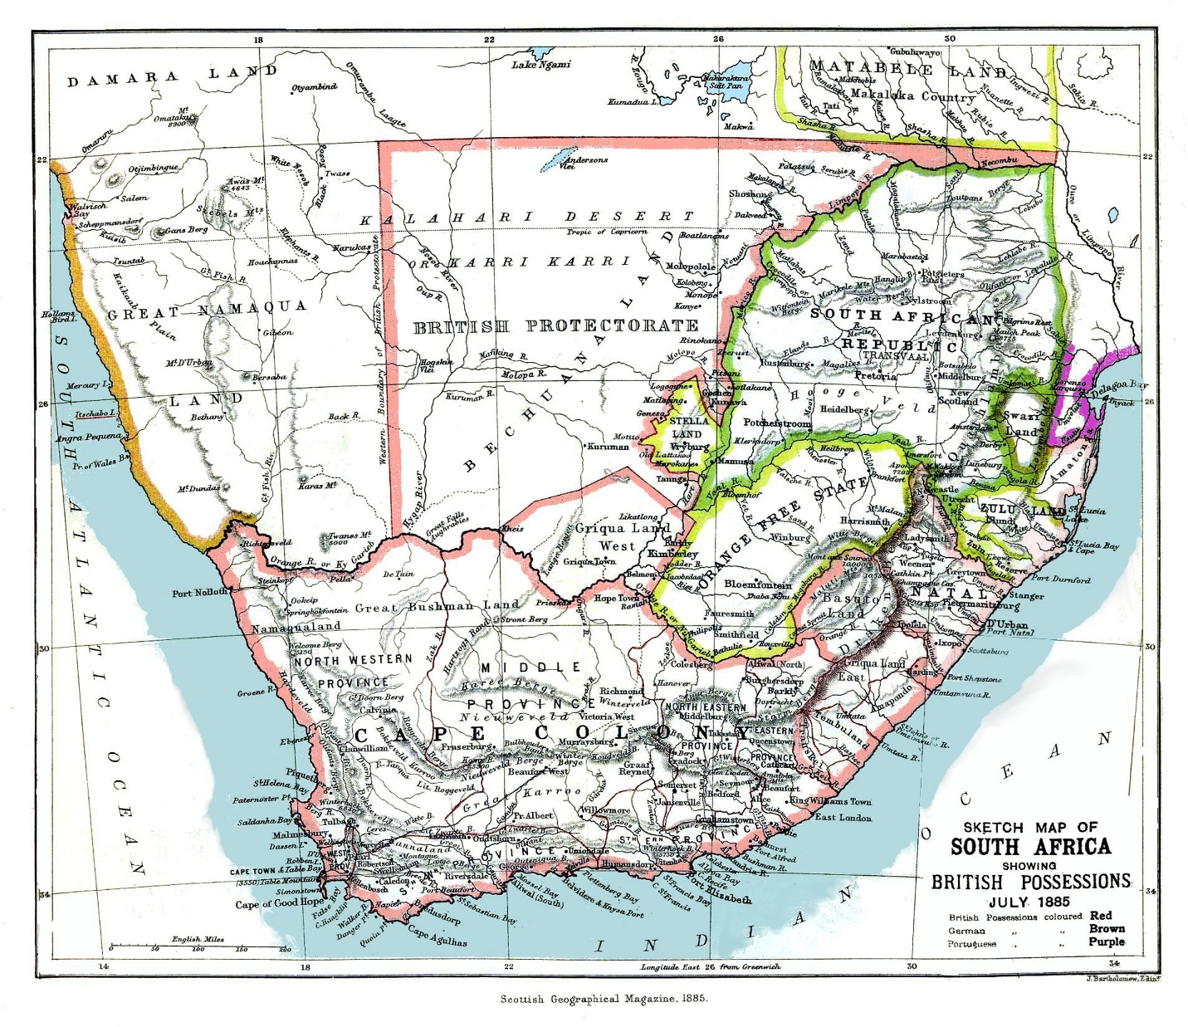
Political Divisions - 1885
Mozambique - Portugal
Namibia - German
South African Republic (Transvaal) - Boer
Botswana - British
Orange Free State - Boer
Drakensberg Mountains
Cape Colony - British

Slide 13
Rail System – 1890
The lifeblood of S. Africa

Slide 14
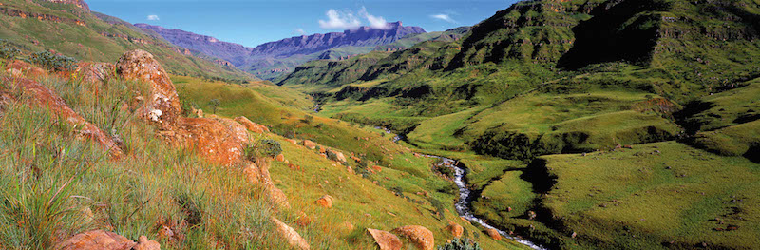
Sani Pass – Drakensberg Mountains

Slide 15
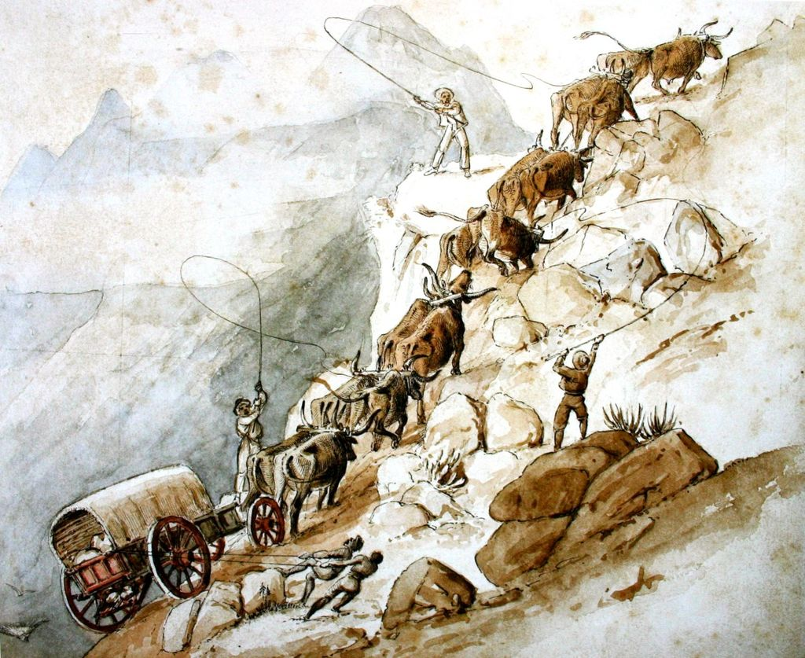
“Trekking” begins 1700
(Boer trekkers escape Dutch & then English)

Slide 16
Background to the Boer War No:1
Conflict between British interests and the Boers’ desire for independence. In the 1830s most Boers (Dutch, German and French descent, and now known as Afrikaners) rejected British rule.
British abolition of slavery (1833) in direct contradiction to Boers belief that they were entitled by their God to own slaves. (St Paul’s admonition to Ephesians and Colossians, “slaves, obey your earthly master”.
Moved North in what became known as the Great Trek.
Established many Republics but later these coalesced into Orange Free State and South African Republic (Transvaal)
1877 – Britain annexed the Transvaal which was in economic decline.
British rule was very unpopular and in 1880 the Boers of the Transvaal rebelled and threw the weak British forces out of Transvaal.
1881 – Armistice signed and the 1st NZ Contingent for the war was disbanded .

Slide 17
Background to the Boer War No:2
1886 – Gold discovered in Transvaal. Huge influx of “uitlanders” mainly British. Uitlanders denied citizenship by Boers.
Cause of increasing tensions between Transvaal, Orange Free State and the British.
1895 – Incursion into Transvaal by British inspired “Jameson Force” in attempt to instigate an uprising by Uitlanders. Jameson Force fails. Cecil Rhodes implicated in the raid & resigns as PM of the Cape Colony.
Britain determined to end Boer independence in both Boer Republics. Spurred on by discovery gold in Transvaal and diamonds in Kimberley (Orange Free State).
September 1899 – Both sides prepare for war.
September 1899 – PM Seddon offers a NZ contingent of 200 mounted infantry and Britain accepts in October 1899, stipulating that no Maoris were to be sent. This was going to be a “white man’s war”.

Slide 18
The Boer Commando System
System dated back to the early days of “The Great Trek”.
When danger threatened, all Boers (or “burgers” or “citizens”) between 16 and 60 were required to join local commandos.
Each man supplied his own horse, rifle, ammunition and rations for 2 weeks.
Commando members elected their own officers, and they could vote to disobey their own officers.
Commandos grouped into a larger force under the command of a General appointed by the republic’s President.
British officers held this organisation in disdain but, for more than 200 years this system had defeated Bantu armies such as the Zulu, and the British Army in the Transvaal.
Both of the final republics (Transvaal and Orange Free State) maintained good artillery units.
Boer republics bought modern weapons in Europe with revenues from newly discovered gold and diamonds

Slide 19
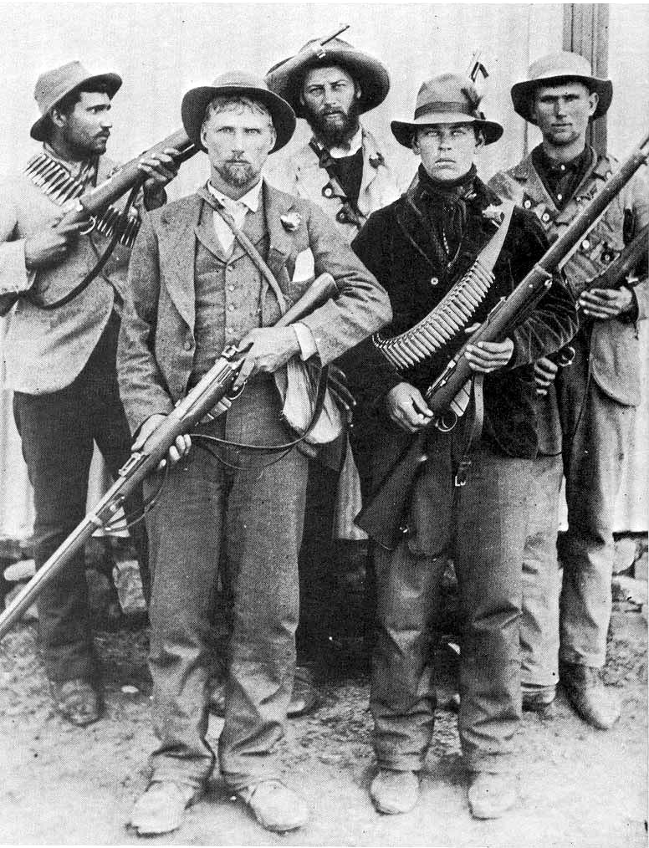
“By God and the Mauser”
Organised as “commandos” – 100 to 200 local men in very loose groupings. Seldom coalesced into groups larger than 500.
Boer “Army” non-existent except for some artillery units.
Boers armed with latest weapons – Mauser rifles, machine guns, and rifled artillery, bought with gold & diamond revenues.
No Boer infrastructure – no supply chains, no ammunition resupply, little medical facilities.
Bound together by religious and family ties, but little coordination of strategy and tactics.

Slide 20
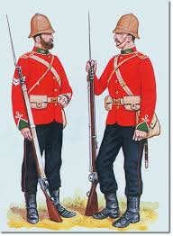
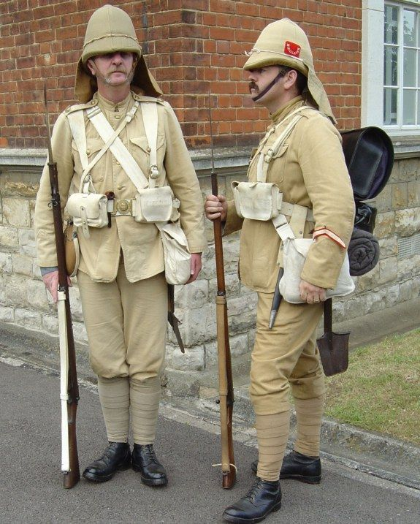
British Uniforms – Boer War

Slide 21
Battle of Spion Kop - 24th January 1900
British tactics, developed on the North-West Frontier of India, Zululand, the Sudan and in other colonial wars against poorly armed tribesmen.
Shoulder to shoulder formations were effective against these types of attack.
A disaster against modern weapons of the Boers. British fail to appreciate the effect of long range, magazine fed rifle fire.
NZ troops using their horses for rapid movement rather than the charge, advancing by fire and manoeuvre in loose formations and making use of cover, rather than the formal advance into a storm of Mauser bullets.

Slide 22
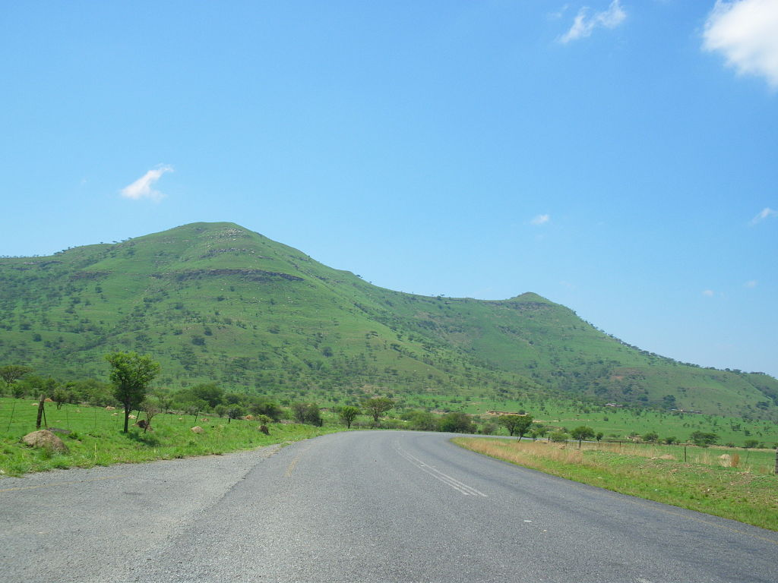
Spion Kop

Slide 23
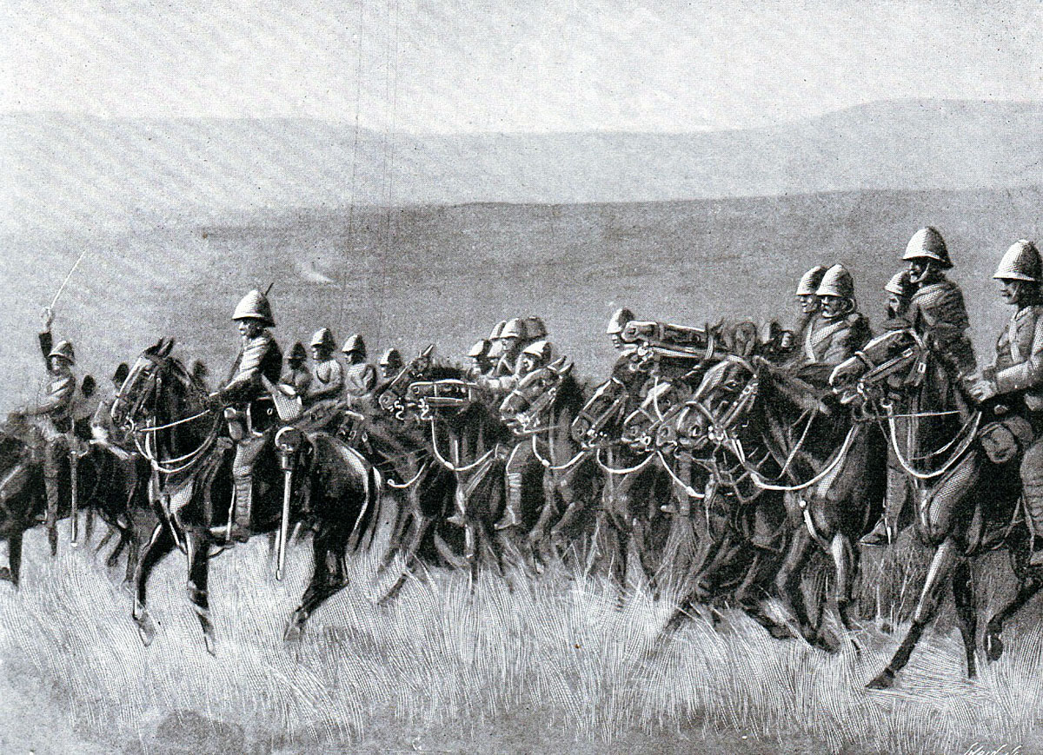
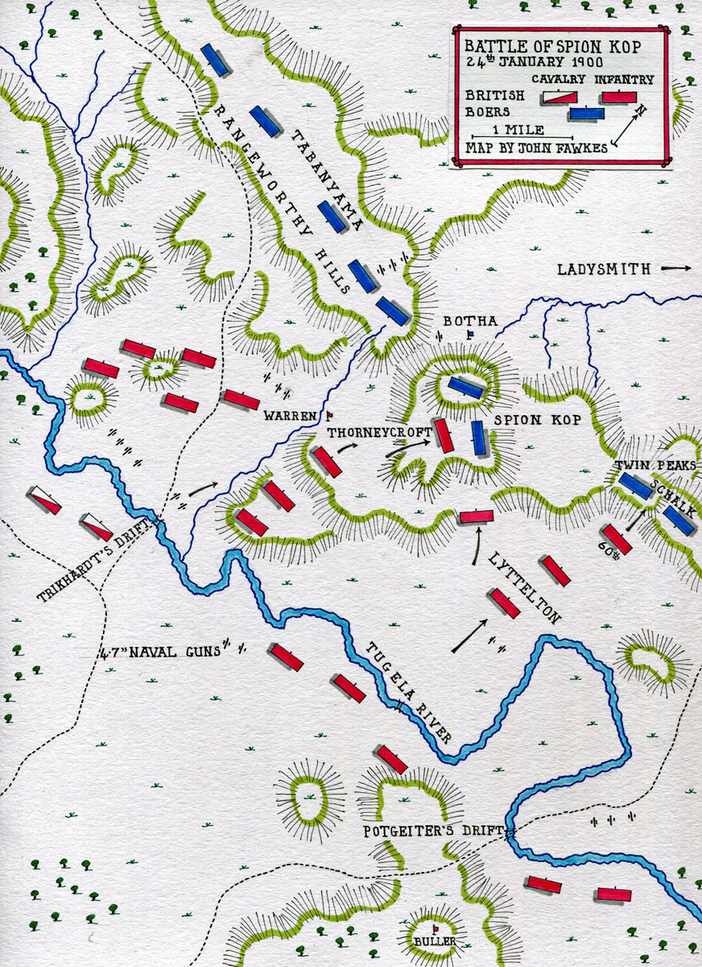
Battle of Spion Kop - 1900
Plenty of elan but too few brains

Slide 24
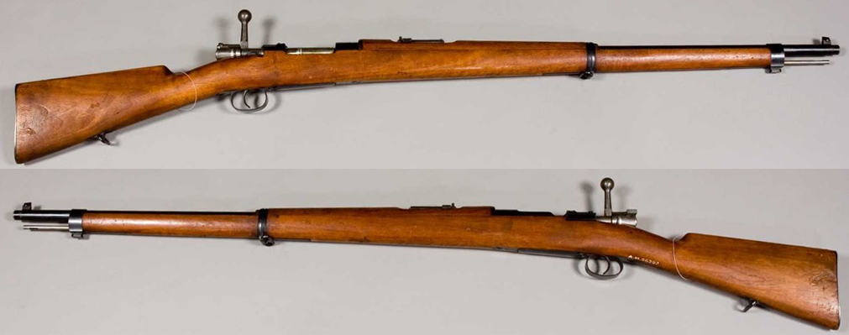
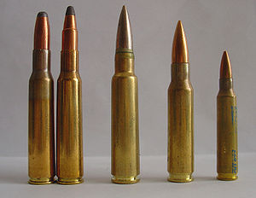
The Boer’s favourite weapon – Mauser
Specifications:
Wt = 3.9 Kgs
Length = 1.220 mms
Muzzle Velocity = 700 m/s (2297 f/s)
Effective range = 500 m or 550 yds
7.5 x 57 mm
.308 mm Winchester
.223 mm Remington
Mauser 7 x 57 mm

Slide 25
Scorched Earth Policy
Kitchener’s Strategy
When Lord Kitchener became the CinC (Nov 1900) he ordered:
  whole-scale destruction of farms
  All farms buildings burnt to the ground.
  All crops destroyed.
  All animals to be slaughtered
Result was:
  90% (or 30,000) of all Boer farms destroyed
  40 towns totally or partially destroyed
  Over 3.6 million sheep slaughtered.
  Concentration camps appear for the first time in history.

Slide 26
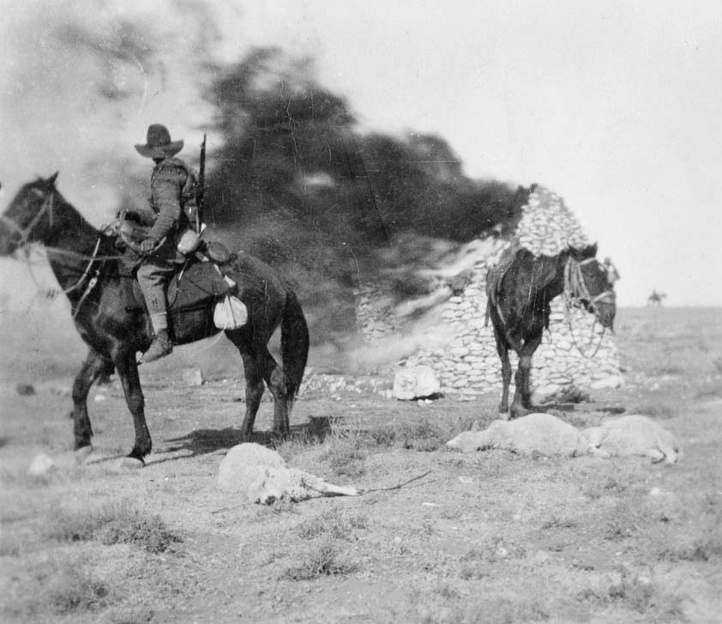
Members of NZ 6th Contingent burn a Boer farm -1901
Note the slaughtered sheep

Slide 27
Concentration camps
As direct result of the Scorched Earth Policy all non-combatant Boers were placed in concentration camps.
Over 130,000 Boer women & children, as well as older men interned in over 55 camps
Suffering and disease were rampant
Estimated that 27,000 died from starvation and disease epidemics.
Of total Boer fatalities only 12% died in battle, but; 65% of the casualties died in concentration camps.
65 Separate concentration camps for Africans were also established. (Boer labourers and tenant farmers)
Up to 14,000 Africans died in these camps.
Captured Boer officers interned in St Helena (Napoleon’s prison island) , or modern Sri Lanka (Ceylon) – most never returned to Africa.
British reformer, Emily Hobhouse, visited all camps and campaigned to ease the suffering.
Her efforts were not liked by Kitchener and staff, but gradually received recognition in the UK

Slide 28
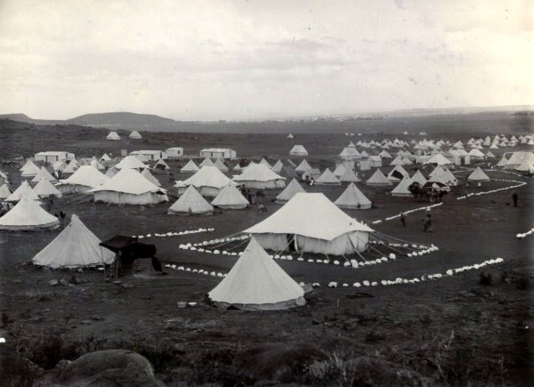
Concentration Camp – Bloemfontein 1901
POWs were then sent to POW
camps on St Helena
or Ceylon (Sri Lanka)

Slide 29
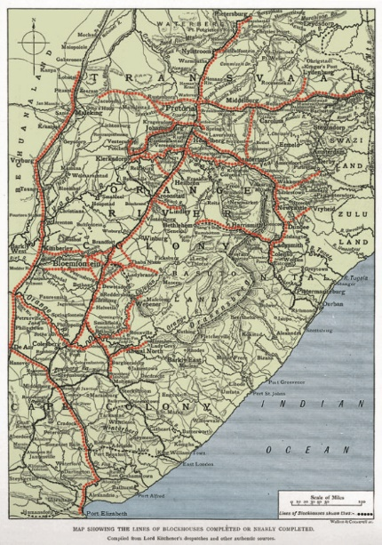
Barbed Wire and Blockhouses -1902
Blockhouses and Wire
Railways South Africa - 1902

Slide 30
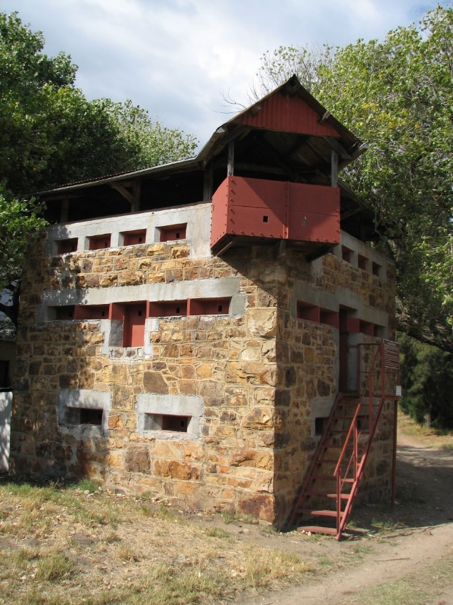
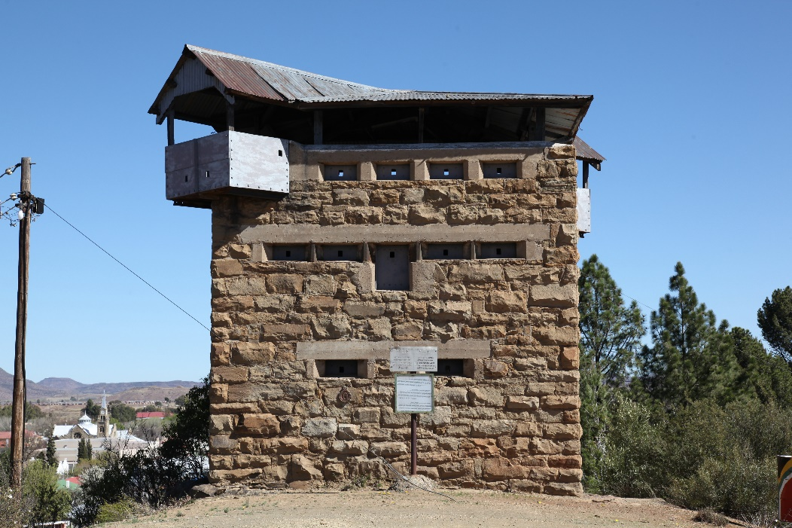
Typical blockhouse
Prefabbed in Cape Town and brought in by rail.
50,000 British + 16,000 African troops defended these blockhouses.
Total Boers in the field = 30,000.

Slide 31
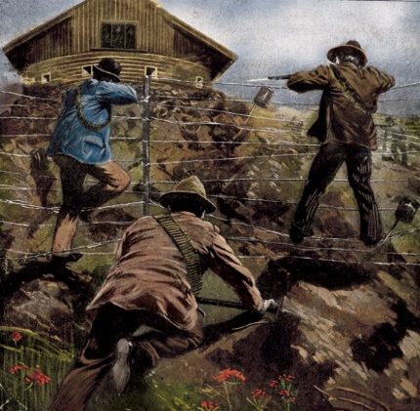
Boers Attack a Blockhouse
Guerrilla Phase of War - 1902

Slide 32
Losses – Boer War – Oct 1899 to May 1902
British Losses = 28,000
Boer Losses = 4000 + over 26,000 civilians in Concentration Camps
African (Boer servants, tenant farmers and camp followers ) Losses = 28,000

Slide 33
END OF PART ONE

Slide 34
To Fight for the Empire
South African War 1899 to 1902
Note the crossed British and New Zealand flags – a recurring theme in 1899

Slide 35
The Link Between New Zealand and the Motherland
Haka written for NZ Contingents
Solo: Kia Kaha – (Be Strong)
All: Hi - (Yes)
Solo: Kia Toa – (Be Brave)
All: Hi – (Yes)
Solo: Puritea te mana o Kuini – (Uphold the supremacy of the Queen)
All: Hi, Ha, Ha – (Yes, Yes, Yes)

Slide 36
Patriotism or Jingoism?
Patriotism – national pride, love, devotion and sense of attachment to a homeland.
Jingoism – excessive bias in judging one’s own country as superior to others - an extreme type of patriotism

Slide 37
Maori in the Boer War
A “White Man’s” War
“If the white races of the world are to employ yellow and black troops in their wars with one another, the end of European civilisation would be within measurable distance.”
Editor of the Evening Post (27 December 1900)
NZ Premier Richard Seddon offers a Maori Contingent – Refused
Maori MP offers to recruit and train 500 Maori to fight in South Africa – refused.

Slide 38
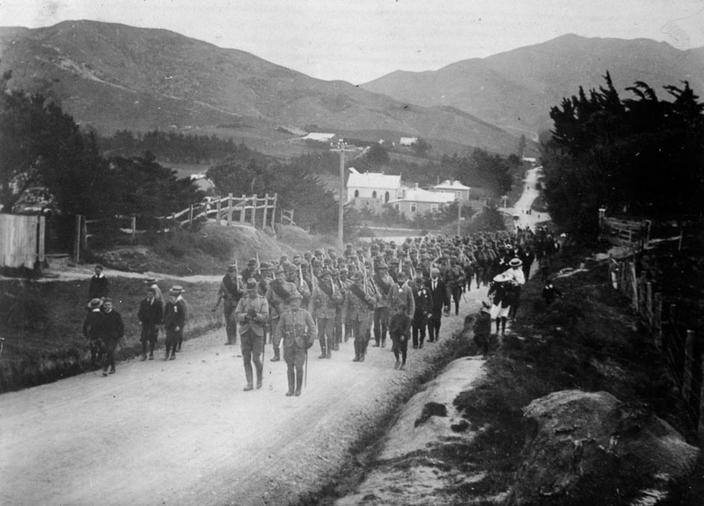
1st NZ Contingent
Men of the 1st Contingent march down Karori Road , Wellington on their way to embarkation.
21 October 1899.

Slide 39
NZ Mounted Infantry
Note: “Mounted Infantry” NOT “Cavalry”. Horses were a mode of transport to get infantry to an attack position. Infantry then dismounted and fought on foot.

Slide 40
The Ngapuhi Nursing Sisters - Whangarei
No “White Mans” War here!

Slide 41
The Greymouth Khaki Corps – 1900 to 1902
Other Patriotic Corps – Dannevirke Huia Khaki Corps, Te Awamutu Amazons

Slide 42
A Ladies Patriotic Group from Temuka
All over NZ patriotic marches, fund raisers, fetes, race meetings, formation bike rides etc raised money to equip the 10 contingents to be sent to South Africa.

Slide 43
Zealandia descends from her throne to
Welcome a Kiwi Officer home!!

Slide 44
NZ Population in 1902 = 750,000.
Highest proportion of any of Britain’s self – governing colonies

Slide 46
Some Conclusions
Myth No: 1 - Success of NZ’s contribution to the war encouraged the myth that NZ required thousands of marksmen, not organised military forces for its defence.
Myth No: 2 – NZ will always “punch above it’s weight” militarily.
Myth No: 3 - New Zealanders are natural soldiers who require only a modicum of training to perform effectively.

Slide 47
Some More Conclusions
Fact No: 1 - It took two years and a quarter of a million men to defeat around 25,000 hard-core guerrillas. This is the reality of asymmetrical warfare in the modern world. There are no quick fixes.
Fact No: 2 – The Boers suffered from the same limitations as Maori in our Land Wars – no military organisation, (each commando fought mainly alone), no infrastructure, (Boers fought with what they came with to the battle.)
Fact No: 3 – Many men returning to NZ joined the Permanent Army or the TF and brought back useful knowledge of modern warfare, and became the backbone of NZ Forces in WW1.
Fact No: 4 – NZ Mounted Rifle units were highly regarded by senior British officers. “Generally better educated and superior to the Australians and Canadians”. “Made themselves very popular out here; they are spoken very well of by all and greatly preferred to the Australians”.
Fact No: 5 – Involvement greatly enhanced a sense of national identity. Henceforth NZ insisted on its troops serving in distinct national units. Caused conflict with Britain in two World Wars.

Slide 48
The Legacy
NZ Commanders had (wherever possible) marked the spots where NZ troops had been buried.
230 NZ troops buried in S Africa.
After the war, the NZ Govt paid for more than 40 monuments to be placed over the spots where NZ soldiers had been buried.
Sites looked after for a time by various “Loyal Guilds”.
Many graves now in advanced states of disrepair. Some have disappeared.
What do we really mean by: “At the going down of the sun, and in the morning, we will remember them”?
Last South African War Veteran dies 27th June 1981

