Slide 1
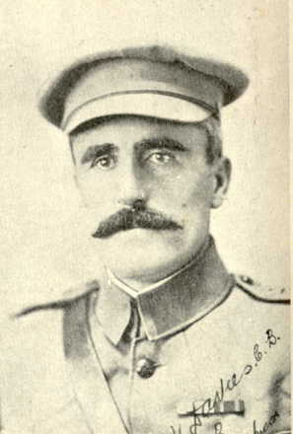
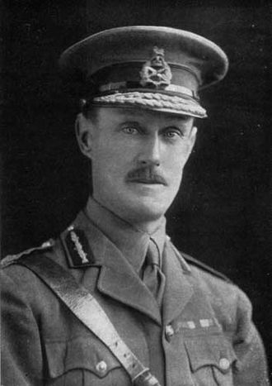
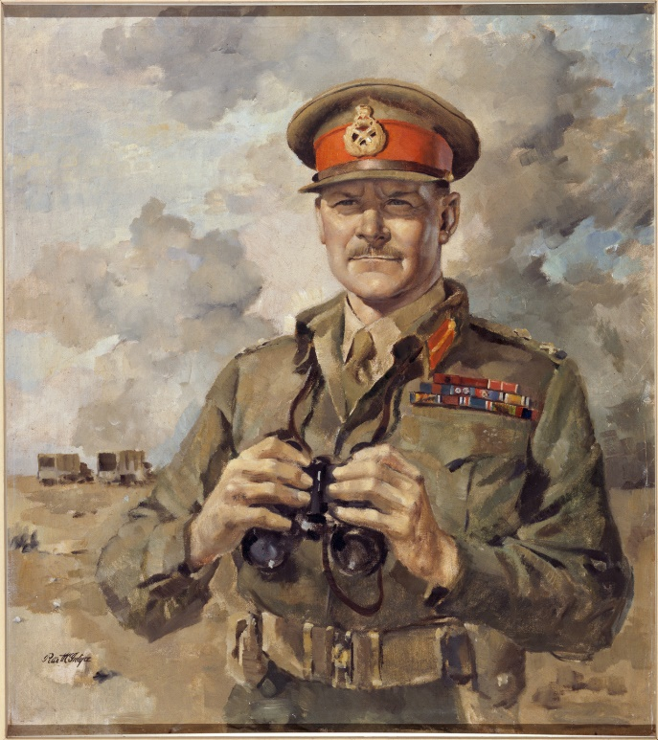
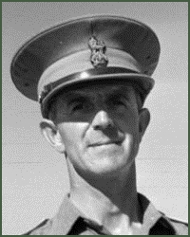
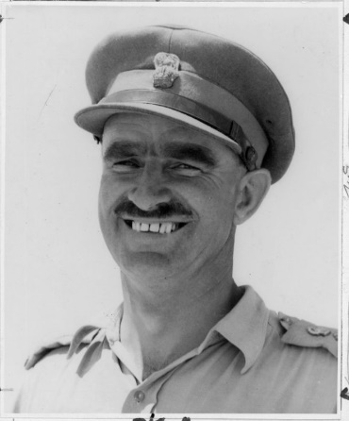
New Zealand Command in War
“Trust;, Training, Thoroughness”

Slide 2
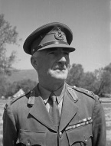
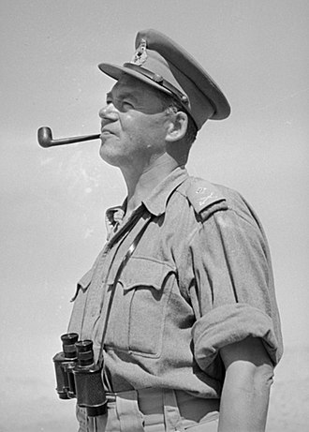
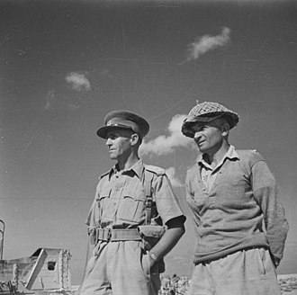
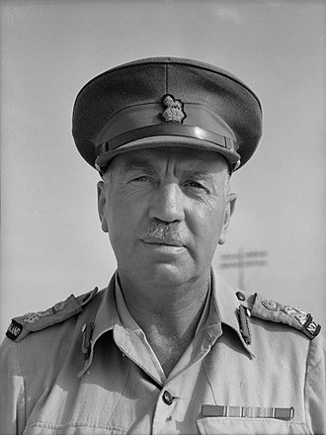
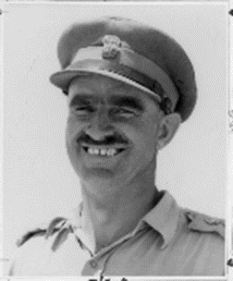
Many were called?
Puttick
?
Kippenberger
?
?
Parkinson
?
Weir
Inglis
Some could not step up to the next level?

Slide 3
Major-General Sir Andrew Russell –
1868 – Napier
Harrow and Sandhurst
1887-1892 5 years Border Regt in Burma and India.
Sheep farming family property Hawkes Bay
Territorial Brigade Comd, Well Mtd Rifles Bde
Comd NZMR Bde, NZEF - 46yrs
GOC NZ& A Division –November 1915
GOC NZ Division 1916-1919

Slide 4
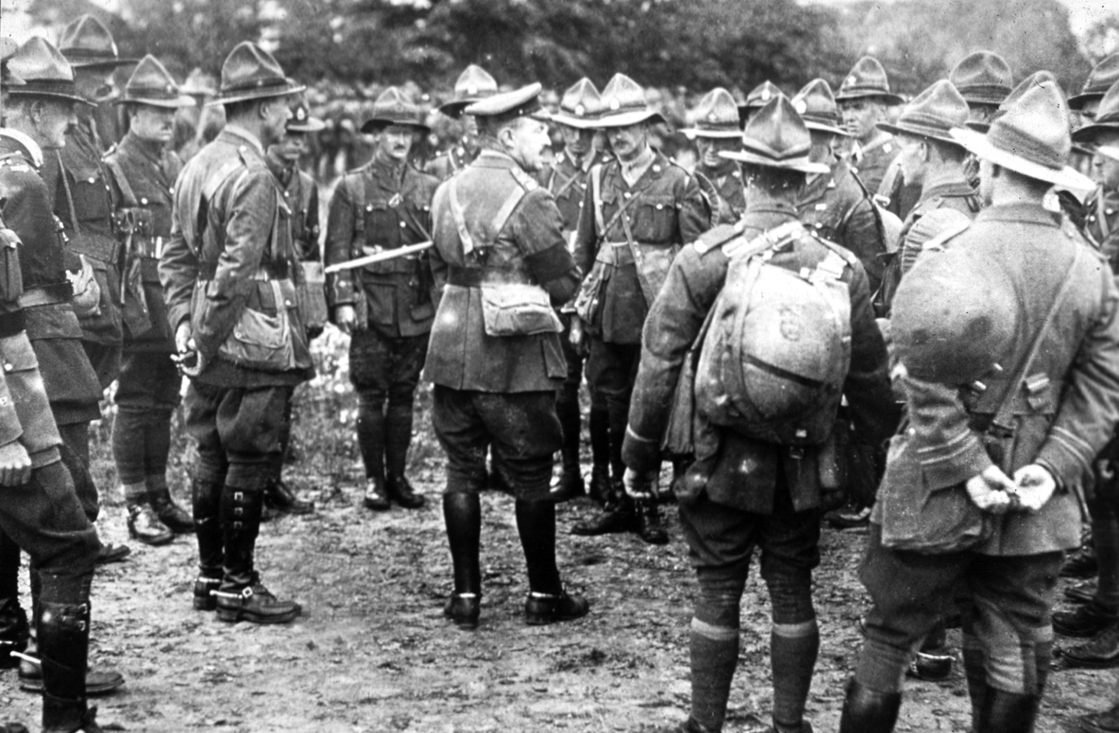
‘Trust,Training,Thoroughness’

Slide 5
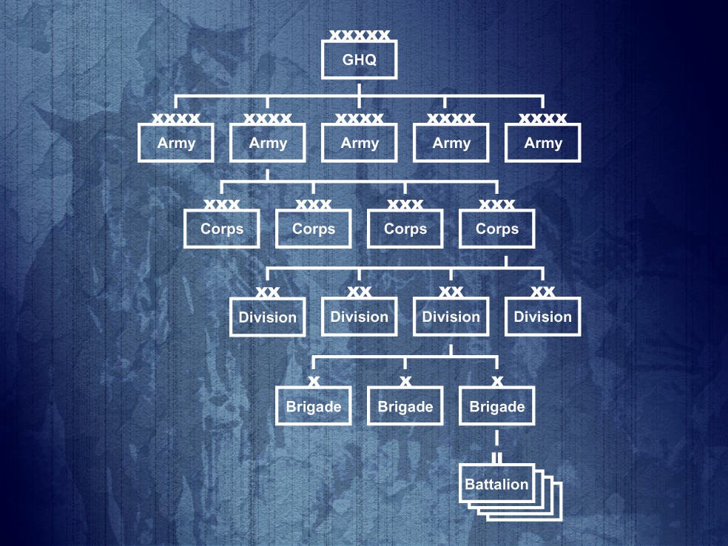
The British Expeditionary Force
1 ANZAC
11 ANZAC
XV Corps 1916
IV Corps 1918

Slide 6
The British Expeditionary Force
Third Army
IV Corps
NZ
Division
1NZ Inf Bde
1 Auck
2 Auck
1 Well
2 Well
2 NZ Inf Bde
1 Cant
2 Cant
1 Otago
2 Otago
3rd NZ Rifle Bde
1 Rifles
2 Rifles
3 Rifles
4 Rifles

Slide 7
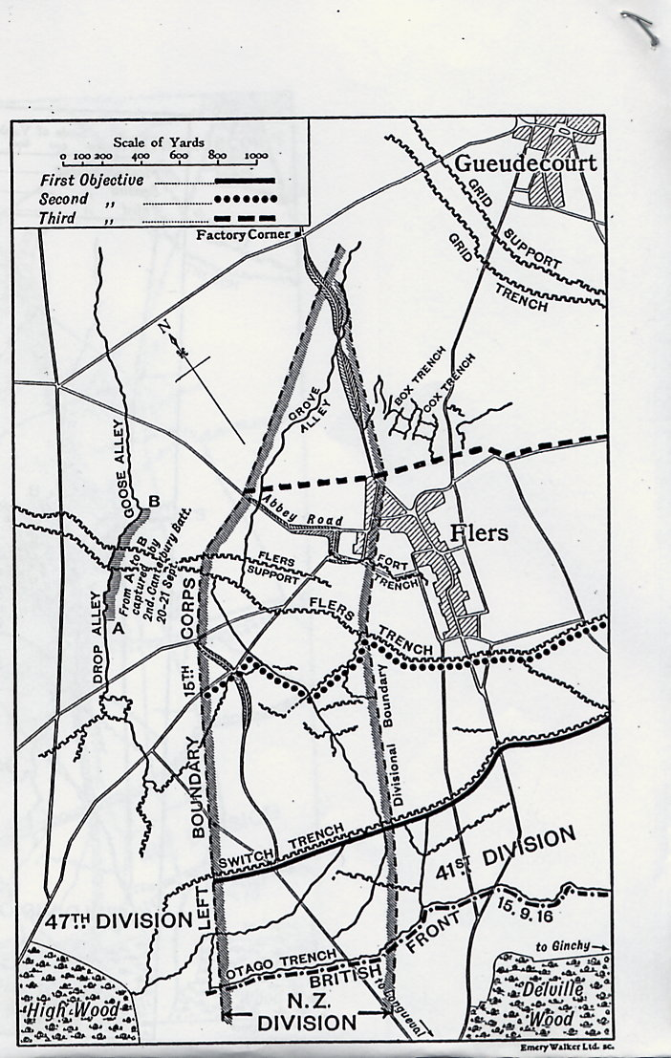
The New Zealand Division on the Somme 15 September 1916

Slide 8
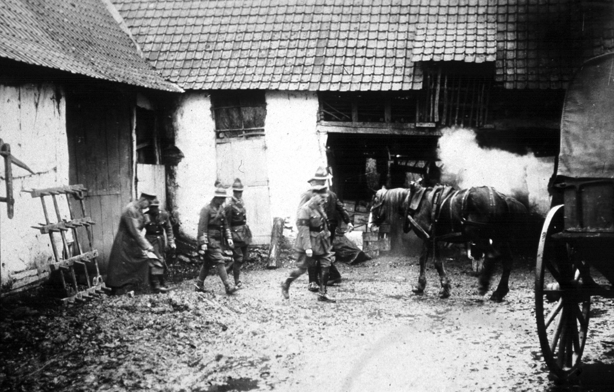
‘I have thought a great deal more about fighting than about administration … but when one sees the waste and unnecessary friction which is set up by want of administrative experience and knowledge, one realises it plays just as important a part in the success of the war as the actual fighting.’
Major-General Sir Andrew Russell, GOC NZ Division

Slide 9
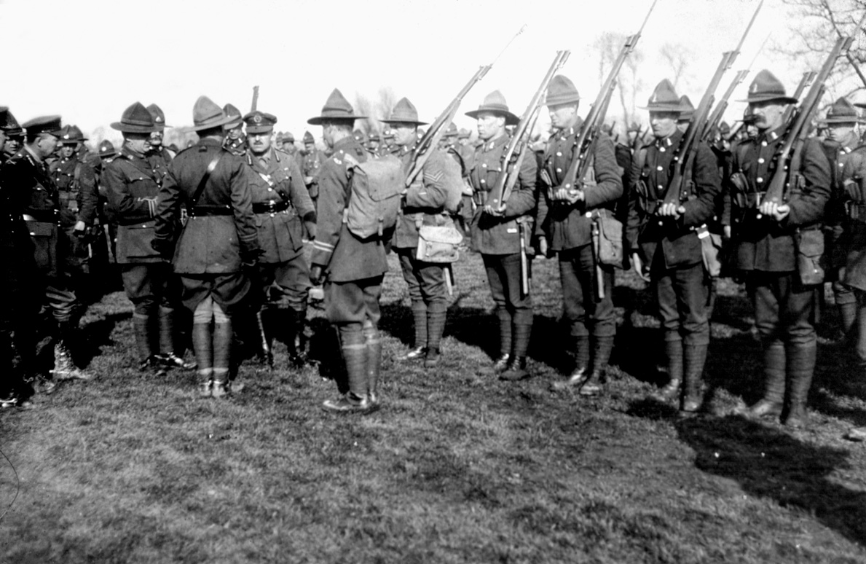
Russell demanded his junior leaders knew their men and did their job
This was a platoon commander’s war

Slide 10
‘Trust, Training, Thoroughness’ 1918
‘I have no hesitation in saying that the men of this
Division are as fit and eager as in the past, and they
really have done extraordinarily well during the last
month, which has given, I think, scope for their inate
[sic] qualities such as which they have not had before.’
Russell to Allen 16 Sep 18

Slide 11
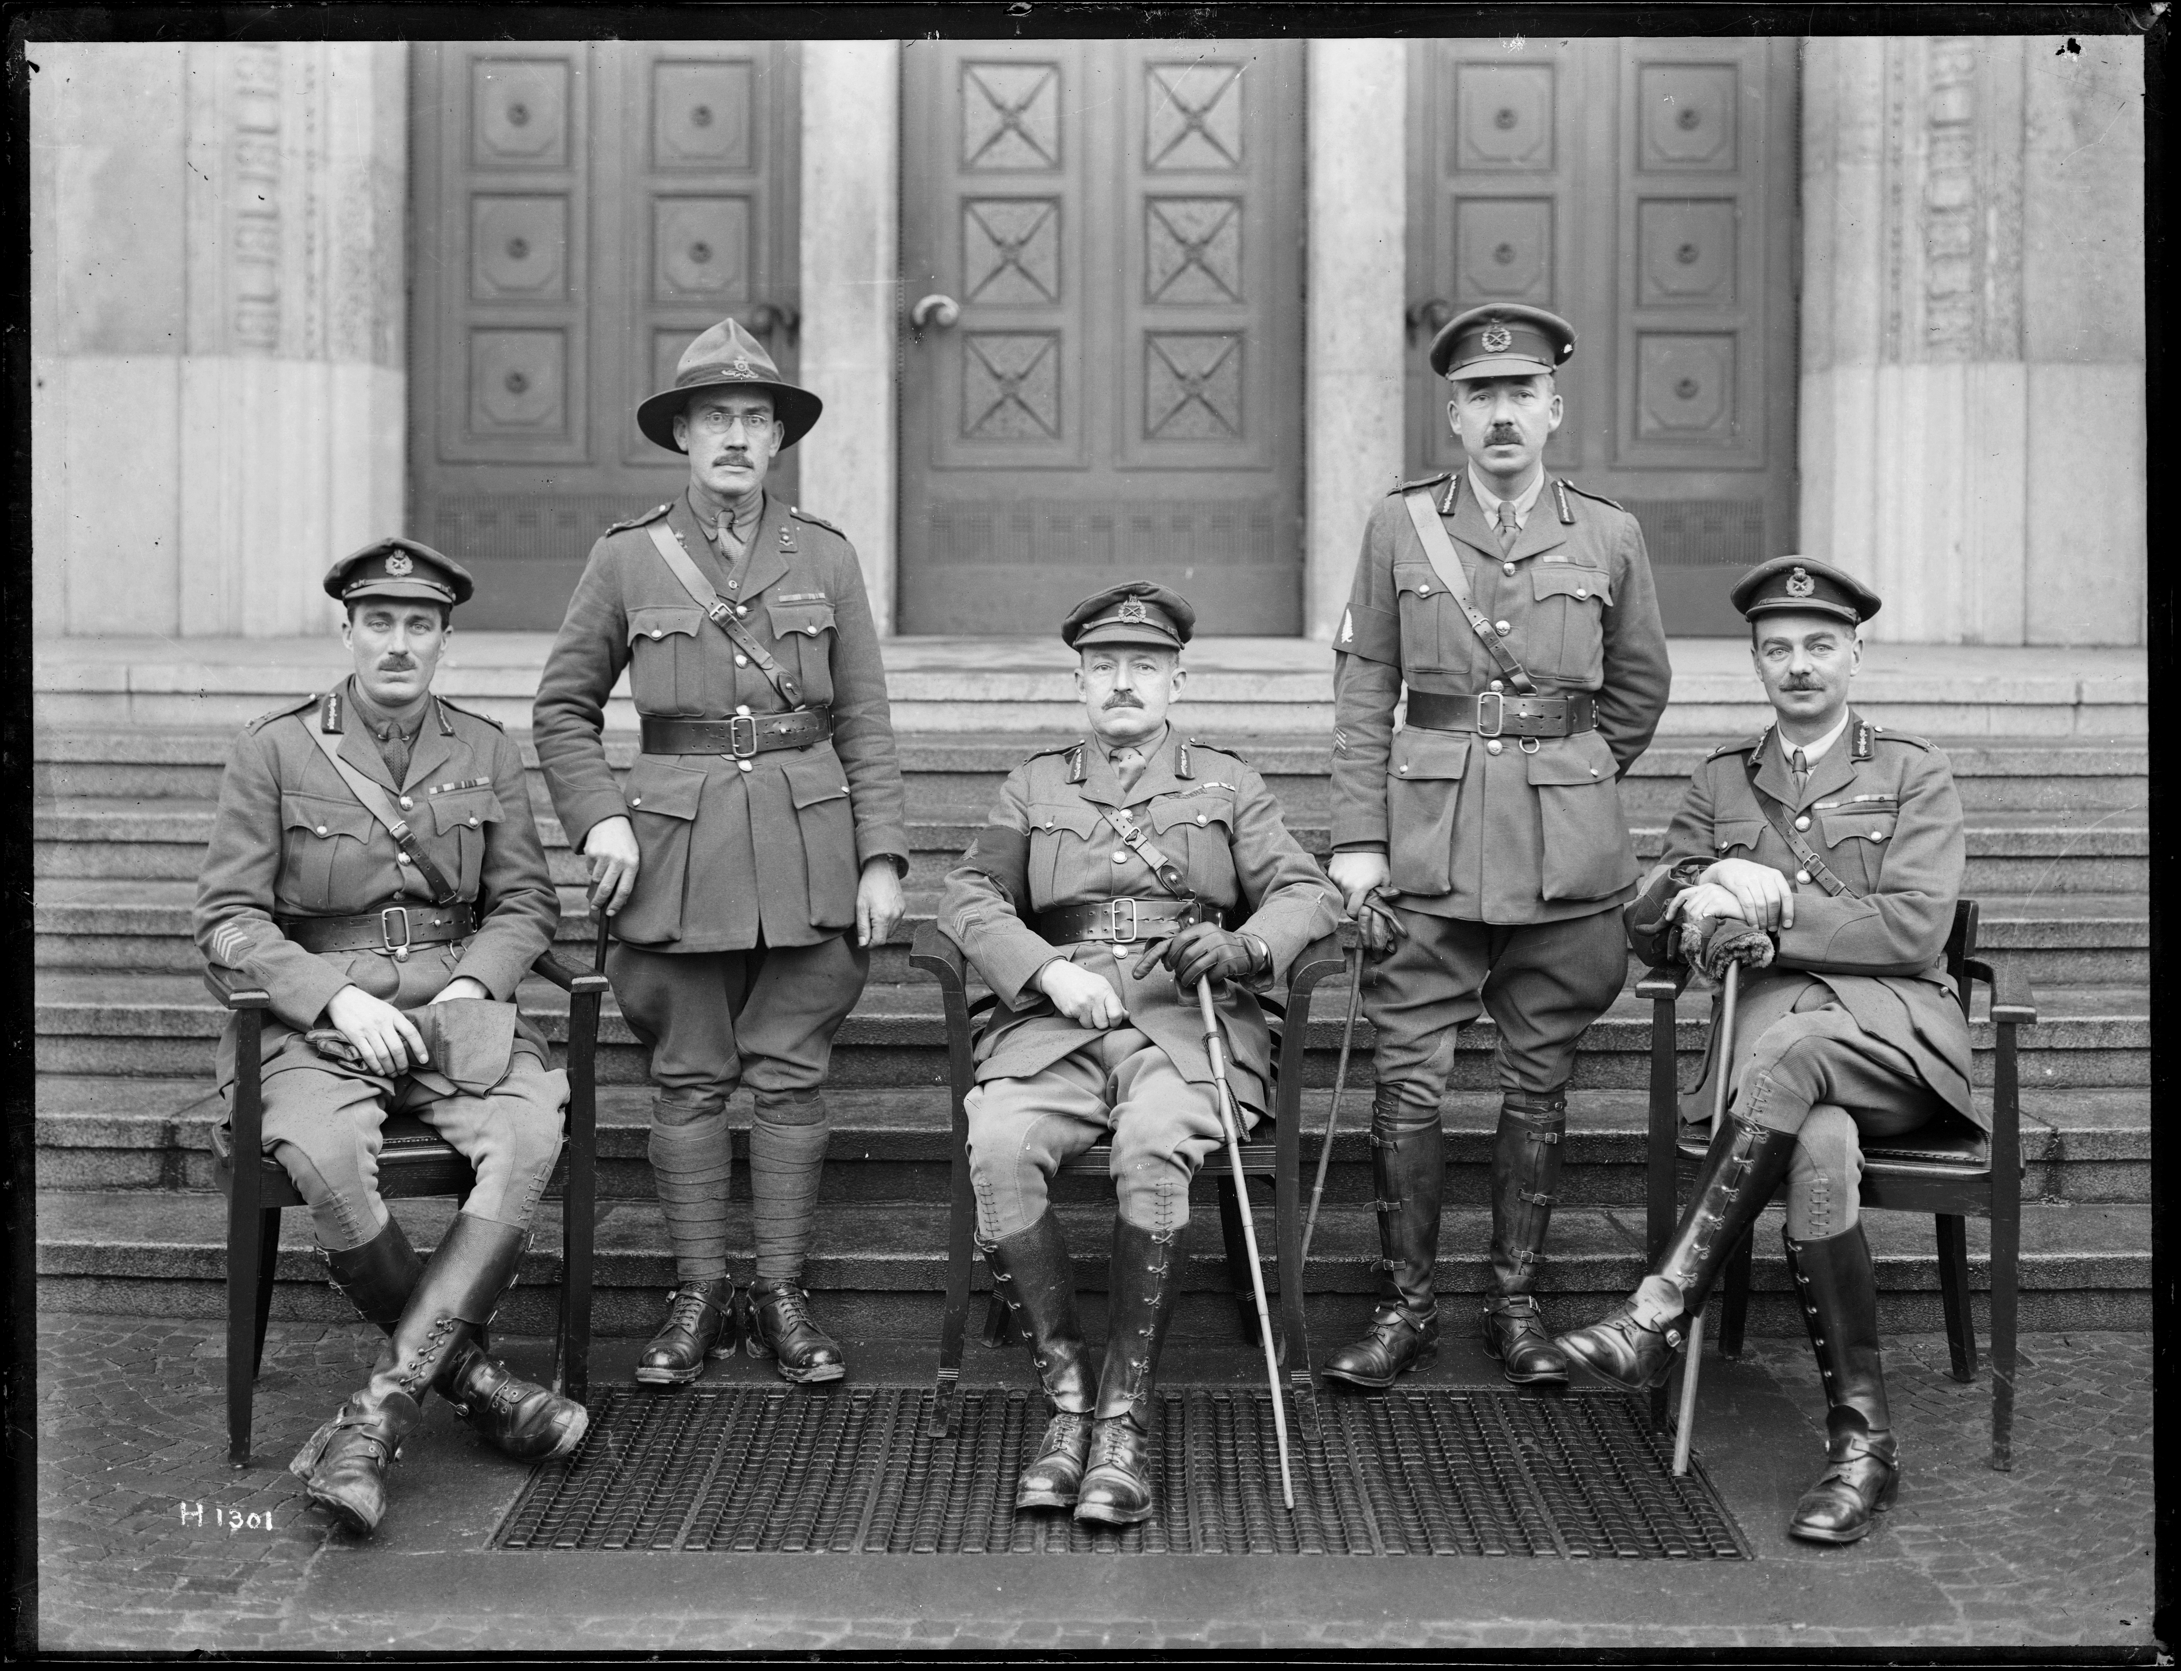
Russell and his Brigadiers
Symon
Young
2nd Bde
Hart
3rd Bde
Russell
GOC
‘The General’
Melvill
1st Bde

Slide 12
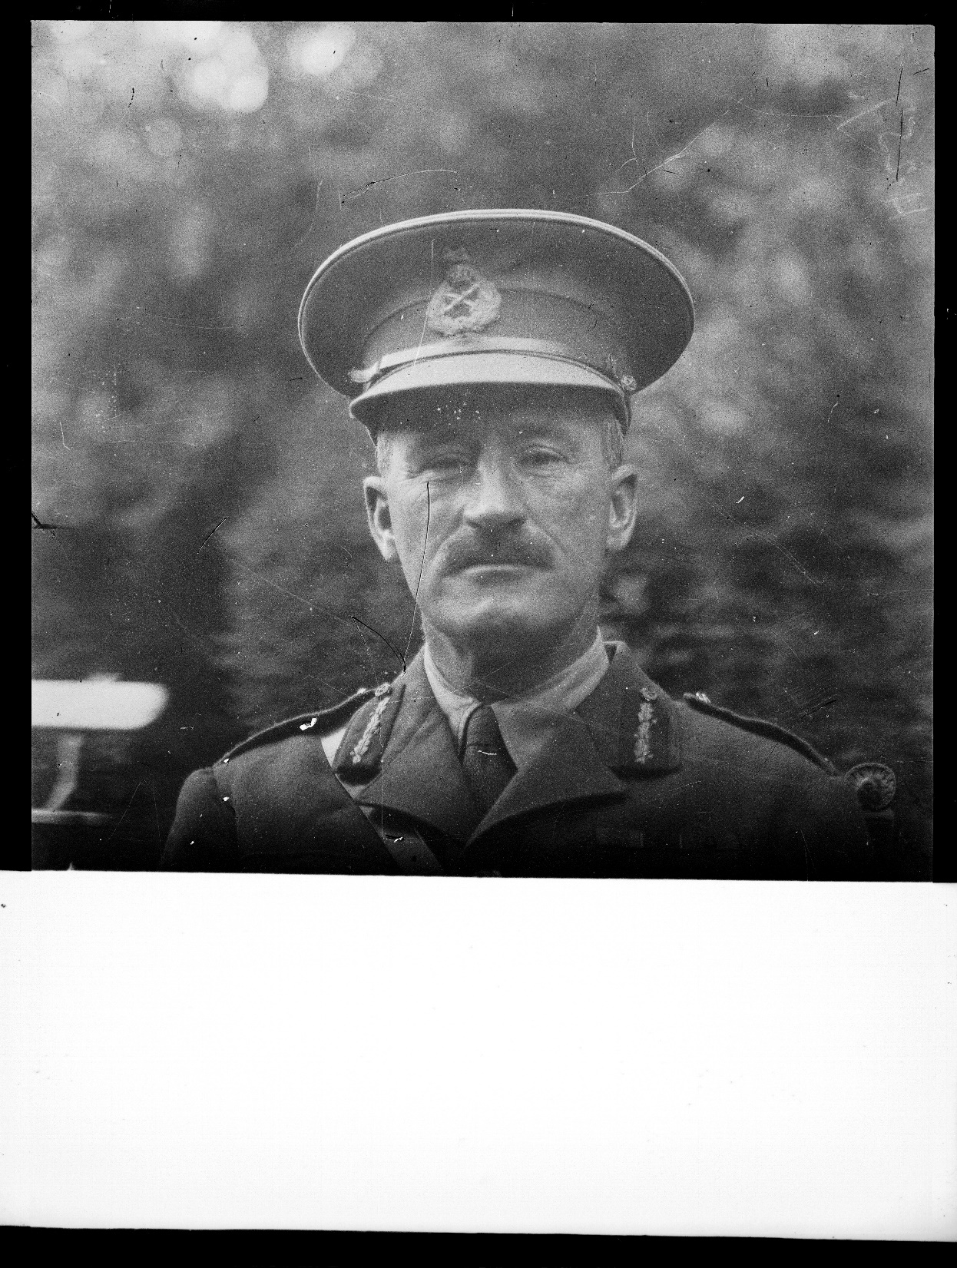
Brigadier-General George Napier Johnston CRA NZ DIV

Slide 13
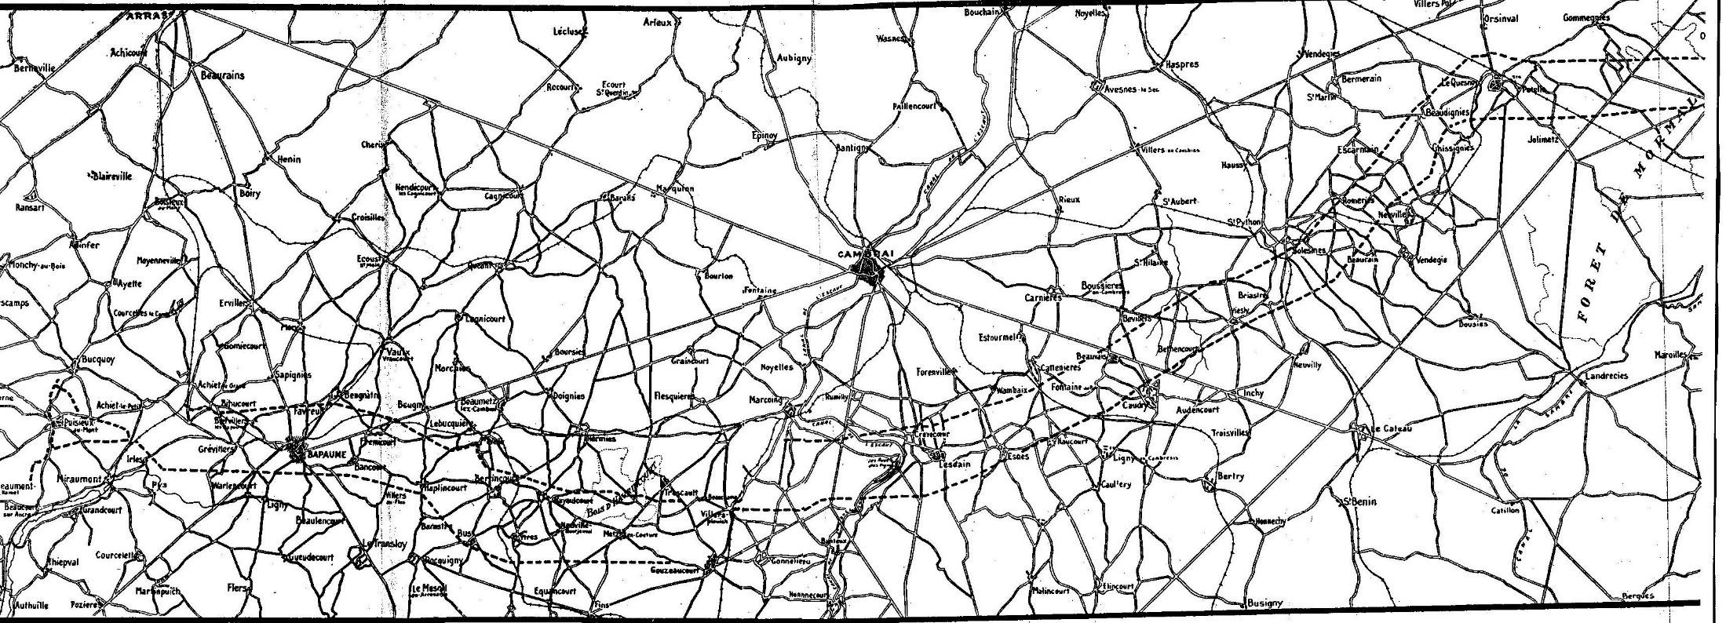
1918 – A year of hard fighting
‘Villages are only obstacles
not ends in themselves’
Russell
‘Ludendorff’s methods in March had widened tactical conceptions and the lessons then taught were not forgotten.’
‘For no words of mine can convey to the layman the feeling of heaven when an artilleryman knows when the Division he is supporting is a good one, and of all the good and very good Divisions of the British Army I would rate the New Zealand Division high among the highest.
Arthur Behrend
‘The N.Z. Division has come all the way from Hebuterne to the present front on the Selle river without a rest (over 100 kilometres). A fine performance.’
FM Sir Douglas Haig, Diary Entry, Oct 1918

Slide 14
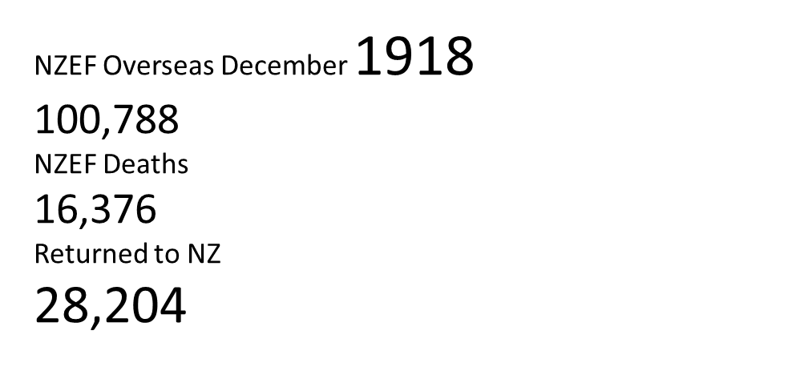
NZEF Casualties 1918
1918 | Dead | Missing | POW | Wounded | Total
January | 432 |  | 2 | 772 | 1206
February | 193 |  |  | 449 | 642
March | 79 |  |  | 369 | 448
April | 885 | 1 | 15 | 2300 | 3201
May | 551 | 1 | 231 | 1121 | 1904
June | 155 | 13 |  | 324 | 492
July | 72 |  |  | 116 | 188
August | 277 |  |  | 869 | 1146
September | 1165 | 17 | 7 | 3455 | 4644
October | 766 | 63 |  | 2028 | 2857
November | 647 | 2 | 5 | 1319 | 1972
1918 | 5,222 | 97 | 260 | 13,122 | 18,701
Totals | 16304 | 1383 | 379 | 41362 | 59428

Slide 15
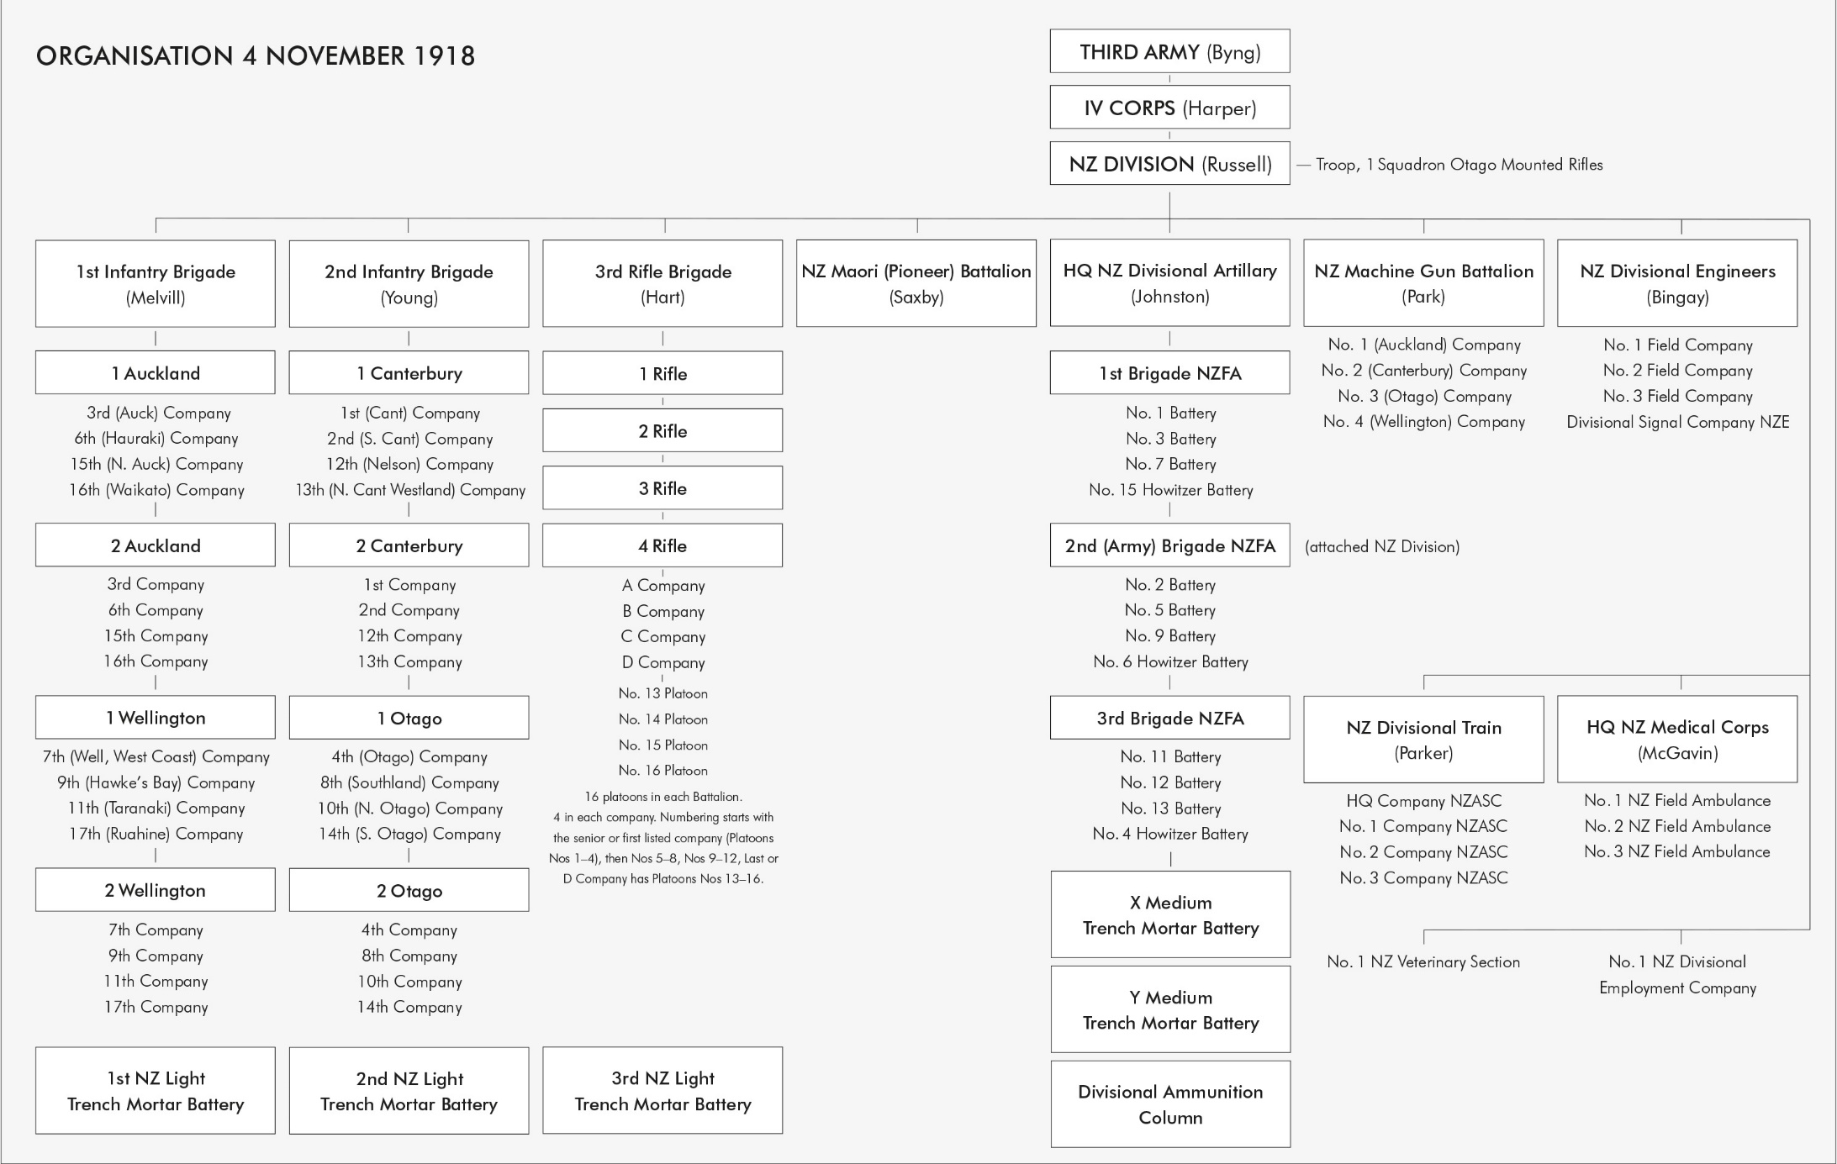
2000 Reinforcements monthly
Divisional strength 31 Oct 18 18,336
Reinforcement Pool
930 officers and 9545 other ranks

Slide 16
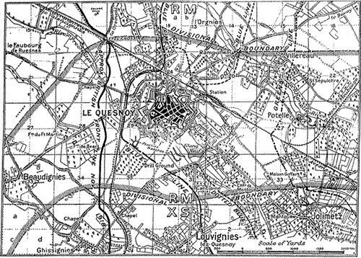
62nd Div
NZ Div
The New Zealand Division in conjunction with the 37th Division to the south on the right flank and the 62nd Division to the north on the left flank of IV Corps were to attack and establish themselves on the line Franc a Louer-Herbignies-Tous Vents, ‘and to exploit success eastward through the Foret de Mormal towards the River Sambre
37th Div

Slide 17
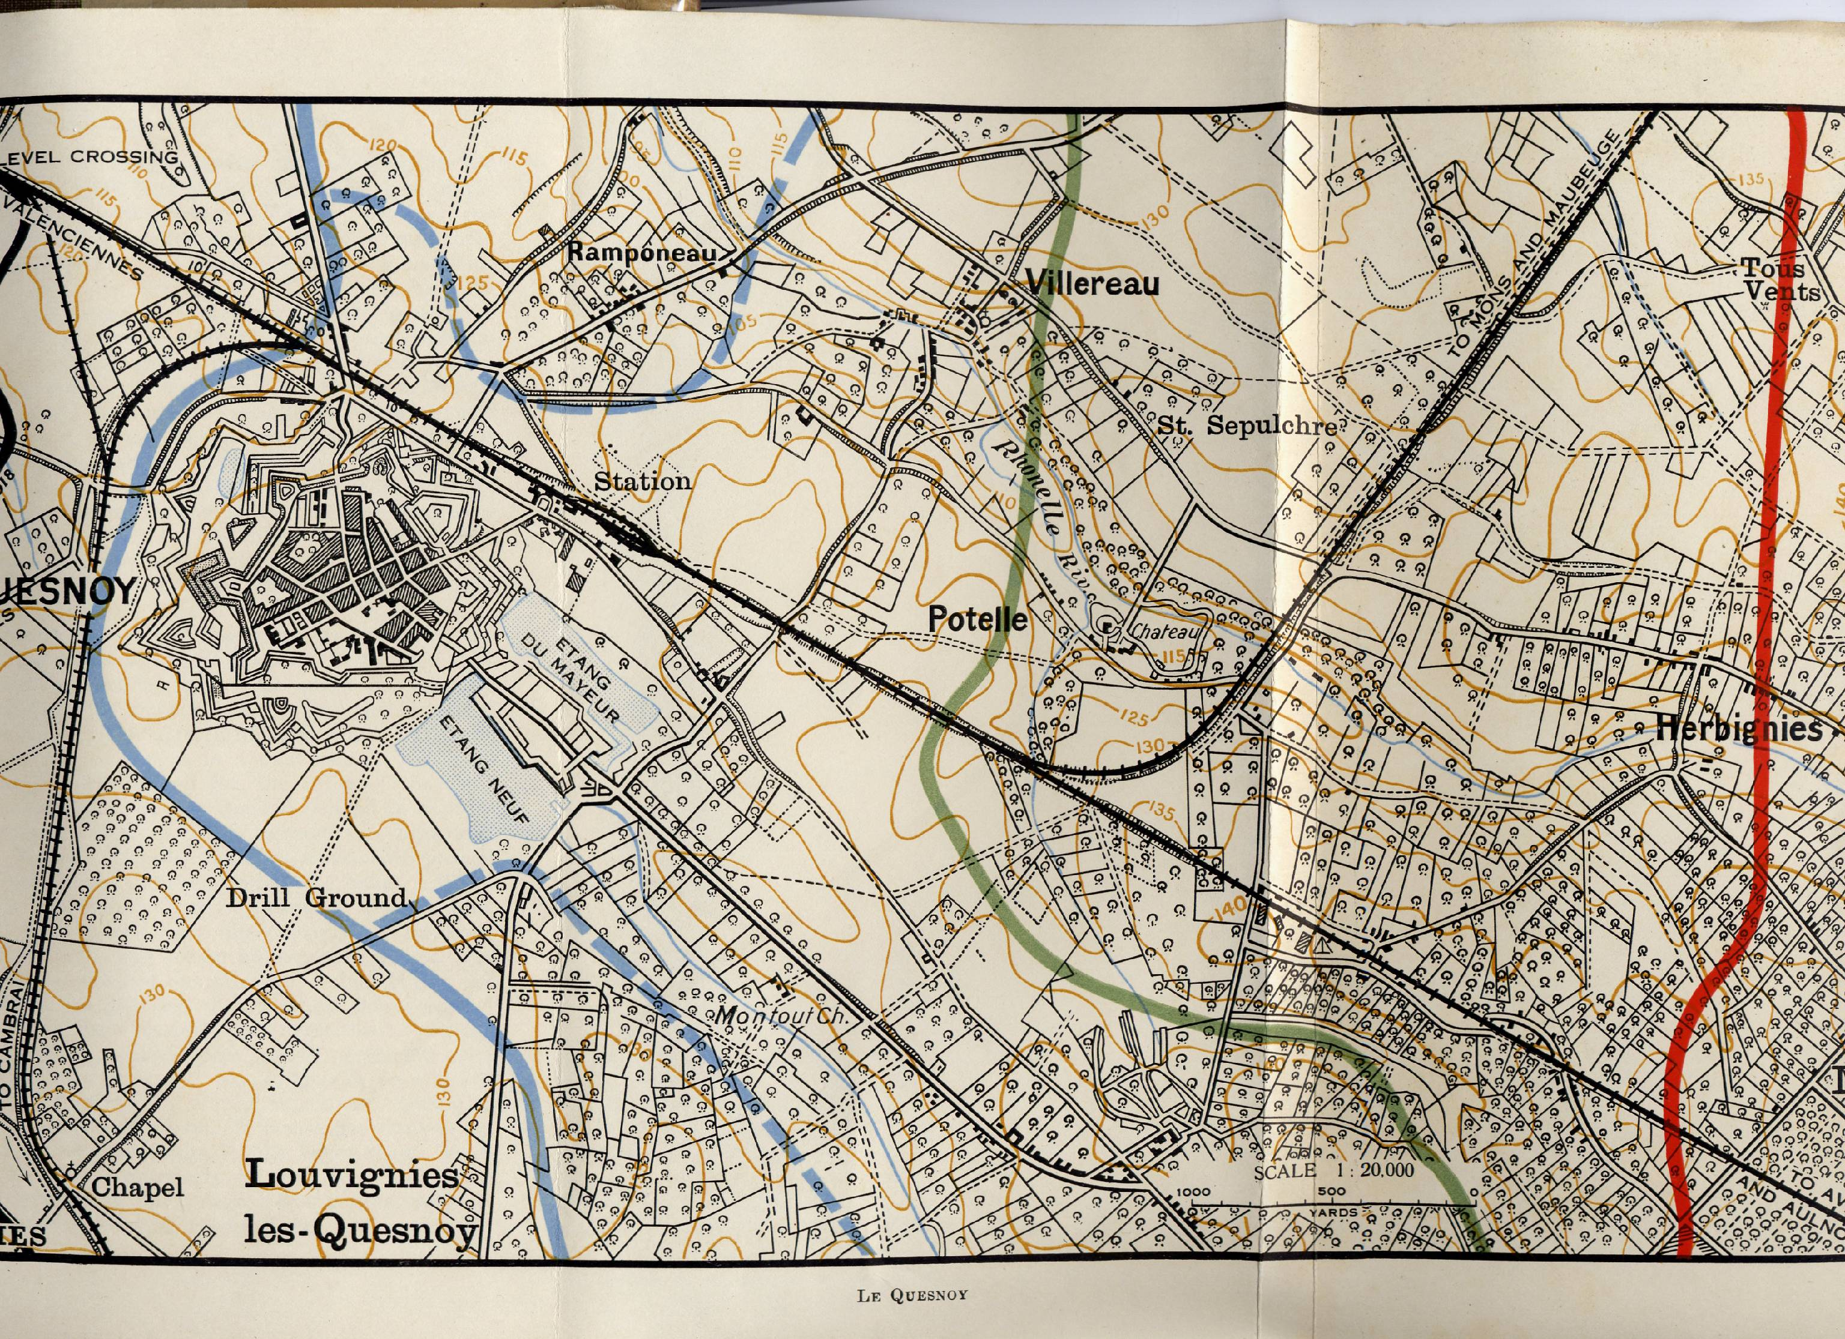
A Sophisticated Artillery Fire Plan 4 November
386 min
7 Arty Bdes
168 guns
+ 3x6 inch Bty
2 Special RE Coys
X and Y 6-inch Mor
MG Bn
3 Lt Trench Mor Bty

Slide 18
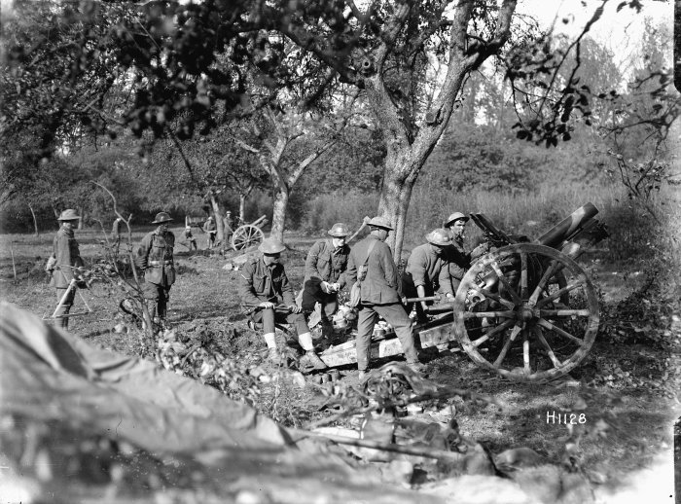

Slide 19
The Infantry Advance 4 November 1918
1 Auck
2 Rifle
2 Well
4 Rifle
3 H &
OMR
1 Well
1 Rifle
3 Rifle

Slide 20
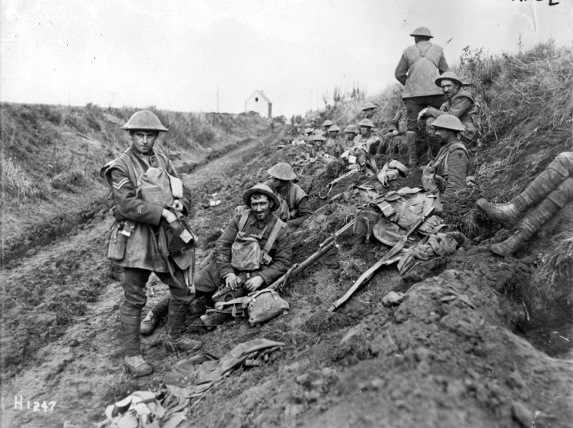

Slide 21
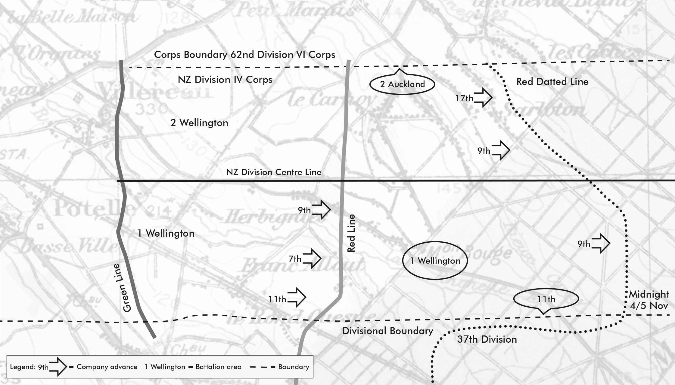
A Superbly conducted Battle for Communications
‘Attacked this morning at 5.30. A very
successful day. Rifle Bde, having
surrounded Quesney [sic] it finally
surrendered. 1st Bde continued
advance and captured over 50 guns.
2 Bde then pushed on thro Forest. ‘
Russell

Slide 22
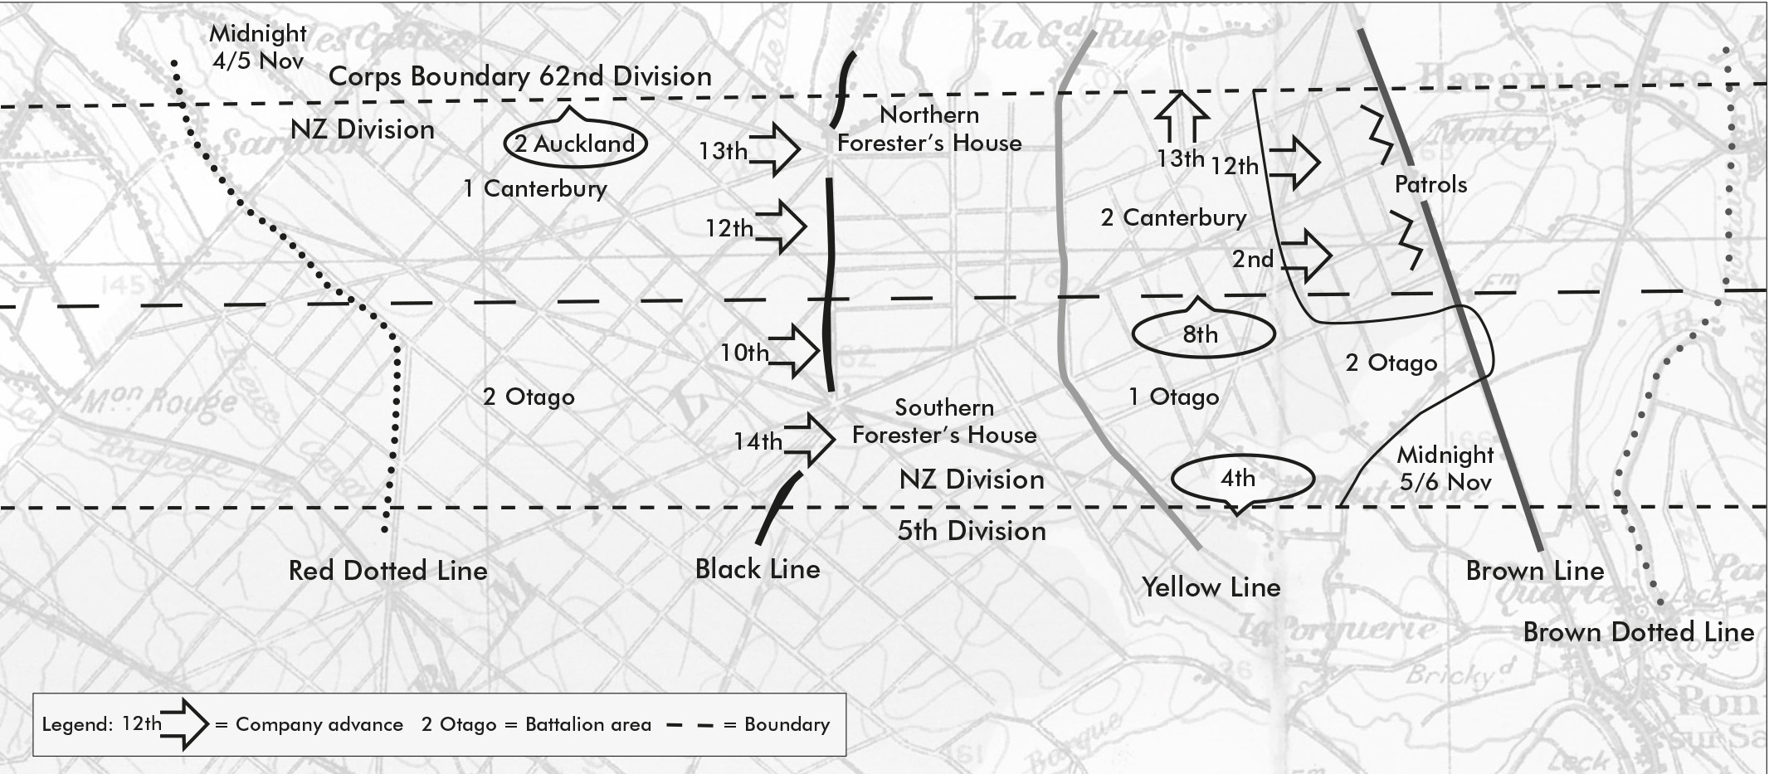
Young’s 2nd Brigade advance to the BROWN LINE 5 November 1918

Slide 23
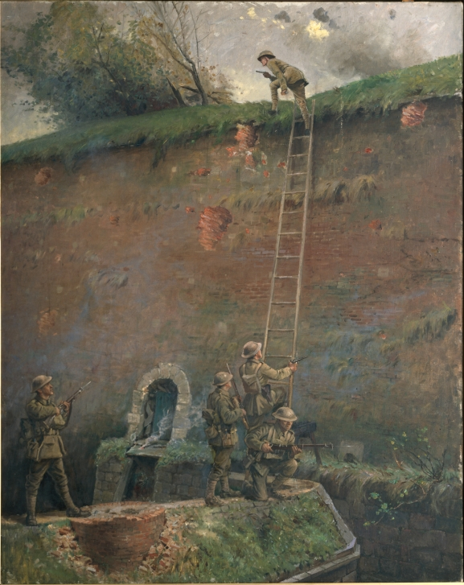
Barrowclough’s 4 Rifles go over the wall
2lt Averill and Kerr
The least tactically significant factor in this battle was the scaling of the walls of Le Quesnoy

Slide 24
Freyberg’s 2 NZ Division 1945
BritishCommonwealth’s outstanding divisional commander
‘Master of what an infantry formation could and could not do’ Weir
NZ Brigades 1945 ‘panzer divisions’ – ‘something in nature of a small Div of all arms’.

Slide 25
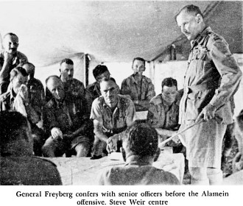
Major-Gen Sir Bernard Freyberg GOC 2 NZ Div – Concentration of Force 1940-1945
Lessons from France and Poland ‘war of machines’
Believed an infantry division needed ‘mobile hitting power’
Wanted integral armoured brigade
‘With such a brigade the Division would be a most formidable fighting formation, well fitted to undertake any operation in the Western Desert with an undoubted reduction in casualties.’

Slide 26
‘Greater Responsibilities’ June 1941 –Freyberg commands NZ’s Army in the Field
Greece and Crete almost cost Freyberg his job.
Fraser, the New Zealand Prime Minister, kept him on after positive reports from both Wavell and Auckinleck but made it clear that under no circumstance was he to commit New Zealand forces to any future operation if he believed he lacked sufficient armour or air power without advising the New Zealand Government of his concerns.
PM NZ to PM UK dated 13 Oct1941, and on 7 Feb1942, Documents, Vol.II: pp. 76, 92-3.

Slide 27
2 New Zealand Division (Crusader Oct 1941)
X
X
2 NZ Div
X
X
X
HQ
NZ Div Arty
4 NZ Bde
5 NZ Bde
6 NZ Bde
Div Cav
4 Fd Regt
18 Bn
21 Bn
24 Bn
27 MG Bn
5 Fd Regt
19 Bn
22 Bn
25 Bn
6 Fd Regt
20 Bn
23 Bn
26 Bn
16 carriers
6x3-inch mor
3x8 25pdr
72 fd guns
28
Maori Bn
7 Anti-tk
Regt
48x 2pdr
16x18pdr
14 LAA
Regt
48x40mm Bofors

Slide 28
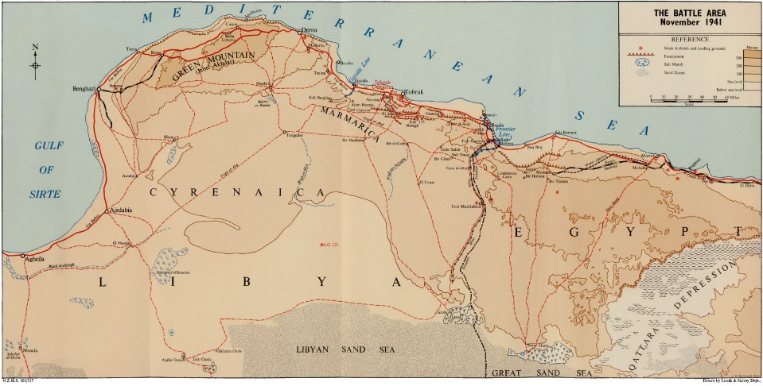

Slide 29
North Africa – ‘Trust, Training,Thoroughness
No trust in Op Crusader Plan plan. Invited defeat in detail.
‘He thought I was over-anxious and I thought him over-confident.’ . Freyberg to Minister of Defence dated 6 February 1941, Documents, Vol.II, pp.90-91.
‘In Libya we started the campaign \well aware of the manoeuvrability of a mobile division and knowing that we could move thirty-five miles in the dark without lights, hit a given spot, deploy, shoot in our field guns. And two and a half hours after first light stage a co-ordinated attack with I Tanks under a full artillery programme.’
Report of Operations
Notes:
The CRUSADER BATTLES November 1941
The battle evolved as Freyberg anticipated. Barrowclough’s 6 Infantry Brigade was initially detached under command of 30 Corps to support the South Africans, followed by the rest of the New Zealand Division, less 5 Infantry Brigade which remained on the Egyptian frontier. At Sidi Rezegh and Belhamed the Division, lacking armoured support, was split up and forced to fight as separate brigades against the bulk of Rommel’s Afrika Korps.
Campaign casualties numbered 4822 including 1081 dead. This included the commanding officers and almost all of the company commanders of five of the 10 New Zealand infantry battalions.
. Documents, Vol.II, p. 84.
. Freyberg to Minister of Defence dated 13 December 1941, Documents, Vol.II, p. 86.

Slide 30
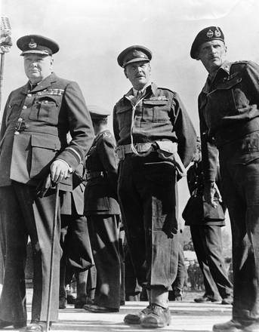
Freyberg and Montgomery 1942-43
I only come under your command for operations, not for discipline or training, and only for operations when the New Zealand Government have given their consent.’ I said to him, ‘I have had great anxiety in the past with higher commanders who have a mania for breaking up military organisation.’

Slide 31
Prep for El Alamein
‘We laid out on the ground a complete replica of the Ridge; we laid minefields and we laid it out exactly like Miteiriya Ridge. We then laid survey pegs and carried out a complete rehearsal for the attack.’
25 Battalion History
26/27 Sep 2 NZ Div full scale div attack with two inf brigades passing through a minefield with infantry moving behind a live lifting barrage, with minefield teams clearing lanes for 9 Armd Bde to pass through.
‘It was not going to be easy and we spared no pains. I have never worked or thought harder than in those weeks, nor have I ever worked troops so hard; and all commanders and staff did the same.’
Brig Kippenberger, Comd 5 NZ Bde

Slide 32
2 New Zealand Division [El Alamein] 1942
X
X
2 NZ Div
X
X
HQ
NZ Div Arty
Atch Armd
Bde
5 NZ Bde
6 NZ Bde
Div Cav
4 Fd Regt
21 Bn
24 Bn
27 MG Bn
5 Fd Regt
22 Bn
25 Bn
6 Fd Regt
23 Bn
26 Bn
28
Maori Bn
7 Anti-tk
Regt
14 LAA
Regt

Slide 33
2 New Zealand Division [Italy] 1943
X
X
2 NZ Div
X
X
X
HQ
NZ Div Arty
4 NZ
Armd Bde
5 NZ Bde
6 NZ Bde
Div Cav
4 Fd Regt
18
Armd Bn
21 Bn
24 Bn
27 MG Bn
5 Fd Regt
19
Armd Bn
23 Bn
25 Bn
6 Fd Regt
20
Armd Bn
28
Maori Bn
26 Bn
22 (Motor)
Bn
7 Anti-tk
Regt
14 LAA
Regt

Slide 34
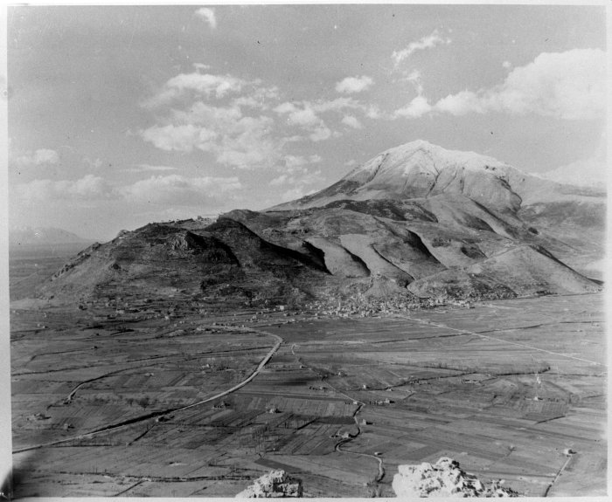
Monte Cassino

Slide 35
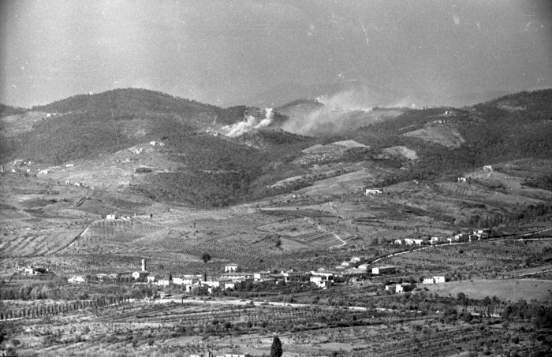
San Michele – Paula Line
‘No ammunition, no attack’
Three field regiments NZFA firing 18,000 rds a day

Slide 36
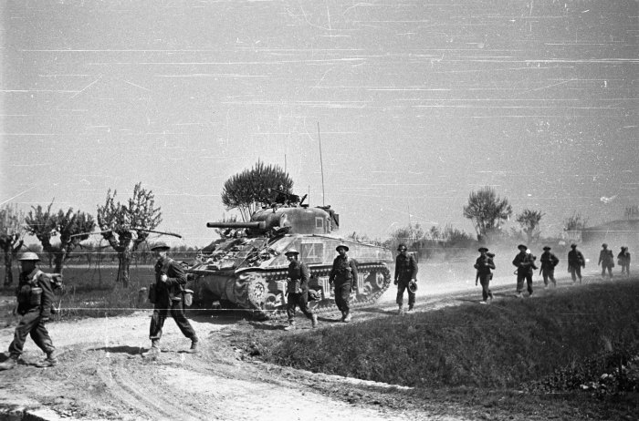
Lombardy Plains 1945
Intensive training with replacement of all long service men. [600 officers and all ORs arrived since Oct 1943]
Reorganisation to increase infantry strength.
‘We will have virtually a new division, well balanced and suited for fighting in close country in Europe, and, by retaining our Armoured Brigade organisation on reduced establishment, our organisation weill be flexible should the force be required for a more mobile role either in Europe or in another theatre.’
Lt-Gen Sir Bernard Freyberg, December 1944

Slide 37
2 New Zealand Division 1945
X
X
2 NZ Div
X
X
X
X
HQ
NZ Div Arty
4 NZ
ArmedBde
5 NZ Bde
6 NZ Bde
9 NZ Bde
4 Fd Regt
18
Armd Bn
21 Bn
24 Bn
Div Cav
Bn
5 Fd Regt
19
Armd Bn
23 Bn
25 Bn
27 Bn
6 Fd Regt
20
Armd Bn
28
Maori Bn
26 Bn
22 Bn
7 Anti-tk
Regt

Slide 38
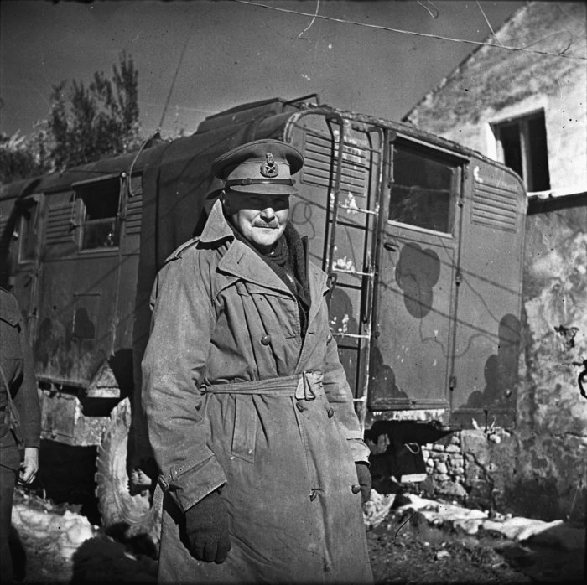
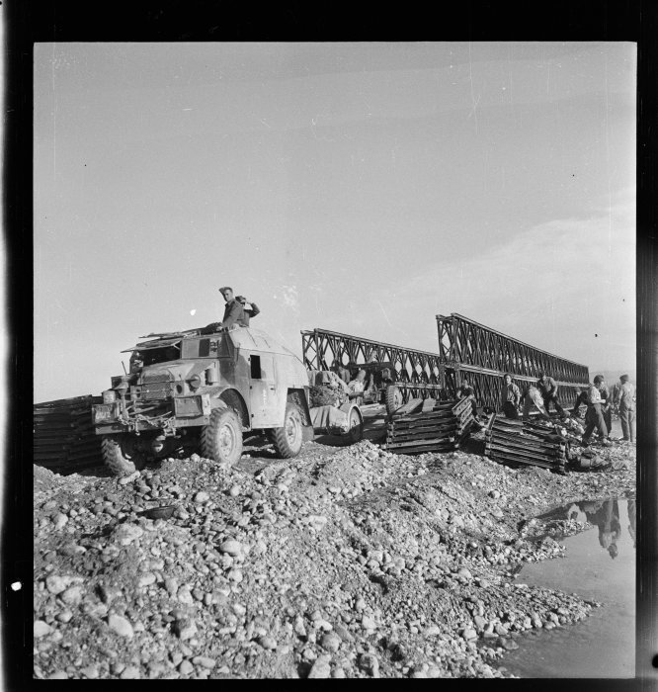
The Battle of the River Lines – Senio to Trieste
Bdes operated as three panzer divisions, inf/armd spt by arty and air
250-300 guns, 500 aircraft and 150 tks
250,000 arty shells
Crocodile tanks
Engr bridging and assault boats

Slide 39
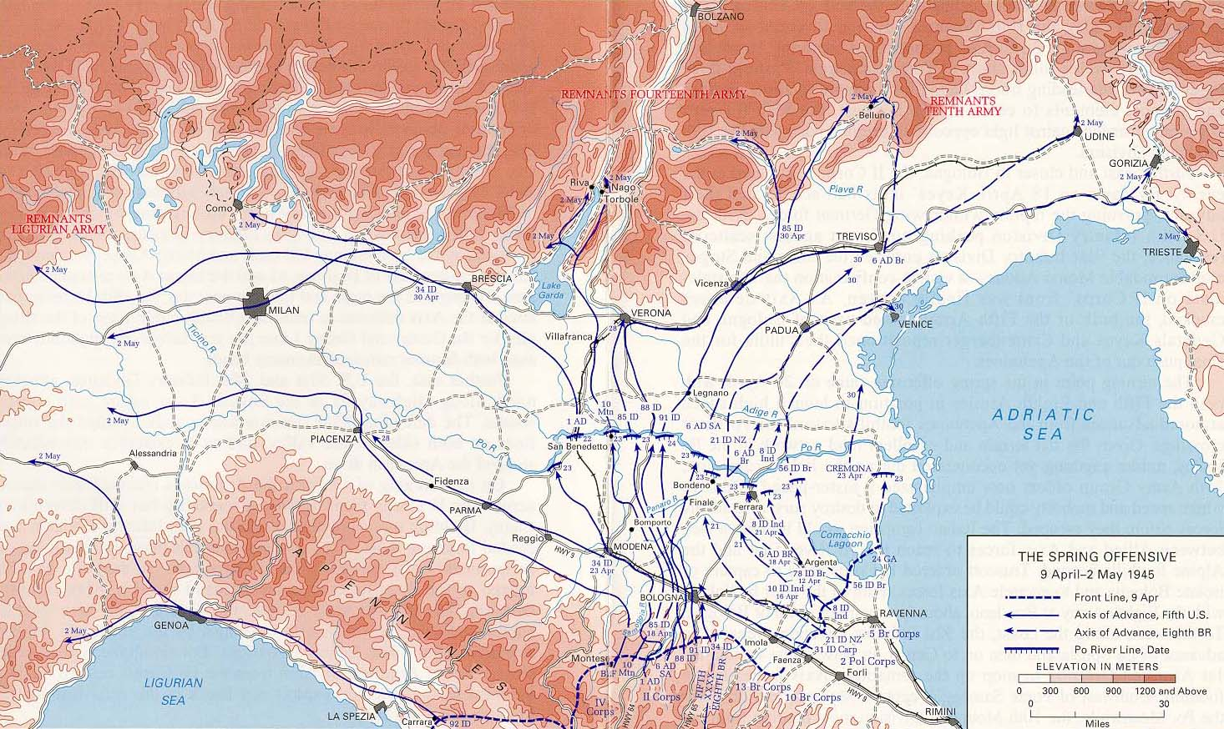

Slide 40
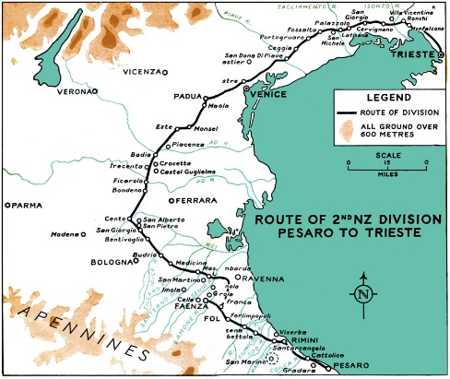

Slide 41
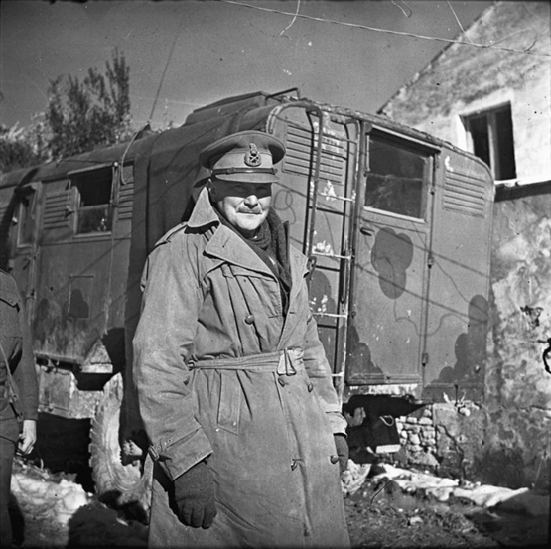
COMBAT EFFECTIVENESS results from LEADERSHIP, REINFORCEMENT AND TRAINING
New Zealand success – Freyberg
Command Experience
Concentration of Force – Divisional coordination
Training at all levels incl Bde and Div
Effectiveness dependent on trained reinforcements. 9 months
Mission Command – achieved through understanding where you fit in to the bigger picture.

Slide 42
New Zealand Command in War
QUESTIONS?
“Trust;, Training, Thoroughness”

