Slide 1
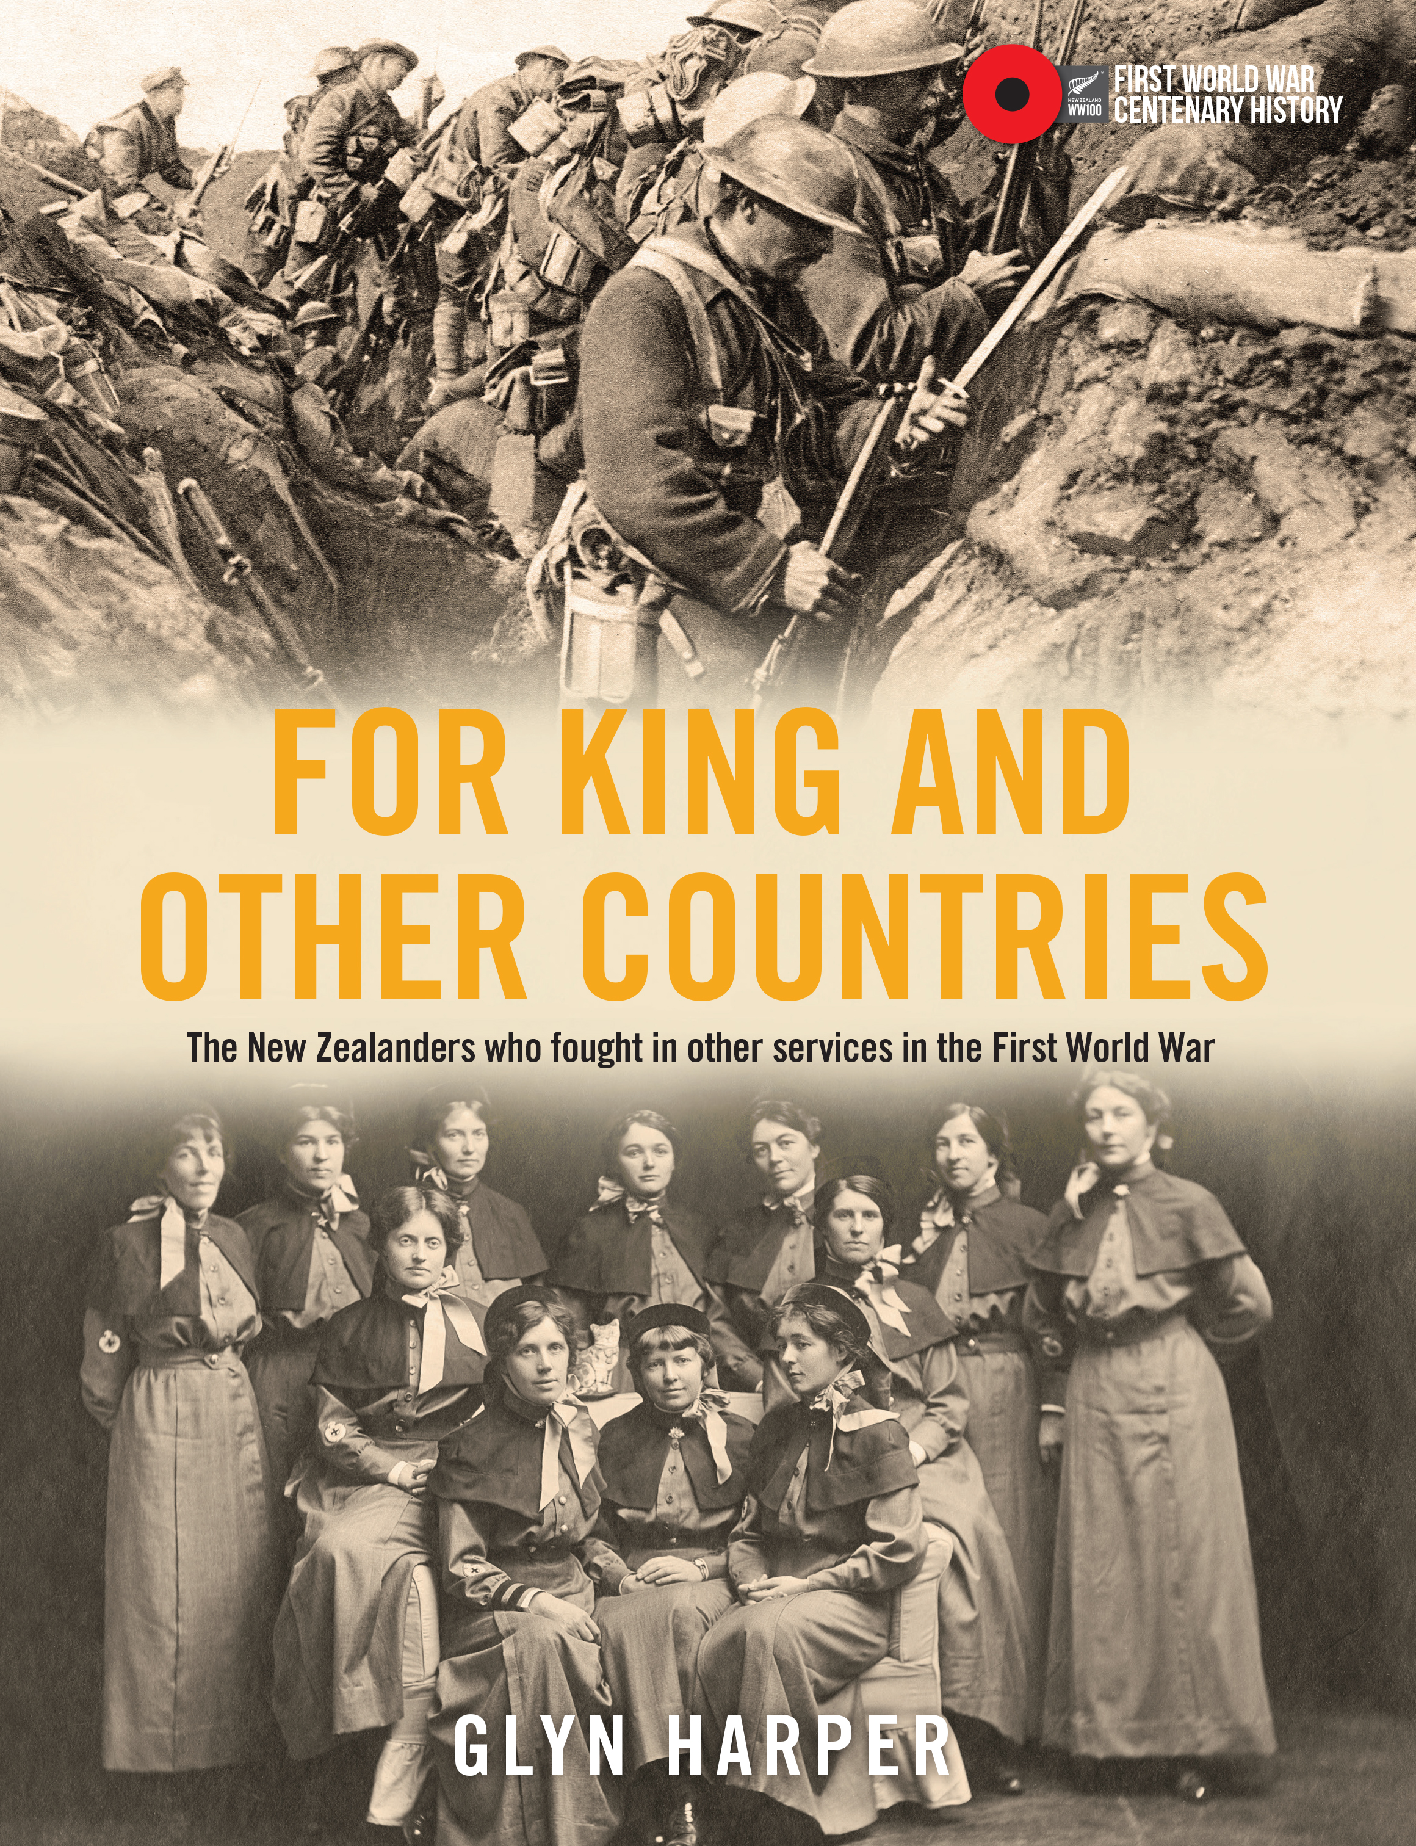
‘For King and other Countries: New Zealanders in other nations’ armies during the First World War.’
Professor GlYn harper
massey university

Slide 2
New Zealand’s massive war effort
124,211 men enlisted into the NZEF
42 per cent men of military age
100,444 embarked for overseas service.

Slide 3
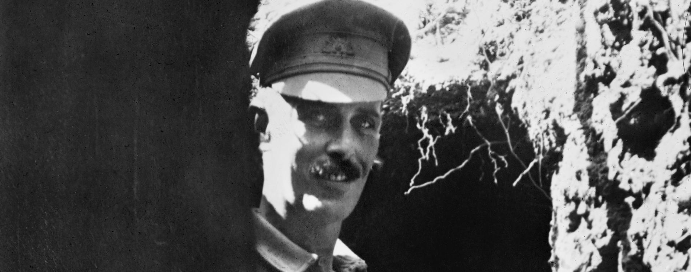
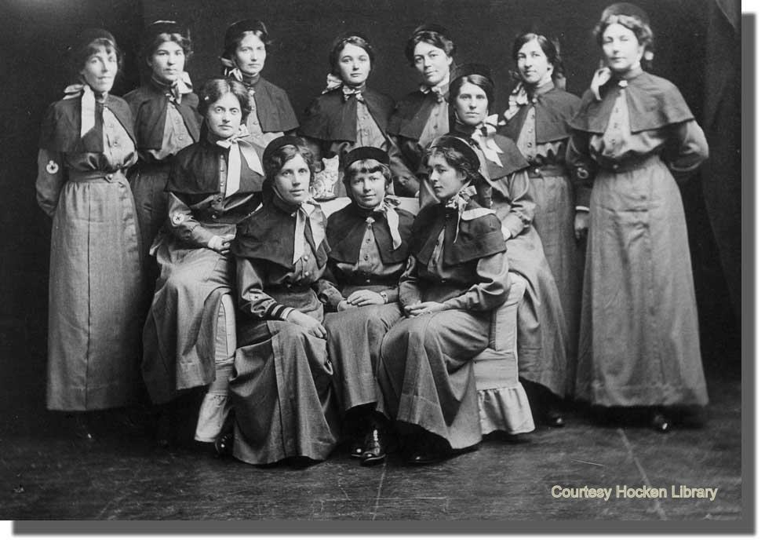
Forgotten New Zealanders
12,000 + New Zealanders
1600 KIA/DOW
BEF
AIF
CEF
AEF
SAF
FFL
Russian Army
Indian Army
Ceylon Planters Rifle Corps
German Army

Slide 4
Who is a New Zealander?
Born here and/or spent some time living in New Zealand

Slide 5
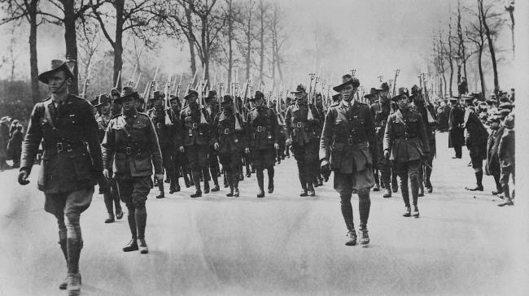
The Australian Imperial Force: the AIF
416,809 volunteers
331,781 embarked for overseas service
21 per cent born outside of Australia
43,000 born in the UK
About 5,000 from NZ

Slide 6
AIF Dwindling numbers
1915: 165,912 men joined AIF
1916: 124,352 voluntary enlistments.
1917: 45,101
1918: just 28,883

Slide 7
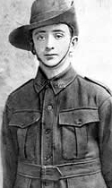
Boy soldiers
Gustav Victor Berg
John Ellums
Many others from NZ

Slide 8
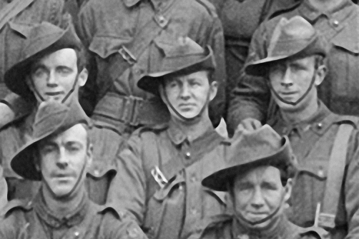
Or old/infirm
Marcus Ferdinand Fraser St John
‘too old and weak to be of any use as a soldier.’

Slide 9
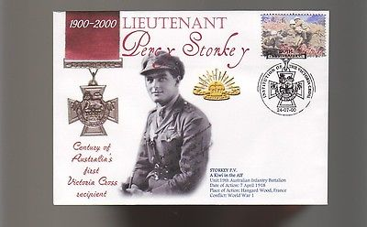
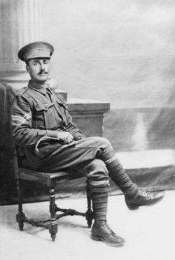
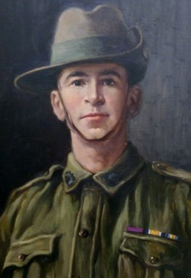
War heroes: NZ born VC’s in the AIF

Slide 10
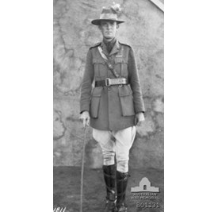
War Hero: William Henry Scott CMG, DSO and Bar, mid x 2

Slide 11
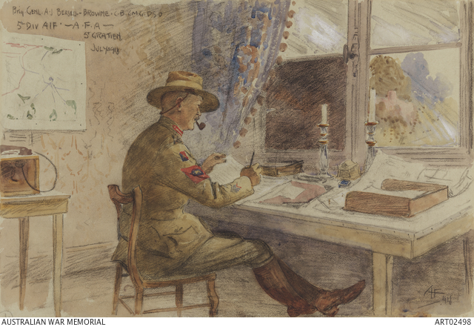
Notable people: Brigadier A.J. Bessell-Browne
CB, CMG, DSO, mid x 10

Slide 12
Notable people: Harold Septimus Power

Slide 13
Bringing Up the Guns (1917)

Slide 14
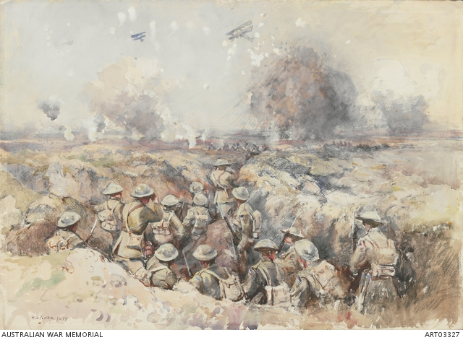
War Ambulance and Battle for Menin Road

Slide 15
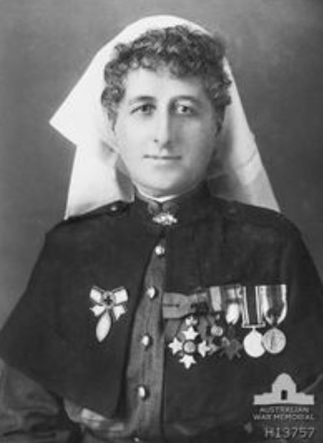
Women too
48 + NZ born women in the AIF
Evelyn Augusta Conyers

Slide 16
Bad character and behaviour: James Glover
James Glover - multiple enlistments
Date of enlistment | Where enlisted | Occupation | Age | Next of Kin | Previous military service
8/6/15 | Liverpool, NSW | Drover | 35 | (wife) Matutangi Glover c/- AE Glover Devonport | No
16/8/15 | Liverpool, NSW | Horse breaker | 34 | Sarah Glover (mother), Wellington | No
4/5/16 | Dubbo, NSW | Hairdresser | 42 8/12 | Jane Glover (wife) Devonport | No
1/6/16 | Newcastle, NSW | Hairdresser | 36 8/12 | Jane Glover (Wife) Devonport | No
30/11/16 | Goulburn, NSW | Labourer | 43 3/12 | Matutangi Glover (wife) Devonport | No
27/2/17 | Wodonga, Vic | Boundary Rider | 40 6/12 | none | No
15/3/17 | Wangaratta, Vic | Boundary Rider | 40 7/12 | Mutatangi Glover (wife) Devonport | Yes - 15 mths Sth Africa
6/8/18 | Brisbane, Qld | Hairdresser | 45 11/12 | Albert Edward Glover (father) Devonport | yes - 6 months Sth Africa

Slide 17
Bad character and behaviour: James Glover
A senior officer’s assessment July 1916:
This man is reported by his Company Commander to be quite unfit for embarkation. His character is bad and he is a disgrace to the uniform.
He should be Court Martialled for absence without leave, for forgery of a pass and for false answer on attestation. If you will return him to this Camp after he has served his present sentence, he will be duly dealt with.

Slide 18
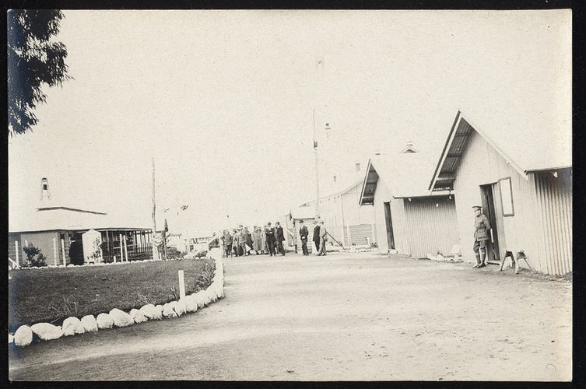
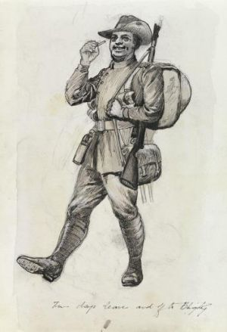
Bad character and behaviour: Robert Orr Miller
Robert Orr Miller never fired a shot at the enemy as he spent most of his military service either locked up or being treated for venereal disease.

Slide 19
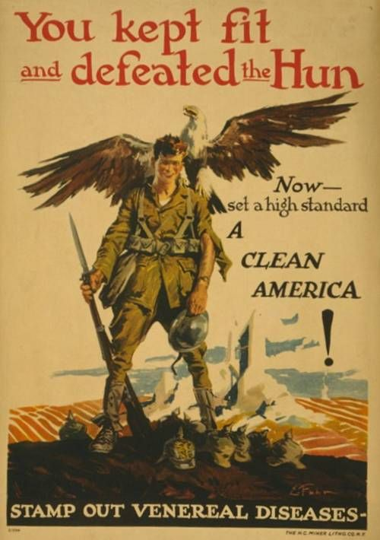
Bad character and behaviour: Robert Orr Miller
Miller’s Medical Board in
March 1918
This soldier is suffering from chronic gonorrhoea, arthritis of both knees with such limitation of movement and much wasting of the lower extremities. He has no urethral discharge and the V.D.G. is cured. The Board is of the opinion that it will be at least 12 months before he is fit for active service and it is quite possible he will never be fit for active service again. The Board recommends that he be discharged as permanently unfit.

Slide 20
New Zealand conman
Henry Moag-Levy
Roger Henry Patrick Farnham Moag
Maxwell Farnham
Roger Moag
Roger Moag-Levy
Hyman Levy

Slide 21
Moag-Levy’s bogus military decorations
Distinguished Service Order
King Edward VII Coronation
King George V Coronation
Queen’s and King’s Boer War, (1899, 1900, 1901)
Zululand Rebellion, 1906
China General Service (1908 – 1910)
China (Lent Chinese Government)
Mandarin Yellow Button 2nd Class
Royal Humane Society Medal 1914

Slide 22
Moag-Levy in trouble

Slide 23
What happened to Moag-Levy?

Slide 24
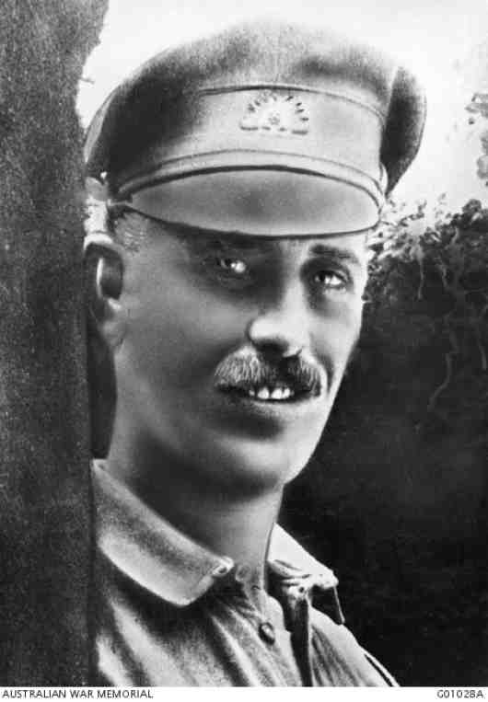
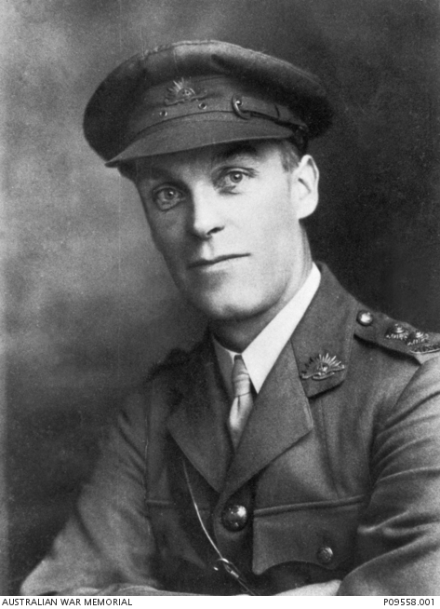
Part of New Zealand’s war effort too.

Slide 25
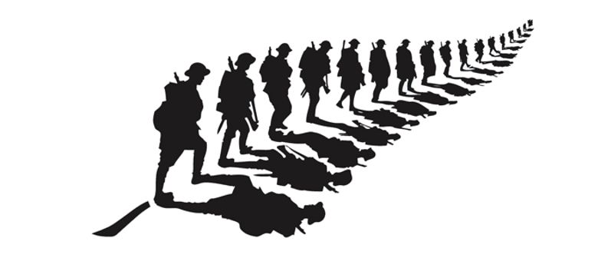
Questions?

