Slide 1
Writing a New Kind of History: New Zealand’s War against the Ottoman Empire
John Crawford

Slide 2
New Zealand’s War against the Ottoman Empire
Chapter 1: Introduction
Chapter 2: Egypt 1914-1915 and the Origins of the Gallipoli Campaign
Chapter 3: Gallipoli, Planning and Initial Operations, April-May 1915
Chapter 4: Gallipoli, June-August 1915
Chapter 5: Gallipoli final operations, the Evacuation and Aftermath; including the Dardanelles Commission
Chapter 6: The Senussi Campaign (a short chapter)
Chapter 7: The Reorganisation of the NZEF and Operations in the Sinai 1916
Chapter 8: The Palestine Campaign 1917-1918 (possibly two chapters)
Chapter 9: Mesopotamia and Dunsterforce
Chapter 10: The End of the War and Beyond, including operations by the NZMR in Egypt in 1919, and the place of New Zealand’s war
with the Ottoman Empire in our national memory.

Slide 3
Headquarters New Zealand and Australian Division – War Diary, 1 May-28 May 1915, WA20, R23487398, Archives New Zealand.

Slide 4
Command Turbulence in the NZEF at Gallipoli

Slide 5
Parade of 6th Reinforcements, Cuba St, Wellinton. Ref:1/2-008482-G. Alexander Turnbull Library.

Slide 6
8 June 1915, WA 23-3-4a, R23487398, Archives New Zealand.

Slide 7
Distribution of Troops (All Ranks) in NZ Expeditionary Force from 1st December 1914 to 1st March, 1916
Date | Total Troops from NZ | NZ Troops in Egypt Not MEF | NZ Troops in MEF Overseas | NZ Troops in MEF in Egypt | Sick, Wounded, Convalescent. MEF and Otherwise Egypt | Sick, Wounded, Convalescent. MEF and Otherwise Cyprus | Sick, Wounded, Convalescent. MEF and Otherwise Malta | Sick, Wounded, Convalescent. MEF and Otherwise Gibraltar | Sick, Wounded, Convalescent. MEF and Otherwise England | Deaths Missing Prisoners | Returned to NZ
1/12/1914 | 8499 | 8433 |  |  |  |  |  |  |  | 4 | 62
1/01/1915 | 8739 | 8584 |  |  | 85 |  |  |  |  | 8 | 62
1/02/1915 | 10713 | 10493 |  |  | 121 |  |  |  |  | 8 | 91
1/03/1915 | 10713 | 10491 |  |  | 123 |  |  |  |  | 8 | 91
1/04/1915 | 12943 | 12517 |  |  | 189 |  |  |  |  | 10 | 227
1/05/1915 | 12943 | 2167 | 7203 | 1515 | 1637 |  | 57 |  |  | 10 | 354
1/06/1915 | 15204 | 4097 | 5082 | 1718 | 1802 |  | 331 | 1 | 1288 | 247 | 638
1/07/1915 | 15297 | 2069 | 5983 | 1752 | 1864 | 17 | 432 | 1 | 1653 | 888 | 638
1/08/1915 | 15297 | 1086 | 5996 | 1804 | 1842 | 13 | 655 | 1 | 1639 | 1041 | 1220
1/09/1915 | 17708 | 2209 | 2854 | 1790 | 2807 | 2 | 1087 | 19 | 2927 | 1780 | 2233
1/10/1915 | 20104 | 3578 | 3557 | 2145 | 2172 |  | 829 | 18 | 3139 | 2433 | 2233
1/11/1915 | 20315 | 2497 | 5556 | 1672 | 1848 |  | 377 | 49 | 3402 | 2510 | 2404
1/12/1915 | 25326 | 8842 | 5488 | 50 | 1622 |  | 343 | 19 | 3327 | 2588 | 3047
1/01/1916 | 27902 | 10022 | 7083 | 50 | 1028 | 2 | 309 | 4 | 3514 | 2638 | 3252
1/02/1916 | 27902 | 3210 | 163 | 14477 | 1112 | 2 | 185 |  | 2469 | 2711 | 3573
1/03/1916 | 31023 | 4693 | 151 | 16022 | 1500 |  | 128 |  | 2215 | 2741 | 3573
John Crawford and Matthew Buck, ‘Phenomenal and Wicked’: attrition and reinforcement in the New Zealand Expeditionary Force at Gallipoli (publication pending).

Slide 8
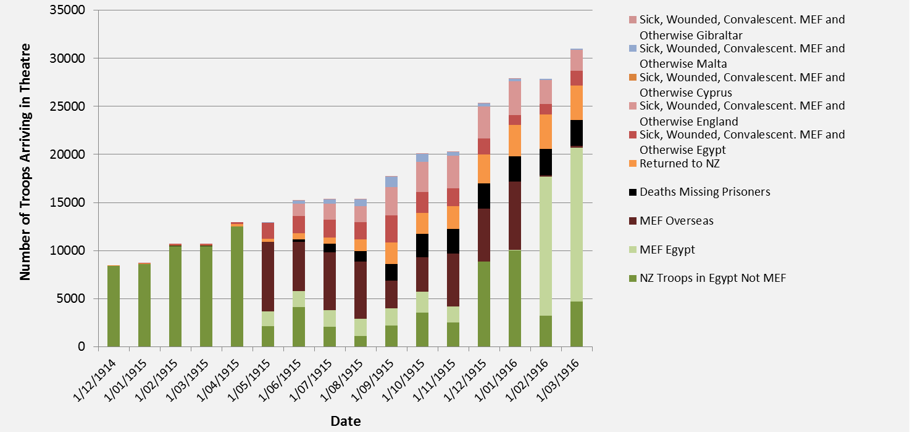
Distribution of Troops (all ranks) in NZ Expeditionary Force from 1st December 1914 to 1st March, 1916
John Crawford and Matthew Buck, ‘Phenomenal and Wicked’: attrition and reinforcement in the New Zealand Expeditionary Force at Gallipoli (publication pending).

Slide 9
Comparison of strengths despatched from Egypt derived from the Distribution Table and other archival sources
John Crawford and Matthew Buck, ‘Phenomenal and Wicked’: attrition and reinforcement in the New Zealand Expeditionary Force at Gallipoli (publication pending).

Slide 10
Canterbury Mounted Rifles, Mudros, Greece. Powles family: Photographs. Ref: PA1-o-811-26-3. Alexander Turnbull Library.

Slide 11
Estimated attrition rates of rifle-armed units in the NZ & A Division, 25 April – 23 September 1915.
Unit | Cumulative sick and wounded not returned to units (a) | Died by 23 Sep 1915 (b) (CWGC) | Approx. total attrition (a+b) | War Establish- ment (WE) | % WE attrition 25 Apr – 23 Sep 1915 | % WE attrition per month (5 months for infantry; 4.38 months for mounted regiments) | % WE attrition per week (22 weeks for infantry; 19 weeks for mounted regiments)
New Zealand Mounted Rifles Regiments
AMR | 413 | 190 | 603 | 549 | 109.84% | 25.08% | 5.78%
CMR | 410 | 172 | 582 | 549 | 106.01% | 24.20% | 5.58%
WMR | 421 | 193 | 614 | 549 | 111.84% | 25.53% | 5.89%
OMR | No Data
New Zealand Infantry Battalions
AIB | 1331 | 386 | 1717 | 1010 | 170.00% | 34.00% | 7.73%
CIB | 1209 | 355 | 1564 | 1010 | 154.85% | 30.97% | 7.04%
OIB | 817 | 452 | 1269 | 1010 | 125.64% | 25.13% | 5.71%
WIB | 1105 | 537 | 1642 | 1010 | 162.57% | 32.51% | 7.39%
Australian Light Horse Regiments
8th ALH | 364 | 203 | 567 | 546 | 103.85% | 23.71% | 5.47%
9th ALH | 433 | 96 | 529 | 546 | 96.89% | 22.12% | 5.10%
10th ALH | 425 | 151 | 576 | 546 | 105.49% | 24.09% | 5.55%
1st ALH | 402 | 121 | 523 | 546 | 95.79% | 21.87% | 5.04%
2nd ALH | 344 | 77 | 421 | 546 | 77.11% | 17.60% | 4.06%
3rd ALH | 342 | 40 | 382 | 546 | 69.96% | 15.97% | 3.68%
Australian Infantry Battalions
13th Btn | 1053 | 381 | 1434 | 1017 | 141.00% | 28.20% | 6.41%
14th Btn | 971 | 381 | 1352 | 1017 | 132.94% | 26.59% | 6.04%
15th Btn | 992 | 560 | 1552 | 1017 | 152.61% | 30.52% | 6.94%
16th Btn | 854 | 442 | 1296 | 1017 | 127.43% | 25.49% | 5.79%
John Crawford and Matthew Buck, ‘Phenomenal and Wicked’: attrition and reinforcement in the New Zealand Expeditionary Force at Gallipoli (publication pending).

