Slide 1
Whitiki: Maori in the First World War

Slide 2
Visiting the Maori Contingent At AVONDALE October 1914

Slide 3
Captain Peacock & Maui Pomare, Avondale 1914

Slide 5
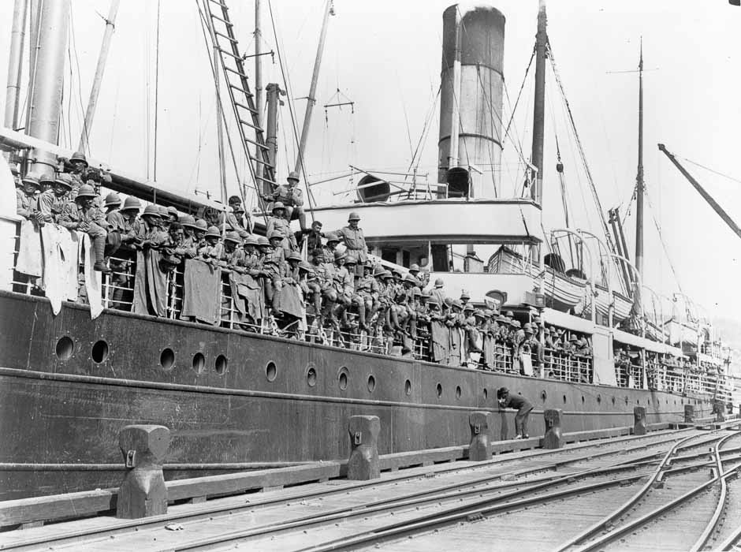
Wellington, Albany, Egypt, Malta

Slide 6
Gallipoli

Slide 7
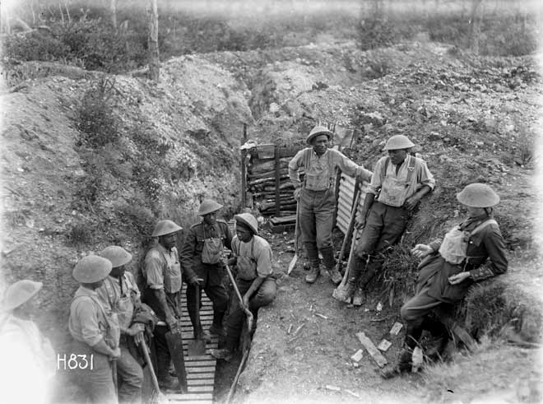
France - Belgium - England

Slide 8
Hat and collar badges
Maori Contingent
N.Z. Pioneer Battalion

Slide 9
KING TE RATA, Tupu Taingākawa, and secretaries and interpreters Hōri Tiro Pāora and Mita Karaka in 1914

Slide 10
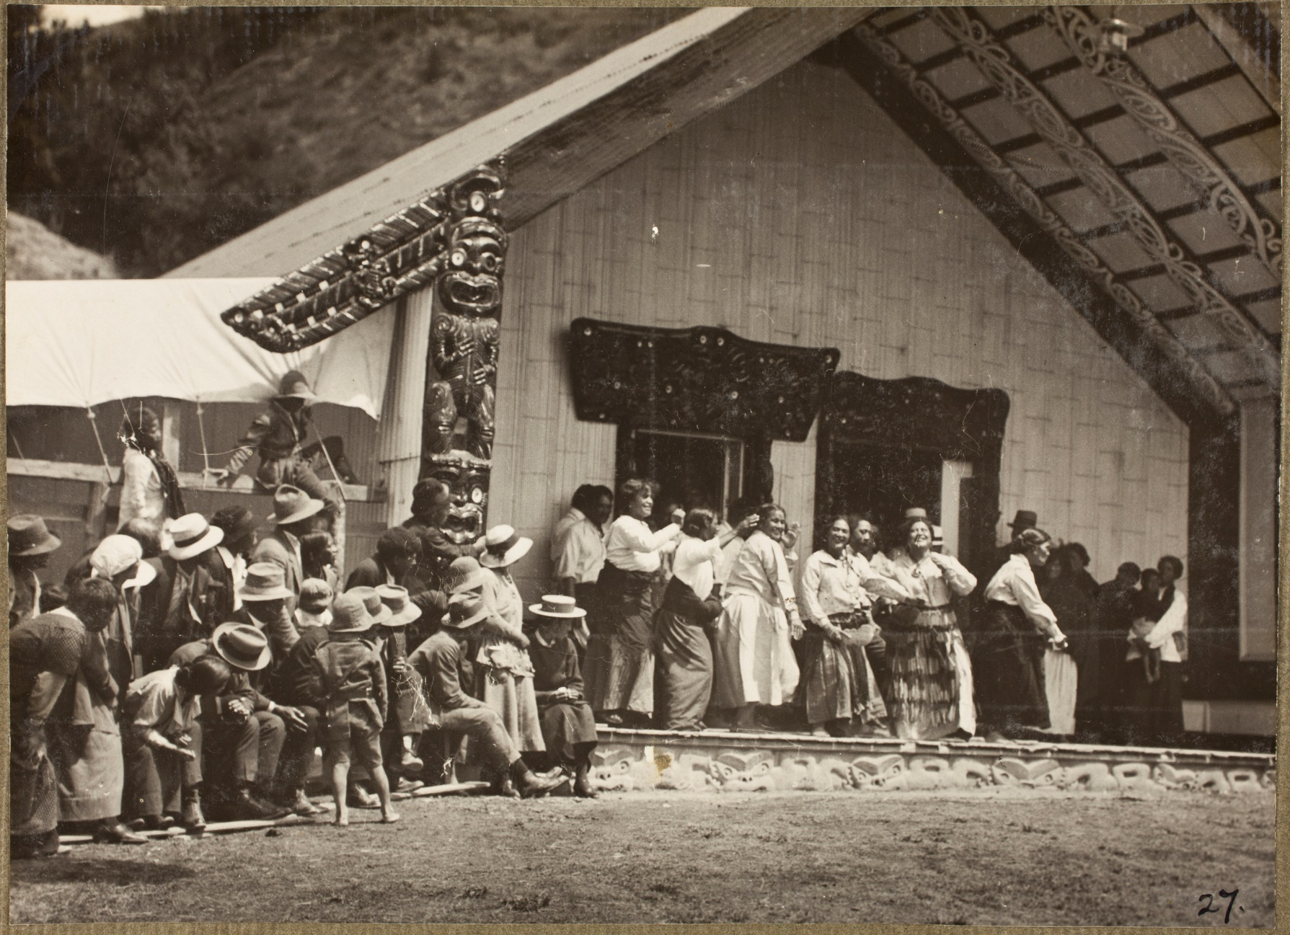
Ko te kupu whakautu a te iwi mo tenei take e tama, e Pomare, “Waiho mai te iwi i tou papa i tou turangawaewae i Aotearoa, kia hinga i hinga ki te papa.” The people’s statement in response in this matter o’ son, Pomare, “Leave the people on your ground, on your homeland New Zealand, so that when they fall, they fall on that ground.”

Slide 11
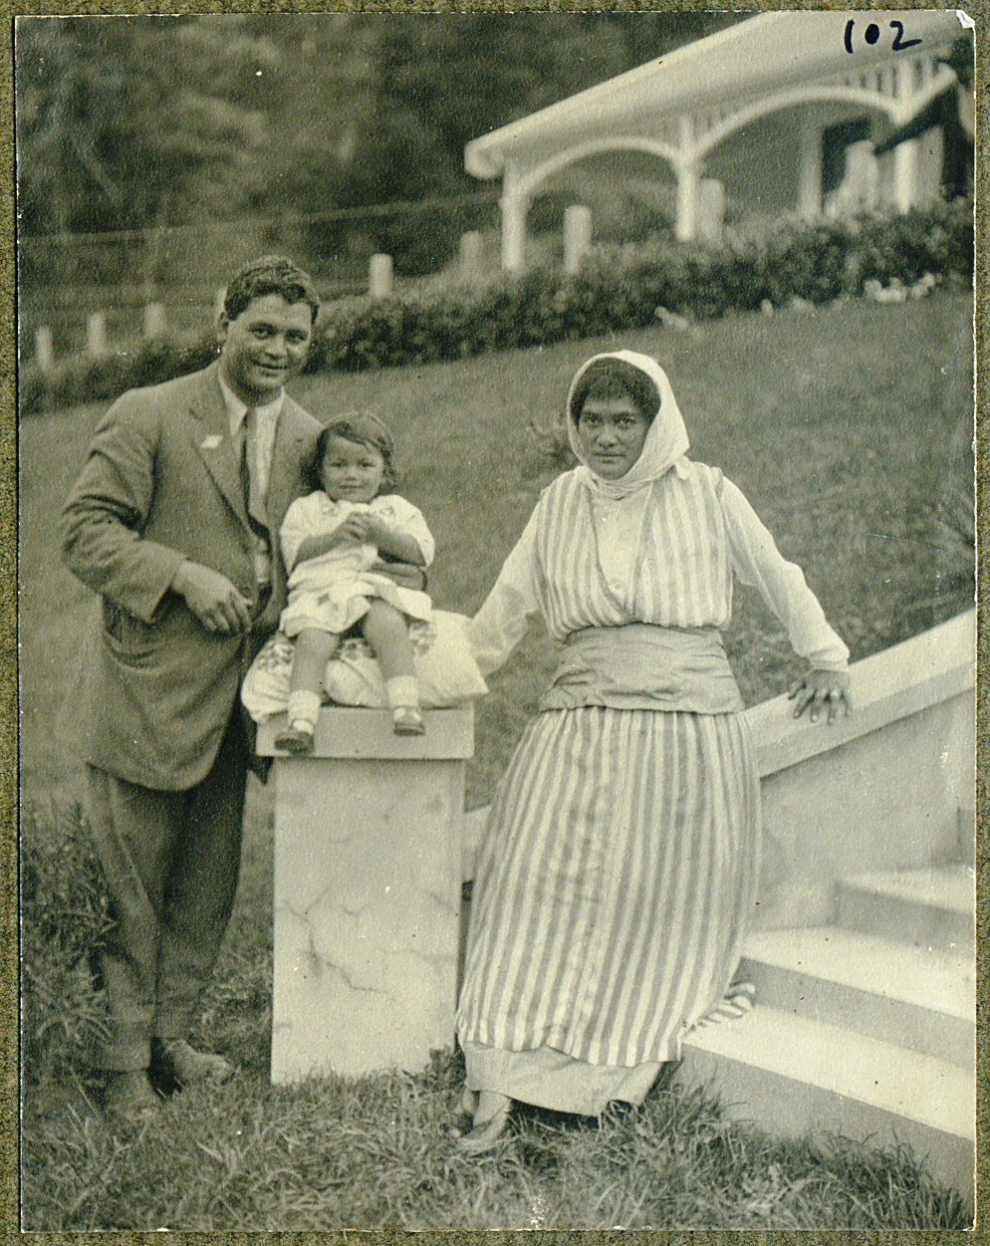
Maori Contingent at Avondale Oct 1914 - Feb 1915

Slide 12
Paraire Tomoana’s Compositions
Come Where Duty Calls
Hoea ra te waka nei,
Hoea hoea ki te pae
Ma te poi e karawhiu
kia rere tika ai.
Blue Eyes
E Pari ra nga tai ki te akau
E hotu ra ko taku manawa Aue!
Haria mai te aroha i ahau. Te iwi e
He Ngakau tangi noa.
Tēnā rā! Tahuri mai!
E te tau! te aroha.
Tēnei rā ahau te tangi nei.
Mōhou kuā wehea nei.
Haere rā! mahara mai.
E te tau! kia mau ki au.
Haere rā! ka tūturu ahau.
Haere Rā!

Slide 13
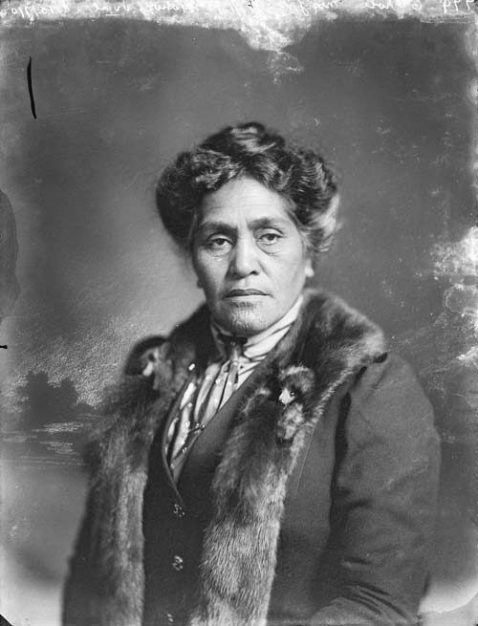
Lady Heni Materoa Carroll

Slide 14
‘A Noble Sacrifice’ Sung in Maori and English, it became a very popular poi item throughout the war period. This is the second of three verses.
Te ope tuarua The second contingent has come No Mahaki rawa, From the Mahaki iwi (of Gisborne) Na Hauiti koe, From Hauiti (of Tologa Bay), Na Porourangi. From Porourangi (Ngati Porou). I haere ai Henare Oh! Henare you went Me to wiwi, With your men, I patu ki te pakanga And fell while fighting Ki Paranihi ra ia. In France. Ko wai he morehu Is there a survivor Hei kawe korero To take the news (of your death) Ki te iwi nui e, To your people, E taukuri nei. In sorrow bowed.

Slide 15
Maori Members of Parliament 1919 Maui Pomare, Sir James Carroll, Apirana Ngata, Tau Henare, Hopere Uru

Slide 16
‘help Maori assume the duties and responsibilities of citizenship and enable them to earn or otherwise obtain and enjoy the benefits which European civilisation had brought to their doors’
Maui Pomare
Gordon Coates

Slide 17
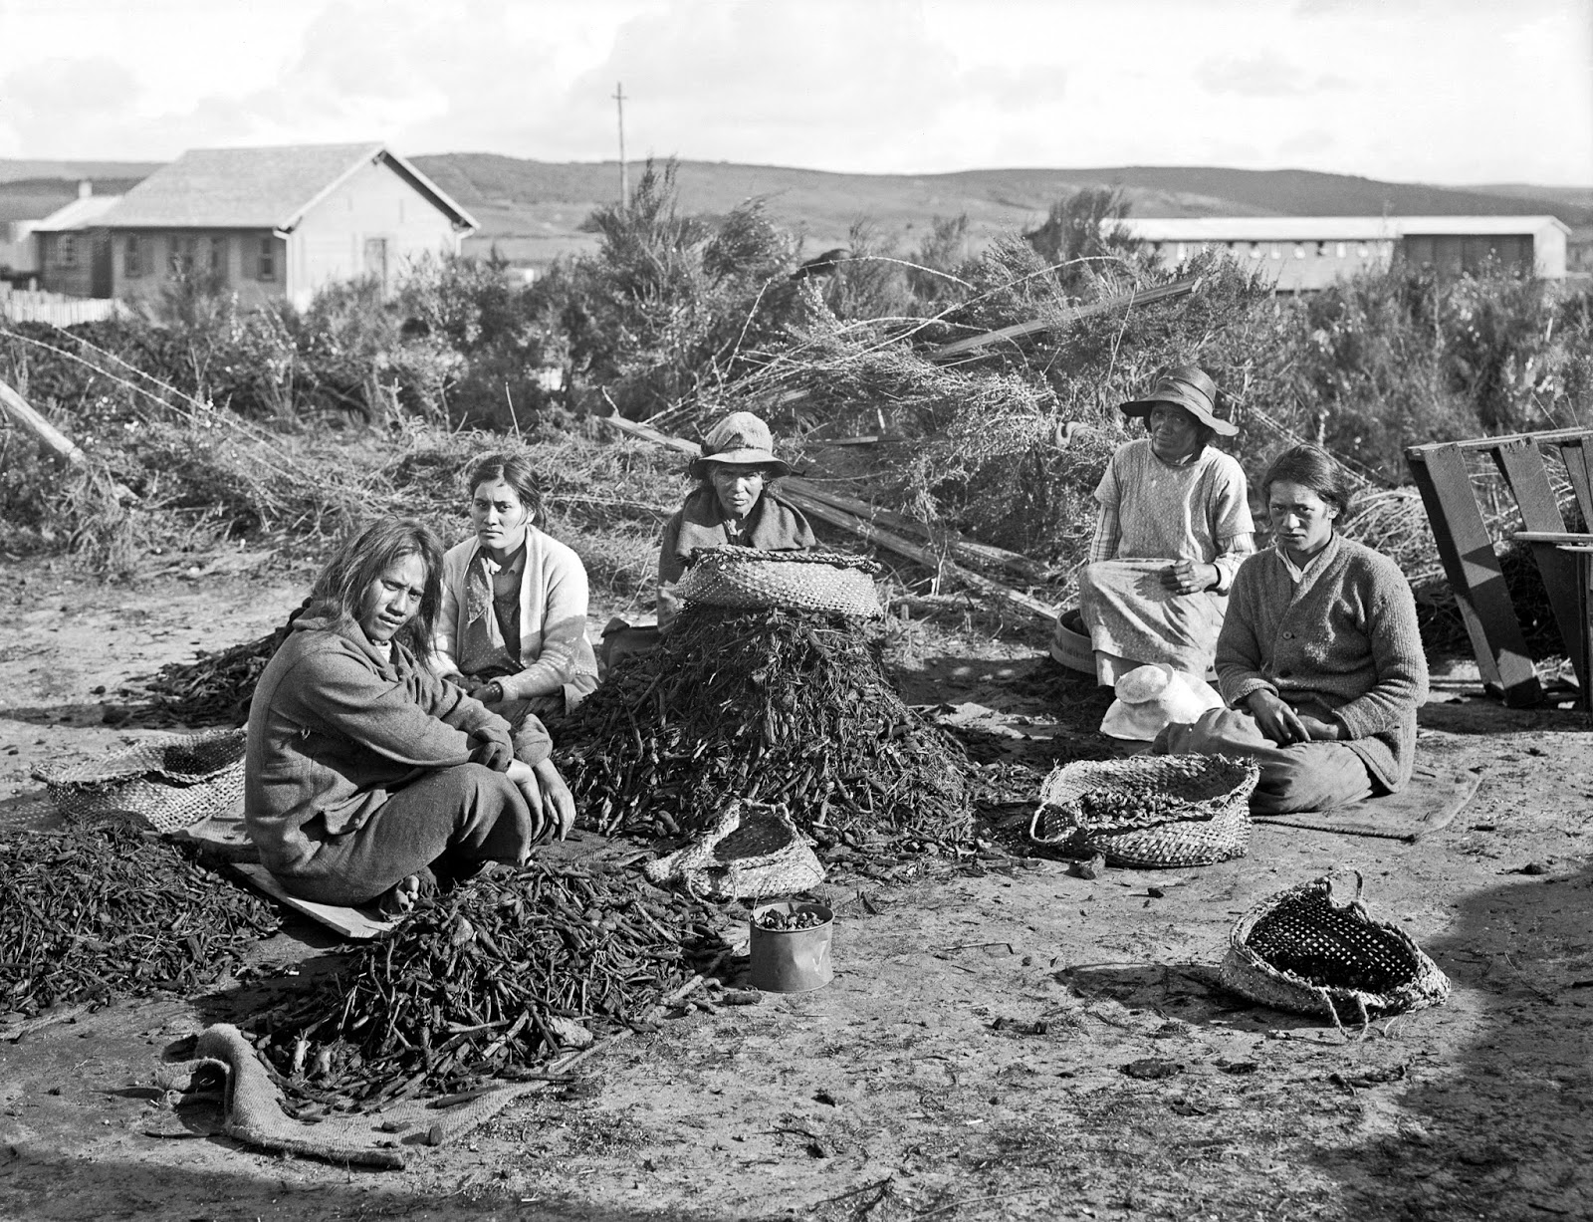
‘The mote in the brother’s eye had to be removed before he could begin to see things as other men saw them’

Slide 18
Ngata farewells men of the 28th (Maori) Battalion, 1940

