Slide 1
The RNZAF in the Pacific 1942-45
Notes:
1. Since its creation in 1937 there has only been one large-scale deployment of the RNZAF and that was to the Pacific in 1942 in support of Operation Cartwheel, which was the US led push to stop Japanese expansionism and retake occupied territory. RNZAF aircraft did not operate in Europe, North Africa, Asia or anywhere else in WW2…though many New Zealanders did.

Slide 2
The RNZAF in the Pacific
1939-1942
War: The struggle to be ready
July 1942-February 1944 – Deployment The first half: Seeking credibility
March 1944-August 1945
The second half: Looking for a fight
Notes:
2. We are going to break the presentation up into three periods. Firstly we will look at the period from 1939-42 and what sort of shape the RNZAF was in and what contribution it was making to the war during this period. Then we will look at the deployment itself which lasted around three years, and to use the vernacular it was very much a game of two halves, and we will look at why that was the case.

Slide 3
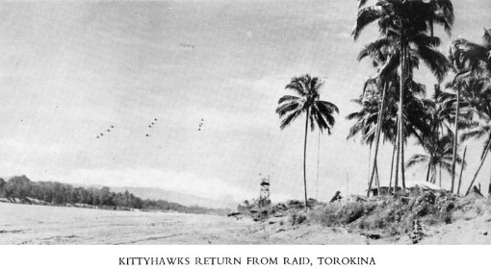
Purpose of Presentation
Overview of the application of New Zealand air power in the Pacific during WW2
Notes:
3. The purpose of this presentation is to give an appreciation of what the application of airpower looks like in the context of the RNZAF and its operational employment in the Pacific Campaign during WW2. War is acted upon at many levels; each member of an alliance often having a discrete, and sometimes hidden, agenda to the overall collective policy, so…what did all this look like in the real world of power politics at the time. Firstly, sitting at the top we have the Allied Policy – which was the defeat and unconditional surrender of Japan, which was decided by Roosevelt, Stalin and Churchill. Sitting below policy we have the Grand Strategy which is what we will need to do to enable policy – which in this case was the destruction of the occupying Japanese forces and the recovery of territory in the Pacific. Next is the Military Strategy which is the military ways by which we will achieve our Grand Strategy – which was a two pronged thrust into the Pacific; from the south (amphibious) through the Solomon Islands and from the west (land) through New Guinea, the immediate aim being to contain Japanese expansion. Strategy should not be too rigid so that it can have bits added on or taken away in response to opportunities and developments. Next we have the Airpower Strategy – which was to provide support for naval and land forces carrying out amphibious and land operations. And finally we have the operational layer of actual Airpower operations which is the ways air power would carry out the strategy – which was by firstly establishing air superiority over the battle space which provided freedom of manoeuvre for the naval and land forces, and then provide ongoing support as required, in what quickly became a war of attrition.

Slide 4
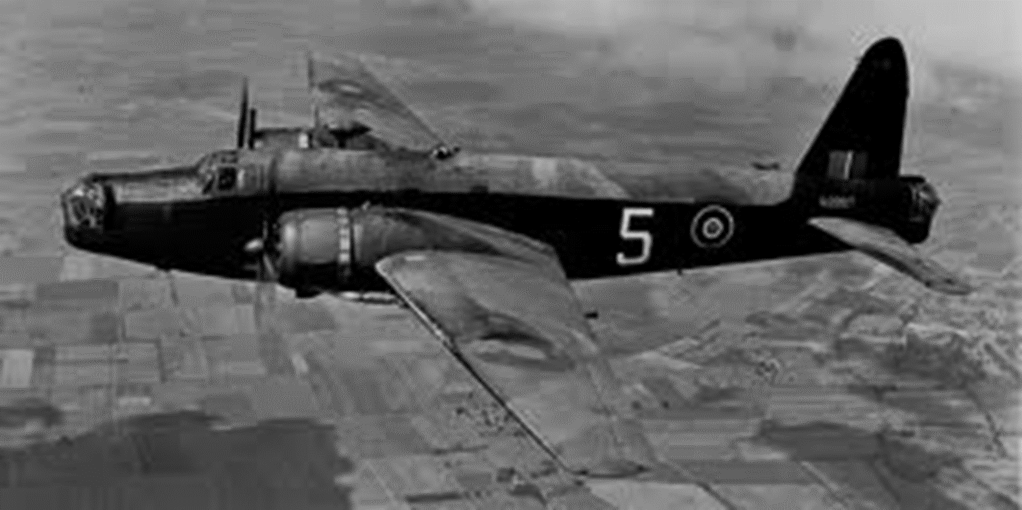
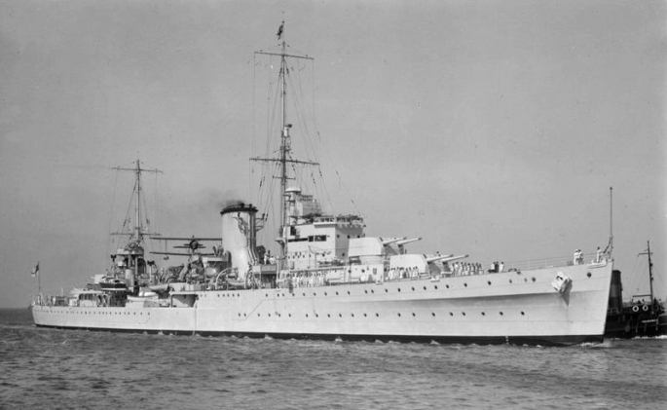
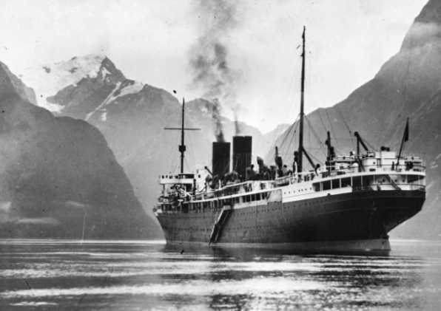
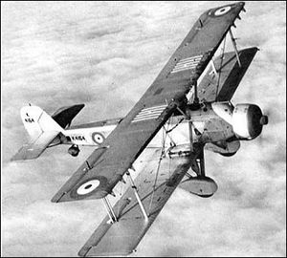
1939-1942 – War: The struggle to be ready
War declared - Defence of the Homeland
BCATP: feeder for RAF
Wellingtons gifted to Britain
Two light/cruisers & one armed merchant cruiser
Vildebeest and Vincent carrying out patrols
Best soldiers in England and Egypt
Notes:
4. So, what shape was New Zealand in to defend itself at the outbreak of the war? At the time war was declared in September 1939 the RNZAF consisted of 91 officers and 665 airmen, with around 400 territorial airmen. The RNZAF had no real offensive or defensive capability and was purely a training organization as part of its commitment to BCATP, which NZ signed up for in 1938. The RNZAF was basically a feeder organization for the RAF with eventual commitments to provide up to 2900 trained and partly trained aircrew per year, though this varied considerably, including up to 1400 pilots. The RNZAF did have on order a force of 30 Wellington medium-bombers, but just as they were about to fly to NZ, a few days before war was declared, the Wellingtons and crews were gifted to Britain in a grand gesture of support. So that left around 40 or so obsolescent Vickers Vildebeest and Vickers Vincent biplanes as our ‘front-line’ aircraft, but of course they weren’t. The Vildebeest was a ponderous torpedo bomber while the Vincent was a (second-hand) army co-op version of same aircraft – they had very limited capability but useful endurance of around 10 hours; they also had around 100 other aircraft which were mostly civilian types seconded from the aeroclubs. The Navy, or more correctly the NZ Division of the RN, had as their principle fighting ships the cruiser Achilles and the light cruiser Leander, which were at least combat worthy. The Achilles was sent to patrol the east coast of S America (and did not return until Feb 1940), and the Leander was sent as an escort for the first deployment of the NZ Div in January 1940; the merchant cruiser Monowai was converted into an armed merchant cruiser, which was completed in August 1940. So we never had what you might call a strong naval deterrent. Our best troops of course were part of NZ 2 Div which deployed to Europe and the Mediterranean during 1940. So basically NZ was defenceless, even more so than we are now.

Slide 5
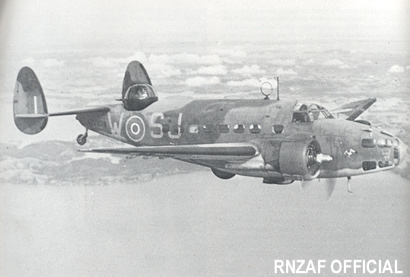
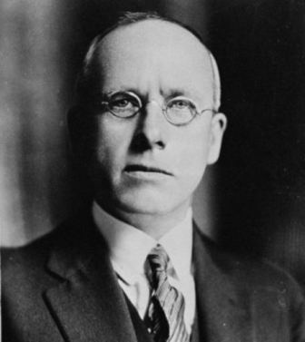
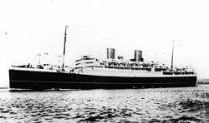
1939-1942 – War: The struggle to be ready
No offensive or defensive capability
German raiders in Pacific
Supply mission Washington
Desperate requests for equipment
Hudsons promised for second half of 1941
Notes:
5. Now…in the period 1919-1936, three reports were commissioned by the government on the requirements for the air defence of NZ, and they had a number of common themes, one being that all agreed that the greatest threat to NZ would be from the sea, most likely in the form of commerce raiders, which is one of the reasons the Wellingtons were ordered, to protect NZ’s SLOCs. In light of this warning and acknowledgement of the threat by the government, the decision to gift the Wellingtons to Britain was perplexing…even to this day; it was definitely a ‘what were they thinking moment’. In the best traditions of Murphy’s Law, German raiders sank four ships around NZ waters in second-half of 1940, and a number of other ships in the Pacific, and by the end of November, after the Rangitane was sunk, PM Fraser pleaded with Churchill for Hudson coastal patrol aircraft, informing him ‘at present the RNZAF possesses not one single aircraft suitable either for recce or for attack against a raider’– the gifting of the Wellingtons bringing no advantage whatsoever, being exposed as the naïve sentimental act that it was – and though vague promises were made by Churchill, they never came with a timeline on them. However in May 1941 a supply mission was set up in Washington – as part of the British mission set up under the Lend-Lease Act. But, all NZ requests had to be approved by Britain before they would even be considered by the US authorities, so obviously Britain saw to her own needs first so it wasn’t until July that 64 Hudson patrol aircraft were authorised for release to NZ over around a 12-month period. So, the conversion of the RNZAF into an operational force in its own right had begun.

Slide 6
1939-1942 – War: The struggle to be ready
Japan enters war – threat of invasion?
36 Hudsons in service – 11,000 pers
Around 500 trainers
Japanese drive south through Rabaul and Solomon Islands –Fall of Singapore
Invasion remote but focus on home defence
Used as lever for more equipment requests including 36 fighters
Roosevelt promises Churchill to supply NZ
Notes:
6. Japan enters war on 7th December 1941 and starts an immediate drive south to form an outer security perimeter for their so called ‘Greater East Asia Co-Prosperity Sphere’. The occupation of Rabaul on New Britain in Jan 1942 caused a ripple of concern in New Zealand and raised the spectre of a Japanese invasion of NZ, even though it was 4000km away. And while the chances of invasion were always remote, at best, the possibility was real in the minds of the general public; the official view of the Allies was that the maritime isolation of NZ would be sufficient for Japanese purposes. So while there is no concrete evidence to support the notion that the government thought invasion likely, it served its interests not to discourage the notion…for two good reasons. Firstly it could be used as a lever for equipment requests, and secondly, there was no better mass mobiliser of the people to accept the government’s war measures, than fear of invasion. And if the situation wasn’t grim enough at the time, the Fall of Singapore in February 1942, merely exacerbated the situation. The shock of the fall of ‘Fortress Singapore’, to which the NZ government had generously donated one million pounds towards creating a RN base in the late 1920s, supposedly guaranteeing NZ’s security, generated further requests for aircraft including fighters. Around this time Roosevelt promised to fulfill all NZ’s military equipment requirements, which would eventually see NZ become a full signatory of the Lend-lease Act later that year.

Slide 7
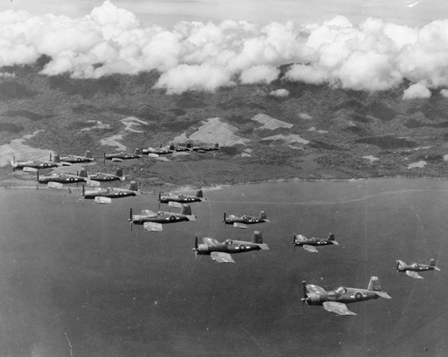
The RNZAF in the Pacific 1942-1945
Notes:
7. Before we move on, I would just like to look at the big picture of why the government sought an active role in the Pacific War, when we were already stretched as it was. Allied policy was the defeat and unconditional surrender of the Japanese, but politics is seldom so simple, and there are often underlying considerations, which may be overt or otherwise. Military power, was, is, and always will be an instrument of policy. The NZ evolving policy in this case was to increase NZ’s profile on the international stage, and specifically in the Pacific, so as to give leverage to post-war settlements that advantaged NZ and minimised the advantage and presence of other players in the Pacific. This was to be achieved by the strategy of making a military contribution to the defeat of the Japanese. All strategies consist of ends, ways, and means. Ends is where you want to be or the desired effects you wish to achieve (the scope of which is limited in direct proportion to your resources), in this case in a strong position to influence post-war settlements, in other words as an enabler of foreign policy aspirations. Ways is what you are going to do to achieve the ends, which in this case was to contribute military forces to the US Pacific Campaign. And means is what you use to do this; namely the equipment, personnel and weapons of the force; this was problematic for NZ as the army and navy were already committed and the RNZAF was not an air combat force, being principally a training organisation for the RAF.

Slide 8
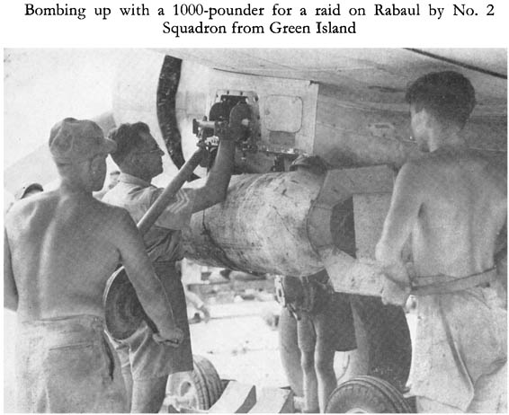
So what?
Basically – as a contribution to war aims
Political
Operational
To be taken seriously RNZAF had to establish credibility
Commitment
Reliability
Competence
Notes:
8. The main obstacle to the RNZAF deploying to the Pacific in a combat role was that the RNZAF as an organisation was not established or trained for combat nor did it have any combat history, only being formed in 1937 – though crucially, it had one advantage. The RNZAF had an increasing cadre of experienced pers returning from RAF service overseas who had flown in combat in the Battle of Britain, Europe, and Singapore. These people would be vital in the transition to a combat air force. The RNZAF had to become a credible force so that the US would wish to have it in-theatre. To have credibility you have to demonstrate a number of things. Firstly you have to show a Commitment of Resources; men and materiel – and be prepared to put them at risk. Secondly you have to demonstrate Reliability – in other words you have to respond positively to requests and show up when you are supposed to with what you have committed. And finally and most importantly you have to demonstrate Competence – in other words complete the task and do so in a sustainable manner (economy of forces). So we will look at the contribution the RNZAF made and how successful it was both Operationally – that’s to say how they actually performed tactically, and also Strategically – did the deployment fulfil the governments aims – the political.

Slide 9
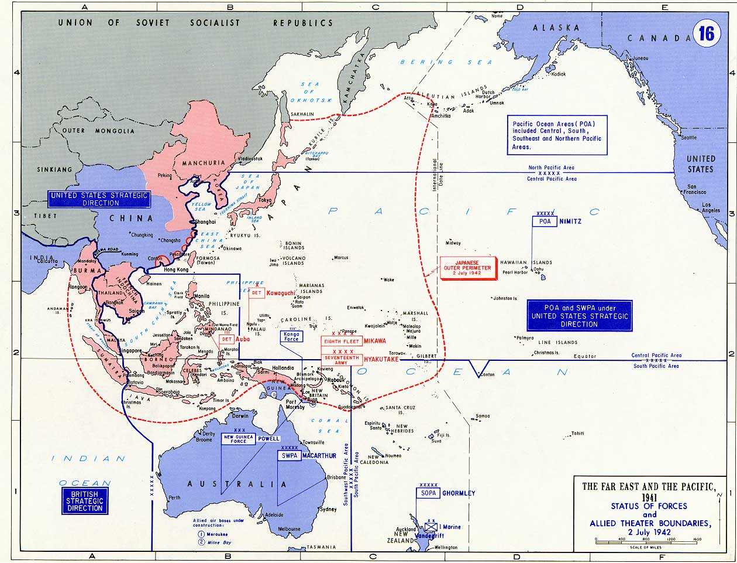
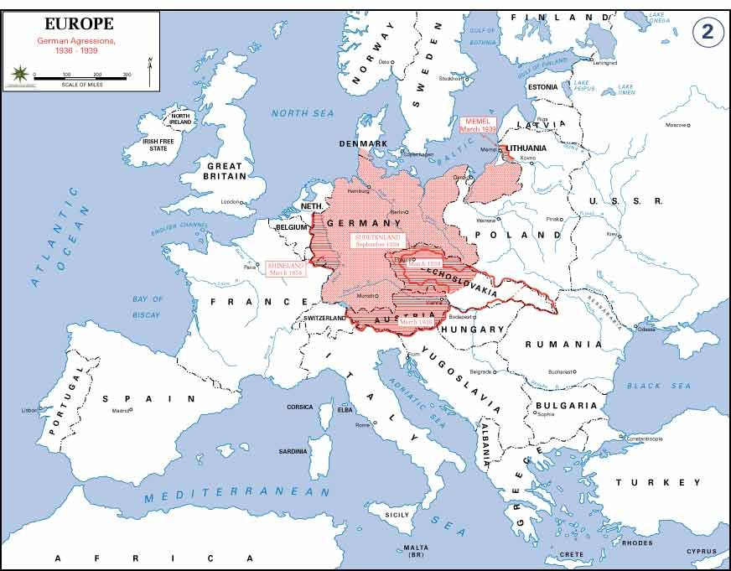
Notes:
9. Let’s take a look at a couple of maps now, so we have an idea of the scope of what NZ was dealing with. This is a map of the Pacific Theatre boundaries as they were in July 1942. You can see there the Japanese Outer perimeter marked with the red dotted line that encompassed their sphere of economic influence, or rather a great big shopping basket of resources that included among other things rubber, tin and oil; the Japanese home islands being bereft of much in the way of natural resources, hence why they set out on a course of economic expansion. The push south was also meant to isolate Chiang Kai-shek from foreign assistance through Rangoon, which it did, forcing the Allies into an air resupply campaign. In March 1942 the Pacific was divided between the two US services, mainly because of personalities and military politics; the navy refused to put the fleets under command of a general, and McArthur in particular who King did not like but Roosevelt did, while McArthur bitterly opposed navy pre-eminence in the Pacific, and refused to put his forces under the command of the navy. So we ended up with the POA which included the SOPAC, with Nimitz in charge and Ghormley commanding SOPAC forces. And we had McArthur commanding the SWPAC.

Slide 10
Notes:
10. This map shows the importance of SLOCs to NZ, and that hasn’t changed. If the Japanese had been allowed to consolidate, and eventually expand their position they would have been in a very good position to disrupt shipping, thus possibly isolating NZ, and perhaps part of the Australian Eastern Seaboard. McArthur wanted to attack Rabaul directly being the strongpoint of the whole southern perimeter – but the JCS considered this would be too costly, so; McArthur would move down the SE coast of NG while the Navy/Marines went for Guadalcanal to prevent the Japanese establishing a strong defensive outpost – this would establish a base for what would later become know as an island-hopping strategy. The latter element of this two-pronged drive was codenamed CARTWHEEL and this is what NZ would soon be supporting. The Japanese considered Guadalcanal a stepping stone to Rabaul, and from there to the home islands – so it was to be held at all costs.

Slide 11
RNZAF AO Pacific 1942-45
Notes:
11. RNZAF AO 1942-45 (map). The highlighted areas mark the main islands of the Solomon’s Campaign and where the RNZAF, among other places, eventually operated from. In the south is Guadalcanal, north of that is New Georgia Island, and still further north is Bouganville. The upper highlight marks Rabaul, the Japanese stronghold of the SOPAC. The arrow is there to give you an idea of scale representing around 500 kms, so it is a big area. It also marks a shipping route taken by Japanese resupply convoys that became known as ‘The Slot’.

Slide 12
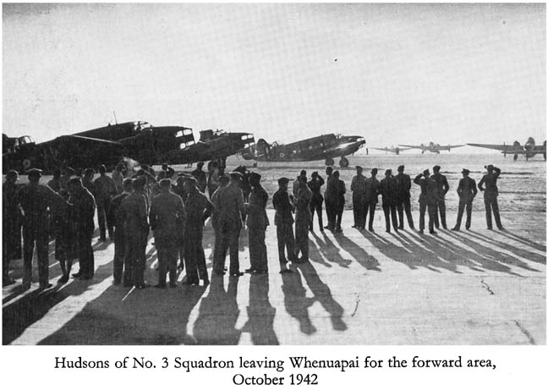
July 1942-February 1944: Deployment
The first half: Seeking credibility
SOPAC – NZ a base for US offensive
Invasion threat diminishes
Credibility to post-war aspirations
NZ seeks combat role – with what?
Repeated requests for equipment
New Caledonia July 1942
Build up to Guadalcanal
Poor preparation though
ultimately successful
Notes:
12. So, what changed in the general situation at home that drove the government to seek an additional combat role? When SOPAC was created, Auckland became Admiral Ghormley’s regional HQ, and he just happened to bring the 2nd Marine Division with him to train in NZ from June 1942 – and while they were not there to defend NZ, remembering our troops were in Egypt, by default Ghormley had responsibility for defending his HQ, but regardless, the presence of thousands of US servicemen brought relief to people and gave them a sense of security anyway. During the first half of 1942 aircraft were arriving in increasing numbers – including fighters from March 1942. And even better news was that Japanese expansion had been well and truly checked at the naval battles of Coral Sea and Midway (May and June 1942 respectively). So, all this good news gave the government a renewed sense of confidence, and thoughts turned towards how NZ might increase its leverage in turning its post-war aspirations into reality. With the navy and army already engaged heavily it was decided to expand the RNZAF and actively seek a combat role in the Pacific. So Fraser let it be known to the US CoN, Admiral King, of the potential of the RNZAF to be part of his planning, Fraser also drew up an ambitious plan for 20 RNZAF squadrons to be operational by 1943. Considering the active role Fraser wished for the RNZAF, there is no evidence to suggest that the Air Force itself was making any plans to fulfil it. When Rear Admiral McCain (COMAIRSOPAC) requested six Vincents to carry out ASW patrols around New Caledonia, it seems to have caught the RNZAF by surprise. Nevertheless, on July 1st 1942 an advance party was on its way by boat, and the decision was also made to send Hudsons as the Vincents would have had to be broken down and sent by sea. This first deployment, was a somewhat ad hoc affair due to a lack of equipment. And while the local US quarter-master unit was happy to make up most of the deficiencies, it was not a good start. However, what subsequently became 9 sqn was employed patrolling the seas out to 400 miles around the coast of New Caledonia and while the tour was generally uneventful, no shipping was lost in the area during 9 Squadron’s tenure, which was not the case before they arrived. So, the squadron fulfilled the RNZAF’s first operational tasking to the satisfaction of all concerned, during a period of intense shipping activity throughout the Guadalcanal campaign.

Slide 13
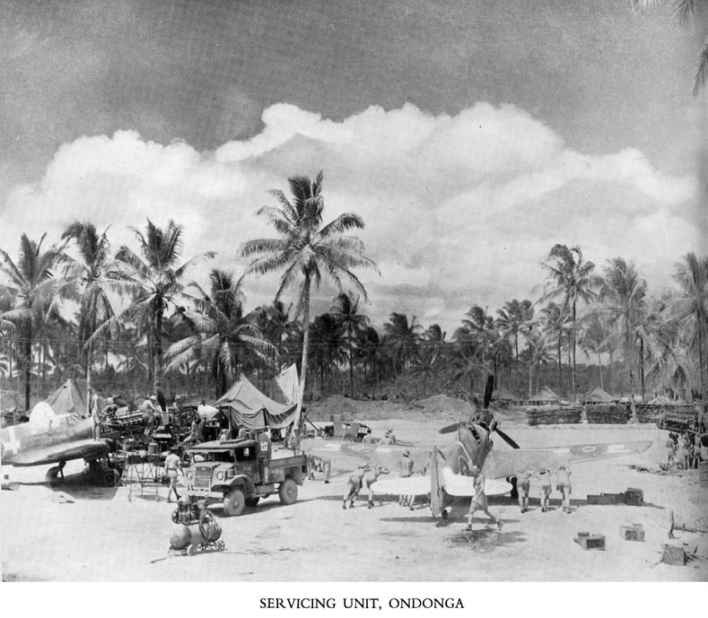
July 1942-February 1944: Deployment -
The first half: Seeking credibility
Shortage of aircraft at Guadalcanal
RNZAF into combat area November 1942
Solid work of (BR) sqns established credibility
1943 – Gathering momentum
Plans for 10-15 sqns
Fighters arrive
Radar Units and
construction crews
(FB) and transport
sqns formed
Notes:
13. The campaign to retake Guadalcanal started in August 1942 and it was no more than a battle for the airfield from which the US could extend the campaign further north, and as usual the commanders were soon asking for more aircraft. They were particularly short of patrol aircraft to intercept Japanese resupply convoys travelling down The Slot, being forced to use B-17 bombers that should otherwise have been employed on bombing missions. So at the request of COMSOPAC, 3 sqn deployed to Guadalcanal in November becoming the first RNZAF unit deployed on combat operations. At this time the battle for Guadalcanal was still in full swing and the airfield was subject to repeated attacks; the island not being finally secured until February 1943. The battle for Guadalcanal was fiercely contested with a high cost to both sides; the Japanese lost 30,000 men, 24 warships, and almost 700 aircraft and crews; the Allies lost 7000 men, over 600 aircraft, and 24 warships. The US would have preferred the RNZAF to deploy earlier but delays in issuing a command directive due to constitutional issues, prevented this. The Hudsons carried out occasional bombing raids on enemy occupied villages but were mostly employed on shipping patrols – being the eyes and ears for strike elements – very successful despite initial doubts about the survivability of the Hudsons against Japanese fighters. Having proved their worth, COMSOPAC placed increasing demands on the RNZAF. Another Hudson sqn was deployed and the first fighters arrived in April. A radar unit was sent up to Guadalcanal from Tonga and proved a great success being responsible for detecting and breaking up numerous air raids. A GHQ was established at Espiritu Santo on Vanuatu to administer the increased RNZAF presence, which included the establishment of repair depots, airfield construction teams, a deployment of flying boats to Fiji, and transport operations commencing following the establishment of 40sqn at Whenuapai in June.

Slide 14
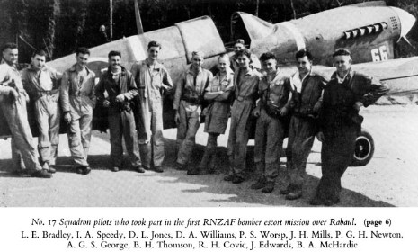
July 1942-February 1944: Deployment -
The first half: Seeking credibility
Credibility established
All deployments at request of COMSOPAC
Fighter Wing formed October 1943
Reputation as tenacious and disciplined fighters
Favoured by American
bomber crews
RNZAF pilots as strike
leaders
Notes:
14. All deployments through 1943 were at the request of COMSOPAC, with most being around 12 weeks though there were frequent extensions. The RNZAF established an enviable reputation for reliability, and only once did they fail to have a full sqn available for operations. Halsey, who replaced Ghormley, even forced the government to deploy one of the home based fighter sqns which Halsey saw little further need for, and which duly deployed in time for the Bouganville landings in November. The Kittyhawks were often employed on bomber escort work to which they were well suited. The bomber crews very much appreciated the flying discipline and teamwork of the RNZAF pilots, who stuck to their job unlike the American fighter pilots who were often accused of being more interested in increasing their ‘scores’ than defending the bombers. With the arrival of a second fighter unit in theatre a NZ Fighter Wing was established at Ondonga on New Georgia Island in October; in the following month the RNZAF station commander took over command of all fighter operations at Ondonga, which included US Army and Marine fighter units, which was a huge statement of the confidence and regard the US commanders had in the ability of the RNZAF operational commanders.

Slide 15
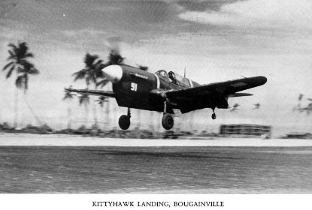
July 1942-February 1944: Deployment -
The first half: Seeking credibility
Isolation of Rabaul
Fighter Wing took part in every major attack
Excellent relationship with Americans
Bomber escort and Fighter
sweeps
Many records of American
appreciation and value of
RNZAF presence
Notes:
15. With the landings at Bougainville in November it put allied aircraft in range of Rabaul. The RNZAF started operating there in the following month mainly engaged on bomber escort and later on fighter sweeps over the islands. The new Ventura medium bombers also started arriving to replace the Hudsons. These operations continued through to mid-February on all but one day due to weather. Having scanned various documents at Archives NZ and spoken to a couple of veterans it is certain that NZ had excellent professional and command relations. The Americans and New Zealanders worked very well together and the American appreciation of the work the RNZAF was doing is a matter of record in numerous documents; diplomatic and military niceties aside it seems indisputable that the US was very happy for the RNZAF to be there.

Slide 16
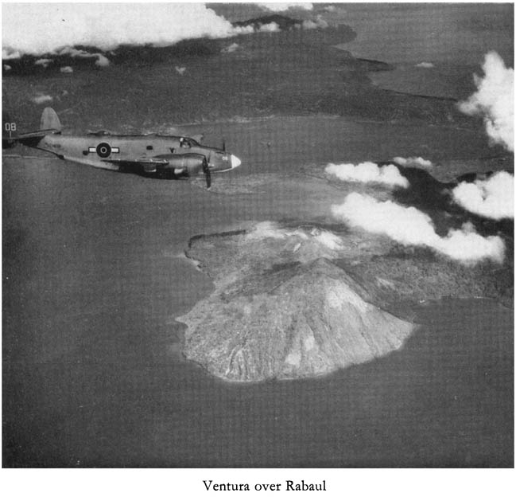
July 1942-February 1944: Deployment -
The first half: Seeking credibility
Solomons Campaign effectively ends February 1944
Japanese aircraft withdraw
Rabaul isolated from sea and
air
100000 remaining Japanese troops
Americans begin move north
What will RNZAF do?
Notes:
16. Due to pressures elsewhere there were no Japanese aircraft reinforcements to the region after December 1943, and on the 17-18 February 1944 US carriers attacked Truk atoll around 1300 km north of Rabaul, which was a large Japanese naval hub, this saw the Japanese move all except around 10 aircraft to Truk two days later; this meant the air war was effectively over. During the campaign the Japanese lost almost 3000 aircraft (SBS) and crews; so why did they lose so many? Well there are a couple of reasons. Firstly they had no formal rescue facilities whatsoever, unlike the Allies, who would literally go to any lengths to recover downed aircrew. And secondly, there was no policy of rotation or rest for Japanese aircrew, and as irreplaceable experienced aircrew were lost, experience levels declined steeply, making them less effective on operations. Regardless, there still remained around 100,000 troops in the area – and while they were isolated and incapable of effective offensive operations they were nevertheless not beaten. So the JCS decided that it would still be too costly to directly assault Rabaul, and as it was not particularly important strategically, there was no point anyway, as long as they were contained. So to summarise the Solomon’s Campaign, the aim was to stop further Japanese expansion and secure SLOCs. Previously the Japanese sought a single decisive battle, but they decided they had to keep Guadalcanal at all costs, as they saw it as the gateway to Rabaul and then the home islands, so they engaged in a war of attrition with the only country that could defeat them.

Slide 17
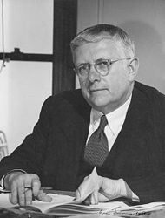
March 1944-August 1945
The second half: Looking for a fight
Politics takes over
Canberra Agreement January 1944
PWC ineffective
Lack of consultation
An affront – King and Hull
Excuse or reason for American unilateralism
No further offensive role for RNZAF?
Restricted to garrison duties
Limited operations to continue in SWPAC
Notes:
17. War is ultimately a political activity and in October 1943 politics reasserted itself. At that time NZ was invited to Canberra by the Australian government to discuss matters of ‘mutual interest’ in regard to the Pacific. The meeting was driven by an ambitious politician called Herbert Evatt, who was the Minister for External Affairs, and he was concerned about the lack of consultation by the great powers with the lesser powers at the summit meetings that had taken place throughout the year, particularly around issues that affected them. The Pacific War Council that had been set up in Washington in April 1942 was no more than a talkfest, and was regarded as ineffective – as no major decisions ever made – Herbert regarded it as no more than a sop to Aus and NZ, and evidence would suggest he was right. The Canberra meeting was given further impetus when at the December Allied summit meeting in Cairo, the US, Great Britain, and China announced their intentions for the Pacific; Australia and New Zealand knew nothing of this until it was released to the press. It wasn’t so much the decisions made, more the process involved. This failure by America and Britain to consult fully on the future of the Pacific Islands with their allies, led to the signing of the Canberra Agreement in January 1944 that set out the independent objectives of the Dominions. At first it appears that Fraser had no intention of signing any formal agreement, but he was put under considerable Australian pressure to do so; so why did he? I believe it was appeasement to Curtin on Fraser’s part, who was annoyed, and embarrassed, when NZ, at the request of Churchill, declined to withdraw its Division from Europe when Japan entered the war, whereas the Australians withdrew their three divisions, and this rankled the Australians, and created tension with NZ. So what was the Canberra Agreement? It was basically a joint declaration of Australian and NZ intent in the post-war Pacific, and at its foundation was that they were not prepared to accept US dominance in the South Pacific. They wanted to minimise US presence south of the Equator, while encouraging it to the north. It further called for a Pacific Conference, to discuss regional security and access to wartime air bases, for civilian airlines, in the post-war period. The Agreement got a mixed reception, some declaring it realistic, and others seeing it as outright hostile to the Americans. What counted though is that it was badly received by the US authorities. The US Secretary of State, Cordell Hull, regarded it as an affront and gave Fraser and Curtin a severe dressing down, and now saw fit to disregard the contribution that Zealand and Australia were making in their attempt to gain a voice in the making of policies affecting their own future security. Admiral King was equally dismayed and consequently refused the RNZAF a further combat role in the Pacific, beyond garrison duties and subduing remaining Japanese forces within their present area of operations. Also, given MacArthur’s indifference to Australian forces, it is likely he shared King’s view; which may have manifested itself in the delayed hand over of NORSOLS to the RNZAF, which effectively limited operations to the peripheral of SWPAC AO. It seems more likely that the Agreement provided a convenient ‘excuse’ to exclude both Australia and New Zealand from further offensive operations north of the equator. Many historians regard the American attitude as underlying a desire to monopolise the Pacific counter-offensive and post-war occupation and control of Japan.

Slide 18
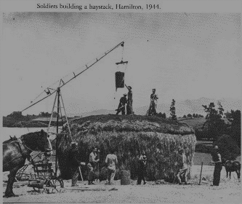
March 1944-August 1945
The second half: Looking for a fight
Manpower shortages
Domestic and service commitments
NZ 3 Division to be disbanded
Loss of amphibious capability
Good strategy, doubtful politics
Notes:
18. By March 1944 NZ had around 155000 men in the services – which was around one-third of male labour force. NZ was fighting a two front war in the Pacific and in Europe. On the domestic front NZ was providing large amounts of produce for Britain and elsewhere, and the shortage of manpower was causing problems during the harvesting and killing season. The RNZAF was still contributing to the CATP and still had plans to expand to 20 operational squadrons, so something had to give. Fraser sought Roosevelt’s guidance as to what might be done. Roosevelt believed NZ’s interests lay in the Pacific, but he decided to let Churchill decide the matter. Subsequently Churchill once again favoured retaining 2 Division in Europe and disbanding 3 Division who were operating in the Pacific, and who were subsequently withdrawn by August. So, 3 Division were sacrificed in favour of the Air Force despite two good reasons not to. The Solomon’s campaign was effectively over – and the RNZAF had no concrete plans for a future combat role. NZ 3 Division is apparently a seldom heard success story, they carried out landings and subsequently cleared Japanese forces from Vella Lavella, Treasury Islands and Green Islands. They were in fact so good that they were selected by COMGEN 1st MAC for incorporation into his Corps for further ops ahead of US and Australian divisions. And while they could no doubt have made a valuable contribution in Philippines or CENPAC – but at what cost? So, it seemed to be a good strategy but bad politics. It was a good strategy as it gave a strong presence with little risk, but lacked a real contribution to strategic aims, whereas 3 Division would have; so it came down to numbers versus deeds, which was in fact the opposite of what they were trying to achieve in 1942.

Slide 19
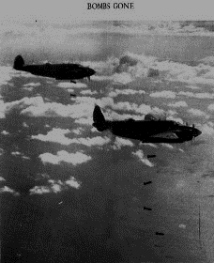
March 1944-August 1945
The second half: Looking for a fight
Needed to maintain presence
Post-war settlements
Australians dominant
Isitt seeks offensive role
RNZAF re-equips and expands
3 possibilities
Notes:
19. PM Fraser determined that in maintaining a large RNZAF presence in the Pacific it would add weight in any post-war Pacific settlement, and it would give some balance to the dominant Australian presence in the SWPAC, and from late 1944 at Bougainville, in other words he wanted to keep the Australians out. The CoAS Isitt frantically sought a further offensive role for the RNZAF, and he wasn’t having much luck. Regardless, expansion and re-equipment continued and the first of the new Corsair fighters appeared in theatre, which were fitted with bomb racks and took on the fighter-bomber role as from March 1944 there was no air opposition, and precious few hard military targets either. Now of course would have been the time to disband some squadrons and make manpower available to industry, but Fraser still believed this might degrade NZ’s position post-war. With the strategic goals in the Solomons more or less concluded the decision was made to liquidise all US SOPAC troops and reassign them; the entire US 13th AF was handed over to MacArthur and SOPAC was declared non-operational in June 1944 as the USN moved into the Central Pacific. Isitt believed there were three possibilities; firstly follow the USN into the Central Pacific, but that was largely a carrier war with little scope for land based air power; secondly, they could transfer to the SWPAC, but the Australians were already there and not having a particularly good experience under MacArthur; and thirdly, move over to SEAC under the British in Burma, but they already had a backlog of RAF aircrew, so it wasn’t looking good.

Slide 20
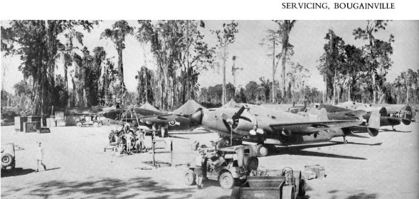
March 1944-August 1945
The second half: Looking for a fight
Criticism at home
Empire building
No real contribution to war effort
Japanese still resisting
Lack of hard military targets
Aircrew still doing
worthwhile job
Little or no contact
with enemy in
latter stages
Notes:
20. By mid-1944 the NZ press was becoming aware of the RNZAF’s situation in the Pacific and the Herald in particular was openly critical of the RNZAF in light of the manpower situation. They claimed it was a top-heavy empire building service that was achieving nothing of strategic consequence; and while it was bigger than the task set for it, there was still the possibility of a future offensive role, in Isitt’s mind anyway, and it provided a balance to Australian forces in Fraser’s mind. Regardless, operations around Rabaul continued with regular fighter-bomber sweeps, and bombing missions even though there were no hard military targets, though they were still taking losses to Japanese AAA which operated through till the end of the war. They also carried out Army co-op with the Australian soldiers tasked with clearing the Japanese off Bougainville. The reason they kept harassing the Japanese was that the US did not want undefeated enemy soldiers returning to Japan after the war. However, in the last few months of the war it became increasingly rare to make contact, and while morale remained high in the forward areas, that was not apparently the case to the rear where monotonous garrison duties were the norm. As an interesting aside, we saw one of the first uses of aircraft in chemical ops. Where RNZAF avengers were used to spray the Japanese soldiers (subsistence) veggie gardens and crops with diesel; and of course the Avengers would later be used in NZ to carry out crop spraying trials.

Slide 21
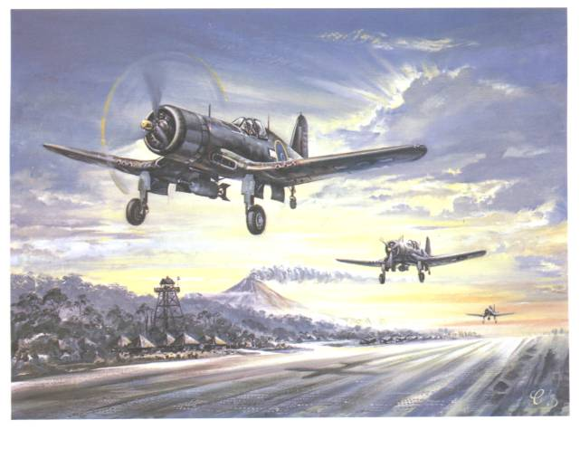
March 1944-August 1945
The second half: Looking for a fight
American loss of interest
Rumours of move to Borneo
War ended
19 operational squadrons
Notes:
21. By the second half of 1944 the Americans had pretty much lost interest in what was happening around the Solomons and what the RNZAF was doing in particular, though control of the NORSOLS AO was still in the hands of the Marines, and remained that way until July 1945. There was a strong rumour that the fighter squadrons were moving to Borneo, and the Fighter Wing moved up north to the Admiralty and Emirau Islands, supposedly to re-equip with Mustangs prior to the move, but it turned out it was just a rumour. There is no real evidence of concrete plans for any further deployment of RNZAF units. And so, the war ended in August with the RNZAF having 13 operational squadrons deployed and around 7000 men.

Slide 22
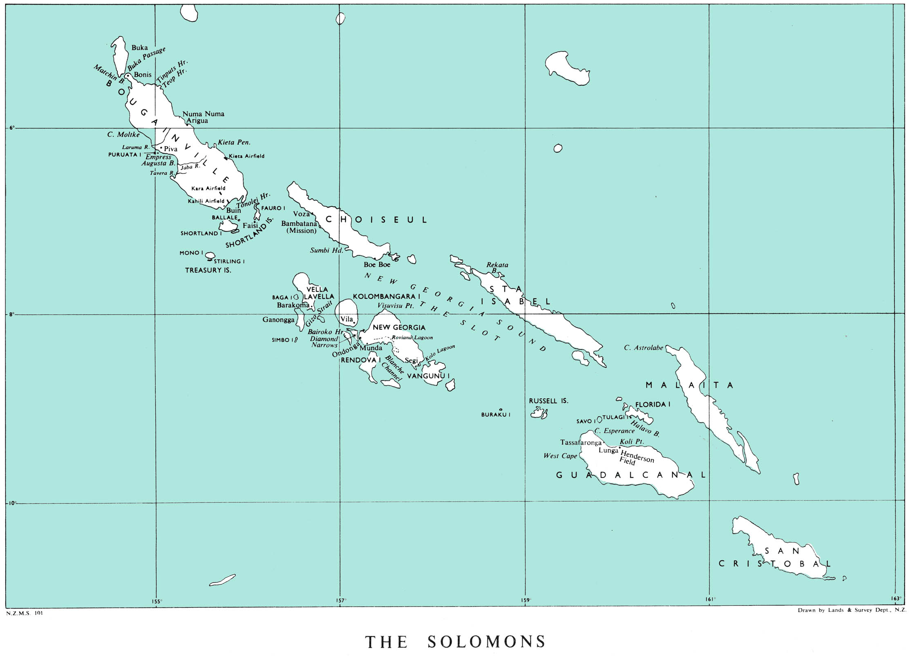
Low Profile
WHY?
War reporting Eurocentric – Mother England
Official War History – Eurocentric
Largely perpetuated ever since
Notes:
22. An extraordinary feature of the Pacific War was its relatively low profile, and there are perhaps a number of reasons for this. War news had always focused on Europe, and the main reason for this was around who controlled the news, which was of course the BBC World Service, who naturally focused on their own troops. The Pacific Islands to most people were just that, just a few small islands with unfamiliar names in unfamiliar places. The US for their part never allowed much news to filter out of the Pacific area; and as we know US policy was always Germany first, and after February 1944 there wasn’t actually that much to report from SOPAC anyway. This low profile was actually perpetuated after the war as the Official War Histories were released. The Official War History, and sometimes the words official and history are an oxymoron, comprises of around 50 volumes. It covers all aspects of NZ’s involvement in the war and for instance, there are three volumes on New Zealander’s in the RAF to around 1400 pages; the Petrol Company supplying 2 Division in Europe had its own volume of 365 pages, and there is even a volume dedicated to Dental Services of 430 pages, and well, the entire RNZAF gets one volume of 344 pages. This low profile seems to have continued ever since, even within the RNZAF.

Slide 23
Conclusions
Credibility established beyond question
There because they were needed
Responded to every request and fulfilled tasks
Superior to US forces in some aspects
Though relegated from Feb44 – never doubted worth
Overtaken by politics?
Notes:
23. So, what conclusions might we take away from this? Well, the Americans clearly had faith in RNZAF’s ability as evidenced by the expanded role they gave the RNZAF throughout the Solomon’s Campaign. Local commanders always contended they never had enough aircraft, and the RNZAF filled the gaps very capably, never failing to meet the task. In some ways they were regarded as superior to US air forces they operated with, and particularly in the areas of aircraft serviceability, flying discipline, and teamwork. But inevitably politics caught up and their involvement was cut short, and while the Canberra Agreement may have had something to do with it, it was probably more of an excuse to go it alone on the part of the US.

Slide 24
Conclusions
So what did New Zealand get out of this?
Nothing!

Slide 25
Conclusions
The US successfully monopolised the last 18 months of the Pacific war and the Japanese surrender
Notes:
25. US successfully monopolised the entire counter-offensive and all major aspects of the Japanese surrender, as well as exercising total post-war control of Japan.

Slide 26
Conclusions
ANZUS – New Zealand’s reward?
Trade-off for accepting peace treaty
Previously reluctant to participate in regional security
US containment policy – Communism in Asia
Wartime alliance indirect influence at best
Notes:
26. NZ and Australia were reluctant to agree to the terms of the peace treaty as they believed it did not guard sufficiently against a resurgence of militarism in Japan. They were also pushing the US for some form of security guarantee in the Pacific region, and were encouraged by the formation of NATO in April 1949, but that was more about maintaining a US military presence in Europe to contain the Soviet Union, consequently President Truman showed no inclination towards a regional security pact in the Pacific, until…1950 and the Korean War. The US saw that it needed to counter the spread of Communism in Asia, and that it needed allies to do so. So, in a somewhat obvious display of cynicism in the best traditions of realpolitik, the ANZUS Pact was signed in Sept 51 in the same week as the Japanese Peace Treaty – very much a case of quid-pro-quo, rather than a nod to wartime co-operation.

Slide 27
Conclusions
New Zealand sidelined in post-war settlements
Despite relative massive contribution
ANZUS a belated consolation prize
Provided for a policy of limited self-reliance over a ‘broad range’ until 1984
Political and Strategic Lessons
Maritime nation – SLOC protection
Absolute reliance on air and sea power
Major powers don’t care much about small powers
Notes:
27. Contributed forces from all three services – relatively biggest in Commonwealth. ANZUS was a belated consolation prize, at best, and didn’t really guarantee anything. Main lessons are that we are a small isolated and vulnerable nation at the bottom of the world, that is absolutely reliant on secure SLOC’s for our wellbeing, and in times of trouble best we have a plan to take care of ourselves for a while, as no one will be rushing to help us.

Slide 28
