Slide 1
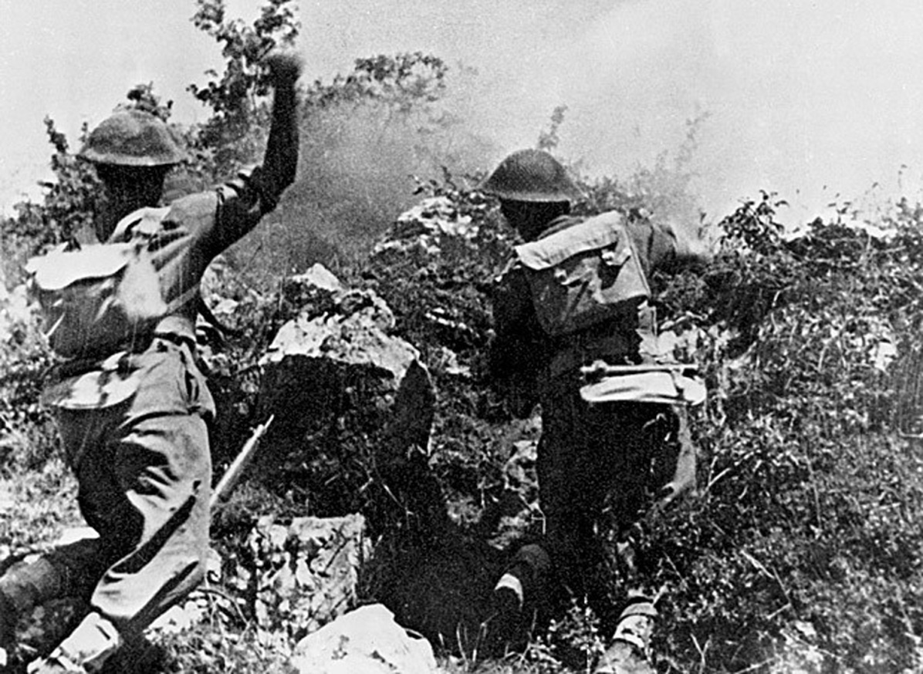
A Mighty Coalition? The Allies and the Battles of Monte Cassino

Slide 2
Allied bombing of Cassino watched by Corps commanders

Slide 3
We are unlikely to see such an array again take the field under one command.

Slide 4
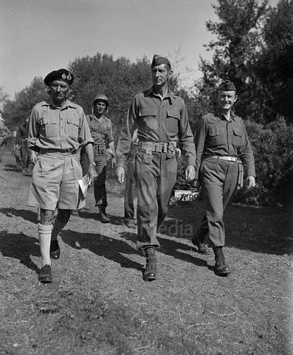
‘Building and sustaining coalitions have been fundamental tasks for British politicians and military leaders over the last three hundred years.’ Nor should it be forgotten that the British Empire and later the British Commonwealth, as epitomised by the Eighth Army in Italy, was always ‘something of a coalition’.

Slide 5
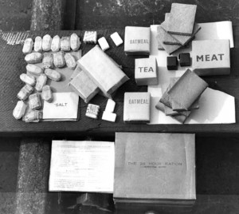
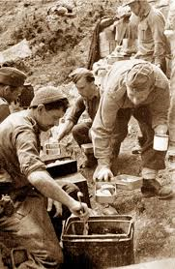
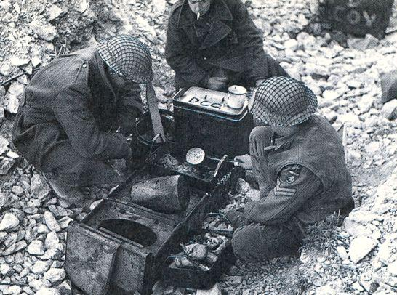
‘We had every nationality in the world in those armies [the Fifth and Eighth Armies]. … and they all ate something different. They had all they could do with what they were doing in keeping them supplied and replaced.’

Slide 6
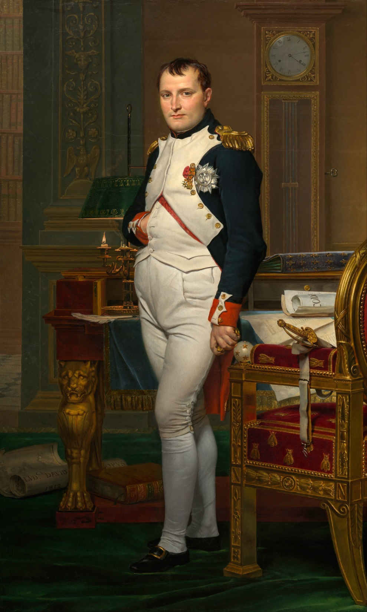
‘It was only natural that there was a little friction. Remember Napoleon; one of his maxims was, “Don’t be an ally – fight them”. I thought of that a million times during the war. The problems of being an ally. Because you had different ammunition, different equipment, different food, different customs, different beliefs and Gods, different languages, you didn’t have a homogenous force like the Germans did that could be moved around at will. We could never do it’.

Slide 8
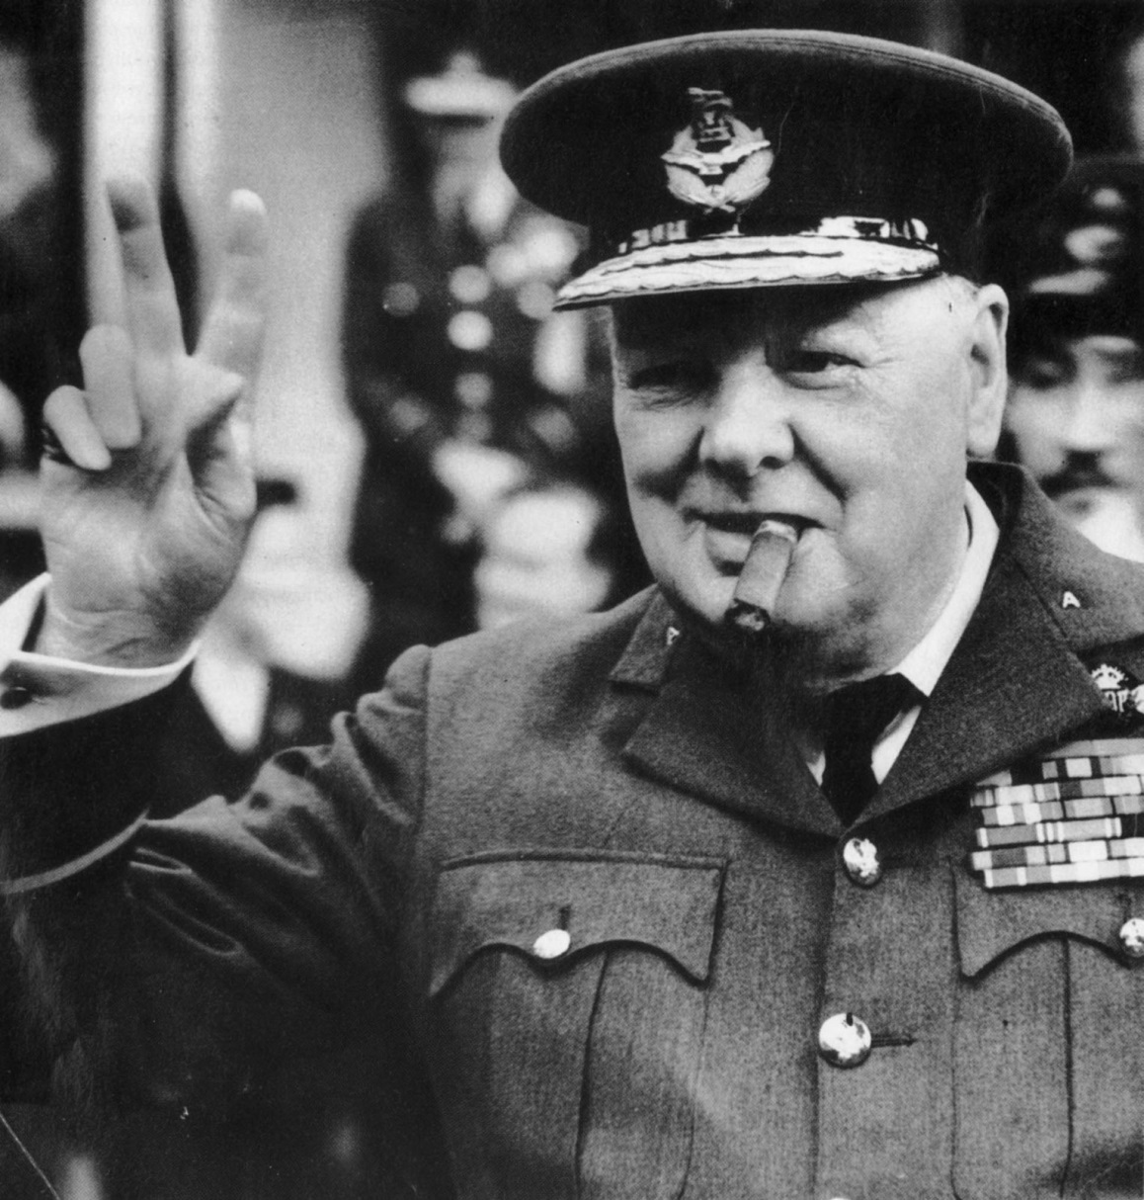
‘There is only one thing worse than fighting with allies – and that is fighting without them.’

Slide 9
The U.S.A

Slide 12
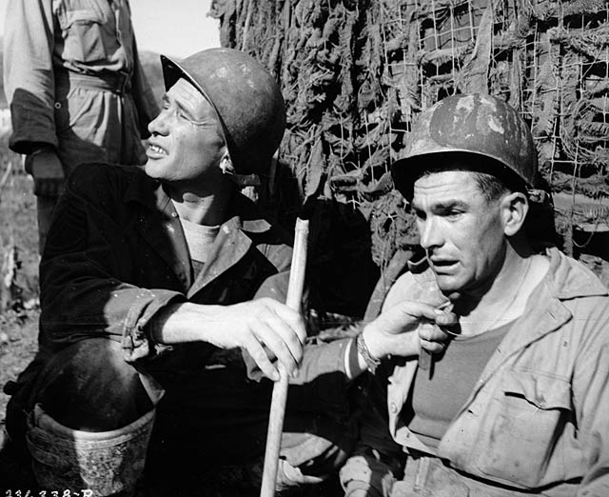
‘My ass was dragging just like everybody else. But as I was a first sergeant I took a responsibility, so I was going to be the last one off. I watched them come down and I can’t imagine men being in any worse shape than that bunch. They were like zombies shuffling along. They were just absolutely exhausted, and it was not our company alone; it was all of them. It was just continual lack of sleep, continual pounding, continual action. It was a nasty, nasty battle in a nasty, nasty war.’

Slide 13
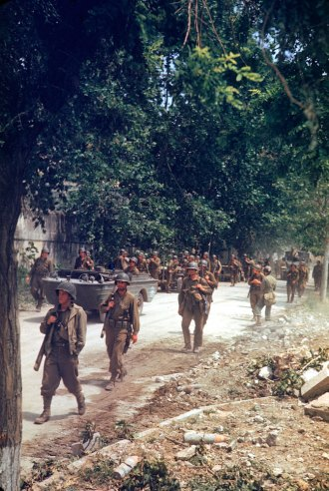
‘We could hear them coming about a mile away, talking at the top of their voices, weapons rattling, boots crunching on the metal and rubble on the road. But to make matters worse, they were coming down the road ‘en masse’ not in small batches or well spread out as I had suggested, but in one great heap as though out for a jaunt’.

Slide 14
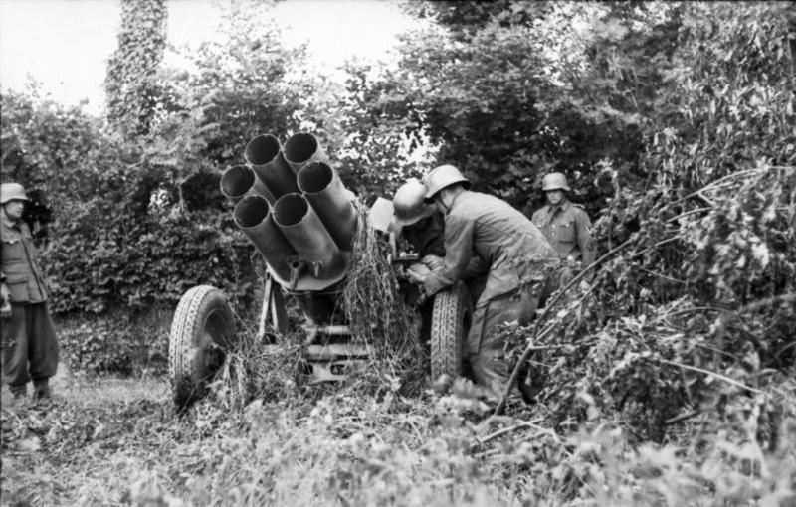
‘When the Americans were about 400 metres away we heard the enemy Nebelwerfers begin their mournful braying as they were wound up. The first salvo of about 20 bombs landed in the middle of the Americans. For a moment there was silence as they scattered to each side of the road, then in the confusion, they stupidly returned en masse and crowded around the casualties in a congested heap of men’.

Slide 15
The US Army 88th Infantry Division, near Bologna, 1944

Slide 16
The United Kingdom

Slide 17
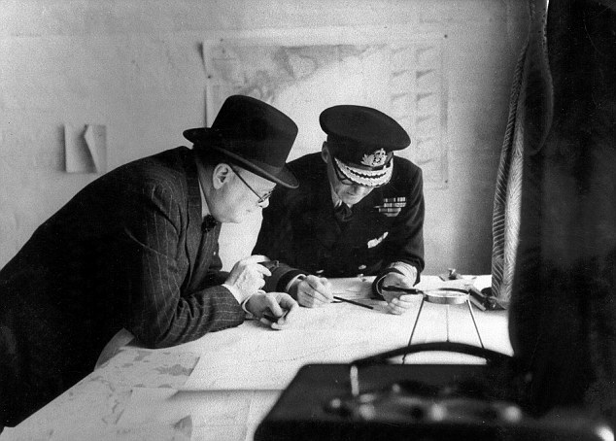
‘(I can see him before the map) the North African thing with the slitting of the soft underbelly of the Mediterranean, (I think that was the term he used), and the thought I had as we hit Italy; that it was a tough old gut that we were trying to slit, instead of a soft underbelly. At any rate Mr. Churchill prevailed’.

Slide 18
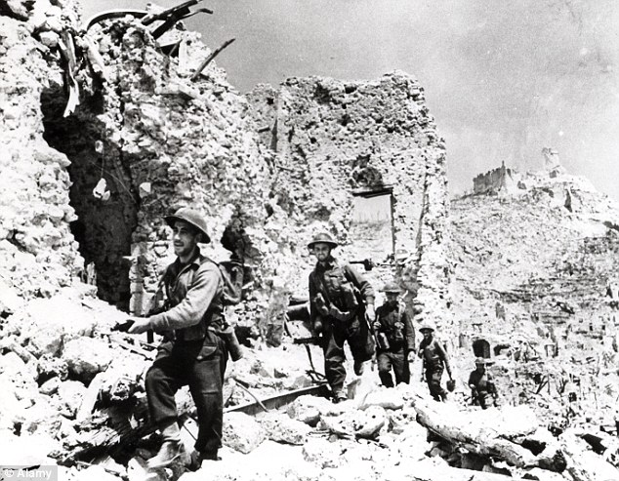
‘The troops had been a long time in the line. … 56th, 46th and Fifth Divisions had been in the face of the enemy for four months, one indeed had spent in combat 115 days out of the 122 since its arrival in Italy.
Not much could be done to ‘rest and refresh’ the troops … [but] great efforts were being made to this end. The continual drain of casualties led to an acute problem of reinforcements for the infantry.’

Slide 19
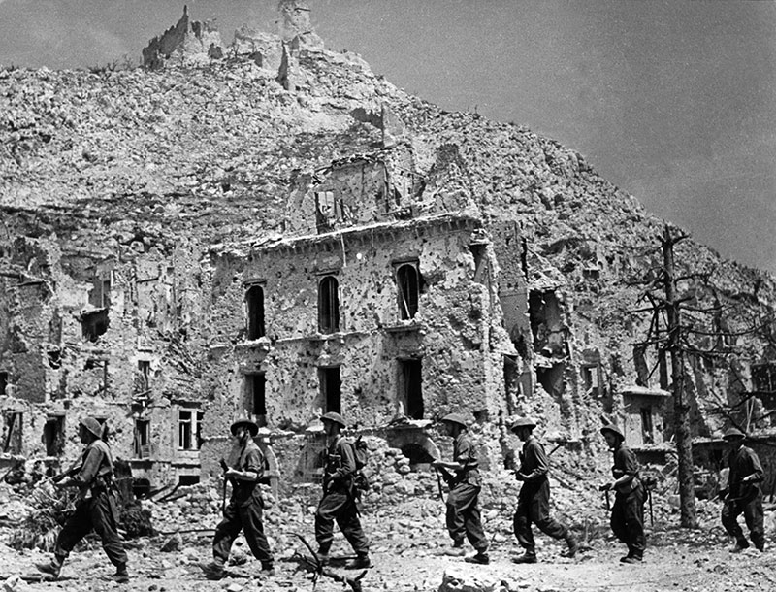
‘But in Italy, the fighting spirit and aggressive quality of British divisions began again to decline, and for the reason of the sheer factor of exhaustion. The British simply could not keep their battalions up to strength and it was very depressing to their men. They had no replacements. The two British divisions at Anzio simply had no punch: it was a very serious situation’.

Slide 20
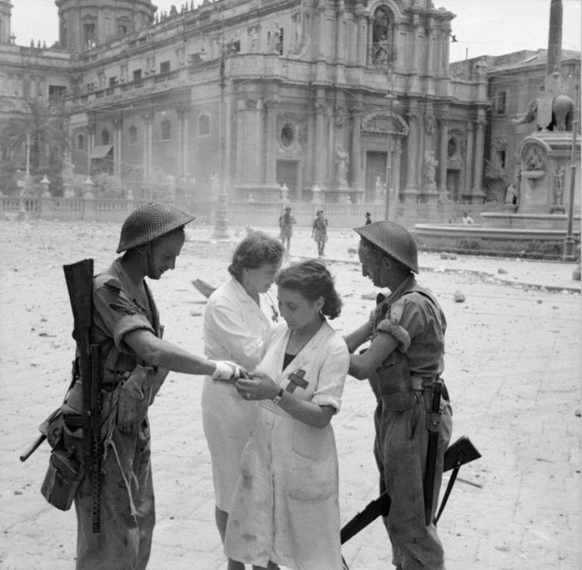
‘They seemed unable to make even a simple reconnaissance without getting into trouble. They would advance with the greatest possible bravery but always with heavy losses, which could not be replaced, and always on a narrow front which gave the enemy an opportunity for his favourite “pinching-off” tactics. I was convinced that, should the enemy launch a determined counter-offensive, and his build-up in strength could have no other object in view, it would strike in the direction of Anzio and the Port, in which case its principal weight would fall on the British’.

Slide 21
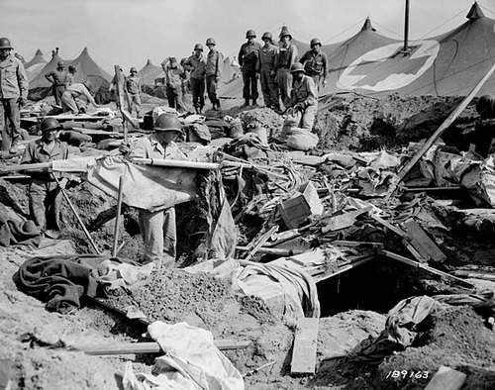
‘a very distinct impression that our allies, despite the means at their disposal, were not committed to going all-out to destroy the enemy, but preferred to wear him down’

Slide 22
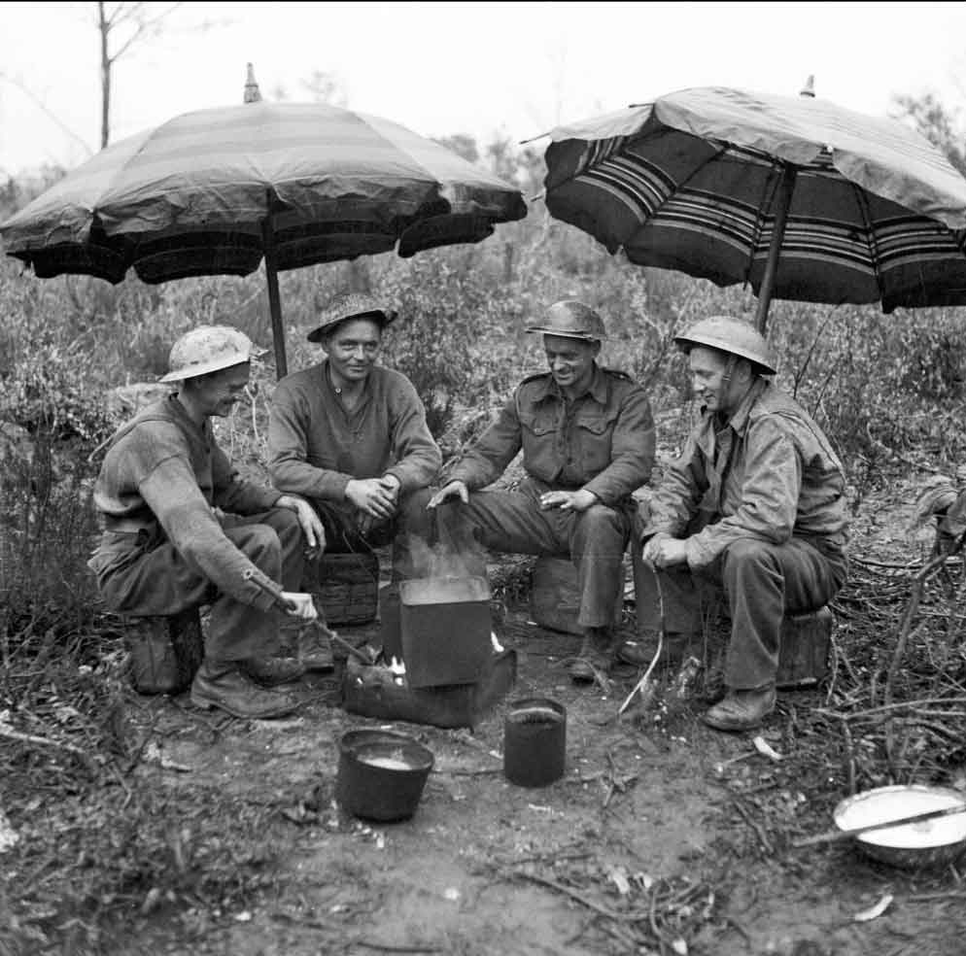
‘It was partly political, but partly because of their sincere belief in that strategy. But once you start on attrition you are lost, you are ruined. Gen. Clark kept pushing the fighting, and rightly so. If you keep the initiative, total losses are less than with the accumulation of losses in a campaign of attrition’.

Slide 23
The Polish Corps

Slide 24
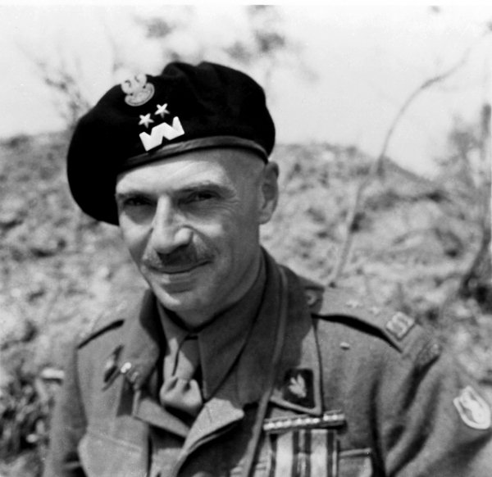
‘In many ways Anders reflected the spirit of the Poles and their national tragedy of the Second World War. Anders, has been described as ‘a slender, handsome cavalryman with the “ardour of a boy,” … and the grit of a man intent on settling scores.’

Slide 26
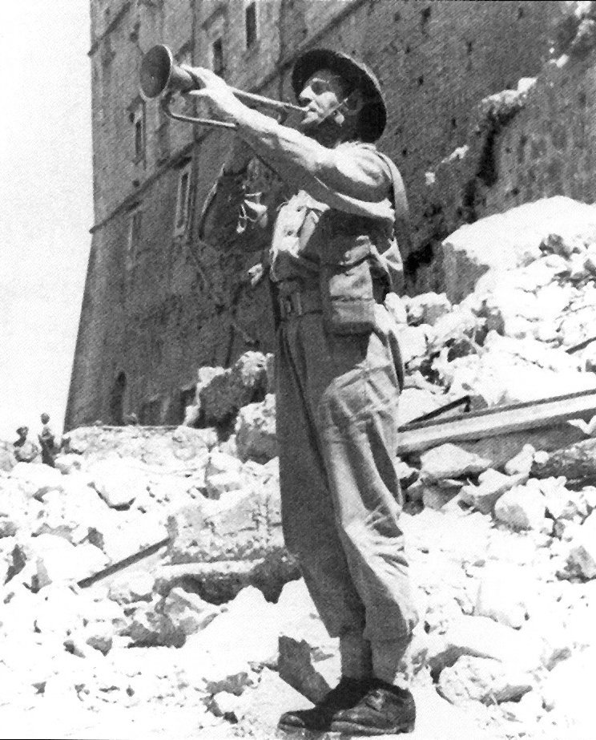
‘Soldiers! The moment for battle has arrived. We have long awaited the moment for revenge and retribution over our hereditary enemy … Trusting in the Justice of Divine Providence we go forward with the sacred slogan in our hearts: God, Honour, Country’.

Slide 27
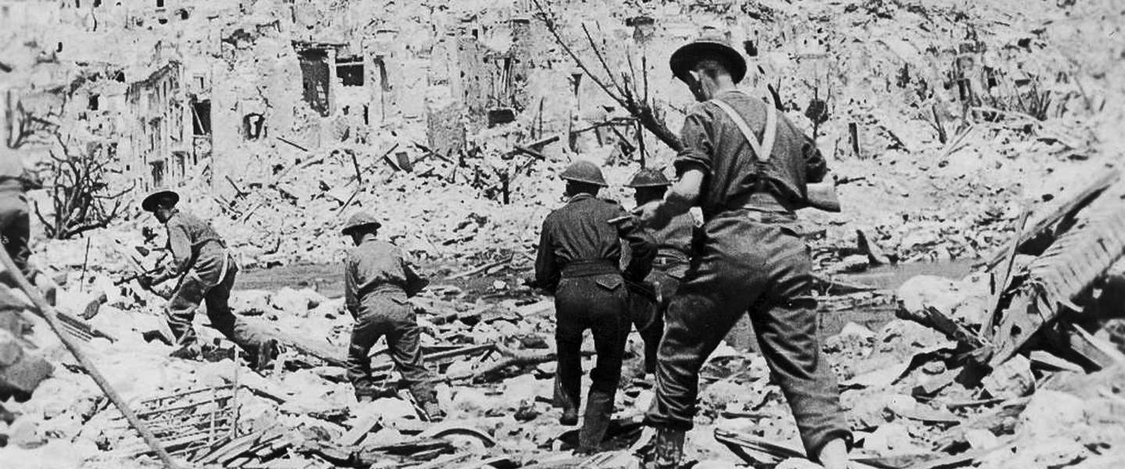
‘solid’

Slide 28
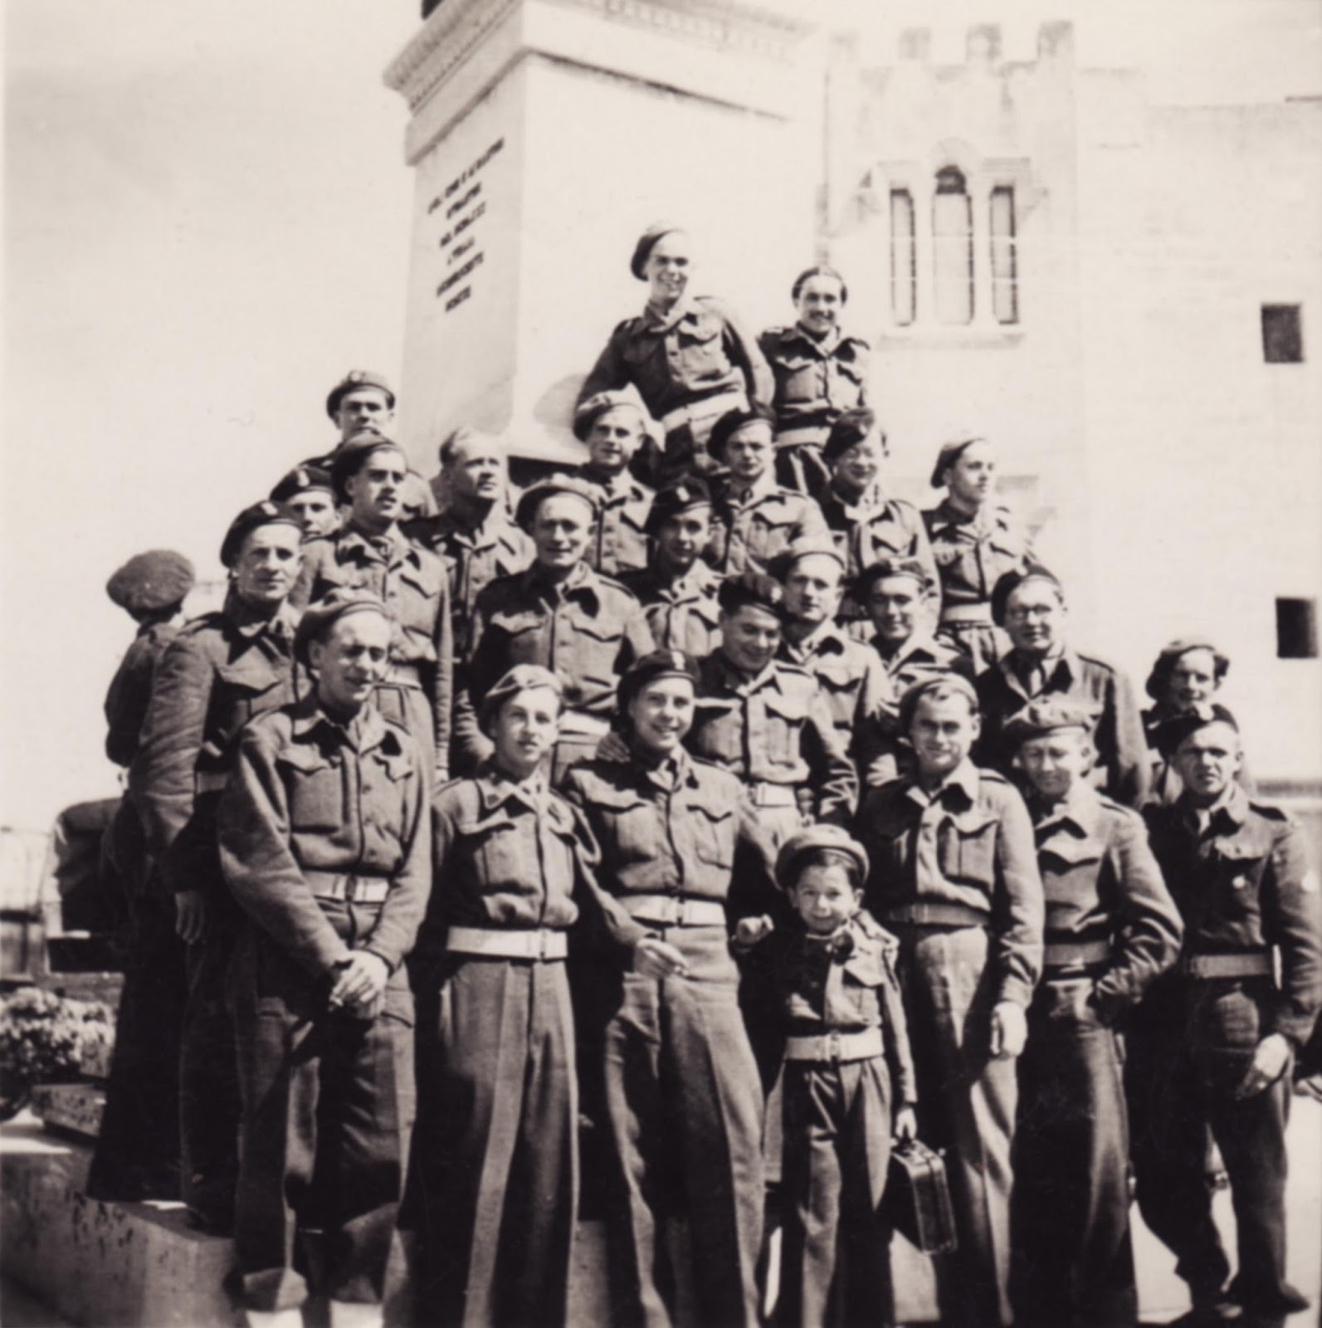
‘the finest personnel of any of our troops. The women that accompanied them were magnificent. All the skills, all the professions, that were just the best out of Warsaw; musically inclined, doctors, mechanics, everything’.

Slide 29
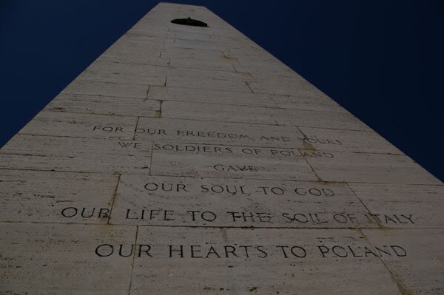
We Polish soldiers
For our freedom and yours
Have given our souls to God
Our bodies to the soil of Italy
And our hearts to Poland

Slide 30
2nd New Zealand Division

Slide 31
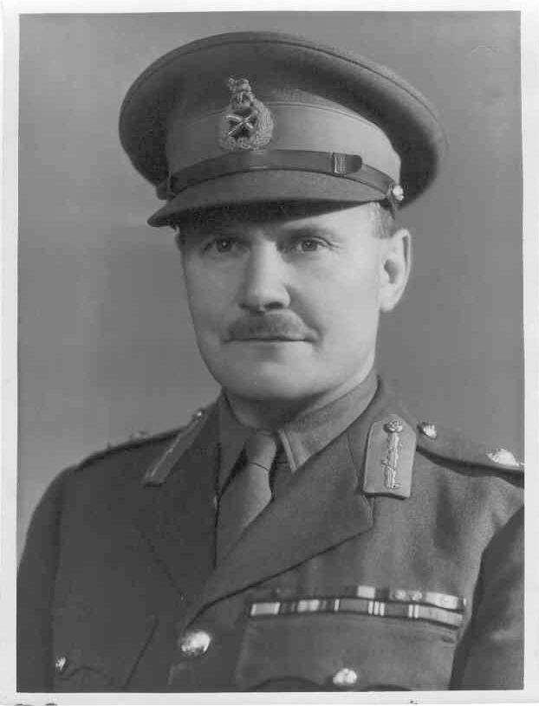
The Salamander

Slide 32
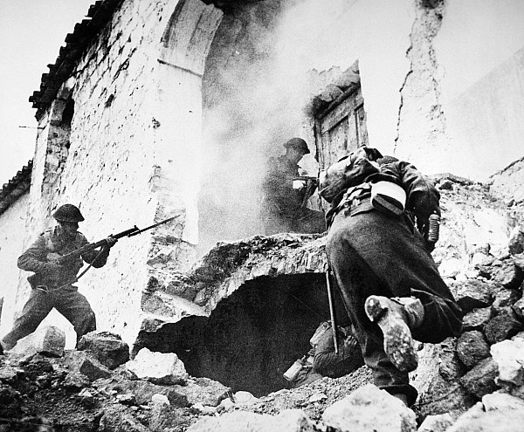
‘Exceptional ’

Slide 33
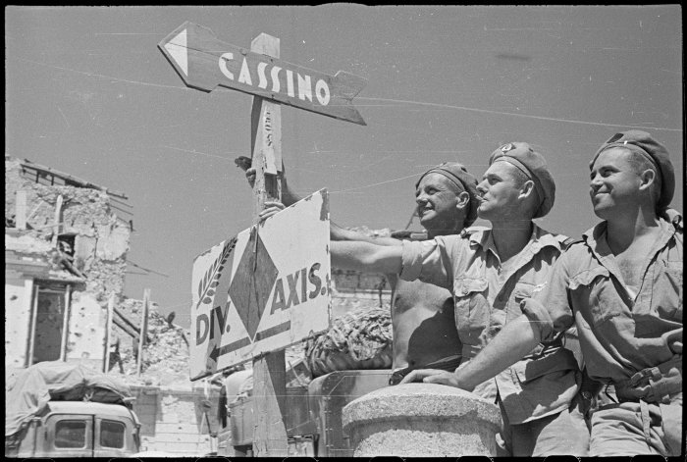
‘unwelcome intruders’
Freyberg was ‘a prima donna’ who had to be ‘handled with kid gloves’

Slide 34
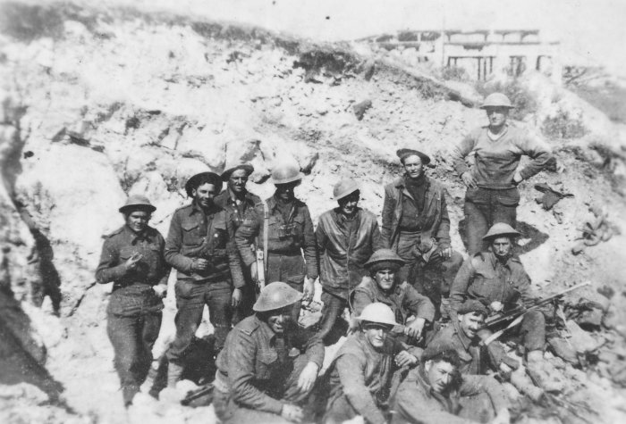
“Don’t be an ally – fight them”
-Napoleon
‘And thus I was about to agree with Napoleon’s conclusion that it is better to fight allies than be one of them’
-Clark

Slide 36
The Coalition

Slide 37
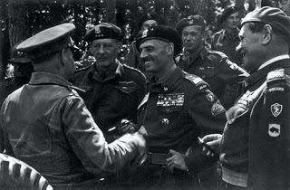
‘a sorry example of coalition warfare’.

Slide 38
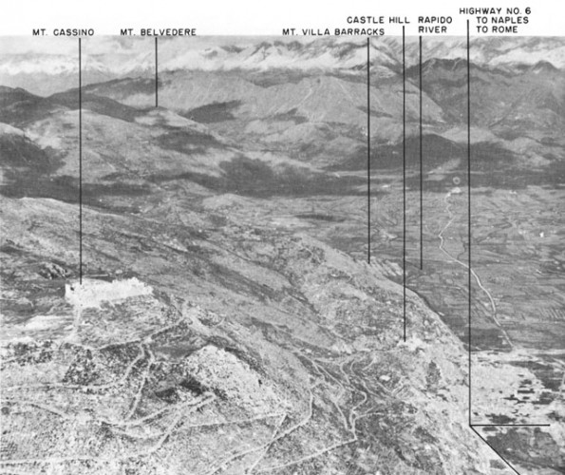
‘Once again we have run into one of the stumbling blocks of coalition warfare. The Allies cannot come to an agreement and co-ordinate their efforts. At the present juncture, questions of prestige are shaping events, each one wanting to make the entry into Rome. History will not fail to pass severe sentence’.

Slide 39
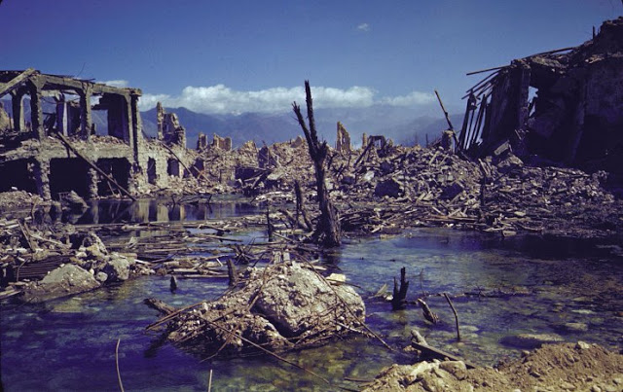
‘When the armies of democracy clashed with the Nazi legions in Italy or Western Europe, the former did not perform particularly well. It is arguable that technology and air power, rather than top-class soldiery enabled the British and the American to compete on equal terms’.

Slide 40
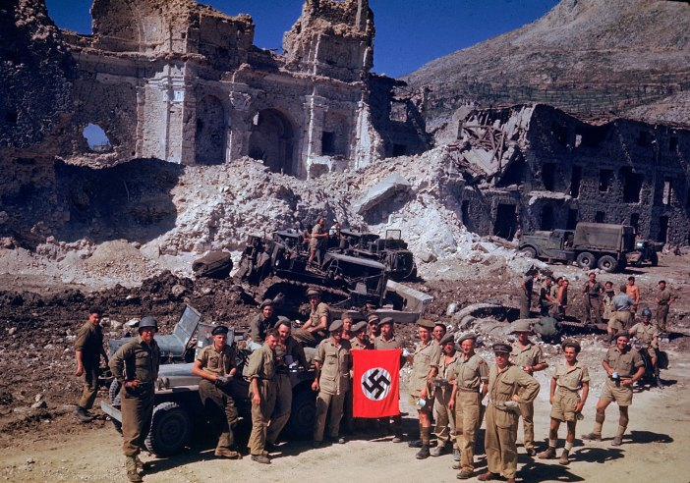
‘We failed at Cassino and this was due to the kind of troops we had. The command had been changed. We weren’t quite a team’.

Slide 41
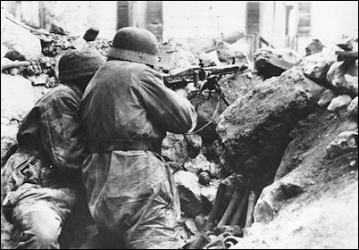
‘at a slender one and one-quarter to one’

Slide 42
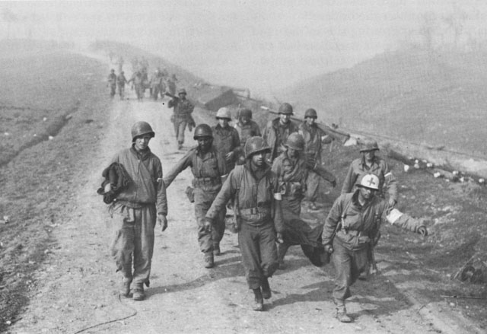
‘Certainly Salerno was inelegant and brutal, a fitting overture for the Italian campaign that followed.’

Slide 44
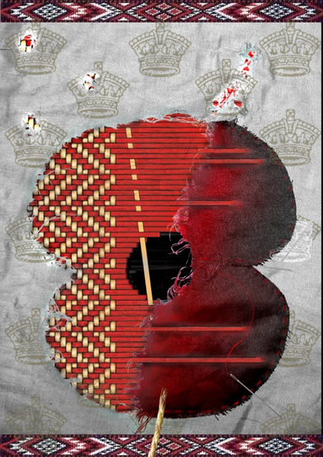
Questions?

