Slide 1
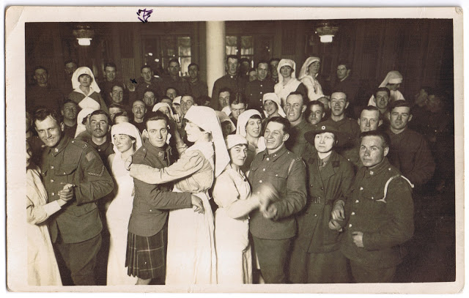
‘A topsy-turvey old world’: from fighting to dancing with the enemy. The New Zealand Division’s War - November 1918 to March 1919 Professor Glyn Harper Massey University New Zealand

Slide 2
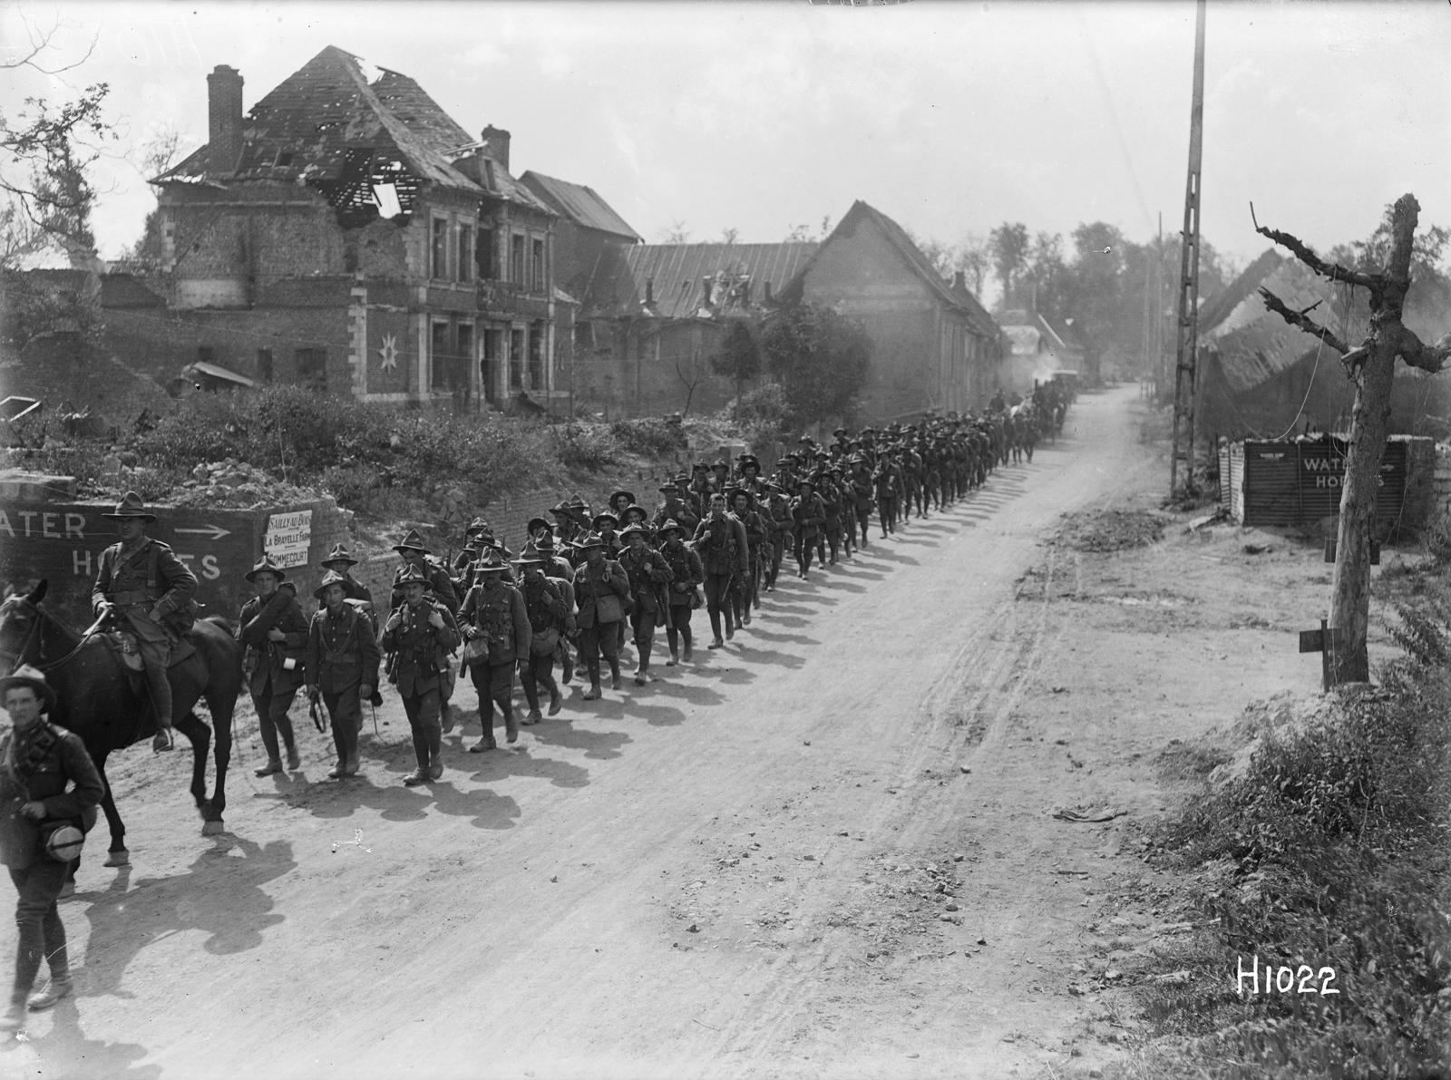
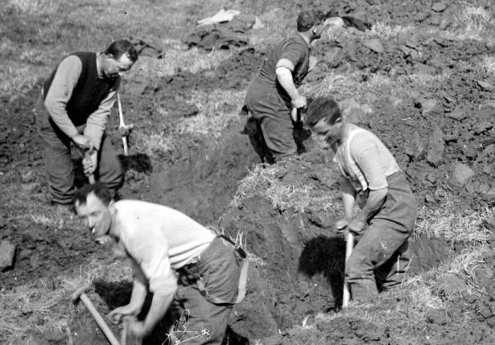
The New Zealand Division in the Hundred Days

Slide 3
The walled town of Le Quesnoy

Slide 4
Captain James Nimmo
‘When we got to the gate, a Corp, another chap and myself were sent into the village to try & find out where a patrol which had gone in earlier in the day was. How I am alive to write this today I don’t know, or at the very least I should have been in Blighty. We got on to the town and were simply overwhelmed by Civies. Laughing, crying, and just about mad with joy. It was ten minutes before we could get away from them. Then two of us searched everywhere near the gate but found no Jerries. We then found out by the aid of a word or two of French & by signs that one of our boys was down the street wounded. The Civies reckoned there were no Jerries round that part so we decided to go and get him. We expected to find out something about the patrol from him.’

Slide 5
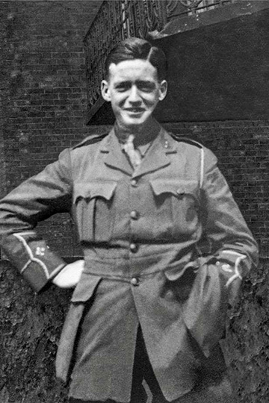
The capture of Le Quesnoy
Lieutenant Leslie Averill
‘one of the most dramatic moments in the Division’s history.’

Slide 6
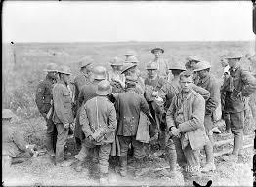
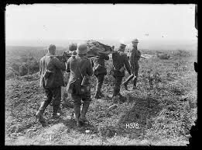
Beyond Le Quesnoy
4 November 1st Brigade had advanced over 10,000 yards (9100 metres) and taken more than 1000 prisoners.
Also captured were 78 guns.
It was the New Zealanders' most successful day of the whole campaign on the Western Front.

Slide 7
Le Quesnoy: the cost
More than 100 New Zealand soldiers were killed in action – virtually the last of the 12,483 who fell on the Western Front between 1916 and 1918.

Slide 8
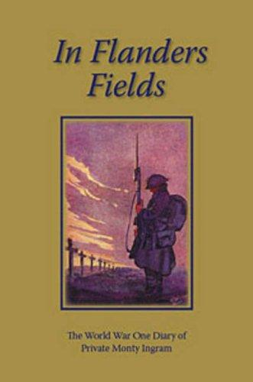
The Armistice
The news of the armistice was received ‘in a matter of fact way, totally devoid of any demonstration of emotion.’
‘There was not even a cheer raised ... everyone thought this information but another false yarn.’
‘In our innermost hearts we had a feeling of deep thankfulness and relief which could not be repressed. However, no outward demonstration was made and the momentous news was most casually received.’
Monty Ingram, In Flanders Fields

Slide 9
The Armistice
Bert Henson: ‘joyful news ... though there was little demonstration worthy of mention, everyone was marvellously pleased.’
Eric Hames: ”Nobody had expected it so soon. We were a bit dazed, and not at all demonstrative. I doubt if we even raised a cheer. The prospect seemed unreal.”
Harold Kretschmar: ‘We didn’t know whether to laugh or cry and it was with a mingled prayer of thankfulness and gratitude to God for his safe deliverance and keeping.’

Slide 10
Some celebrations: away from the front
James Marris: ‘The boys had a great night in spite of P.M.C. [President of the Mess Committee, usually a senior member] Thus ended “Der Tag
Geoffrey Wild: ‘We got rest of day off and pretty nearly everyone got drunk.’

Slide 11
Nurse Fanny Speedy
‘PEACE BLESSED PEACE,’
‘The whole thing seems too big to realise and too sad to understand. The men in the trenches must thankfully rejoice that there is not another winter to spend in France in the trenches. London will be a blaze of light tonight.’

Slide 12
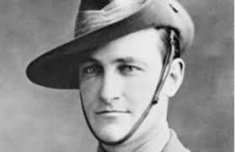
Setting London Ablaze
But at midnight someone started a fire at the base of the Nelson Monument and ‘a big New Zealander took charge’. The New Zealander climbed up high on the structure and called to the crowd below to ‘come and feed the flames’.

Slide 13
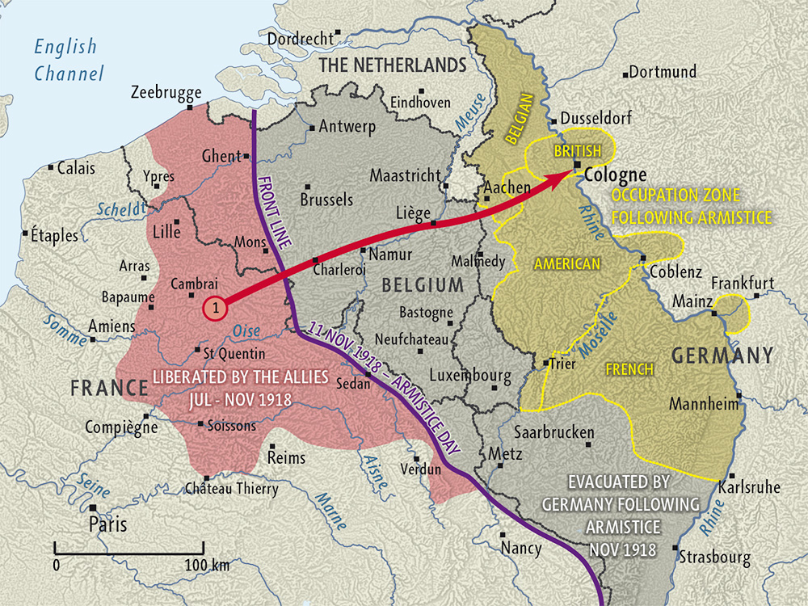
The New Zealand Division’s march to Germany

Slide 14
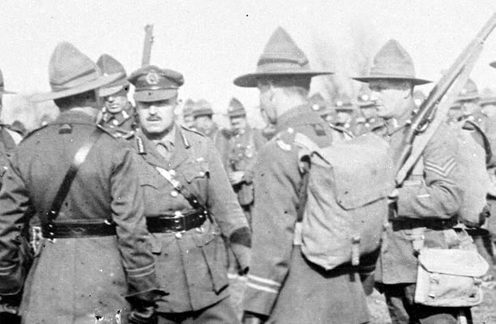
Trouble in the ranks
We don’t want to go to Germany. We want to go home.
Some did. Bill Tume: ‘We all wanted to go to Germany — to see what sort of a country we were battling with. That’s what I wanted.”

Slide 15
Arriving in Cologne
Bert Henson: ‘Went through town, tho’ not through main street. March was without incident. No apparent hostile sentiment. Some looked a bit sour, but often we got smiles and hand waves. Very beautiful city.’
Lawrence Blyth: ‘We got to the Hohenzollern Bridge. It’s a beautiful bridge. We did something there which we had travelled 12,000 miles to do. We relieved ourselves of an ambition that had taken us four and a half years — we all piddled in the Rhine.’

Slide 16
The New Zealanders in Cologne
- sight seeing
The zoo
Opera
robbery

Slide 17
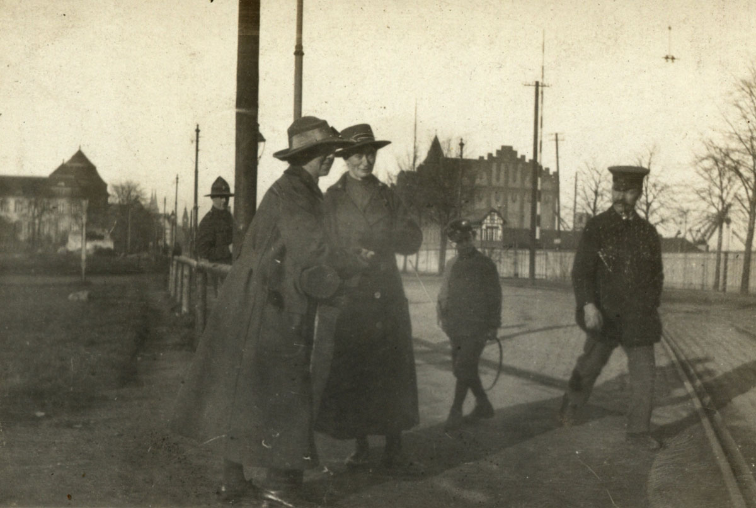
The New Zealanders in Cologne: fraternisation
venereal disease rates
Monty Ingram: ‘Have received strict orders prohibiting us from fraternising with the civilians, but these orders are already honoured mostly in the breach. The girls are willing to “fraternise”, so what can one expect from a soldier.’
According to one New Zealand officer, ‘a stick of chocolate was said to be worth a German girl’s virginity any time.’
As one soldier recalled: ‘We had “Red Lights” in Boulonge and Etaples, but this far exceeded anything we had previously witnessed’.

Slide 18
The New Zealanders in Cologne: fraternisation
Bert Henson watched some of his friends dancing with German girls on Boxing Day 1918.
it was ‘a topsy, turvey old world’. He found it ‘ludicrous’ that just weeks before they had been ‘fighting their kin bitterly for over four years.’
Henson was uncomfortable with the change: ‘now to dance with them: makes one think. Personally, my memory is not so short.’
A week later his views had not changed. ‘I do not dance, but even if I did I don’t think I could bring myself to swing a fraulein around the room.’ Henson thought ‘there would be the dickens to pay if the heads got to know.’ It was with considerable relief that on 14 January Henson wrote: ‘The long looked-for day has come — at last. I am on my way home.

Slide 19
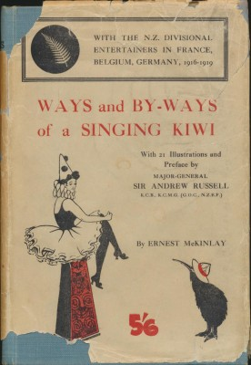
A ‘galling’ experience
A shop sign: ‘Now then, Diggers, take back something to remember Germany by.’
Ernest McKinlay: ‘We had plenty to remind us what their diabolical war had cost us.’

Slide 20
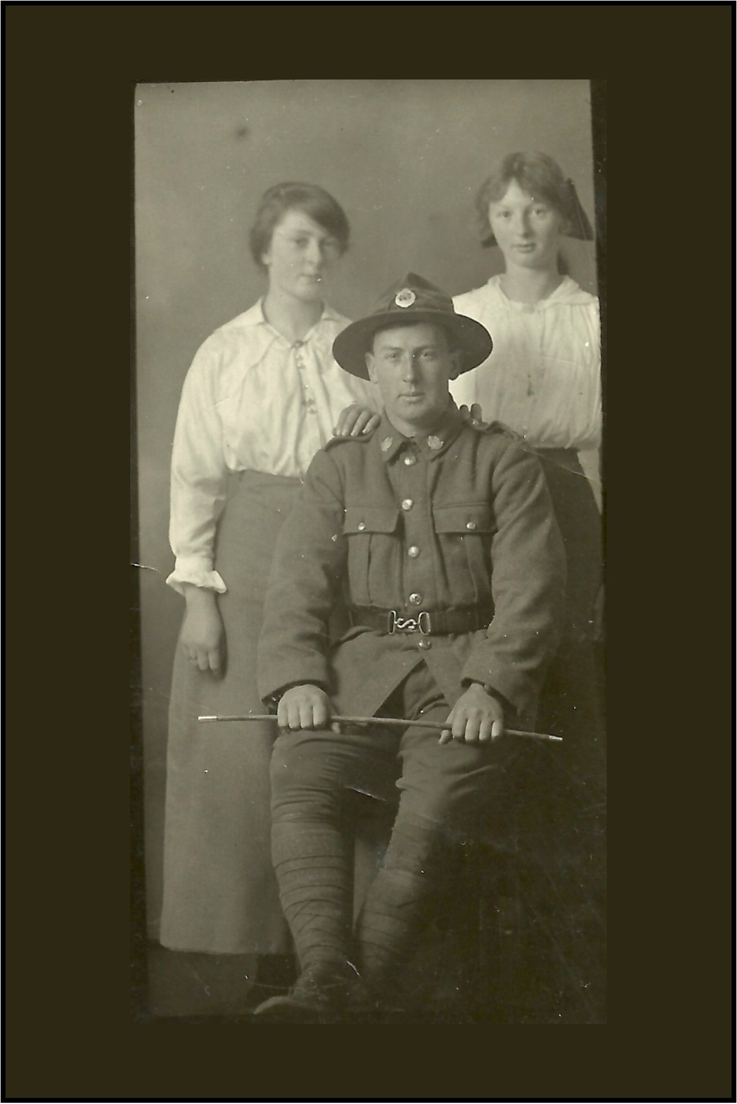
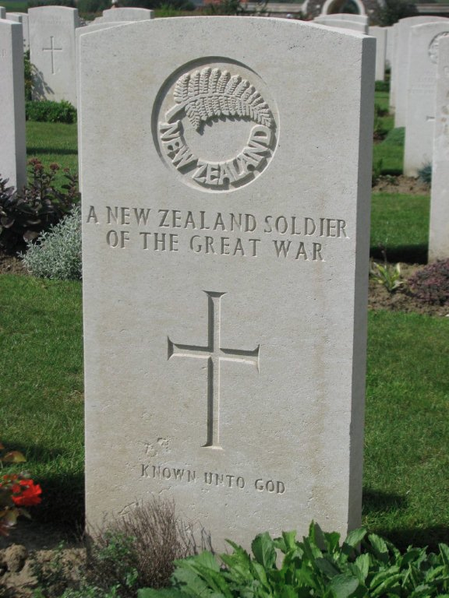
New Zealand Division disbanded
On 25 March 1919, the New Zealand Division was officially disbanded.
It had been a long and brutal journey from Gallipoli to Germany.

Slide 21
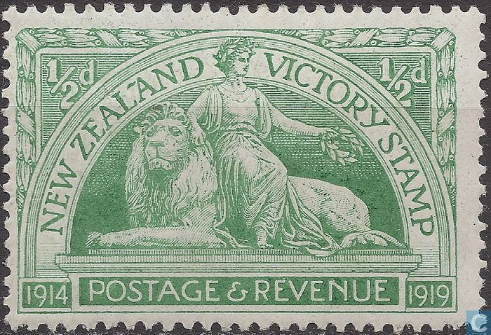
Questions?

